Slide 1
Compilers for Embedded Systems
Flipped Classroom 8
Bit-True Data and Value Flow Analysis,
Fix SPM Allocation
Heiko Falk
Institute of Embedded Systems
Electrical Engineering, Computer Science and Mathematics
Hamburg University of Technology
Notes:
Prepare special WCC build for showing CfES fix SPM allocation:
Configure and build regular WCC build in ~/RESEARCH/WCC/WCCBUILDS/CFES:
configure –C --enable-debug --without-doxygen-doc
make –j 4
Modify config_wcc.h in order to activate CfES SPM allocation:
#define WITH_CFES 1
#define WITH_CFES3 1
Rebuild: make –j 4
make -f 8-Makefile buildspm
Set up VPN connection for aiT WCET analysis!
1

Slide 2
Learning Objectives of Today’s Session
To understand how simple circuits for computer arithmetics can be used to derive bit-true data flow analyses.
To be aware of the nature of simple bit-true code optimizations like, e.g., constant folding, constant propagation and dead code elimination.
To see the difference between compile-time and run-time, and how this is exploited for fix SPM allocation.
Notes:
2

Slide 3
Questions & Answers
Video 7b: Bit-true Analysis and Optimizations
?
?
Video 7c: Memories
?
?
Video 7d: Fix SPM Allocation (Functions, global Variables)
?
?
Notes:
3

Slide 4
Bit-True Analysis of Simple Operations
Boolean Operations
Bitwise AND, OR, ...
Top-Down Analysis:
Set result bits of AND to '0' ('1' for OR) whenever a corresponding input bit is '0' ('1', resp.)
Bottom-Up Analysis:
Whenever an input bit of AND is '0' ('1' for OR), set the corresponding "partner" input bit to 'X';
If output bits are 'X', set corresponding bits of all inputs to 'X', too
Shift Operations
Top-Down Analysis:
Shift input vector left/right by shift amount, fill vacant bits depending on arithmetical/logical shift
Bottom-Up Analysis:
Set shifted-out input bits to 'X';
If output bits are 'X', set corresponding reverse-shifted input bits to 'X', too
Notes:
4
- Show top-down/bottom-up analysis of OR: make -f 8-Makefile tcBitOR01
- Logical left-shift: make -f 8-Makefile tcBitSH01
- Arithmetical right-shift: make -f 8-Makefile tcBitSH02

Slide 5
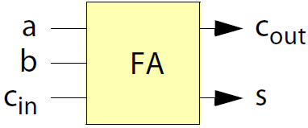
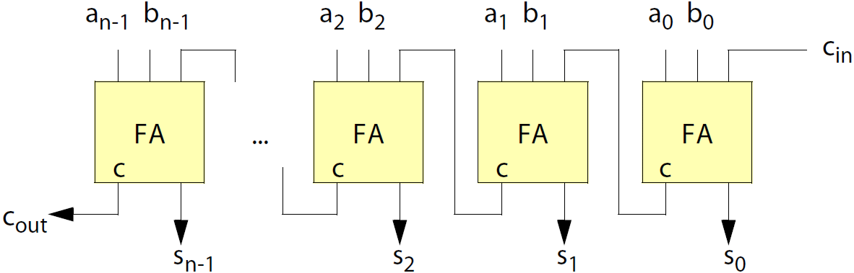
Bit-True Analysis of Arithmetical Operations
a | b | c_{in} | s | c_{out}
0 | 0 | 0 | 0 | 0
0 | 0 | 1 | 1 | 0
0 | 1 | 0 | 1 | 0
0 | 1 | 1 | 0 | 1
1 | 0 | 0 | 1 | 0
1 | 0 | 1 | 0 | 1
1 | 1 | 0 | 0 | 1
1 | 1 | 1 | 1 | 1
Addition
Top-Down Analysis mimics Ripple-Carry Adder
Bottom-Up Analysis:
If some isolated output bit is 'X', we can't set the corresponding input bits to 'X'!
If block of most-significant output bits is all 'X', set corresponding bits of all inputs to 'X'
Notes:
5
- Show operator + from wirupdownvalue.cc, Boolean equations for Full-Adder translated for half-order L4
- Show top-down analysis of ADD: make -f 8-Makefile tcBitADD01
- Show bottom-up analysis of ADD with isolated 'X': make -f 8-Makefile tcBitADD02
- Show bottom-up analysis of ADD with block of most-significant 'X'es: make -f 8-Makefile tcBitADD03

Slide 6
Bit-True Analysis of Arithmetical Operations
Subtraction
Top-Down Analysis:
Reduces subtraction to addition in two's complement: a - b = a + (-b) with -b = ~b + 1
Bottom-Up Analysis:
If some isolated output bit is 'X', we can't set the corresponding input bits to 'X'!
If block of most-significant output bits is all 'X', set corresponding bits of all inputs to 'X'
Notes:
6
- Show both operators - from wirupdownvalue.cc showing reduction of - to + in 2's complement
- Show top-down/bottom-up analysis of SUB: make -f 8-Makefile tcBitSUB01

Slide 7
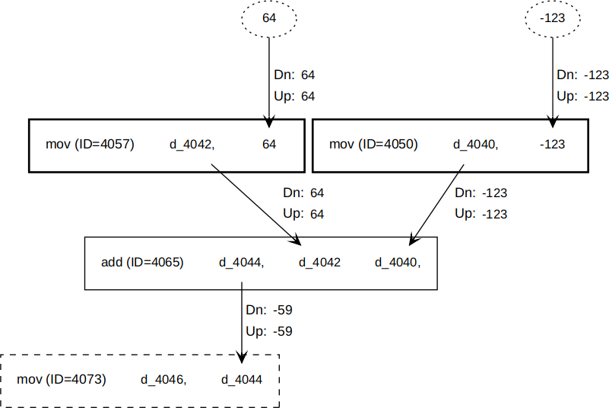
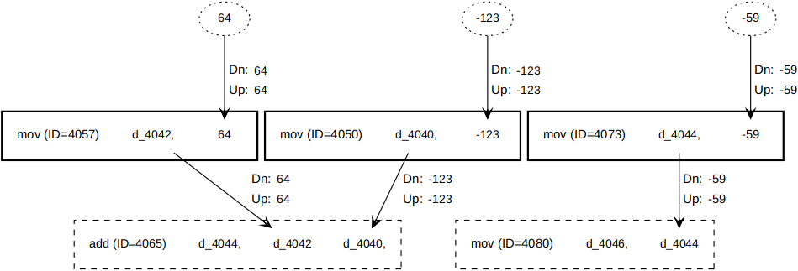
Bit-True Optimization
Constant Folding
Searches for operations in LIR which produce
only '0', '1' or 'X' bits as outputs, i.e., constants
Previous ADD example:
Optimize LIR by directly loading
the constant value into the
target register:
Notes:
7

Slide 8
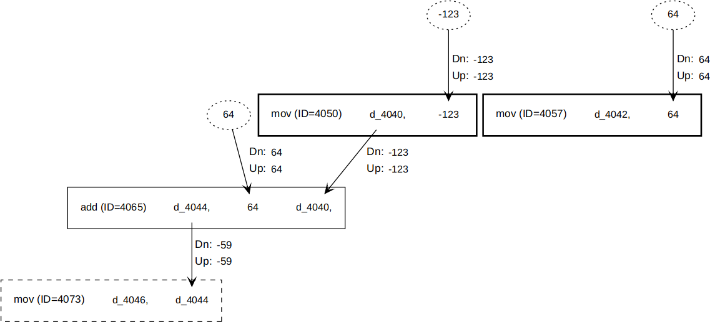
Bit-True Optimization
Constant Propagation
Searches for operations in LIR where some
input register only contains '0', '1' or 'X' bits,
i.e., constants
Previous ADD example:
Optimize LIR by directly placing
the constant value in the operation
as immediate operand:
Notes:
8

Slide 9
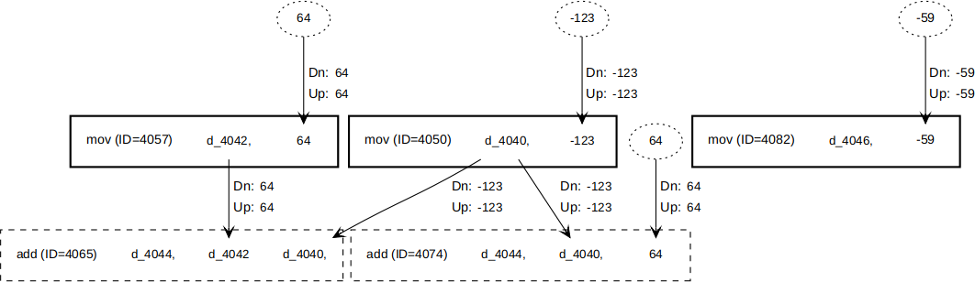
Bit-True Optimization
Dead Code Elimination
Searches for operations in LIR whose outputs are not used or only contain 'X' bits
Previous ADD example:
Optimize LIR by recursively marking such operations as dead and setting all bits of all incoming edges as 'X';
Finally, all dead operations are removed from LIR
dead
dead
X
X
dead
dead
dead
X
X
X
X
dead
dead
Notes:
9
Run qsort example in command line:
- make -f 8-Makefile cfold: Highlight newly created MOV operations with constants, highlight folding of 2 conditional branches
- make -f 8-Makefile cprop: Highlight newly created ADD operations with immediate operands, highlight substitution of SUB with registers by ADD with immediate
- make -f 8-Makefile dce: Highlight deletion of lots of unnecessary operations.
Compare sizes of ASM codes: wc -l 4-qsort-exam.O0.s (690); wc -l 4-qsort-exam.cfold_cprop_dce.s (635) - ~10% less
Maybe show diff of ASM codes: diff --side-by-side 4-qsort-exam.O0.s 4-qsort-exam.cfold_cprop_dce.s

Slide 10
Fix SPM Allocation of Functions for WCET Minimization
Workflow of Fix SPM Allocations
Compiler decides on memory layout at compile-time, no optimization decisions are taken during run-time
Optimized memory layout determined by compiler is enforced by tailored linker script
Resulting binary executable contains
  Information which functions shall be allocated to which memory, and
  Startup code which copies all functions to their proper memories before entering main
Notes:
10
- Show overall workflow: make -f 8-Makefile spm
- Explain following aspects of WCC run:
- 2 WCET analyses are required before actual SPM allocation, in order to determine WCET gain per function
- WCC dynamically creates ILP formulation at compile-time, and solves it using lp_solve again at compile-time
- Optimal results produced by lp_solve are imported into WCC and used to realize memory allocation and generate linker script
- ILP for shown fix SPM allocation very simple: Binary decision variables per LIR function; objective function maximizes WCET gain per LIR function (WCET reduction multiplied by execution frequency); SPM capacity constraint

Slide 11
Videos for Next Week
Video 7e: Fix SPM Allocation (Functions, basic blocks, global Variables) (00:55:45 h)
Video 7f: SPM Allocations for Multi-Process Applications (00:49:57 h)
Video 8a: Life Time Analysis (00:46:43 h)
☞ Don’t forget to prepare one question for the above video!
Notes:
11

