Slide 1
Compilers for Embedded Systems
Summer Term 2022
Heiko Falk
Institute of Embedded Systems
Electrical Engineering, Computer Science and Mathematics
Hamburg University of Technology

Slide 2
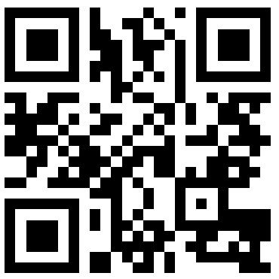
People
Have your smart phone
with QR scanner ready!
Course
Prof. Dr. Heiko Falk
  Institute of Embedded Systems
  E-Mail: Heiko.Falk@tuhh.de
  Building E, Room 3.034
And what about you?
Enter the acronym of your degree program
(e.g., AIW, CS, ET, …) here:
fqd.me/3LRtKer

Slide 3
Organizational Issues
Module “Compilers for Embedded Systems”
Course and block labs
Desired Prerequisites
Computer Architecture
Embedded Systems
Compiler Construction
Mode of Operation
Hybrid: Pre-recorded lecture videos electronically via Stud.IP, classroom sessions and labs physically on-campus
Make sure to register to Stud.IP course “Compiler für Eingebettete Systeme / Compilers for Embedded Systems”
In the TUNE portal, make sure to register for the exam “Compiler für Eingebettete Systeme” (no. 655)

Slide 4
Course (1)
Organization
Pre-recorded lecture videos covering the entire course are already provided via Stud.IP
Weekly interactive classroom sessions (“Flipped Classroom”):
Tuesday, 15:00 – 16:30, M 1.582
Interaction:
  During the above classroom sessions
  Via the Stud.IP forum that is regularly checked by me
  Electronically with me via Stud.IP and/or e-mail
Material
Lecture slides and videos are provided electronically via Stud.IP
Further reading according to articles and textbooks cited in all following chapters

Slide 5
Course (2)
Weekly Workflow
In week n, you watch a given number of videos independently and asynchronously
For each video, everyone of you prepares one question about the video’s content
In week n+1, we meet for the next classroom session, where I will collect your questions about the previously watched videos, give answers, do interactive quizzes, perform in-depth exercises, provide background information etc.
Make sure to bring a tablet or mobile phone with QR code scanner!

Slide 6
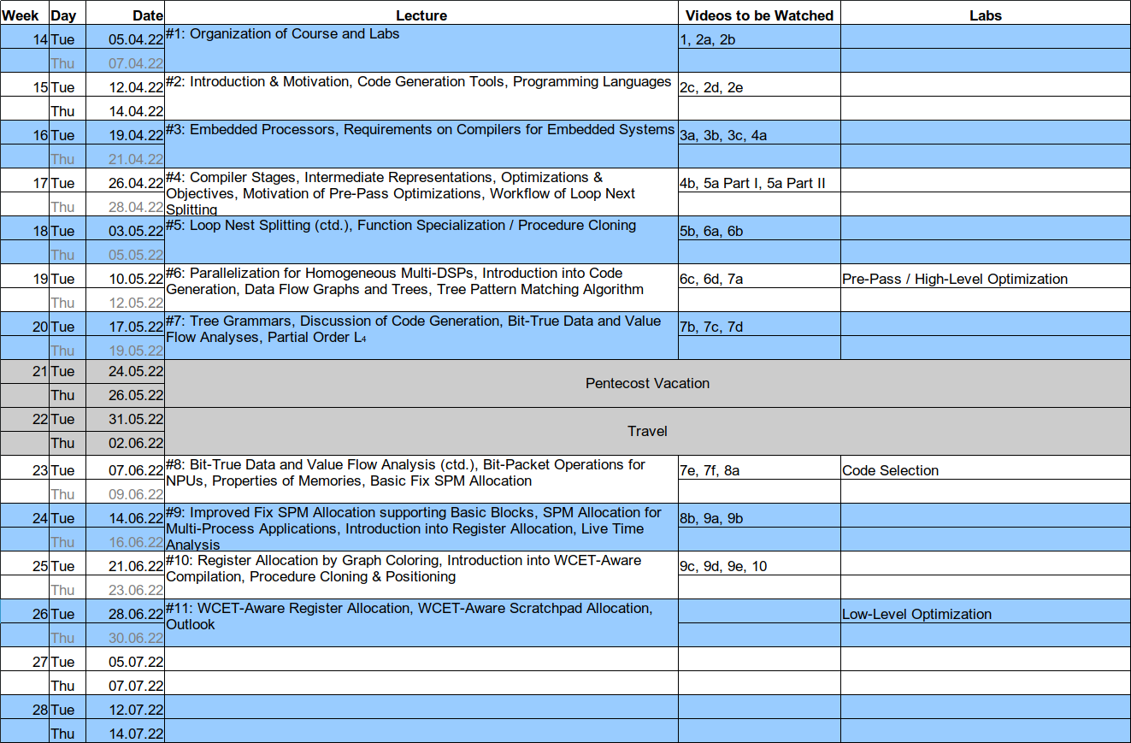
Suggested Lecture and Video Schedule

Slide 7

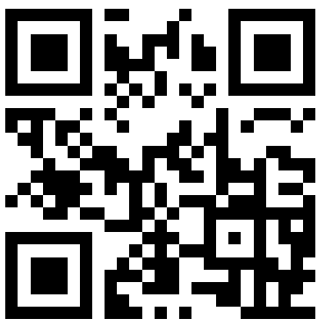
Labs
Organization
Learning compiler construction: Get your hands dirty in the mud!
Weekly exercise sheets and tutorials inappropriate
Hands-on implementation of a (simple) ANSI-C compiler in front of a monitor and keyboard
Labs usually organized as block events allow for working concentrated, playing around and learning directly in front of the computer
Tentative Appointments
1st Lab: KW 19, 09.05. (Pre-Pass / High-Level)
2nd Lab: KW 23, 06.06. (Instruction Selection)
3rd Lab: KW 26, 27.06. (Low-Level)
fqd.me/3v632cj

Slide 8
Feedback
Feedback and Questions
Give me feedback about the course, the labs, and their contents. Only with your feedback, the quality can be kept high.
Pose questions!
Indicate errors to me!
Use the opportunity to contact me outside the lecture hall: Heiko.Falk@tuhh.de!

Slide 9
Final Examination
According to Module Description
Oral examinations (30 min, 6 ECTS credit points)
Exam language: German or English
No tools or aids
Individual appointments possible during examination period after this summer term
Exception: No appointments for exams from July 18th to August 5th

Slide 10
Videos for Next Week
Video 1: Introduction (00:45:08 h)
Video 2a: Code Generation Tools (00:26:02 h)
Video 2b: Source Languages for Compilers for ES (01:10:43 h)
☞ Don’t forget to prepare one question for each of the above videos!
Notes:
10

