Slide 1
Compilers for Embedded Systems
Summer Term 2022
Heiko Falk
Institute of Embedded Systems
Electrical Engineering, Computer Science and Mathematics
Hamburg University of Technology

Slide 2
Chapter 1
Introduction & Motivation

Slide 3
Embedded Systems
Definition: Embedded Systems (ES) are
  information-processing systems
  that are embedded into a larger, surrounding product.
The fact that embedded systems process information is not decisive for a purchase
Instead: Benefit of surrounding product influences purchase decision
[P. Marwedel. Embedded System Design. Springer, 2011]

Slide 4
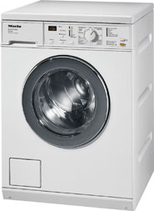

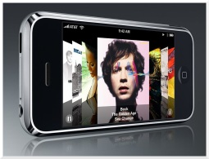
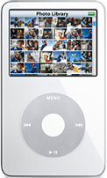
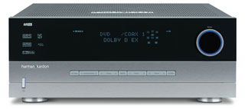


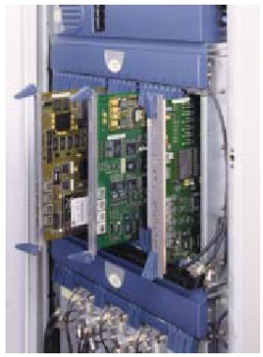
Application Areas of Embedded Systems
Consumer products
Multimedia
Transportation
Telecommunication
Building management, robotics, …

Slide 5
Relevance of Embedded Systems
Smartphones 113 m. devices 2007 ↝ 25.6% increase p.a.
365 m. devices 2012
UMTS 402 m. customers worldwide 2008
30 m. new customers per quarter
Energy consumption of mobile broadband infrastructure
42.8 m. kWh 2005 ↝ 124.4 m. kWh 2011
Broadband internet
576 m. customers 2011 ↝ 100% increase compared to
2007
US consumer electronics
∅ household: 25 devices, ∅ adult: 1,200$ p.a.
[www.itfacts.biz]

Slide 6





Demands on Embedded Systems (1)
Efficiency
Runtime efficiency
Energy consumption
Code size
Physical size / weight
Cost

Slide 7
Demands on Embedded Systems (2)
Real-Time Capabilities
Definition: For some input x, a computer system computes some f(x).
  A Non-Real-Time System is correct if it computes f(x) correctly.
  A Real-Time System is correct if the computation of f(x) completes within given time bounds.
A too late computation of f(x) by a Real-Time System is as severe as a functionally incorrect computation.

Slide 8
Demands on Embedded Systems (3)
Real-Time Capabilities
“Hard” Real-Time System:
Late computation of f(x) ↝ Catastrophic consequences
(loss of human life, environmental damages, …)
Example airbag control:
Command to ignite the airbags: 15ms
Deadline miss: Danger of injuries for passengers or saviors. Thus: Do not fire airbags
“Soft” Real-Time System: No catastrophic consequences
Example DVD player:
Deadline miss during frame decoding: Frame-Drop
Not nice but (usually) not disastrous

Slide 9
Demands on Embedded Systems (4)
Dependability / Safeness
Life span of embedded systems: Typically several years
During the entire lifetime: No outage
Example throttle valve control:
Production volume: 2 m. units per year
Allowed error rate: 1 unit per year
Maintainability, (Limited Extensibility)
Error search and diagnosis, reconfiguration during runtime
Design Automation (↝ Time to Market)
Specification, synthesis, code generation

Slide 10
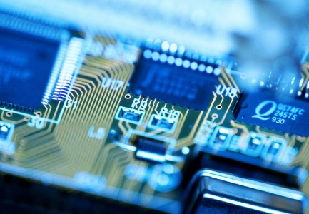
Design Process of Embedded Systems
Standard-SW
(RTOS, ...)
HW/SW Co-Design
– Task scheduling
Design space exploration
HW/SW Partitioning
...
HW & SW
Specifi-
cation
Specifi-
cation
Application Know-How
HW De-
sign
HW/SW Co-Synthesis
Implementation
HW com-
ponents
– HW Synthesis
– SW Code generation
Binary
Code
Validation; Evaluation (Efficiency, Real-Time aspects, Energy, ...)

Slide 11
Topics of the Course
Overview
Introduction & Motivation
Compilers for Embedded Systems – Requirements & Dependencies
Internal Structure of Compilers
Pre-Pass Optimizations
HIR Optimizations and Transformations
Code Generation
LIR Optimizations and Transformations
Register Allocation
WCET-Aware Compilation
Outlook

Slide 12
General References
Embedded Systems
Peter Marwedel. Embedded System Design. Springer, 2011.
ISBN 978-94-007-0256-1
Full-text available as e-book via TUHH library: https://katalog.tub.tuhh.de/Record/1650607989
Compiler Construction
Steven S. Muchnick. Advanced Compiler Design & Implementation. Morgan Kaufmann, 1997.
ISBN 978-1-55860-320-2
Andrew W. Appel. Modern compiler implementation in C. Cambridge University Press, 2004.
ISBN 0-521-60765-5

