Slide 1
Compilers for Embedded Systems
Summer Term 2022
Heiko Falk
Institute of Embedded Systems
Electrical Engineering, Computer Science and Mathematics
Hamburg University of Technology

Slide 2
Chapter 2
Compilers for Embedded Systems –
Requirements & Dependencies

Slide 3
Outline
Introduction & Motivation
Compilers for Embedded Systems – Requirements & Dependencies
Internal Structure of Compilers
Pre-Pass Optimizations
HIR Optimizations and Transformations
Code Generation
LIR Optimizations and Transformations
Register Allocation
WCET-Aware Compilation
Outlook

Slide 4
Chapter Contents
Compilers for Embedded Systems – Requirements & Dependencies
  Code Generation Tools
    Compiler, Assembler, Linker
    Source Code, Assembly Code, Object Code, Binary Code
  Source Languages for Compilers for Embedded Systems
    C, C++, Java
  Embedded Processors
    Digital Signal Processors
    Multimedia Processors
    Very Long Instruction Word Machines
    Network Processors
  Requirements on Compilers for Embedded Systems
    Code Quality vs. Compilation Times

Slide 5

Design Process of Embedded Systems
Standard-SW
(RTOS, ...)
HW/SW Co-Design
– Task scheduling
Design space exploration
HW/SW Partitioning
...
HW & SW
Specifi-
cation
Specifi-
cation
Application Know-How
HW De-
sign
HW/SW Co-Synthesis
Implementation
HW com-
ponents
– HW Synthesis
– SW Code generation
Binary
Code
Validation; Evaluation (Efficiency, Real-Time aspects, Energy, ...)

Slide 6
Code Generation Tools
Source
Code
Compiler
Assembly
Code
Assembler
Linker
Binary
Code
Object
Code

Slide 7
Source
Code
Compiler
Assembly
Code
Source Code
Programming language, legible and comprehensible for humans
Standard constructs: Loops, procedures, variables, ...
High abstraction level: Machine-independent algorithms
Assembly Code
Symbolic machine code
Limited legibility and comprehensibility for humans
Machine language constructs: ALU operations, registers, …
Low abstraction level: Machine-specific representation

Slide 8
Assembly
Code
.align 1
.global encode
.type encode,@function
encode:
mov %d15, %d5
mov %d12, %d4
movh.a %a12, HI:h
lea %a12, [%a12] LO:h
movh.a %a13, HI:tqmf
lea %a13, [%a13] LO:tqmf
ld.w %d14, [%a13] 4
ld.w %d10, [%a12] 4
mul %d14, %d10
  Readable plain text
  No / few real addresses
  Instead: Symbolic addresses
  e.g., encode, h, tqmf
# Load address of array h to A12
# Load address of array tqmf to A13
# Load tqmf[1] to D14
# Load h[1] to D10
# Multiply

Slide 9
Assembly
Code
Assembler
Object
Code
Object Code
Binary representation of assembly code, no longer legible
No plain text mnemonics, 0/1 bit sequences instead
Whenever possible, symbolic addresses replaced by real ones
Assembler
Line-by-line translation
Assembly instructions → machine instructions
Within a single assembly file: Address Resolution

Slide 10
Object
Code
Translation (Example: Infineon TriCore 1.3)
Address Resolution
Symbolic address h declared in very same assembly file:
  Symbol h is known to assembler
  Replacement of h by relative address, relative within the object file
h is unknown to assembler:
  Defer address resolution at a later point in time
mul %d14, %d10
MUL D[a], D[b] (SRR)
1010 1110 11100010
b
a
0xE2
15
12
11
8
7
0

Slide 11
Object
Code
Linker
Binary
Code
Binary Code
Executable program representation
All symbolic addresses replaced by real addresses
Lowest possible abstraction level
Linker
Union of many object files and libraries to a single, executable program
Address resolution using libraries of object code
Layout of code in memory

Slide 12

Binary
Code
Example Address Resolution
Object code contains jump to external function: call abs
Search abs in all other object files and libraries
Add code of abs to binary executable file
Example Memory Layout of Binary Code
Binary code consists of functions decode, encode, abs, main
Memory layout finally defines effective addresses
decode
encode
abs
main
main
decode
abs
encode

Slide 13
Chapter Contents
Compilers for Embedded Systems – Requirements & Dependencies
  Code Generation Tools
    Compiler, Assembler, Linker
    Source Code, Assembly Code, Object Code, Binary Code
  Source Languages for Compilers for Embedded Systems
    C, C++, Java
  Embedded Processors
    Digital Signal Processors
    Multimedia Processors
    Very Long Instruction Word Machines
    Network Processors
  Requirements on Compilers for Embedded Systems
    Code Quality vs. Compilation Times

Slide 14
Source Languages for Compilers for Embedded Systems
In the following
Brief digest of most common programming languages
No claim to be complete!
Imperative Programming Languages
C
Object-Oriented Programming Languages
C++
Java

Slide 15
ANSI-C: Properties (1)
Purely Imperative
  No object-orientation: No classes, no objects
  C-Program: Set of functions
  Function main: Standardized starting point
  Functions: Sequence of statements, execution in sequential order
int filtep( int rlt1, int al1, int rlt2, int al2 )
{
long pl, pl2;
pl = 2 * rlt1;
pl = (long) al1 * pl;
pl2 = 2 * rlt2;
pl += (long) al2 * pl2;
return( (int)(pl >> 15) );
}

Slide 16
ANSI-C: Properties (2)
Standardized Programming Language
  ISO/IEC 9899:1999 (E)
Standard Data Types
  signed / unsigned char
  signed / unsigned short
  signed / unsigned int
  signed / unsigned long
  signed / unsigned long long
  float, double, long double, _Bool

Slide 17
ANSI-C: Properties (3)
Composed Data Types
  Arrays
  Structures
  Variants
0
1
2
int h[ 3 ];
h[ 1 ] = 42;
h
42
x
y
struct point { int x; char y; } p;
p.x = 42;
p
42
x / y
union point { int x; char y; } p;
p.y = 42;
p
42

Slide 18
ANSI-C: Properties (4)
Pointers and Memory Management
  Pointers
0
1
2
int h[ 3 ];
int *p = &h[ 1 ];
h[ 1 ] = 42;
*p = 12;
h
42
p

Slide 19
ANSI-C: Properties (5)
Pointers and Memory Management
  Pointers
  Dynamic memory management
0
1
2
int h[ 3 ];
int *p = &h[ 1 ];
h[ 1 ] = 42;
*p = 12;
h
12
p
char *p = (char *) malloc( 100 );
p[ 1 ] = 42;
free( p );
/* Allocation of 100 Bytes */
/* Memory deallocation */
Dynamic memory management explicitly by programmer!

Slide 20
ANSI-C: Properties (6)
Architecture-Dependence & Unspecified Behavior
  Bit-width of int ≅ word-length of a CPU
  int on 16-bit machine: [ -32768, 32767 ]
  int on 32-bit machine: [ -2147483648, 2147483647 ]
  Behavior of >> operator (shift right)
  logic shift – Most Significant Bit (MSB) filled with ‘0’:
  arithmetic shift – MSB filled with old MSB:
  Signedness of char:
  signed char [ -128, 127 ] vs. unsigned char [ 0, 255 ]
-8 >>_{l} 1 = 1000 >>_{l} 1 = 0100 = 4
-8 >>_{a} 1 = 1000 >>_{a} 1 = 1100 = -4

Slide 21


ANSI-C: Discussion
Pros
Standardized, widespread programming language
Many (freely available) existing code generation tools
Large already existing source code base (open source & proprietary)
Despite high abstraction level: Low-level programming still possible
Machine-orientation
Effort to construct a compiler still acceptable
Cons
Machine-orientation, lacking portability of source code
Programmer-responsible memory management error-prone
No object-orientation

Slide 22
ANSI-C++: Properties
ANSI-C + Object-Orientation + …
Classes & Objects
Elements, member functions/methods
Constructors & destructors
Inheritance
Protection of class elements: public, protected, private
Virtual methods & polymorphic classes
Exception handling
Generic programming: Templates
Standard Template Library (STL)

Slide 23
ANSI-C++: Pros
Higher-order programming language, fulfills desire for OO in Embedded Systems
Existing ANSI-C source codes can often be adopted
Wide dissemination
Many (freely available) existing code generation tools
Large already existing source code base (open source & proprietary)
Despite high abstraction level: Low-level programming still possible
Machine-orientation

Slide 24
ANSI-C++: Cons (1)
Some C++ constructs lead to high overheads, too high for Embedded Systems
  Time between throwing and catching unclear due to destructors
  Increased memory consumption due to internal data structures
Example Exceptions:
try {
object o;
...
Code…;
}
catch( E ) {
// Error handling
}
o must
be
destroyed!
Exception E is thrown here...
... and caught here

Slide 25
ANSI-C++: Cons (2)
  B and C both feature a very own implementation of bar().
  High run-times due to dynamic type checking and method lookup.
Example Purely Virtual Classes:
class A {
virtual bar() = 0;
}
class B : public A { class C : public A {
virtual bar(); virtual bar();
} }
A *foo; ...; foo->bar(); // B::bar()?? C::bar???

Slide 26
Embedded C++
Subset of C++, Specifically Designed for Embedded Systems
No purely virtual classes
No exceptions
No templates
No namespaces
(“Features such as namespaces […] are difficult to understand, increasing the chances of programmer errors.”)
No multiple inheritance
No STL data structures (Standard Template Library)
[Embedded C++ Slashes Code Size And Boosts Execution.
www.ghs.com/wp/ec++article2.html]

Slide 27
Java: Pros
Programming Language with consequent object-oriented design
Modular structure, allows for excellent SW abstraction
Good type mechanisms
Good language constructs for modelling of behavior and control
Mathematical model similar to C++, but said to be better
Transparent memory protection, automatic Garbage Collection
Code said to be better legible than C++
No pointers
Java Byte Code Interpreter: High portability of Java source code

Slide 28
Java: Cons
Enormous Resource Demands
Disadvantages of Java’s OO constructs similar to C++
Byte code interpretation during run-time
Just-In-Time translation often infeasible for Embedded Systems
Real-time behavior of Garbage Collection?
Today: Even lean Java (EmbeddedJava) unsuitable for systems that have to be fast and are resource-constrained
Excerpt from Sun’s (ancient) license agreement for Java:
”Software is not designed or licensed for use in on-line control of aircraft, air traffic, aircraft navigation or aircraft communications; or in the design, construction, operation or maintenance of any nuclear facility.”
[Formerly at java.sun.com/products/plugin/1.2/license.txt]

Slide 29
Chapter Contents
Compilers for Embedded Systems – Requirements & Dependencies
  Code Generation Tools
    Compiler, Assembler, Linker
    Source Code, Assembly Code, Object Code, Binary Code
  Source Languages for Compilers for Embedded Systems
    C, C++, Java
  Embedded Processors
    Digital Signal Processors
    Multimedia Processors
    Very Long Instruction Word Machines
    Network Processors
  Requirements on Compilers for Embedded Systems
    Code Quality vs. Compilation Times

Slide 30
Digital Signal Processors
Properties
Optimized for digital signal processing
(e.g., filters, Fourier transformation, ...)
Heterogeneous register files, grouped for special purposes
Limited parallelism during instruction execution
Dedicated address generation units / addressing modes
Multiply-Accumulate instruction (a = a + b * c)
Zero-Overhead Loops
Saturating arithmetic
Efficiency and real-time capabilities extremely important

Slide 31
DSPs: Heterogeneous Register Files (1)
Example Infineon TriCore 1.3:
Separate address & data registers
Address Registers
Data Registers
A15
A14
A13
A12
A11
A10
A9
A8
A7
A6
A5
A4
A3
A2
A1
A0
D15
D14
D13
D12
D11
D10
D9
D8
D7
D6
D5
D4
D3
D2
D1
D0

Slide 32
DSPs: Heterogeneous Register Files (2)
Example Infineon TriCore 1.3:
Separate address & data registers
Registers with particular meaning
64-bit data registers (extended Registers)
Upper & lower context (UC & LC): UC automatically saved during function call, LC not
Address Registers
Data Registers
A15 (Implicit AREG)
A14
A13
A12
A11 (Return Addr)
A10 (Stack Ptr)
A9 (Global AREG)
A8 (Global AREG)
A7
A6
A5
A4
A3
A2
A1 (Global AREG)
A0 (Global AREG)
D15 (Implicit DREG)
D14
D13
D12
D11
D10
D9
D8
D7
D6
D5
D4
D3
D2
D1
D0
E14
UC
E12
E10
E8
E6
LC
E4
E2
[Infineon AG. TriCore User’s Manual, Volume 1. 2008]
E0

Slide 33
DSPs: Limited Parallelism
Example Infineon TriCore 1.3:
Integer Pipeline: Arithmetical/logical instructions,
conditional branches
Load/Store Pipeline: Memory accesses, address computations,
unconditional branches, function calls
Loop Pipeline: Loop instructions
Limited Parallelism:
  Pipelines work independently / parallel in the ideal case
  If not the ideal case:
  Stall in L/S Pipeline → Stall in I-Pipeline and vice versa

Slide 34
DSPs: Address Generation Units (AGUs)
General Structure of Address Generation Units:
Address registers (AR) contain effective addresses for memory accesses
Instruction word encodes which AR to use (AR pointer)
ARs can be loaded with constants explicitly encoded in the machine instruction (immediate operands)
AR
pointer
Immediate
value
Address
register
Effective
address

Slide 35
DSPs: Address Generation Units (AGUs)
General Structure of Address Generation Units:
ARs can be in-/decreased via a simple ALU
Increment / decrement by offset given as immediate operand
Increment / decrement by constant “1” as offset
AR
pointer
Immediate
value
”1”
+ -
Address
register
Offset
Effective
address

Slide 36
DSPs: Address Generation Units (AGUs)
General Structure of Address Generation Units:
Increment / decrement by contents of Modifier Register (MR)
Instruction word encodes which MR to use (MR pointer)
MRs can be loaded explicitly with immediate values
AR
pointer
Immediate
value
MR
pointer
”1”
+ -
Address
register
Offset
Modifier
register
Effective
address

Slide 37
DSPs: Address Generation Units (AGUs)
General Structure of Address Generation Units:
Load AR: AR = <const>
Load MR: MR = <const>
Modify AR: AR ± <const>
Auto-Increment: AR ± “1”
Auto-Modify: AR ± MR
“Auto”-operations: Parallel to data path, no extra run-time, highly efficient!
All others: Need extra instruction for data path, less efficient.
AR
pointer
Immediate
value
MR
pointer
”1”
+ -
Address
register
Offset
Modifier
register
Effective
address

Slide 38
DSPs: Conventional Loop Code
C-Code of a Loop: Conventional Assembly Code:
(TriCore 1.3)
int i = 10;
do {
...
i--;
} while ( i );
mov %d8, 10;
.L0:
...
add %d8, -1;
jnz %d8, .L0;
Properties
Decrement & conditional branch: Both in Integer Pipeline
☞ no parallel execution of these instructions
2 clock cycles * 10 iterations = 20 cycles (min.) loop overhead
In presence of delay slots for branches even worse!

Slide 39
DSPs: Optimized Loop Code
C-Code of a Loop: Zero-Overhead Loops:
(TriCore 1.3)
int i = 10;
do {
...
i--;
} while ( i );
mov %a12, 10;
.L0:
...
loop %a12, .L0;
Properties
Decrement & conditional branch: Parallel in Loop Pipeline
loop instruction: Consumes run-time only in 1st and last iteration
☞ only 2 clock cycles loop overhead

Slide 40
Problem of Standard Wrap-Around Computer Arithmetic (1)
Standard Arithmetic leads to Wrap-Around in case of Over-/Underflows
Problem: Computed results with Wrap-Around are…
  not only incorrect
  but also implausible / not even close to the correct solution
The resulting error is maximal (most-significant bit position 2^{n} gets lost), not minimal! Example:
(4 bits, 2’s compl.): |(7 +_{wrap} 1) –_{exact} (7 +_{exact} 1)| =
|(0111₍₂₎ +_{wrap} 0001₍₂₎) –_{exact} 8)| =
|1000₍₂₎ –_{exact} 8| =
|-8 –_{exact} 8| = 16

Slide 41
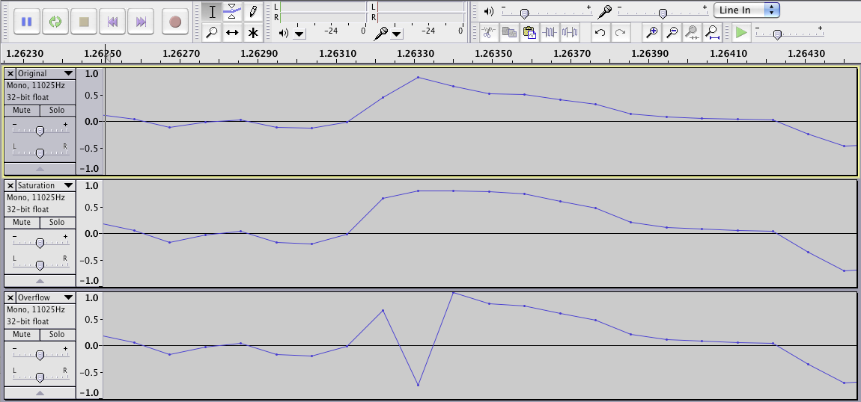
Problem of Standard Wrap-Around Computer Arithmetic (2)
Large deviation between computed result (with overflow) and desired result, highly dramatic during signal processing (e.g., amplifying of an audio signal / luminance adjustment of an image pixel)

Slide 42
Lesser Error with Saturating Arithmetic
Saturating arithmetic for additions or multiplications yields the maximally/minimally representable value in case of over-/underflows.
Examples
Absolute value representation (4 bits, unsigned):
8 +_{sat} 8 = 1000₍₂₎ +_{sat} 1000₍₂₎ = 7 +_{sat} 11 → 15 ≠ 18
10000₍₂₎ → 1111₍₂₎ = 15 ≠ 16
2’s complement representation (4 bits, signed):
7 +_{sat} 1 = 0111₍₂₎ +_{sat} 0001₍₂₎ = -5 –_{sat} 7 → -8 ≠ -12
1000₍₂₎ → 0111₍₂₎ = 7 ≠ 8
In particular, saturating arithmetic never produces sign inversions!

Slide 43
Another Example
a 0111
b + 1001
Standard Wrap-Around arithmetic (1)0000
Saturating arithmetic 1111
(a+b)/2: correct 1000
Wrap-Around arithmetic 0000
Saturating arithmetic using >> 0111 „almost correct“
Suitable for DSP / multimedia applications
  Interrupts generated by overflows
  ☞ Real-time requirements violated…?
  Exact values of less importance anyway
  Wrap-Around arithmetic produces inferior results

Slide 44
Saturating Arithmetic: Discussion
Pros
More plausible results in case of over-/underflows
Cons
More time-consuming to compute
Associativity and other laws violated
DSPs usually allow to choose between saturating and standard arithmetic (they feature correspondent variants of machine instructions)
“Saturation” in IEEE 754 floating point standard:
Over-/underflows produce ± infinity as result
Further IEEE 754 operations do not change this result!

Slide 45
DSPs: Real-Time Capabilities
The Timing Behavior of a Processor should be predictable!
Properties causing trouble:
Accesses to shared hardware resources
  Caches with replacement strategies with problematic timing behavior
  Unified caches for both code and data (conflicts between data and instructions)
  Pipelines with stall cycles (“bubbles”)
  Multi-cores with unpredictable communication/bus delays
Branch prediction, speculative instruction execution
Interrupts that can happen at any time
Memory refreshes at any time
Machine instructions with data-dependent execution latencies
Avoid as many of these problematic properties as possible

Slide 46
Multimedia Processors
Properties
Optimized for, e.g., image and audio processing
Well-known commercial products:
Intel MMX, SSE or SSE2; AMD 3DNow!; Sun VIS;
PowerPC AltiVec; HP MAX
Motivation: Multimedia software often does not use the full word-length of a processor (i.e., int), but only parts of it (e.g., short or char).
SIMD principle: Single Instruction, Multiple Data
Parallel handling of several “little” pieces of data by 1 machine instruction

Slide 47
SISD vs. SIMD Execution
Exercise: Perform two Additions of 2 short Variables each
SISD principle (Single Instruction, Single Data):
Load first 2 summands in registers,
int addition,
Load second 2 summands in registers,
int addition
Costs: 2 full additions
SIMD principle (Single Instruction, Multiple Data):
Load first 2 summands in upper halves of registers,
Load second 2 summands in lower halves of registers,
SIMD addition
Costs: 1 addition

Slide 48
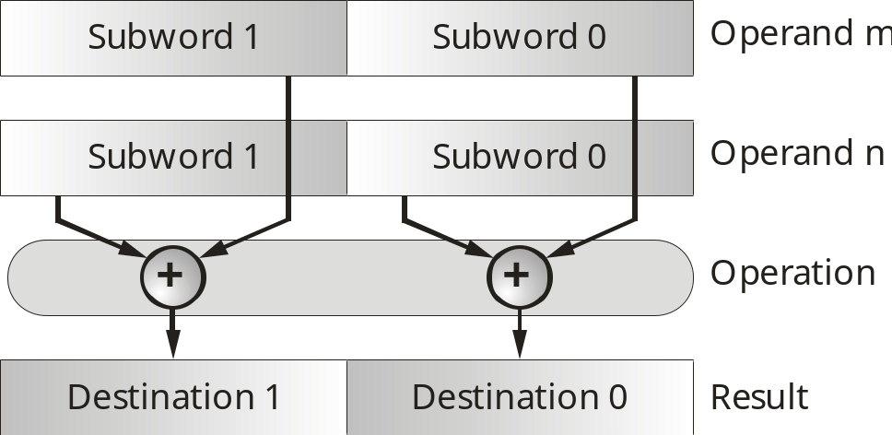
Illustration SIMD Addition
SIMD Half-Word Addition:
SIMD instructions also common for quarter-words:
4 parallel char additions for a 32-bit processor

Slide 49
Very Long Instruction Word (VLIW)
Motivation
Performance boost by exploiting instruction-level parallelism
Conventional Processors:
1 integer ALU
1 multiplier
1 (heterogeneous) register file
VLIW Processors:
n integer ALUs
n multipliers
n (heterogeneous) register files
Interconnection network

Slide 50
Example: M3 VLIW Processor
Group Memory
Interconnection Network
REG
REG
REG
MAC
ALU
MAC
ALU
MAC
ALU
  Slice 0
  Slice 1
  Slice 15

Slide 51
VLIW Instruction Word
1 instruction word contains 1 VLIW machine instruction
1 VLIW instruction contains n VLIW operations
Each operation controls exactly one Functional Unit (FU)
Fixed matching of operations in the instruction with FUs:
Operation 0 ↔ FU 0, Operation 1 ↔ FU 1, ...
Group Memory
Interconnection Network
  Slice 0
  Slice 1
  Slice 15
VLIW instruction
  Op₀
  Op₁
  Op₁₅

Slide 52
Network Protocols
Communication between distant Processors
Communication media error-prone
Payload is divided into packets
Packets are augmented with additional information (Header)
Example IPv4 Header:
0
7
15
23
26
31
Version
Length
Service Code
Total Packet Length
Identification
Flags
Fragment Offset
Time To Live
Protocol
Header Checksum
Source IP Address
Destination IP Address

Slide 53
Bit Packets (1)
Bit Packets in Protocol Headers
Headers are divided in regions with different meaning
These bit regions are not aligned with processor word-lengths
Bit packet:
  Sequence of consecutive bits
  of arbitrary length
  starting at arbitrary bit positions
  and eventually crossing word boundaries
Efficient manipulation of data at bit-level necessary!

Slide 54
Bit Packets (2)
Network Processing Units (NPUs)
Software for network protocol processing:
High amount of code dealing with processing of bit packets
Typical C-Code (GSM kernel, TU Berlin):
Instruction set of NPUs:
Special-purpose machine instructions to extract, insert & manipulate bit packets
xmc[0] = (*c >> 4) & 0x7;
xmc[1] = (*c >> 1) & 0x7;
xmc[2] = (*c++ & 0x1) << 2;
xmc[2] |= (*c >> 6) & 0x3;
xmc[3] = (*c >> 3) & 0x7;

Slide 55
Operations on Bit Packets
Extraction of Bit Packets
Insertion of Bit Packets
Register R1
Register R0
Size
Offset1
extr R2, R0, <Offset1>, <size>;
Register R2
Register R2
insert R0, R2, <Offset2>, <size>;
Size
Register R1
Register R0
Offset2

Slide 56
Chapter Contents
Compilers for Embedded Systems – Requirements & Dependencies
  Code Generation Tools
    Compiler, Assembler, Linker
    Source Code, Assembly Code, Object Code, Binary Code
  Source Languages for Compilers for Embedded Systems
    C, C++, Java
  Embedded Processors
    Digital Signal Processors
    Multimedia Processors
    Very Long Instruction Word Machines
    Network Processors
  Requirements on Compilers for Embedded Systems
    Code Quality vs. Compilation Times

Slide 57
Most Important Requirements on Compilers for ES
Maximal Code Quality
Run-time efficiency
Low energy consumption
Low code size
Meaningful Measures
Best-possible mapping of source language to machine language
Exploitation of strong compiler optimizations
Reuse of code fragments
Maximal exploitation of fast and small memories
Consideration of the WCET (Worst-Case Execution Time)
...
Maximal parallelization
Real-time ability
...

Slide 58
Less Important Requirements
Speed of the Compiler Itself
Situation for “standard” desktop computers:
  Large amount of available resources
  Code quality of less interest
  Compilers shall quickly generate correct code
Situation for Embedded Systems:
  Code quality of utmost importance
  Compiler shall generate highly-optimized code
  In the design process of Embedded Systems, compilers are called
  less frequently than when programming for desktop computers
☞ High Run-Times of Optimizing Compilers are acceptable!

Slide 59
References
Code Generation Tools
John R. Levine. Linkers & Loaders.
Morgan Kaufmann, 2000.
ISBN 1-55860-496-0
Programming Languages
Brian W. Kernighan, Dennis M. Ritchie. The C Programming Language.
Prentice Hall, 1988.
ISBN 0-13-110362-8
Embedded C++ Home Page.
http://www.caravan.net/ec2plus, 2002.
The Real-Time Specification for Java.
http://www.rtsj.org, 2007.

Slide 60
References
Processors & Instruction Sets
Peter Marwedel. Embedded System Design. Springer, 2011.
ISBN 978-94-007-0256-1
Rainer Leupers. Code Optimization Techniques for Embedded Processors. Kluwer Academic Publishers, 2000.
ISBN 0-7923-7989-6
Jens Wagner. Retargierbare Ausnutzung von Spezialoperationen für Eingebettete Systeme mit Hilfe bitgenauer Wertflussanalyse. Dissertation University of Dortmund, Computer Science 12, 2006.

Slide 61
Summary (1)
Code Generation Tools
Assembler and linker as further important tools besides compilers
Address resolution, memory layout and libraries
Source Languages for Compilers for Embedded Systems
ANSI-C: widespread imperative programming language; allows machine-oriented low-level programming; error-prone memory management; unspecified language details
C++: similar to C; high overhead due to some object-oriented language constructs
Java: very high overhead due to byte code interpretation; no real-time capabilities due to dynamic garbage collection during run-time
ANSI-C most common programming language for Embedded Systems

Slide 62
Summary (2)
Embedded Processors
Partially highly specialized instruction sets (multiply-accumulate, insert/extract, SIMD)
Special registers and address generation units
High degree of parallelism (several pipelines, multitude of functional units)
Requirements on Compilers for Embedded Systems
Code quality primary concern
Compile-times only secondary, in contrast to compilers for desktop computers

