Slide 1
Compilers for Embedded Systems
Summer Term 2022
Heiko Falk
Institute of Embedded Systems
Electrical Engineering, Computer Science and Mathematics
Hamburg University of Technology

Slide 2
Chapter 3
Internal Structure of Compilers

Slide 3
Outline
Introduction & Motivation
Compilers for Embedded Systems – Requirements & Dependencies
Internal Structure of Compilers
Pre-Pass Optimizations
HIR Optimizations and Transformations
Code Generation
LIR Optimizations and Transformations
Register Allocation
WCET-Aware Compilation
Outlook

Slide 4
Chapter Contents
Internal Structure of Compilers
  Compiler Stages
    Front-End: Lexical Analysis, Syntactical Analysis, Semantical Analysis
    Back-End: Code Generation, Register Allocation, Instruction Scheduling
  Intermediate Representations
    High-Level, Medium-Level & Low-Level IRs
    Case Studies: ICD-C, MIR, LLIR
    Structure of a Highly-Optimizing Compiler
  Optimizations & Objectives
    Abstraction Levels of Optimizations
    Average-Case & Worst-Case Execution Time
    Code Size
    Energy Consumption

Slide 5
The Front-End (1)
Source
Code
Lexical
Analysis
Token
Sequence
Lexical Analysis (Scanner)
Decomposition of the source code in lexical units (tokens)
Detection of tokens (regular expressions, finite automata)
Tokens represent strings of specific significance for the source language (e.g., identifier, constants, keywords)

Slide 6
The Front-End (2)
Source
Code
Lexical
Analysis
Token
Sequence
Syntactical
Analysis
Syntax
Tree
Syntactical Analysis (Parser)
Let G be the grammar of the source language
Decides whether token sequence can be inferred from G.
Syntax tree: Tree-like code representation based on the production rules of G used during inference
Error processing

Slide 7
The Front-End (3)
Source
Code
Lexical
Analysis
Token
Sequence
Syntactical
Analysis
Syntax
Tree
Semantical
Analysis
IR
Semantical Analysis (IR Generator)
Name and scope analysis of symbols
Type analysis
Creation of symbol tables (mapping of identifiers to their types and locations)
Generation of an intermediate representation (IR)

Slide 8
The Back-End (1)
IR
Code
Generation
Virtual
Code
Code Generation (Instruction Selection)
Selection of machine instructions to implement the given IR
Often – Generation of virtual code: non-executable assembler code; assumes an infinite amount of virtual registers, instead of a processor’s limited/finite amount of physical registers
Alternatively – Generation of code with stack accesses: executable assembler code; very restricted use of registers; variables are kept in memory (e.g., older GCCs at optimization level O0)

Slide 9
The Back-End (2)
IR
Code
Generation
Virtual
Code
Register
Allocation
ASM
Code
Register Allocation
Either: Mapping of virtual to physical registers
Or: Replacement of stack accesses by keeping data in registers
Insertion of memory transfers (spilling) if number of available physical registers is insufficient

Slide 10
The Back-End (3)
IR
Code
Generation
Virtual
Code
Register
Allocation
ASM
Code
Instruction
Scheduling
ASM
Code
Instruction Scheduling
Rearrangement of machine instructions in order to increase instruction-level parallelism
Dependence analysis between machine instructions (data- & control-flow dependencies)

Slide 11
Putting It All Together
Source
Code
Lexical
Analysis
Token
Sequence
Syntactical
Analysis
Syntax
Tree
Semantical
Analysis
IR
Code
Generation
Virtual
Code
Register
Allocation
ASM
Code
Instruction
Scheduling
ASM
Code
Course “Compilers for Embedded Systems”
Front-end not considered any further
( Course “Compiler Construction”)
Focus: Back-end & compiler optimizations

Slide 12

Open Question
Source
Code
Lexical
Analysis
Token
Sequence
Syntactical
Analysis
Syntax
Tree
Semantical
Analysis
IR
Code
Generation
Virtual
Code
Register
Allocation
ASM
Code
Instruction
Scheduling
ASM
Code
Where should optimizations be placed inside the compiler?
Code
Optimization

Slide 13
Code Optimization
Definition
Compiler stage that reads code, modifies it and outputs it.
Code modification aims to improve the code.
Remarks
Optimizations usually do not generate optimal code (often undecidable), but (hopefully) better code.
Code improvement is done subject to an objective function.
Existence of Formal Code Analyses
Code modifications must not break correctness of the code.
Optimizations must decide whether modifications of the code are legal or not.
Formal code analyses are used to take these decisions.
Examples: Control & data flow analyses, dependence analyses, ...

Slide 14
Prerequisites for Code Optimization
Required Compiler Infrastructure
Effective internal representation of code that
  easily supports code manipulation and
  provides all necessary analyses for optimizations.
Intermediate code Representations (IR)
Where should Optimizations be placed inside the Compiler?
Optimizations (usually) take place at the IR level within a compiler.
Intermediate Representations (IRs)
Compiler-internal data structures that model/represent the code to be translated or to be optimized.
Good IRs also provide required code analyses, in addition to optimizations.

Slide 15
Chapter Contents
Internal Structure of Compilers
  Compiler Stages
    Front-End: Lexical Analysis, Syntactical Analysis, Semantical Analysis
    Back-End: Instruction Selection, Register Allocation, Instruction Scheduling
  Intermediate Representations
    High-Level, Medium-Level & Low-Level IRs
    Case Studies: ICD-C, MIR, LLIR
    Structure of a Highly-Optimizing Compiler
  Optimizations & Objectives
    Abstraction Levels of Optimizations
    Average-Case & Worst-Case Execution Time
    Code Size
    Energy Consumption

Slide 16
Abstraction Levels of IRs (1)
float a[20][10];
... a[i][j+2] ...;
High-Level
Medium-Level
Low-Level
t1 ← a[i,j+2]
t₁ ← j+2
t₂ ← i*10
t₃ ← t₁+t₂
t₄ ← 4*t₃
t₅ ← addr a
t₆ ← t₅+t₄
t₇ ← *t₆
r1 ← [fp-4]
r2 ← r1+2
r3 ← [fp-8]
r4 ← r3*10
r5 ← r4+r2
r6 ← 4*r5
r7 ← fp-216
f1 ← [r7+r6]

Slide 17
Abstraction Levels of IRs (2)
High-Level IRs
Representation very close to source code
Often: Abstract syntax trees
Variables & types used to store and represent data
Preservation of complex control & data flow operations (esp. loops, if-then / if-else statements, Array accesses [])
Back-transformation of a high-level IR into source code easy
[S. S. Muchnick. Advanced Compiler Design & Implementation.
Morgan Kaufmann, 1997]

Slide 18
Abstraction Levels of IRs (3)
Medium-Level IRs
Three-address code: a₁ ← a₂ op a₃;
IR independent of source language & target processor
Temporary variables used to store data
Complex control & data flow operations simplified and broken down (labels & branches, pointer arithmetic)
Control flow in form of basic blocks
Definition: A basic block B=(I₁, ..., I_{n}) is an instruction sequence of maximal length such that
  B is entered only via its very first instruction I₁ and
  B is left only via its very last instruction I_{n}.

Slide 19
Abstraction Levels of IRs (4)
Low-Level IRs
Representation of machine code
Operations correspond to machine instructions
Registers used to store data
Transformation of a low-level IR into assembly code easy

Slide 20
High-Level IR: ICD-C (1)
IR
Compilation
Unit
1 C file when simultaneously translating
several source code files
Function
Loop Statements (for, do-while, while-do)
Selection Statements (if, if-else, switch)
Jump Statements (return, break, continue, ...)
...
Statement
Binary & Unary Expressions (+, -, *, /, ...)
Assignment operators (=, +=, -=, ...)
Index & component accesses (a[x], a.x, ...)
...
Expression

Slide 21
High-Level IR: ICD-C (2)
IR
associated
symbol tables
Global ST
Compilation
Unit
File ST
Function
Funct. ST
Basic
Block
Statement
Local ST
Expression
[Informatik Centrum Dortmund e.V.
www.icd.de/en/es/icd-c-compiler, Dortmund, 2015]

Slide 22
ICD-C: Code Example
struct A {
int b;
...
} a;
int c;
...
a.b += c*3;
IR_ExpStmt
IR_AssignExp
+=
.
IR_ComponentAccessExp
IR_BinaryExp
*
a
b
c
3
IR_SymbolExp
IR_SymbolExp
IR_SymbolExp
IR_IntConstExp
IR_SymbolTable
IR_ComposedType
IR_SymbolTable
a: IR_ComposedType
c: IR_BuiltinType (int)
(struct A)
components:
IR_SymbolTable
b: IR_BuiltinType (int)
...

Slide 23
ICD-C: Features
ANSI-C Compiler Front-end: C89 + C99 standards
GNU Inline-assembly
Included Analyses: Data flow analyses
Control flow analyses
Loop analyses Pointer analyses
Interfaces:
  ANSI-C dump of the IR as interface to external tools
  Interface to code selector in compiler back-ends
Internal Structure:
  Object-oriented design (C++)

Slide 24
Medium-Level IR: MIR (1)
MIR Program: 1 – N Program Units (i.e., functions)
Program Unit: begin MIRInst* end
MIR Instructions:
  Quadruples: 1 operator, 3 operands (3-address code)
  Types of instructions:
  Assignments, jumps (goto), conditions (if),
  function call & return (call, return),
  parameter passing (receive)
  Can contain MIR expressions

Slide 25
Medium-Level IR: MIR (2)
MIR Expressions:
  Binary operators: +, -, *, /, mod, min, max
  Comparison operators: =, !=, <, <=, >, >=
  Shift & logical operators: shl, shr, shra, and, or, xor
  Unary operators: -, !, addr, cast, *
Symbol Table:
  Contains variables and symbolic registers
  Entries have types: integer, float, boolean
[S. S. Muchnick. Advanced Compiler Design & Implementation.
Morgan Kaufmann, 1997]

Slide 26
MIR: Properties
MIR is not a High-Level IR
  Closeness to source language lacking
  High-level constructs are missing: Loops, array accesses, ...
  Only few and mostly simple operators present
MIR is not a Low-Level IR
  Closeness to target architecture lacking: Behavior of operands is defined in machine-independent way
  Concepts of symbol tables, variables and types not low-level
  Abstract mechanisms for function calls, returns, and parameter passing
MIR is a Medium-Level IR.

Slide 27
Low-Level IR: LLIR (1)
LLIR
Function
Basic
Block
Instruction
Machine instruction
Contains 1-N machine operations
Operations are executed in parallel ( VLIW)
Operation
Machine operation
Contains assembly opcode (e.g., ADD, MUL, ...)
Contains 0-M parameters

Slide 28
Low-Level IR: LLIR (2)
LLIR
This LLIR structure is completely processor-independent:
  An LLIR consists of some arbitrary, generic functions
  An LLIR function consists of...
  An LLIR operation consists of some arbitrary, generic parameters
Function
Basic
Block
Instruction
Registers
Integer constants & labels
Addressing modes
...
Operation
Parameter

Slide 29
Low-Level IR: LLIR (3)
LLIR
LLIR becomes processor-specific by providing
a processor description:
Function
TriCore 1.3:
Registers = {D0, ..., D15, A0, ..., A15}
Mnemonics = {ABS, ABS.B, ..., XOR.T}
Status flags = {C, V, ..., SAV}
...
Basic
Block
Instruction
[Informatik Centrum Dortmund e.V.
www.icd.de/en/es/icd-c-compiler, Dortmund, 2015]
Operation
Parameter

Slide 30
LLIR: Code Example (Infineon TriCore 1.3)
ld.w %d_0, [%A10] 12;
Load memory contents from address [%A10] 12 in register d_0
Recall: Register A10 = Stack pointer  Physical register
Address [%A10] 12 = Stack pointer + 12 Bytes
(so-called Base + Offset Addressing)
TriCore features no register d_0  Virtual data register
LLIR_Operation
ld.w
LLIR_Parameter
PARAM_REGISTER
LLIR_Parameter
PARAM_OPERATOR
LLIR_Parameter
PARAM_REGISTER
LLIR_Parameter
PARAM_CONSTANT
OPER_BASE
12
LLIR_Register
d_0
LLIR_Register
A10

Slide 31
LLIR: Features
Retargetability:
  Adaptability to support various distinct processors (e.g., DSPs, VLIWs, NPUs, ...)
  Modelling of various instruction set architectures (ISAs)
  Modelling of various kinds of register sets
Included Analyses:
  Data flow analyses
  Control flow analyses
Interfaces:
  Import and export of assembly files
  Interface to code generation

Slide 32
Back to the Open Question...
Where should Optimizations be placed inside the Compiler?
Optimizations (usually) take place at the IR level within a compiler.
Structure of an Optimizing Compiler with 2 IRs:
Source
Code
Lexical
Analysis
Token
Sequence
Syntactical
Analysis
Syntax
Tree
Semantical
Analysis
High-
Level IR
Code
Optimization
Low-
Level IR
Code
Generation
High-
Level IR
Code
Optimization
Low-
Level IR
Register
Allocation
Low-
Level IR
Instruction
Scheduling
ASM
Code

Slide 33
Chapter Contents
Internal Structure of Compilers
  Compiler Stages
    Front-End: Lexical Analysis, Syntactical Analysis, Semantical Analysis
    Back-End: Instruction Selection, Register Allocation, Instruction Scheduling
  Intermediate Representations
    High-Level, Medium-Level & Low-Level IRs
    Case Studies: ICD-C, MIR, LLIR
    Structure of a Highly-Optimizing Compiler
  Optimizations & Objectives
    Abstraction Levels of Optimizations
    Average-Case & Worst-Case Execution Time
    Code Size
    Energy Consumption

Slide 34
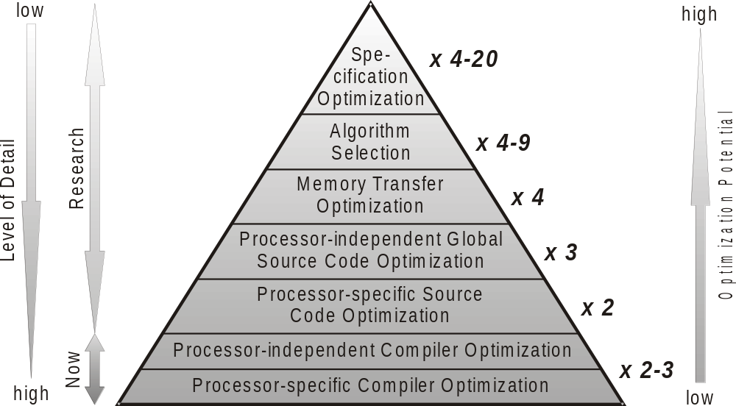
Abstraction Levels of Optimizations (1)
[H. Falk. Source Code Optimization Techniques for Data Flow Dominated Embedded Software. Kluwer, 2004]

Slide 35
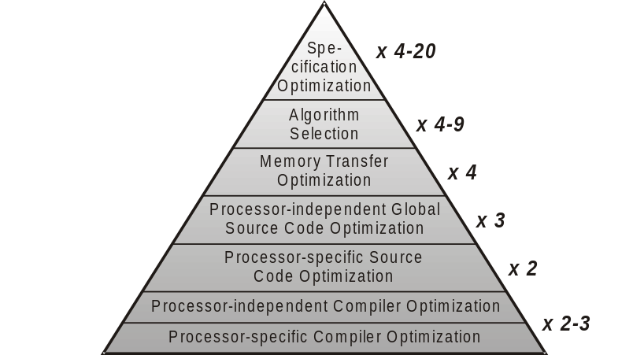
Abstraction Levels of Optimizations (2)
Compiler Optimization
Everything that is included in today’s compilers
Processor-specific: low-level
Processor-independent: high-level
Typical speed-ups: Factor 2 to 3 altogether
Cf. chapters 5 – 9

Slide 36
Abstraction Levels of Optimizations (3)
Source Code Optimization
Transformation of source code such that subsequent compiler generates more efficient code
Processor-specific: Support the compiler in mapping source to target language
Processor-independent: Machine-independent improvement of the source code’s structure
Partly automated, partly manual
Typical speed-ups: 2x or 3x
Cf. chapter 4

Slide 37
Abstraction Levels of Optimizations (4)
Memory Transfer Optimization
Reduction of data and code transfers from memory to processor at a very abstract level
E.g., restructuring of an algorithm’s data structures, reorganizing of (multi-dimensional) arrays in memory, merging or splitting of arrays
Only manually
Typical speed-ups: ca. 4x

Slide 38
Abstraction Levels of Optimizations (5)
Algorithm Selection
Replacement of entire algorithms of a program by other, more efficient implementations
E.g., Bubblesort → Quicksort
Replacement must preserve functional behavior of the program
Only manually
Typical speed-ups: 4x – 9x

Slide 39
Abstraction Levels of Optimizations (6)
Specification Optimization
Replacement of algorithms just as during “Algorithm Selection”
But: Replacement is allowed to change the program’s functional behavior
E.g., Replacement of double floating-point numbers by single-precision or integer values; replacement of complex formulae by simpler approximations (sin, cos)
Only manually
Also known as Approximate Computing
Typical speed-ups: 4x – 20x

Slide 40
Objective Function: (Typical) Run-Time
Average-Case Execution Time (ACET)
An ACET-optimized program shall run faster during a “typical” execution using “typical” input data.
The Objective Function of Optimizing Compilers per se. Strategy: “Greedy”, i.e., whenever the execution of code at run-time can be saved somewhere, this is actually also done.
ACET-optimizing Compilers usually do not have a precise ACET Model.
Exact impacts of optimizations on the effective run-time are completely unknown to the compiler.
ACET optimizations are usually beneficial, but sometimes only neutral or even disadvantageous

Slide 41
Example: Function Inlining
main() {
...
a = min( b, c );
...
...min( f, g )...
}
main() {
...
a = b<c ? b : c;
...
...f<g ? f : g;
}
int min( int i,
int j ) {
return(
i<j ? i : j );
}
Potential Run-Time Reduction due to:
Code for parameter and return value passing redundant
Code to jump into the called function redundant
Memory allocation at beginning of called function eventually redundant
Potential enabling of other optimizations that otherwise fail due to function boundaries

Slide 42
Objective Function: Code Size
Generation of a minimal Amount of Code, measured in Bytes
Trivial Modelling:
Compiler knows exactly which machine instructions it generates and how many bytes each individual instruction takes.
Often in Conflict with Run-Time Minimization: Example Inlining
Inlining copies a function’s body to the place of the function call
For large functions and/or many calls of a function in the code: Heavy increases in terms of code size!
Code size-minimizing optimizing compilers:
  Completely deactivated Function Inlining

Slide 43
Objective Function: Energy Consumption (1)
Generation of Code that consumes minimal Electrical Energy
Modelling usually includes both Processor and Memories
Simple Energy Model for Processors:
Base Costs of a machine instruction: Energy consumption of the processor during execution of this single machine instruction
Determination of base costs (e.g., for an ADD instruction):
.L0:
...
ADD d0, d1, d2;
ADD d0, d1, d2;
ADD d0, d1, d2;
...
LOOP a5, .L0;
Loop that contains the examined instruction very often.
Execution on real hardware
Energy measurement: Ampere meter
Breakdown of result to one single ADD
Repetition for the entire instruction set

Slide 44
Objective Function: Energy Consumption (2)
Simple Energy Model for Processors:
Inter-instruction Costs between two successive machine instructions: Model activation and deactivation of Functional Units (FUs)
Example: ADD executed in ALU, MUL in dedicated multiplier
Loop that contains the examined instruction pair very often.
Execution and measurement as done for base costs
Breakdown of result to one single pair of ADD and MUL
Repetition for all possible combinations of FUs
.L0:
ADD d0, d1, d2;
MUL d3, d4, d5;
ADD d0, d1, d2;
MUL d3, d4, d5;
...
LOOP a5, .L0;

Slide 45
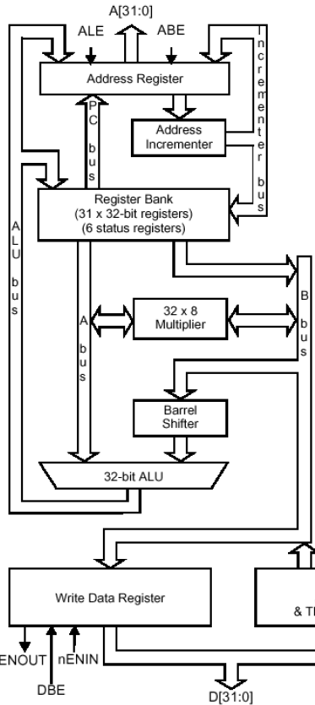
Objective Function: Energy Consumption (3)
Functional Units of ARM7 Processors
Functional units: Address incrementer, 32x8 multiplier, barrel shifter and ALU
Example from previous slide: power-on ALU for ADD, perform addition.
Hereafter: Power-on multiplier for MUL, charge busses to/from multiplier.
Finally: Power-down multiplier after MUL, discharge busses.
Power-on/-down of FUs & charging/discharging of wires costs lots of electrical energy!
[ARM Limited. ARM7TDMI Technical Reference Manual. 2004]

Slide 46
Objective Function: Energy Consumption (4)
Computation of the CPU Energy by Compiler
Sum up base costs of all generated machine instructions
Sum up inter-instruction costs of all successive instruction pairs
Multiply by estimated execution counts per basic block
Computation of Memory Energy by Compiler
Either using data sheets from manufacturers, or based on measurements
Principle: Energy consumption per load or store memory access
Simple for static RAMs (SRAM), difficult for Caches and dynamic RAMs (DRAM)
[V. Tiwari et al. Power Analysis of Embedded Software: A First Step Towards
Software Power Minimization. IEEE Transactions on VLSI, December 1994]
[S. Steinke et al. An Accurate and Fine Grain Instruction-Level Energy Model
Supporting Software Optimizations. PATMOS Workshop, September 2001]

Slide 47
Objective Function: Worst-Case Run-Time (1)
Worst-Case Execution Time (WCET):
Maximal run-time of a program over all possible input data.
Problem:
Determination of a program’s WCET intractable! (Would include solving the Halting problem)

Slide 48
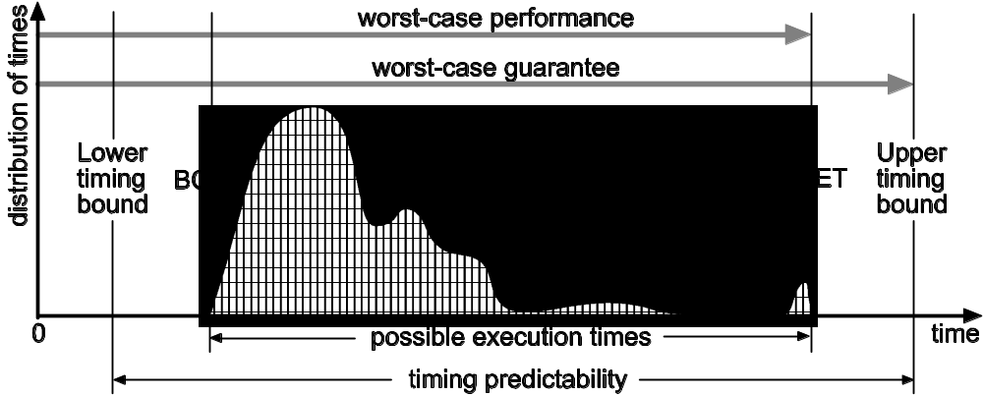
Objective Function: Worst-Case Run-Time (2)
Solution: Estimation of upper bounds of the actual (unknown) WCET
Requirements on WCET Estimates:
  Safeness: WCET ≤ WCET_{EST}!
  Tightness: WCET_{EST} – WCET → minimal
Deadline

Slide 49
References
Compiler Stages and IRs
Steven S. Muchnick. Advanced Compiler Design & Implementation. Morgan Kaufmann, 1997.
ISBN 1-55860-320-4
Andrew W. Appel. Modern compiler implementation in C. Cambridge University Press, 1998.
ISBN 0-521-58390-X
Abstraction Levels of Optimizations
H. Falk. Source Code Optimization Techniques for Data Flow Dominated Embedded Software. Kluwer Academic Publishers, 2004.
ISBN 1-4020-2822-9

Slide 50
Summary (1)
Compiler Stages
Significance of individual phases within a compiler
Focus here on compiler back-end
Location of optimizations within the compiler
Intermediate Representations
Effective compiler-internal representations of code; facilitate manipulation and analysis of code
Different abstraction levels: Close to source language; independent of source language and processor architecture; close to processor architecture

Slide 51
Summary (2)
Optimizations & Objective Functions
Many classes of optimizations having high potential are not automatable
Focus here on compiler and source code optimizations
Average-Case Execution Time: Objective function of almost every compiler; compilers, however, to not feature an ACET timing model
Code size: Often in contradiction with ACET
Energy consumption: Energy models for processors (base & inter-instruction costs) and memory
Worst-Case Execution Time: not computable; WCET estimation

