Slide 1
Compilers for Embedded Systems
Summer Term 2022
Heiko Falk
Institute of Embedded Systems
Electrical Engineering, Computer Science and Mathematics
Hamburg University of Technology

Slide 2
Chapter 4
Pre-Pass Optimizations

Slide 3
Outline
Introduction & Motivation
Compilers for Embedded Systems – Requirements & Dependencies
Internal Structure of Compilers
Pre-Pass Optimizations
HIR Optimizations and Transformations
Code Generation
LIR Optimizations and Transformations
Register Allocation
WCET-Aware Compilation
Outlook

Slide 4
Chapter Contents
Pre-Pass Optimizations
  Motivation of Pre-Pass Optimizations
  Loop Nest Splitting
    Embedded Multimedia: MPEG 4 Motion Estimation
    Workflow of Loop Nest Splitting
    Condition Satisfiability
    Condition Optimization & Genetic Algorithms
    Search Space Generation
    Search Space Exploration
    Results (ACET, Energy, Code Size)

Slide 5
Motivation of Pre-Pass Optimizations (1)
Retrospect: Structure of an Optimizing Compiler with 2 IRs:
Question: May only the compiler optimize code?
Source
Code
Lexical
Analysis
Token
Sequence
Syntactical
Analysis
Syntax
Tree
Semantical
Analysis
High-
Level IR
Code
Optimization
Low-
Level IR
Code
Generation
High-
Level IR
Code
Optimization
Low-
Level IR
Register
Allocation
Low-
Level IR
Instruction
Scheduling
ASM
Code

Slide 6

Motivation of Pre-Pass Optimizations (2)
Optimizations outside a compiler are called
Post-pass if they take place after the compiler
Pre-pass if they take place before the compiler
Advantages of Pre-Pass Optimizations
Source code transformations more easily comprehensible.
Allow for manually “playing” with an optimization technique before a laborious implementation.
Independent of the actual compiler due to source code-level; principally applicable for each individual compiler of the source language.
Due to source code-level independent of the actual target architecture; principally applicable for arbitrary architectures.

Slide 7
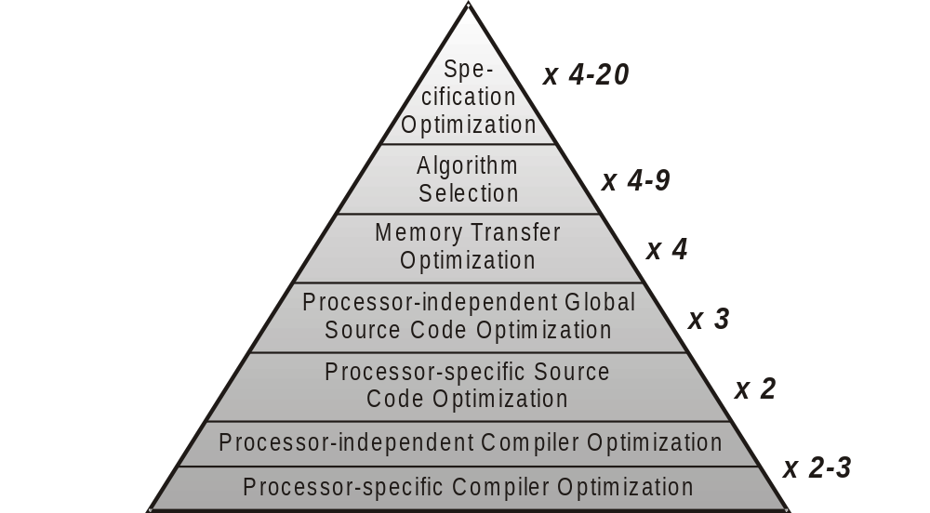
Abstraction Levels of Optimizations
Pre-Pass
Optimizations
CfES
Chapter 4

Slide 8
Chapter Contents
Pre-Pass Optimizations
  Motivation of Pre-Pass Optimizations
  Loop Nest Splitting
    Embedded Multimedia: MPEG 4 Motion Estimation
    Workflow of Loop Nest Splitting
    Condition Satisfiability
    Condition Optimization & Genetic Algorithms
    Search Space Generation
    Search Space Exploration
    Results (ACET, Energy, Code Size)

Slide 9
Application Domain of Loop Nest Splitting
Embedded Multimedia Applications
Data flow dominated, i.e., get large amounts of data as inputs, compute large volumes of data as output
(in contrast to control flow dominated control applications).
Largest part of the run-time consumed by (deeply) nested loops
Simple loop structures with statically known or analyzable lower and upper bounds
Manipulation of large, multi-dimensional arrays
Typical example: Streaming applications like MPEG4

Slide 10
Example: MPEG4 Motion Estimation
i
Reference Frame
Actual Frame
36x36 Pixels
Search Region
vx
x
144 Pixels
vy
x4
4x4 Pixels
y4
y
196 Pixels

Slide 11
Source Code MPEG4 Motion Estimation
for (i = 0; i < 20; i++)
for (x = 0; x < 36; x++)
for (y = 0; y < 49; y++)
for (vx = 0; vx < 9; vx++)
for (vy = 0; vy < 9; vy++)
for (x4 = 0; x4 < 4; x4++)
for (y4 = 0; y4 < 4; y4++) {
if (4*x+x4<0 || 4*x+x4>35 ||
4*y+y4<0 || 4*y+y4>48)
then_block_1; else else_block_1;
if (4*x+vx+x4–4<0 || 4*x+vx+x4–4>35 ||
4*y+vy+y4-4<0 || 4*y+vy+y4-4>48)
then_block_2; else else_block_2; }

Slide 12
Observations
When Compiling and Executing this Source Code
Execution of 91,445,760 if-statements in total
Very irregular control flow due to if-statements
Additional arithmetical overhead:
Multiplications, additions, comparisons, logical or, ...
Performance of this code limited by control flow, and not by the computation of motion vectors!

Slide 13
Loop Nest Splitting
Automated Loop & If-Statement Analysis
x, y, x4 and y4 never carry values such that conditions 4*x+x4<0 and 4*y+y4<0 are ever true.
Conditions can be replaced by constant truth value ‘0’.
For x ≥ 10 or y ≥ 14, both if-statements are always satisfied so that their then-parts are always executed.
For more than 92% of all executions of the innermost y4-loop, both if-statements are satisfied.

Slide 14
Source Code after Loop Nest Splitting
for (i = 0; i < 20; i++)
for (x = 0; x < 36; x++)
for (y = 0; y < 49; y++)
if (x >= 10 || y >= 14) // Splitting-If
for (; y < 49; y++) // Second y-loop
for (vx = 0; vx < 9; vx++) ... { // No
then_block_1; then_block_2; } // If-Stmts
else
for (vx = 0; vx < 9; vx++) ... {
if (0 || 4*x+x4>35 || 0 || 4*y+y4>48) // Old
then_block_1; else else_block_1; // If-Stmts
if (4*x+vx+x4–4<0 || 4*x+vx+x4–4>35 || ...
then_block_2; else else_block_2; }

Slide 15
Optimized Code Structure
Splitting-If
Whenever the condition of the splitting-if is satisfied, the conditions of all original if-statements are automatically also satisfied.
Then-part of the splitting-if thus contains no original if-statements any more, but only their then-parts.
If splitting-if is not satisfied, no safe statement about the conditions of the original if-statements is possible.
Else-part of the splitting-if contains all original if-statements in order to keep the code correct.

Slide 16
Why Second y-Loop?
Intuitive Code:
Optimized Code:
☞ Splitting-If:
1 execution for
each individual y ∈ [14, 48]
for (x=0; x<36; x++)
for (y=0; y<49; y++)
if (x>=10 || y>=14)
for (vx=0; vx<9; vx++) ...
15
16
y =
14
☞ Splitting-If:
1 execution for
all y ∈ [14, 48] altogether
for (x=0; x<36; x++)
for (y=0; y<49; y++)
if (x>=10 || y>=14)
for (; y<49; y++)
for (vx=0; vx<9; vx++) ...
15
16
y =
14

Slide 17
Phases of Loop Nest Splitting
Condition Satisfiability: Finds individual conditions in if-statements that are always or never satisfied.
Condition Optimization: For each single condition C, find a “simpler” condition C’ such that C’ ⇒ C holds (whenever C’ is true, C is also true).
Search Space Generation: Combine all single conditions C’ to one data structure G that models all if-statements including their structure (&&, ||).
Search Space Exploration: Using G, determine a condition for the splitting-if that minimizes the number of totally executed if-statements.

Slide 18
Workflow of Loop Nest Splitting (1)
4*x+3*x4>20 x-x4>3 3*x+x4<0 6*x-20*x4<61
( && ) || ||
x4
x4
x4
x4
x
x
x
x
Note:
This example does not correspond to the MPEG4 code from the previous slides!
Assumed loop bounds:
0 ≤ x ≤ 13
0 ≤ x4 ≤ 3
1 - Condition Satisfiability

Slide 19

Workflow of Loop Nest Splitting (2)
4*x+3*x4>20 x-x4>3 3*x+x4<0 6*x-20*x4<61
( && ) || ||
x4
x4
x4
x
x
x
x4
x4
x4
x
x
x
1 - Condition Satisfiability
2 - Condition Optimization

Slide 20
Workflow of Loop Nest Splitting (3)
4*x+3*x4>20 x-x4>3 3*x+x4<0 6*x-20*x4<61
( && ) || ||
x4
x4
x
x
x4
x4
x4
x
x
x
1 - Condition Satisfiability
2 - Condition Optimization
3 - Search Space Generation

Slide 21
Workflow of Loop Nest Splitting (4)
4*x+3*x4>20 x-x4>3 3*x+x4<0 6*x-20*x4<61
( && ) || ||
x4
x4
x
x
x4
x
x>=7 || x4>=1
1 - Condition Satisfiability
2 - Condition Optimization
3 - Search Space Generation
4 - Search Space Exploration

Slide 22



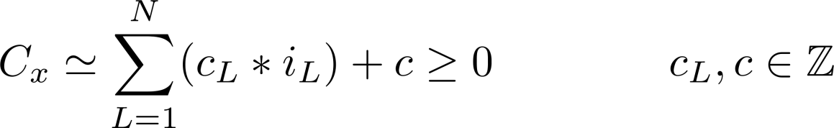
Prerequisites
Bounds of Loops
All lower and upper bounds are constant
If-Statements
Sequence of loop-dependent conditions, all of which are combined using logical AND or OR
  Format:
Loop-Dependent Conditions
Linear expressions over index variables of the loops
  Format:

Slide 23




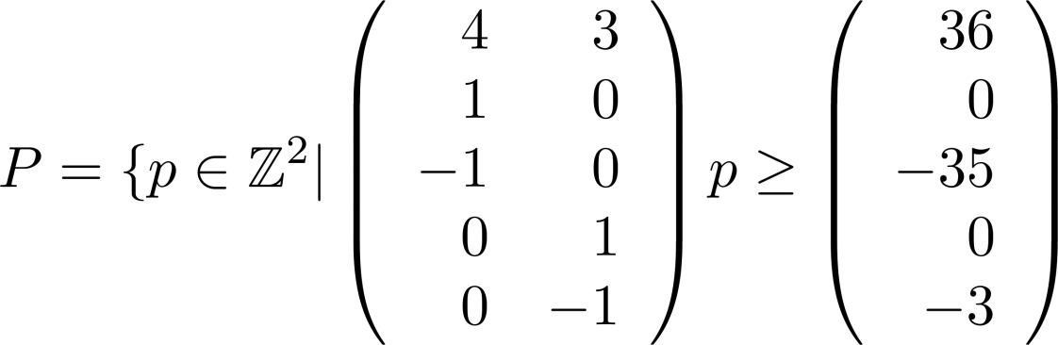
Polytopes & Linear Conditions
Definition (Polyhedra / Polytopes)
Polyhedron
Polyhedron is called Polytope iff
Example: Model of Linear Conditions in Nested Loops
4*x + 3*x4 > 35 for x , x4 as polytope
x4
x

Slide 24





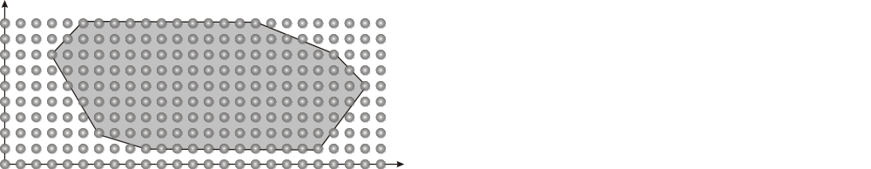
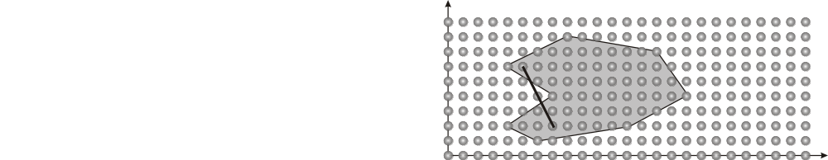
Convexity of Polytopes
Definition (Convexity)
A set is called convex if each convex combination of
is in and .
Less Formally
Each line between any two arbitrary points and from must lie completely in .
Polytopes are convex.
Convex
Not convex

Slide 25

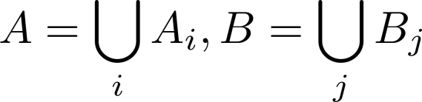
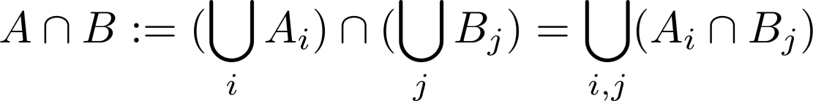
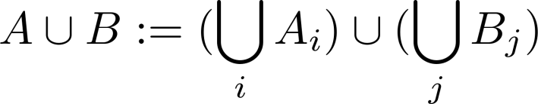
Operations on Polytopes
Properties
The Intersection of two polytopes is again a polytope.
The Union of two polytopes is not a polytope, since the resulting set is not necessarily convex.
Definition (Finite Union of Polyhedra, FUP)
For polyhedra , is called a Finite Union of Polyhedra (FUP).
Set Operations on FUPs

Slide 26
Phase 1 – Condition Satisfiability
Goal
To identify loop-dependent conditions C_{x} that constantly evaluate to ‘true’ or ‘false’, irrespectively of the values of index variables of all surrounding loops.
Approach
Translate each condition C_{x} into a polytope P_{x} ( slide 23)
Test for the empty set: P_{x} == Ø ⇒ C_{x} always ‘false’
Test for the universe: P_{x} == U ⇒ C_{x} always ‘true’
Source Code Modification
Replacement of all these constantly true or false conditions in the source code by constants ‘0’ or ‘1’.

Slide 27
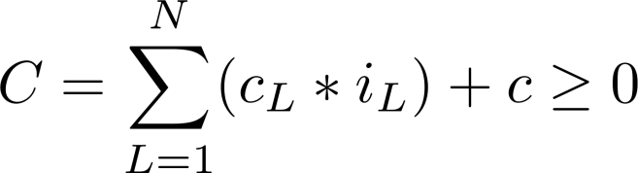




Phase 2 – Condition Optimization
Given
loops and one condition
Assumed fictive Situation
for ( loop )
...
for ( loop )
if ( ) ...
Goal: To determine intervals such that:
is satisfied for all loop iterations within these intervals
Minimization of the number of executions of if-statements after a hypothetical loop nest splitting based on these intervals.
Assumption: The loops contain only 1 if-statement with only 1 condition. All other if-statements & conditions are quasi suppressed.

Slide 28


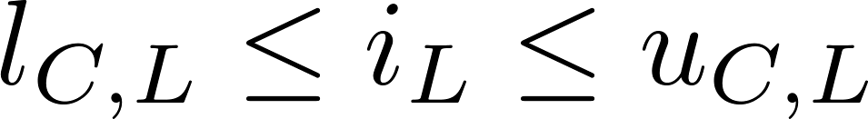
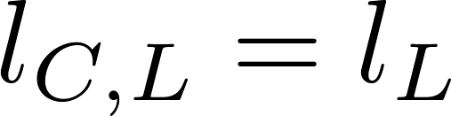


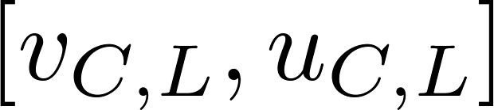

Optimization of a Condition C
Determination of values and for every loop
Interpretation: is satisfied for all
Optimization goal:
All values and minimize the total amount of executed if-statements
Simplification: The linearity of implies
either or
Consequence: Determination of only one value
Either or satisfies condition

Slide 29
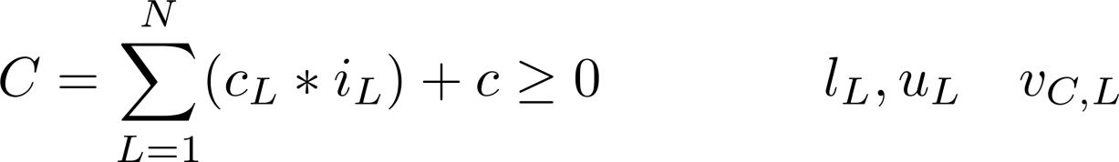
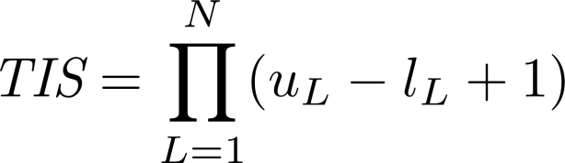
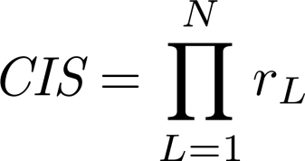
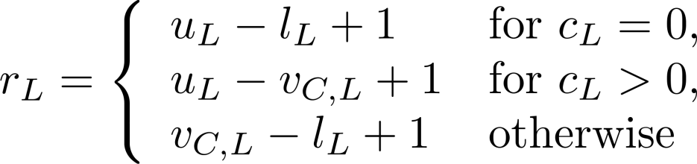
Some Definitions...
Given:
Total Iteration Space
Constrained Iteration Space
Splitting Loop
(#Executions of the innermost loop’s body)
(#Executions of the innermost loop’s body, constrained to regions specified by values )
(Index of that loop where splitting will take place)

Slide 30
Illustration (1)
Loop 1
for (i = 0; i < 20; i++)
for (x = 0; x < 36; x++)
for (y = 0; y < 49; y++)
for (vx = 0; vx < 9; vx++)
for (vy = 0; vy < 9; vy++)
for (x4 = 0; x4 < 4; x4++)
for (y4 = 0; y4 < 4; y4++) {
if (4*x+vx+x4-4>35)
then_block_1; else else_block_1; }
Loop N=7
Note:
Loops are enumerated from 1 ... N from the outermost to the innermost loop.
Only 1 condition in if-statement instead of the many ones from slide 11!

Slide 31
Illustration (2)
Loop 1
for (i = 0; i < 20; i++)
for (x = 0; x < 36; x++)
for (y = 0; y < 49; y++)
for (vx = 0; vx < 9; vx++)
for (vy = 0; vy < 9; vy++)
for (x4 = 0; x4 < 4; x4++)
for (y4 = 0; y4 < 4; y4++) {
if (4*x+vx+x4-4>35)
then_block_1; else else_block_1; }
Loop N=7
TIS:
Amount of executions of the code within the curly braces.
Here: 20 * 36 * 49 * 9 * 9 * 4 * 4 = 45,722,880

Slide 32
Illustration (3)
Loop 1
for (i = 0; i < 20; i++)
for (x = 0; x < 36; x++)
for (y = 0; y < 49; y++)
for (vx = 0; vx < 9; vx++)
for (vy = 0; vy < 9; vy++)
for (x4 = 0; x4 < 4; x4++)
for (y4 = 0; y4 < 4; y4++) {
if (4*x+vx+x4-4>35)
then_block_1; else else_block_1; }
Loop
Let be given.
Condition is satisfied for all x ≥ 10 and i, y, ..., y4 ≥ 0.
CIS: 20 * (36 – 10) * 49 * 9 * 9 * 4 * 4 = 33,022,080

Slide 33


Illustration (4)
for (i = 0; i < 20; i++)
for (x = 0; x < 36; x++)
if (x >= 10)
for (; x < 36; x++) ...
for (y4 = 0; y4 < 4; y4++) {...}
else
for (y = 0; y < 49; y++) ...
for (y4 = 0; y4 < 4; y4++) {
if (4*x+vx+x4-4>35) ... }
CIS: Number of executions of the code in curly braces for x ≥ 10.
Hypothetical Code for
Splitting Loop since splitting-if needs to be placed in 2nd loop.
Question: How often would all if-statements shown here be executed?

Slide 34

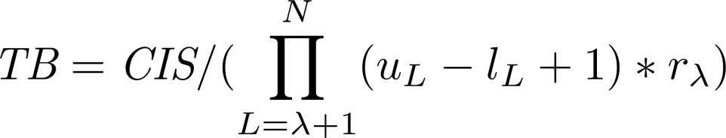
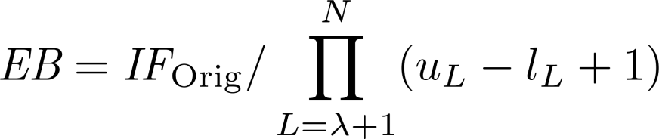
Counting of If-Statement Executions
#If-Statements after Splitting
#Original if’s
#Splitting-if’s
#Then-Blocks
#Else-Blocks
(#Original if’s + #Splitting-if’s)
(Total iterations without constrained iterations)
(CIS without iterations of loops
inside of )
(#Original if’s without loop iterations
inside of )

Slide 35



Illustration (5)
for (i = 0; i < 20; i++)
for (x = 0; x < 36; x++)
if (x >= 10)
for (; x < 36; x++) ...
for (y4 = 0; y4 < 4; y4++) {...}
else
for (y = 0; y < 49; y++) ...
for (y4 = 0; y4 < 4; y4++) {
if (4*x+vx+x4-4>35) ... }

Slide 36


Illustration (6)
for (i = 0; i < 20; i++)
for (x = 0; x < 36; x++)
if (x >= 10)
for (; x < 36; x++) ...
for (y4 = 0; y4 < 4; y4++) {...}
else
for (y = 0; y < 49; y++) ...
for (y4 = 0; y4 < 4; y4++) {
if (4*x+vx+x4-4>35) ... }

Slide 37


Illustration (7)
for (i = 0; i < 20; i++)
for (x = 0; x < 36; x++)
if (x >= 10)
for (; x < 36; x++) ...
for (y4 = 0; y4 < 4; y4++) {...}
else
for (y = 0; y < 49; y++) ...
for (y4 = 0; y4 < 4; y4++) {
if (4*x+vx+x4-4>35) ... }

Slide 38
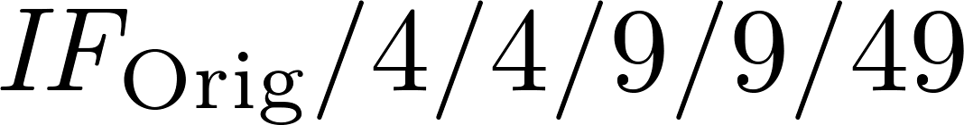
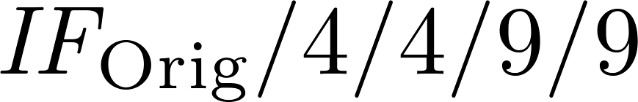
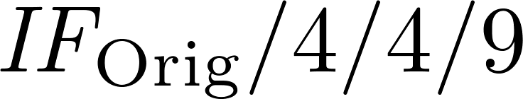
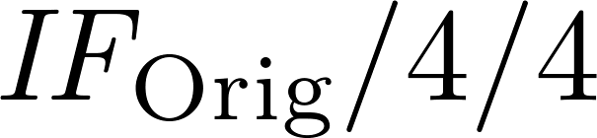

Illustration (8)
for (i = 0; i < 20; i++)
for (x = 0; x < 36; x++)
if (x >= 10)
for (; x < 36; x++) ...
for (y4 = 0; y4 < 4; y4++) {...}
else
for (y = 0; y < 49; y++)
for (vx = 0; vx < 9; vx++)
for (vy = 0; vy < 9; vy++)
for (x4 = 0; x4 < 4; x4++)
for (y4 = 0; y4 < 4; y4++) {
if (4*x+vx+x4-4>35) ... }

Slide 39
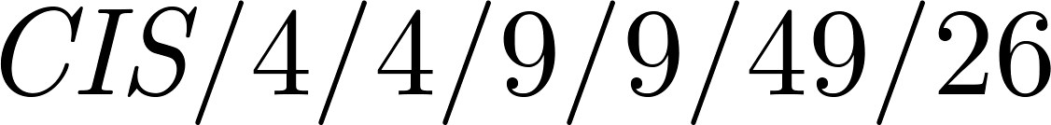
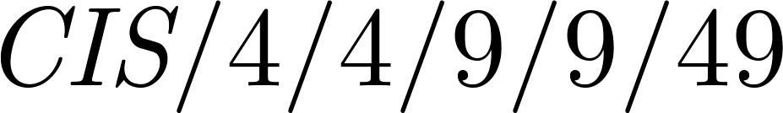
Illustration (9)
for (i = 0; i < 20; i++)
for (x = 0; x < 36; x++)
if (x >= 10)
for (; x < 36; x++)
for (y = 0; y < 49; y++)
for (vx = 0; vx < 9; vx++)
for (vy = 0; vy < 9; vy++)
for (x4 = 0; x4 < 4; x4++)
for (y4 = 0; y4 < 4; y4++) {
...}
else
...
in analogy to
previous slide

Slide 40

Illustration (10)
for (i = 0; i < 20; i++)
for (x = 0; x < 36; x++)
if (x >= 10)
for (; x < 36; x++) ...
for (y4 = 0; y4 < 4; y4++) {...}
else
for (y = 0; y < 49; y++) ...
for (y4 = 0; y4 < 4; y4++) {
if (4*x+vx+x4-4>35) ... }

Slide 41

Computation of Values
Wrap-Up
For a condition and given values , we can compute how many if-statements would be executed after splitting based on .
Very nice, but...
... who produces good values for ?
☞ A Genetic Algorithm

Slide 42
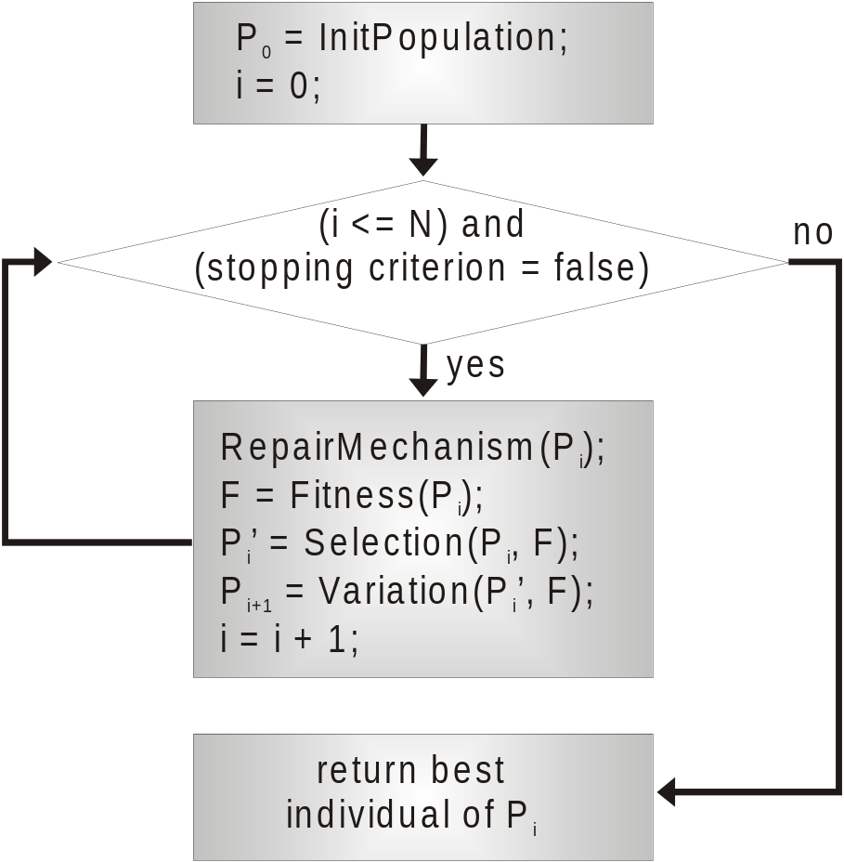
Workflow of Genetic Algorithms (1)
In the style of natural evolution, “survival of the fittest”
Optimization loop i = 0, 1, ...
Each iteration i maintains population P_{i}; a population contains several individuals
An individual represents one possible solution for the modeled optimization problem
<INTERLUDE>

Slide 43
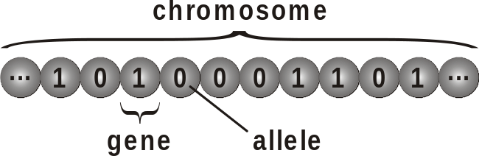
Workflow of Genetic Algorithms (2)
An individual’s data structure is called chromosome.
A chromosome consists of many genes that are used to save data.
One actual value stored in a gene is called allele.
<INTERLUDE>

Slide 44
Workflow of Genetic Algorithms (3)
A fitness function computes the fitness of each individual inside P_{i}.
From P_{i}, a subset P_{i}’ of highest / lowest fitness is selected (selection, depending on whether a minimization or maximization problem is optimized).
P_{i}’ is completed to the next population P_{i+1} by randomly generating new individuals (variation)
<INTERLUDE>

Slide 45
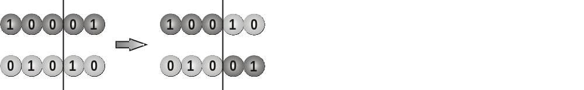
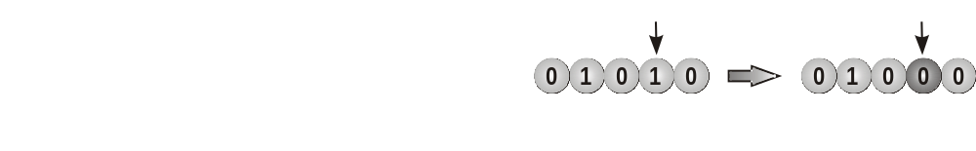
Workflow of Genetic Algorithms (4)
Variation makes use of two basic genetic operators:
Cross-over:
Mutation:
<INTERLUDE>

Slide 46
Workflow of Genetic Algorithms (5)
Due to the randomness in variation, P_{i} can contain individuals that do not represent valid solutions: Repair mechanism.
Termination of the GA if
  max. N iterations reached,
  best observed fitness unchanged for y iterations,
  ...
Final result is that individual from last population with best fitness.
</INTERLUDE>

Slide 47


Genetic Algorithm for Condition Optimization
Chromosomal Representation
For N nested loops, each chromosome has N genes
Each gene holds one integer number
Gene L represents the value to be optimized
Domain of each gene L restricted to interval
Fitness
Fitness of an individual =
Invalid individuals represent iterations within the loop nest in which condition is not always satisfied
Invalid individuals obtain a very poor fitness

Slide 48
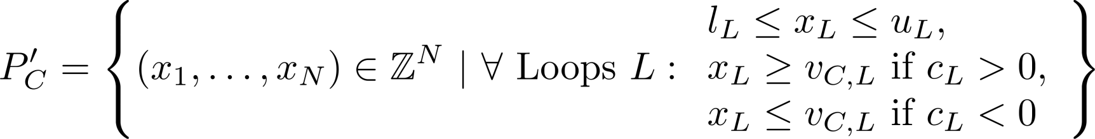
Result of Condition Optimization
Inputs to Condition Optimization
Linear condition
Loop bounds
Output of the Genetic Algorithm
Values of the individual with best fitness
Output of Condition Optimization Phase
Polytope

Slide 49






Phase 3 – Search Space Generation
Given: If-statements, conditions & polytopes
Construction of FUPs P_{i} for each full if-statement IF_{i}
Construction of a Global FUP (Global Search Space)
FUP G models iteration space in which all if-statements are satisfied.
Constructed by intersecting all FUPs P_{i} of the individual if-statements:

Slide 50

Phase 3 – Structure of the FUP G
Consequence of Using the Operator on the Previous Slide
G is a finite union of polytopes and can thus be seen as:
Interpretation:
Each polytope denotes
one region in the iteration space of the entire loop nest in which all if-statements are satisfied.

Slide 51

Global Search Space for MPEG Code

Slide 52

Global Search Space & Splitting-If (1)
Direct Translation of G into Splitting-If
if ( (x == 0 && vx == 0 && y >= 13) || (x >= 10) ||
(y == 0 && vy == 0 && x >= 9) || (y >= 14) )
Not a Good Idea
This splitting-if must be placed in vy-loop (3rd-innermost!)
Leads to 10,103,760 executions of if-statements in total

Slide 53
Global Search Space & Splitting-If (2)
Alternative: Use only sub-polytopes of G for splitting-if.
Legal, since each sub-polytope by itself already satisfies all if-statements.
if ( x >= 10 )
  This sub-polytope is also not a good solution
    Leads to 25,401,820 if-statement executions
if ( ( x >= 10 ) || ( y >= 14 ) )
  This combination of sub-polytopes is a good solution
    Leads to 7,261,120 if-statement executions

Slide 54
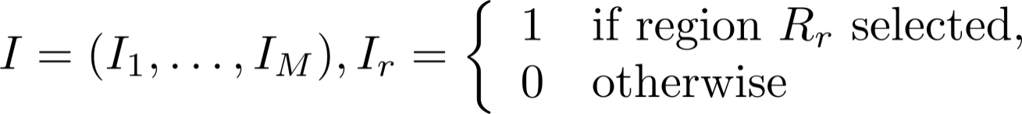
Phase 4 – Search Space Exploration
GA: Selects regions from
Individual: Bit-vector that marks the selected regions
Individual
Fitness function computes again
#{If-statement executions} after loop nest splitting
Fitness function minimized by GA
Resulting Splitting-If
Placed in the outermost possible loop of the loop nest
Contains all conditions and operators as specified by the selected regions

Slide 55
Relative Run-Times after Loop Nest Splitting
100% = Run-times of the benchmarks without Loop Nest Splitting

Slide 56
Relative Energy Consumption (ARM7) after LNS
100% = Values of the Benchmarks without Loop Nest Splitting

Slide 57
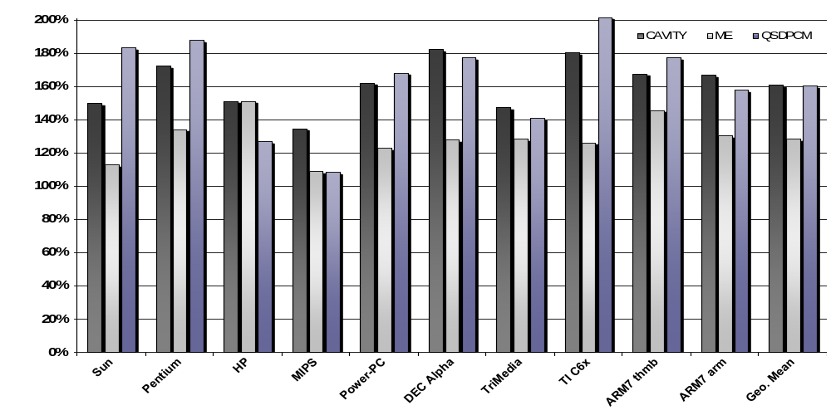
Relative Code Size after Loop Nest Splitting
100% = Size of the benchmarks without Loop Nest Splitting

Slide 58
References
Loop Nest Splitting
H. Falk, P. Marwedel. Control Flow driven Splitting of Loop Nests at the Source Code Level. DATE Conference, Munich, 2003.
H. Falk. Control Flow Optimization by Loop Nest Splitting at the Source Code Level. University of Dortmund, Technical Report No. 773, Dortmund 2003.

Slide 59
Summary
Non-Compiler Optimizations
Post-pass after compiler, e.g., at linker-level
Pre-pass before compiler, at source code level
Loop Nest Splitting
Control flow optimization in data flow-dominated multimedia applications
Polytopes used to model linear conditions and loops
Genetic algorithms used to optimize polytope models
Significant reductions in terms of ACET and energy (and WCET), but partially heavy code size increases

