Slide 1
Compilers for Embedded Systems
Summer Term 2022
Heiko Falk
Institute of Embedded Systems
Electrical Engineering, Computer Science and Mathematics
Hamburg University of Technology

Slide 2
Chapter 5
HIR Optimizations and Transformations

Slide 3
Outline
Introduction & Motivation
Compilers for Embedded Systems – Requirements & Dependencies
Internal Structure of Compilers
Pre-Pass Optimizations
HIR Optimizations and Transformations
Code Generation
LIR Optimizations and Transformations
Register Allocation
WCET-Aware Compilation
Outlook

Slide 4
Chapter Contents
HIR Optimizations and Transformations
  Motivation
  Function Specialization / Procedure Cloning
    General-Purpose Functions in specialized Contexts
    Interlude: Standard Optimizations & WCET Estimation
    Function Specialization and WCETs
    Results (WCET_{EST}, ACET, Code Size)
  Parallelization for Homogeneous Multi-DSPs
    Introduction, Multi-DSP Architectures
    Program Recovery
    Data Partitioning & Strip Mining
    Parallelization
    Memory Assignment, Array Descriptors, DMA
    Results

Slide 5
Motivation of HIR Optimizations
High-Level IRs:
Very close to source language
High-level language constructs (esp. loops, function calls with parameter passing, array accesses) preserved
High-Level Optimizations
Exploit particularly these HIR features
Focus on strong reorganization of loops and function relationships
Are difficult to realize at lower abstraction levels, since required high-level information (e.g., loop bounds or function call relationships) get lost and are difficult to reconstruct

Slide 6
Chapter Contents
HIR Optimizations and Transformations
  Motivation
  Function Specialization / Procedure Cloning
    General-Purpose Functions in specialized Contexts
    Interlude: Standard Optimizations & WCET Estimation
    Function Specialization and WCETs
    Results (WCET_{EST}, ACET, Code Size)
  Parallelization for Homogeneous Multi-DSPs
    Introduction, Multi-DSP Architectures
    Program Recovery
    Data Partitioning & Strip Mining
    Parallelization
    Memory Assignment, Array Descriptors, DMA
    Results

Slide 7
Function Specialization
Also Called “Procedure Cloning”
Rather old and well-known compiler technique (1993)
Goals: To enable other optimizations, to reduce the overhead to pass parameters during function calls
Approach: Of particular functions, specialized copies (“clones”) are created which have less parameters than the original function
Specialization so-called Interprocedural Optimization
Explicit consideration of calling relationships between functions during an optimization
In Contrast to Intraprocedural Optimizations
Optimization just locally inside a function f, without consideration of functions that f calls, or by which f is called

Slide 8
Typical Function Calls
int f( int *x, int n, int p ) {
for (i=0; i<n; i++) {
x[i] = p * x[i];
if ( i == 10 ) { ... }
}
return x[n-1];
}
int main() {
... f( y, 5, 2 ) ...
... f( z, 5, 2 ) ...
return f( a, 5, 2 );
}
Observations
f is called several times
f has 3 arguments
Arguments n and p are instantiated several times with constants 5 and 2

Slide 9
More Observations
int f( int *x, int n, int p ) {
for (i=0; i<n; i++) {
x[i] = p * x[i];
if ( i == 10 ) { ... }
}
return x[n-1];
}
int main() {
... f( y, 5, 2 ) ...
... f( z, 5, 2 ) ...
return f( a, 5, 2 );
}
f is so-called general-purpose function: Via parameter n, an array x of arbitrary size can be treated
Control flow in f depends on function parameter
f is used in main in a special-purpose context: Processing of arrays of size n = 5.

Slide 10
Specialization of General-Purpose Functions
int f( int *x, int n, int p ) {
for (i=0; i<n; i++) {
x[i] = p * x[i];
if ( i == 10 ) { ... }
}
return x[n-1];
}
int main() {
... f_5_2( y ) ...
... f_5_2( z ) ...
return f_5_2( a );
}
int f_5_2( int *x ) {
for (i=0; i<5; i++) {
x[i] = 2 * x[i];
if ( i == 10 ) { ... }
}
return x[4];
}

Slide 11
Expected Effects of Specialization
Reduction of the Average-Case Execution Time ACET due to
Enabling of other standard compiler optimizations inside the specialized function
Less code to be executed for parameter passing when calling the specialized function

Slide 12
Standard Optimizations after Cloning (1)
Constant Folding
Pre-computation of expressions with purely constant operands already at compile-time
Example:
Original code + Cloning + ConstFold
a = p * n; a = 2 * 5; a = 10;
<INTERLUDE>

Slide 13
Standard Optimizations after Cloning (2)
Constant Propagation
Replacement of accesses to variables that provably have constant content by the constant itself
Example:
Original code + Cloning + ConstFold
+ ConstProp
a = p * n; a = 2 * 5; a = 10;
for (…; i<a; …) for (…; i<a; …) for (…; i<10; …)
<INTERLUDE>

Slide 14
Standard Optimizations after Cloning (3)
Strength Reduction
Replacement of computationally expensive computations (e.g., multiplications, divisions, ...) by “cheaper” operations (e.g., additions, subtractions, shifts, ...)
Example:
Original code + Cloning + StrengthRed
x[i] = p*x[i]; x[i] = 2*x[i]; x[i] = x[i]<<1;
<INTERLUDE>

Slide 15
Standard Optimizations after Cloning (4)
Control Flow Optimizations
Determination of possible value ranges of variables after constant folding and propagation; removal of redundant if-statements whose conditions are always true or always false
( see also chapter 4 – Loop Nest Splitting / Condition Satisfiability)
Example:
Original code + Cloning + ControlFlowOpt
for(i=0;i<n;i++) for(i=0;i<5;i++) for(i=0;i<5;i++)
{ { {
…; …; …;
if (i==10) …; if (i==10) …; }
} }
</INTERLUDE>

Slide 16
Expected Effects of Specialization
Reduction of the Average-Case Execution Time ACET due to
Enabling of other standard compiler optimizations inside the specialized function
Fewer code for parameter passing to be executed when calling the specialized function
Increase of Code Size due to
Generation of potentially many novel, specialized clones

Slide 17
Impact of Cloning on WCET Estimation
Function Specialization and WCET considered only in very recent research
Recall
Worst-Case Execution Time WCET:
Upper bound of a program’s run-time over all possible input data
WCET Estimation
Via static analysis of the binary code of executable programs
In the following: Workflow of the static WCET Analyzer aiT
[AbsInt Angewandte Informatik GmbH,
http://www.absint.com/ait, Saarbrücken, 2020]

Slide 18
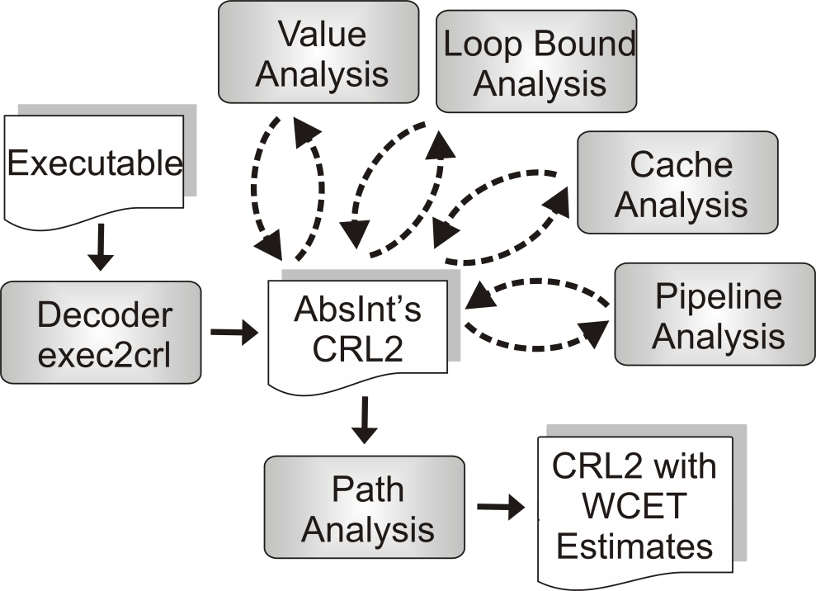
Workflow of the WCET Analyzer aiT (1)
Input: Binary executable P to be analyzed
exec2crl: Disassembler, translates P into aiT’s low-level intermediate representation CRL2
Value analysis: Computes possible contents of processor registers for any point in time during P’s execution.
Note: P is never executed by aiT! P is „only“ analyzed.
<INTERLUDE>

Slide 19
Workflow of the WCET Analyzer aiT (2)
Loop bound analysis: Tries to determine lower and upper bounds for the number of iterations of each loop in P.
Cache analysis: Makes use of a formal cache model, classifies each memory access in P as definite cache hit, definite cache miss, or unknown.
<INTERLUDE>

Slide 20
Workflow of the WCET Analyzer aiT (3)
Pipeline analysis: Includes an accurate model of the processor’s pipeline. Depending on the pipeline’s initial state, possible cache states etc., possible states of the pipeline at the end of each basic block of P are determined. Result of the pipeline analysis is the WCET_{EST} of each individual basic block.
<INTERLUDE>

Slide 21
Workflow of the WCET Analyzer aiT (4)
Path analysis: Models all possible execution paths within P under consideration of the WCET_{EST} of all basic blocks. Determines the longest possible execution path within P which leads to the overall WCET_{EST} of P.
Result of the path analysis is, e.g., the length of this longest path, i.e., P’s WCET_{EST}.
<INTERLUDE>

Slide 22
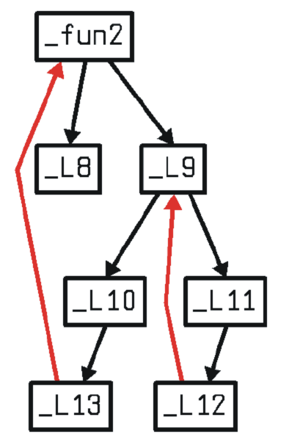
Workflow of the WCET Analyzer aiT (5)
Control Flow Graph (CFG)
Fundamental code representation during path analysis
Definition: CFG = (V, E, s) is a directed graph with
V = { b₁, ..., b_{n} } (set of all basic blocks, cf. chapter 2)
E = { (b_{i} → b_{j}) | basic block b_{j} can be executed immediately after b_{i} }
s ∈ V = the unique start node of the CFG
int fun2() {
for (; a1<30; a1++ ) {
for (; b1<a1; b1++ )
printf( “%d\n”, b1 );
printf( „%d\n“, a1 );
}
return a1; }
<INTERLUDE>

Slide 23
Complexity Issues
Problem: WCET analysis is not computable with today’s machines! If WCET were computable, one could decide in O(1) if WCET < ∞ and thus solve the Halting problem.
Reason: It is not computable how long P stays in loops. Automatic loop bound analysis is applicable only to simple classes of loops. (Analogously for recursive function calls.)
<INTERLUDE>

Slide 24
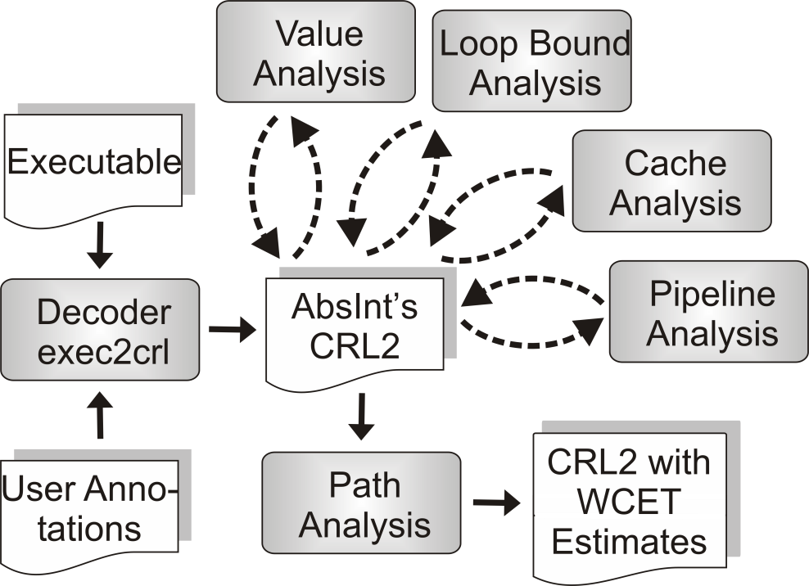
Annotations for WCET Analysis
Solution: The user of aiT must mandatorily provide information about, e.g., minimal and maximal iteration bounds of loops and recursion depths.
Annotation file: Contains such user-provided annotations (“flow facts”) and is – besides the program P to be analyzed – another external input to aiT.
<INTERLUDE>
</INTERLUDE>

Slide 25
Why Specialization and WCET_{EST}?
Motivation
Frequent occurrences of general-purpose functions in special-purpose contexts in embedded software
Loop bounds are particularly often controlled by function parameters
Loop bounds are particularly critical for WCET estimates
Procedure Cloning allows the extremely precise annotation of loop bounds for WCET analysis
[P. Lokuciejewski. Influence of Procedure Cloning on WCET Prediction. CODES+ISSS, Salzburg, 2007]

Slide 26
Loop Bound Annotations & Cloning (1)
int f( int *x, int n, int p ) {
// loopbound min 0, max n
for (i=0; i<n; i++ ) {
x[i] = p * x[i];
if ( i == 10 ) { ... }
}
return x[n-1];
}
Original code
Loop annotation extremely imprecise since annotation must cover all invocations of f.
If f is called somewhere with n = 2,000 as maximal value, 2,000 loop iterations have to be considered always.
For calls like, e.g., f( a, 5, 2 ), 2,000 loop iterations are likewise assumed
Heavy WCET overestimation

Slide 27
Loop Bound Annotations & Cloning (2)
int f_5_2( int *x ) {
// loopbound min 5, max 5
for (i=0; i<5; i++ ) {
x[i] = 2 * x[i];
if ( i == 10 ) { ... }
}
return x[4];
}
Cloned code
Loop annotation extremely precise since annotation covers all invocations of f_5_2 exactly.
For calls like, e.g., f_5_2( a ), exactly 5 iterations are assumed
Exact WCET estimation
Original function f or other additional clones of f are fully independent of annotations in f_5_2
No interdependencies between all these versions of f w.r.t. WCET analysis

Slide 28
Realization of Function Specialization (1)
Caution when Applying Function Specialization
Increase of code size during cloning must not be neglected!
Cloning of every possible function which is called at least twice with the same constant as argument is usually unacceptable
Parameter-Driven Application of Function Specialization
Size G: Never clone a function f which is larger than G
Amount of constant arguments K: clone a function f only if at least K% of all calls of f contain constant arguments that can be used for cloning

Slide 29
Realization of Function Specialization (2)
Given
Function f to be specialized
Dictionary arg that maps the arguments of f to be specialized to the constant values to be used
Approach Using HIR ICD-C
Create new function type T’ that corresponds to the Type T of f, but without those arguments from arg to be specialized
Create new function symbol S’ of type T’; add S’ to that symbol table in which f is declared
Create a copy f’ of the code of f with function symbol S’; add f’ to the same compilation unit that also holds f

Slide 30
Realization of Function Specialization (3)
Given
Function f to be specialized
Dictionary arg that maps the arguments of f to be specialized to the constant values to be used
Approach Using HIR ICD-C (ctd.)
For each argument a ∈ arg to be specialized:
  Create new local variable v’ in f’
  Create assignment v’ = <arg[a]>; at the very beginning of f’
  Replace each occurrence of a in f’ by v’

Slide 31
Realization of Function Specialization (4)
Given
Function f to be specialized
Dictionary arg that maps the arguments of f to be specialized to the constant values to be used
Approach Using HIR ICD-C (ctd.)
For each function call c of f to be specialized:
  Remove all arguments a ∈ arg to be specialized from the parameter list of c
  Replace called function f by f’ within c

Slide 32
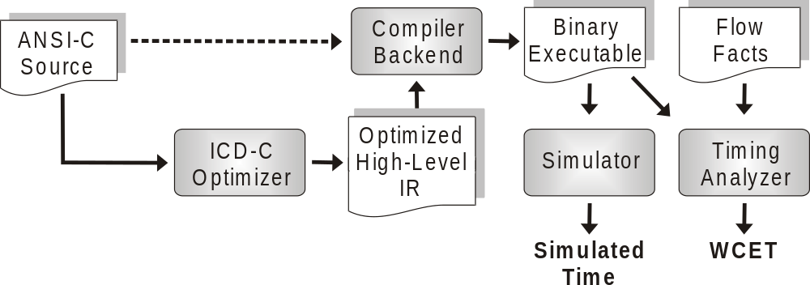
Workflow of Function Specialization
Function specialization
Constant folding & propagation
Strength reduction
If-statements
G = 2,000 ICD-C expressions
K = 50%
Considered Processors
Infineon TriCore TC1796
ARM 7 TDMI (ARM and THUMB instruction sets)

Slide 33

Relative WCET_{EST} after Procedure Cloning
WCET_{EST} reductions from 13% up to 95%!
Notes:
EPIC: 1 Filter-Funktion, die geklont wird, enthält 32 Schleifen, die z.T. vierfach-verschachtelt sind. Die Schleifeniterationen hängen z.T. von Funktionsargumenten ab. Diese Funktion wird oft (6x) aufgerufen, nach Cloning ist jeder dieser Aufrufe spezialisiert und mit exakten Flow Facts annotiert.
GSM: Filter-Funktion, die mit Konstanten 13, 14 und 120 aufgerufen wird, die die Schleifeniterationen steuert. Ursprünglich muss diese Schleife mit dem max-Wert 120 annotiert werden, was nach Cloning viel präziser gemacht werden kann.

Slide 34
Relative ACETs after Procedure Cloning
Marginal ACET reductions of 3% max.
Impact of overhead for parameter passing and of successive optimization on ACET apparently negligible.

Slide 35
Relationship between WCET_{EST} and ACET
Very Astonishing
How can one and the same optimization have such a different influence on seemingly similar criteria like WCET_{EST} and ACET?
Reasons
Code before cloning only poorly annotatable
☞ aiT computes quite imprecise WCET estimates
Code after cloning precisely annotatable
☞ aiT computes much more precise WCET estimates
Specialization obviously improves tightness of WCET_{EST} considerably
( cf. chapter 3 – Objective Functions)
The real (and unknown) WCETs are expected to be reduced only as marginally as ACETs are

Slide 36

Relative Code Sizes after Procedure Cloning
Code size increases from 2% up to 225%!

Slide 37
Chapter Contents
HIR Optimizations and Transformations
  Motivation
  Function Specialization / Procedure Cloning
    General-Purpose Functions in specialized Contexts
    Interlude: Standard Optimizations & WCET Estimation
    Function Specialization and WCETs
    Results (WCET_{EST}, ACET, Code Size)
  Parallelization for Homogeneous Multi-DSPs
    Introduction, Multi-DSP Architectures
    Program Recovery
    Data Partitioning & Strip Mining
    Parallelization
    Memory Assignment, Array Descriptors, DMA
    Results

Slide 38


Parallelization for Multi-DSPs
Material kindly made available by
Björn Franke and Michael O’Boyle
University of Edinburgh, UK
School of Informatics

Slide 39
Parallelization for Multi-DSPs
Motivation
Performance demands of complex systems often exceed capabilities of a single processor
(e.g., radar, sonar, medical image processing, HDTV, ...)
Multiple DSPs operating in parallel provide enough performance, but...
  little or no hardware support for the parallel execution of software
  even less support of parallel programming paradigms by development tools
  existing source codes are often written in low-level style which impedes an effective parallelization

Slide 40
Parallelizing Compilers
Research Area “High-Performance Computing”
Research on vectorizing compilers for more than 40 years
Traditionally Fortran compilers
These vectorizing compilers are usually not suitable for Multi-DSPs, since their assumptions on the memory hierarchy are unrealistic:
  Communication between processes via shared memory
  Memory has only one single, shared address space
  Caches can be local and/or shared, but cache coherence issues are solved in hardware
☞ De facto no parallelizing compilers available for Multi-DSPs

Slide 41
Multi-DSPs
<Int 1, 100>
DSP Core 0
<Int 2, 100>
DSP Core X
Mem
Bank 1
Mem
Bank 2
Mem
Bank 1
Mem
Bank 2
<Remote X1, 100>
Bus
<Ext, 100>
Several address spaces:
Internal 1 & 2, external, remote DSP core
Use of internal memories:
High bandwidth, low access latencies
Use of remote memories:
ID of remote DSPs must be known
External
Memory

Slide 42
Workflow of Parallelization
Program Recovery
Removal of undesired low-level constructs from code
Replacement by high-level constructs
Detection of Parallelism
Identification of loops amenable for parallelization
Partitioning and Allocation of Data
Minimization of communication overhead between DSPs
Locality Improvement of Memory Accesses
Minimization of accesses to memories of remote DSPs
Optimization of Memory Transfers
Use of DMA for burst transfers

Slide 43
Code Example for 2 parallel DSPs
/* Array declarations */
int A[16], B[16], C[16], D[16];
/* Declaration & initialization of pointers */
int *p_a = A, *p_b = &B[15], *p_c = C, *p_d = D;
/* Loop over all array elements */
for (i = 0; i < 16; i++)
*p_d++ = *p_c++ + *p_a++ * *p_b--;
*p_d++ = *p_c++ + *p_a++ * *p_b--;
Low-level array accesses via pointers; explicit pointer arithmetic ( cf. chapter 2, auto-increment addressing)
Disadvantageous for parallelization since ad hoc no
structure in array accesses visible and analyzable

Slide 44
Program Recovery
/* Array declarations */
int A[16], B[16], C[16], D[16];
/* Loop over all array elements */
for (i = 0; i < 16; i++)
D[i] = C[i] + A[i] * B[15-i];
Replacement of pointer accesses by explicit array operators [ ]
Structure of array accesses better visible, more amenable for subsequent analyses

Slide 45
Program Recovery
/* Array declarations */
int A[16], B[16], C[16], D[16];
/* Loop over all array elements */
for (i = 0; i < 16; i++)
D[i] = C[i] + A[i] * B[15-i];
One-dimensional “flat” arrays too unstructured for parallelization
for Multi-DSPs
Partitioning of arrays onto available parallel DSPs unclear

Slide 46
Data Partitioning
/* Partitioned array declarations */
int A[2][8], B[2][8], C[2][8], D[2][8];
/* Loop over all array elements */
for (i = 0; i < 16; i++)
D[i/8][i%8] = C[i/8][i%8] +
A[i/8][i%8] * B[(15-i)/8][(15-i)%8];
New, two-dimensional array declarations
First dimension equals number of available parallel DSPs
Original flat arrays now partitioned in disjoint areas that can
be processed independently from each other

Slide 47
Data Partitioning
/* Partitioned array declarations */
int A[2][8], B[2][8], C[2][8], D[2][8];
/* Loop over all array elements */
for (i = 0; i < 16; i++)
D[i/8][i%8] = C[i/8][i%8] +
A[i/8][i%8] * B[(15-i)/8][(15-i)%8];
Extremely costly and complex addressing required
Reason: Arrays are multi-dimensional; loop index variable i used to index the arrays is purely sequential

Slide 48
Strip Mining of i-Loop
/* Partitioned array declarations */
int A[2][8], B[2][8], C[2][8], D[2][8];
/* Nested loop over all array elements */
for (j = 0; j < 2; j++)
for (i = 0; i < 8; i++)
D[j][i] = C[j][i] + A[j][i] * B[1-j][7-i];
Splitting of sequential iteration space of i into two independent, two-dimensional iteration spaces
Iteration spaces of new loop nest now matches nicely with data layout
Only affine expressions for array accesses

Slide 49
Strip Mining of i-Loop
/* Partitioned array declarations */
int A[2][8], B[2][8], C[2][8], D[2][8];
/* Nested loop over all array elements */
for (j = 0; j < 2; j++)
for (i = 0; i < 8; i++)
D[j][i] = C[j][i] + A[j][i] * B[1-j][7-i];
How can this code be parallelized for two DSPs?

Slide 50
Parallelization (for Processor 0)
/* Definition of the processor ID */
#define MYID 0
/* Partitioned array declarations */
int A[2][8], B[2][8], C[2][8], D[2][8];
/* Simple loop over all array elements for DSP No. MYID */
for (i = 0; i < 8; i++)
D[MYID][i] = C[MYID][i] + A[MYID][i] * B[1-MYID][7-i];
Insertion of an explicit processor ID
Array accesses now make use of processor ID
For N parallel processors, N different HIR codes are generated each of which with a unique processor ID

Slide 51
Parallelization (for Processor 0)
/* Definition of the processor ID */
#define MYID 0
/* Partitioned array declarations */
int A[2][8], B[2][8], C[2][8], D[2][8];
/* Simple loop over all array elements for DSP No. MYID */
for (i = 0; i < 8; i++)
D[MYID][i] = C[MYID][i] + A[MYID][i] * B[1-MYID][7-i];
This structure makes explicit which code will run on which DSP
It still remains unclear how the arrays are distributed onto local memory banks or on external memories, and how accesses to memory banks of remote DSPs happen

Slide 52
Array Descriptors
Two-dimensional array A[2][8] is partitioned into two sub-arrays A0 and A1 along the first dimension
Each sub-array An is assigned to the memory of processor n
Original, two-dimensional array accesses need to be re-directed towards A0 and A1 using array descriptors
A[0][5]
A[0][5]
DSP 0
DSP 1
Array Descriptors
A0 | A1
A0 | A1
Sub-Array
A0[0...7]
Sub-Array
A1[0...7]

Slide 53
Memory Assignment (for Processor 0)
/* Definition of the processor ID */
#define MYID 0
/* Partitioned array declarations & array descriptors */
int A0[8]; extern int A1[8]; int *A[2] = { A0, A1 };
int B0[8]; extern int B1[8]; int *B[2] = { B0, B1 }; ...
/* Simple loop over all array elements for DSP No. MYID */
for (i = 0; i < 8; i++)
D[MYID][i] = C[MYID][i] + A[MYID][i] * B[1-MYID][7-i];
Arrays in DSP-internal and remote memories
Array accesses via descriptors in unchanged syntax

Slide 54
Memory Assignment (for Processor 0)
/* Definition of the processor ID */
#define MYID 0
/* Partitioned array declarations & array descriptors */
int A0[8]; extern int A1[8]; int *A[2] = { A0, A1 };
int B0[8]; extern int B1[8]; int *B[2] = { B0, B1 }; ...
/* Simple loop over all array elements for DSP No. MYID */
for (i = 0; i < 8; i++)
D[MYID][i] = C[MYID][i] + A[MYID][i] * B[1-MYID][7-i];
Descriptor access to local arrays inefficient due to additional indirection
Scheduling problems: A[i][j] can have varying access latency if i references local or remote memory

Slide 55
Locality Improvement for Array Accesses
/* Definition of the processor ID */
#define MYID 0
/* Partitioned array declarations & array descriptors */
int A0[8]; extern int A1[8]; int *A[2] = { A0, A1 };
int B0[8]; extern int B1[8]; int *B[2] = { B0, B1 }; ...
/* Simple loop over all array elements for DSP No. MYID */
for (i = 0; i < 8; i++)
D0[i] = C0[i] + A0[i] * B[1-MYID][7-i];
Direct accesses to local arrays; refrain from accesses via descriptors whenever possible
Maximal exploitation of high bandwidths of local memories

Slide 56
Locality Improvement for Array Accesses
/* Definition of the processor ID */
#define MYID 0
/* Partitioned array declarations & array descriptors */
int A0[8]; extern int A1[8]; int *A[2] = { A0, A1 };
int B0[8]; extern int B1[8]; int *B[2] = { B0, B1 }; ...
/* Simple loop over all array elements for DSP No. MYID */
for (i = 0; i < 8; i++)
D0[i] = C0[i] + A0[i] * B[1-MYID][7-i];
8 sequential accesses to consecutive array elements in remote memory
Inefficient, since 8 full bus cycles are required

Slide 57
Insertion of DMA Burst Transfers
/* Definition of the processor ID */
#define MYID 0
/* Partitioned array declarations & array descriptors */
int A0[8]; extern int A1[8]; int *A[2] = { A0, A1 };
int B0[8]; extern int B1[8]; int *B[2] = { B0, B1 }; ...
/* Temporary DMA buffer */
int temp[8];
DMA_get( temp, &(B[1-MYID]), 8 * sizeof( int ) );
/* Simple loop over all array elements for DSP No. MYID */
for (i = 0; i < 8; i++)
D0[i] = C0[i] + A0[i] * temp[7-i];
Block-wise loading of a local buffer from remote memory via DMA
Array accesses in loop use only local memory

Slide 58
Experimental Setup
Multi-DSP Hardware
4 parallel Analog Devices TigerSHARC TS-101 @250 MHz
768 kB local SRAM per DSP, 128 MB external DRAM
Parallelized Benchmark Programs
DSPstone: small DSP kernels, low code complexity
UTDSP: complex applications, compute-intensive code
Results: Run-times
for purely sequential code running on 1 DSP
for code after program recovery
for code after data partitioning and memory assignment
for code after locality improvement & DMA

Slide 59
Results – DSPstone

Slide 60
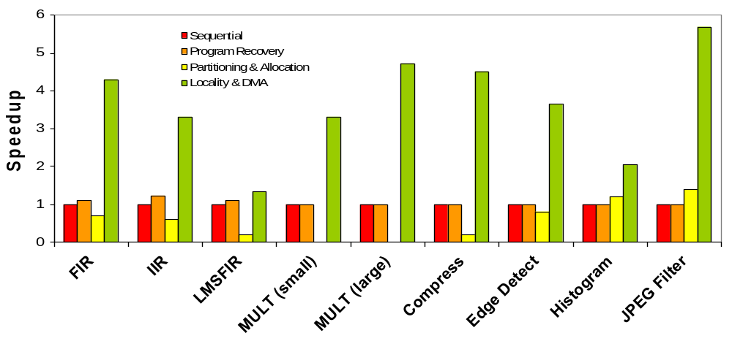
Results – UTDSP

Slide 61
Discussion
Mean Overall Speedups
DSPstone: 4.06x
UTDSP: 3.38x
All benchmarks: 3.68x
Very Astonishing
How is it possible to achieve (mean) speedups of a factor of 4 for DSPstone if parallelization is done for 4 DSPs?

Slide 62
Reasons for Over-Proportional Speedups
Over-Proportional Speedups > 4 for 4 parallel DSPs
Parallelized code is more amenable for subsequent compiler optimizations than original sequential code
Example:
Sequential i-loop ( cf. Slide 47): 16 iterations
i-loop parallelized for 2 DSPs (Slide 49): 8 iterations
Parallelized loops possibly candidates for Loop Unrolling:
Fully unrolled loop without any branches!
No delay slots, no potential for branch misprediction
<loop body>;
<loop body>;
...
<loop body>;
for (i = 0; i < 8; i++)
<loop body>;
8 times

Slide 63
References
Function Specialization
D. Bacon, S. Graham, O. Sharp. Compiler Transformations for High-Performance Computing. ACM Computing Surveys 26(4), 1994.
(Excellent survey paper on compiler optimizations in general!)
P. Lokuciejewski, H. Falk, H. Theiling. Influence of Procedure Cloning on WCET Prediction. CODES+ISSS, Salzburg 2007.
Parallelization for Homogeneous Multi-DSPs
B. Franke, M. O´Boyle. A Complete Compiler Approach to Auto-Parallelizing C Programs for Multi-DSP Systems. IEEE Transactions on Parallel and Distributed Systems 16(3), 2005.

Slide 64
Summary
HIR Optimizations
Restructuring of Loops
Restructuring of functions and their calling relationships
Function Specialization / Procedure Cloning
Specialization of general-purpose functions
Enable standard optimizations within specialized functions, simplify code for parameter passing
Impact on ACET marginal, but huge for WCET_{EST}
Parallelization for Homogeneous Multi-DSPs
Focus on exploitation of local memories and address ranges
Speedups mostly linear in the number of available parallel DSPs

