Slide 1
Compilers for Embedded Systems
Summer Term 2022
Heiko Falk
Institute of Embedded Systems
Electrical Engineering, Computer Science and Mathematics
Hamburg University of Technology

Slide 2
Chapter 7
LIR Optimizations and Transformations

Slide 3
Outline
Introduction & Motivation
Compilers for Embedded Systems – Requirements & Dependencies
Internal Structure of Compilers
Pre-Pass Optimizations
HIR Optimizations and Transformations
Code Generation
LIR Optimizations and Transformations
Register Allocation
WCET-Aware Compilation
Outlook

Slide 4
Chapter Contents
LIR Optimizations and Transformations
  Generation of Bit-Packet Operations for NPUs
    Motivation of Bit-True Data and Value Flow Analyses
    Partial Order L₄
    Bit-True Analysis: Forward and Backward Simulation
    Bit-True Optimizations: Dead Code Elimination; Generation of insert/extract operations
  Scratchpad Memory Optimizations
    Properties of Main Memories, Caches and Scratchpads
    Fix SPM Allocation (Functions, global Variables)
    Fix SPM Allocation (Functions, Basic Blocks, global Variables)
    SPM Allocations for Multi-Process Applications (partitioned, exclusive, hybrid)

Slide 5
Follow-Up: Data Flow Graphs
Data Flow Graph
Node represents an operation
Edges between nodes represent definitions (DEFs) and uses (USEs) of data
Accuracy of a DFG
At the LIR level, a DFG node denotes a single machine operation
Since the operands of machine operations are usually processor registers, the edges thus represent the data flow through entire registers.

Slide 6
DFGs & Bit-Packets
Bit-Packets
Sequence of consecutive bits
of arbitrary length
starting at arbitrary positions
and eventually crossing word-boundaries
DFGs and Bit-Packets
DFGs model data flow based on atomic registers
Information about irregularly-structured portions of registers is not provided
Classical DFG-based techniques are usually inappropriate to generate bit-packet operations!

Slide 7
Example
TPM and Bit-Packets
Composed rule
dreg: tpm_BinaryExpAND( tpm_BinaryExpSHR(
dreg, const ), const )
can cover the expression(c >> 4) & 0x7 and generate the efficient operation EXTR.U d_0, d_c, 4, 3
But: TPM reaches its limits for more complex code patterns to be covered
  What if numbers 4 / 0x7 are not given as constants, but as values of variables?
  What if other combinations of operators beyond & / >> are used to extract and insert bit-packets in C?
Tree grammar would grow quickly and would still generate code of rather poor quality!

Slide 8
Approach
Application of a Conventional Code Selection
Tree grammar produces LIR containing machine operations that use entire registers as operands
Tree grammar produces no bit-packet operations
Using rules like, e.g.,
dreg: tpm_BinaryExpAND( dreg, const )
dreg: tpm_BinaryExpSHR( dreg, const )
the expression (c >> 4) & 0x7 would naively be covered and translated into
SH d_0, d_c, -4; AND d_1, d_0, 7;
Subsequent LIR Optimization
Detects operations that extract / insert bit-packets and creates corresponding extr / insert bit-packet operations.

Slide 9
Classical Data Flow Analysis
Problem
Classical data flow analyses (DFA) allow reasoning about the flow of information at the register-level:
  Which operation uses / defines a certain piece of data residing in a certain register?
  Which operations are data flow-dependent?
Classical data flow analyses allow no statements about
  the value of information, i.e., the potential value that a register can have at a certain point of time, or about
  the potential value that a part of a register can have at a certain point of time.

Slide 10
Bit-True Value Flow Analysis
Value Flow Analysis (VFA)
Analyzes data flow, similar to DFA
but performs additional estimations about the contents of the memory cells involved in the computations.
Bit-True Data and Value Flow Analysis (BDVFA)
Value flow analysis is done for each individual bit of the involved memory cells.
Allows statements about the potential value of each bit of a memory cell at a certain point of time.
In the following: Presentation of a BDVFA with multi-valued logic for registers as supported memory cells.

Slide 11
Data and Value Flow Graph (DVFG)
Definition (Data and Value Flow Graph)
Let F be an LIR function. The Data and Value Flow Graph (DVFG) of F is a directed graph DVFG = (V, E, d, u) with
Node set V identical with that of classical DFGs ( cf. chapter 6)
Let op_{i}(p_{i,1}, ..., p_{i,n}) and op_{j}(p_{j,1}, ..., p_{j,m}) be two operations of F with parameters p_{i,x} and p_{j,y}, resp. Let v_{i} and v_{j} be the nodes representing op_{i} and op_{j}. For each use of a register r by p_{j,y} that is defined by p_{i,x}, the DVFG contains an edge e = (v_{i}, v_{j}) ∈ E.
d and u provide bit-true value estimates for the edges e ∈ E (Down and Up values). Let r be that register that is modeled by e, and let r have a width of k bits. Then, d and u are functions d | u: E → L₄^{k} with L₄ being a partial order representing the potential value of a single bit.

Slide 12
The Partial Order L₄ (1)
Per bit of a register, an element from L₄ is used to model which value this bit can have:
0 – The considered bit has the value 0
1 – A bit has a value of 1
U – A bit’s value is completely unknown
X – The value of a bit is irrelevant (don’t care)
L – The value of a bit is unknown, but its provenience (Location) is known
N – Like L, but the bit with known provenience has been inverted once (Negated location)
X
0
1
L
N
U

Slide 13
The Partial Order L₄ (1)
L₄ is a partial order:
A ‘<‘ operator defines a less-than relation between elements from L₄ as shown by the directed edges in the Hasse chart
U provides least information and is thus the smallest element according to the < operator
X provides most information and is thus the largest element according to the < operator
Hasse chart has four horizontal levels
☞ L₄
X
0
1
L
N
U

Slide 14
Examples for L₄ (1)
For some edge e, let r be an 8-bit register that is modeled by e.
Graphical notation: represents up value, down value
Exemplary labels for edge e and their interpretation:
The values of all bits of r are completely unknown.
The value of r is 42.
Bit 3 of r is irrelevant; r can be equal to 34 or 42.
r is completely irrelevant
☞ r has no effect on the data flow at all
UUUUUUUU
00101010
0010X010
XXXXXXXX

Slide 15
Examples for L₄ (2)
In addition, r’ is an 8-bit register that represents an input value for the considered LIR function F (e.g., a function parameter).
Exemplary labels for edge e and their interpretation:
The value of bit 5 of r is unknown. But it is identical
with the value of bit 2 of r’.
The value of bit 5 of r is unknown. But it is identical
with the negated value of bit 4 of r’.
r contains a bit-packet consisting of bits 2 to 0 of r’,
starting at bit position 3 inside r.
00L_{r’,2}00000
00N_{r’,4}00000
00L_{r’,2}L_{r’,1}L_{r’,0}000

Slide 16
Arithmetic in L₄ – Conjunction
Remark:
If L/N values with
different
provenience are
combined, the conjunction always produces U.
∧ | 1 | 0 | L_{i} | N_{i} | U | X
1 | 1 | 0 | L_{i} | N_{i} | U | X
0 | 0 | 0 | 0 | 0 | 0 | 0
L_{i} | L_{i} | 0 | L_{i} | 0 | U | U
N_{i} | N_{i} | 0 | 0 | N_{i} | U | U
U | U | 0 | U | U | U | U
X | X | 0 | U | U | U | X

Slide 17
Arithmetic in L₄ – Disjunction
Remark:
If L/N values with
different
provenience are
combined, the disjunction always produces U.
∨ | 1 | 0 | L_{i} | N_{i} | U | X
1 | 1 | 1 | 1 | 1 | 1 | 1
0 | 1 | 0 | L_{i} | N_{i} | U | X
L_{i} | 1 | L_{i} | L_{i} | 1 | U | U
N_{i} | 1 | N_{i} | 1 | N_{i} | U | U
U | 1 | U | U | U | U | U
X | 1 | X | U | U | U | X

Slide 18
Arithmetic in L₄ – Negation
¬ | 1 | 0 | L_{i} | N_{i} | U | X
 | 0 | 1 | N_{i} | L_{i} | U | X

Slide 19
Workflow of the BDVFA
Given
A low-level intermediate representation LIR to be optimized
Two-Phased Approach
For each function F of LIR:
  Compute the initial data and value flow graph D = (V, E, Ø, Ø) of F with empty down and up functions d und u
  Determine down values d(e) of all edges by applying forward analysis
  Determine up values u(e) of all edges by applying backward analysis

Slide 20
Forward Analysis
Goal
To compute only values for D
value d(e) represents the bit-true result of a node v ∈ V (i.e., of an outgoing edge of v), if the operator of v is applied to all its operands (i.e., to the values of incoming edges of v).
Approach
(Repeated) traversal through D following the edges’ direction
☞ “Forward” Analysis
For each currently visited node v ∈ V:
  Apply Forward Simulation of v’s operator to all values of all incoming edges
  Store new values for the outgoing edges of v

Slide 21
Workflow of Forward Analysis (1)
queue<DVFG_node> q = <set of all source nodes of D>;
d(e) = U* for all edges e ∈ E;
while ( !q.empty() )
  DVFG_node v = <first element of q>; q.remove( v );
  E_{out} = { e ∈ E | e = (v, v_{x}) }; E_{in} = { e ∈ E | e = (v_{x}, v) };
  if ( <v represents a constant number c> )
  d’(e) = {0, 1}* = <binary representation of c> for all e ∈ E_{out};
  else
  if ( <v represents an unknown input variable i of F> )
  d’(e) = {L_{i}}* = <bit locations of i> for all e ∈ E_{out};
  else
  d’(e) = <forward simulation of v> for all e ∈ E_{out};

Slide 22
Workflow of Forward Analysis (2)
while ( !q.empty() )
  ... <see previous slide>;
  for ( <all edges e = (v, v_{x}) ∈ E_{out}> )
    if ( <current d(e) is bit-wise less than d’(e) according to < operator
    in L₄> )
      d(e) = d’(e);
      if ( !q.contains( v_{x} ) )
      q.insert( v_{x} );

Slide 23
Remarks
Constants and input variables provide initial values for the values of leaf nodes with elements 0, 1 and L.
For a k-bit register r modeled by edge e, forward analysis firstly computes an intermediate value d’(e).
d(e) ∈ L₄^{k} is only set to this intermediate value d’(e) ∈ L₄^{k} if
  for at least one bit position i (0 ≤ i ≤ k) d_{i}(e) < d’_{i}(e) holds
  AND
  for no bit position i (0 ≤ i ≤ k) d’_{i}(e) < d_{i}(e) holds
Since only steadily increasing bit values are assigned to the values in the course of the analysis, each node v ∈ V is only added a finite number of times to the queue q.
Forward analysis terminates necessarily, run-time complexity is O( |E| ).

Slide 24
Forward Simulation (1)
Goal
For each node v ∈ V that represents a machine operation op in the LIR of F, and for each outgoing edge e ∈ E_{out}:
Forward simulation computes the value of e depending on the values of all incoming edges e_{in,1}, ..., e_{in,N} ∈ E_{in}:
d’(e) = FS_{op}( d(e_{in,1}), ..., d(e_{in,N}) )
Challenge
To provide a bit-true simulation function FS_{op} for each possible machine operation of LIR based on L₄^{k}.
FS_{op} must model the behavior of op for the considered target processor exactly and bit-true!

Slide 25
Forward Simulation (2)
Overall Approach
Each and every machine operation op can in principle be described at the bit-level using the Boolean standard operators ∧, ∨ and ¬.
Describe FS_{op} as formula over the operators ∧, ∨ and ¬ of L₄^{k}, in analogy to a Boolean description of op.
Bitwise Logical Operators
Bitwise logical machine operations op (e.g., AND, OR, NOT, XOR, NOR, NAND, ...) can easily be modeled in L₄^{k} using ∧, ∨ and ¬.
Approach clear.

Slide 26
Forward Simulation (3)
Arithmetical Operations
Derivation of a representation in L₄^{k} for arithmetical machine operations op laborious, but doable.
Example addition:
  Half-adder: Adds bits a, b ∈ L₄, produces bits s, c ∈ L₄:
  s = a ⊗ b = (a ∧ ¬b) ∨ (¬a ∧ b); c = a ∧ b;
  Full-adder: Adds bits a, b, c_{in} ∈ L₄, produces bits s, c_{out} ∈ L₄:
  s = (a ⊗ b) ⊗ c_{in}; c_{out} = (a ∧ b) ∨ (a ∧ c_{in}) ∨ (b ∧ c_{in});
  k-bit addition in L₄^{k}:
  Successively apply formulae of full-adder to bit positions 0, ..., k and compute bits of the resulting sum.

Slide 27
Forward Simulation (4)
Register Transfer Operations
Copying of register contents (Register-Register-Moves) is easily modeled in L₄^{k} by copying of values.
Memory Transfer Operations
Since the BDVFA provides bit-true data and value flow information explicitly only for registers and NOT for external memories,
  store-operations anyways do not generate any values, since they are typically sinks in the DVFG,
  load-operations only generate U* as values.
☞ Other classes of machine operations need to be modeled similarly.

Slide 28
Example Forward Simulation
L_{a,7}L_{a,6}L_{a,5}L_{a,4}L_{a,3}L_{a,2}L_{a,1}L_{a,0}
00000011
L_{b,7}L_{b,6}L_{b,5}L_{b,4}L_{b,3}L_{b,2}L_{b,1}L_{b,0}
a
3
00000101
b
&
3
5
b
2
<<
00000L_{b,7}L_{b,6}L_{b,5}
00000010
>>
>>
000000L_{a,1}L_{a,0}
00L_{b,7}L_{b,6}L_{b,5}L_{b,4}L_{b,3}L_{b,2}
|
3
&
7
000L_{a,1}L_{a,0}000
00000111
000L_{a,1}L_{a,0}L_{b,7}L_{b,6}L_{b,5}
<<
|
00000L_{b,4}L_{b,3}L_{b,2}
L_{a,1}L_{a,0}L_{b,7}L_{b,6}L_{b,5}000
L_{a,1}L_{a,0}L_{b,7}L_{b,6}L_{b,5}L_{b,4}L_{b,3}L_{b,2}
r

Slide 29
Backward Analysis (1)
Motivation and Goals
Conjunction, disjunction and negation in L₄ produce X (don’t care) only if one of their operands is already X.
Since the values of source nodes of the DVFG only consist of 0, 1 and L, the forward analysis never generates X.
Goal of backward analysis is thus to generate X for individual bit positions under consideration of the values computed so far.

Slide 30
Backward Analysis (2)
Approach
(Repeated) traversal through D in reverse direction of the edges
☞ “Backward” Analysis
For each currently visited node v ∈ V:
  Answering of the question which bits of the values of incoming edges of v are irrelevant, so that still the exact values of v’s outgoing edges are created.
  Apply Backward Simulation of v’s operator to values of the incoming and outgoing edges
  Store new values for the incoming edges of v

Slide 31
Workflow of Backward Analysis
queue<DVFG_node> q = <set of all sink nodes of D>;
u(e) = d(e) for all edges e ∈ E;
while ( !q.empty() )
  DVFG_node v = <first element of q>; q.remove( v );
  E_{out} = { e ∈ E | e = (v, v_{x}) }; E_{in} = { e ∈ E | e = (v_{x}, v) };
  for ( <all edges e = (v_{x}, v) ∈ E_{in}> )
    u’(e) = <backward simulation of v using E_{out} and E_{in} \ {e}>;
    if ( <current u(e) is bit-wise less than u’(e) according to < operator
    in L₄> )
      u(e) = u’(e);
      if ( !q.contains( v_{x} ) )
      q.insert( v_{x} );

Slide 32
Backward Simulation (1)
Goal
For each node v ∈ V that represents a machine operation op in the LIR of F, and for each incoming edge e ∈ E_{in}:
Backward simulation computes the value of e depending on the values of all outgoing edges e_{out,1}, ..., e_{out,N} ∈ E_{out} and of all incoming edges except e itself:
u’(e) = BS_{op}( u(e_{out,1}), ..., u(e_{out,N}), u( e_{in} ∈ E_{in} \ {e} ) )
In Analogy to Forward Simulation
A bit-true simulation function BS_{op} must be provided for each possible machine operation of LIR based on L₄^{k}.

Slide 33
Backward Simulation (2)
Overall Approach
Exploitation of neutral elements and of zero elements of operators in order to identify don’t cares.
Bitwise Logical Operators
Let b_{1,k} and b_{2,k} ∈ L₄ be single bits at position k of the value of the two operands of a logical operation and let b_{3,k} be the k-th bit of the value of the operation’s result.
For b_{2,k} = b_{3,k} = 0:
b_{1,k} AND b_{2,k} = b_{3,k} ⇔ b_{1,k} AND 0 = 0 ⇔ X AND 0 = 0
Analogously for OR: b_{1,k} OR 1 = 1 ⇔ X OR 1 = 1
Approach for other logical operations similar.

Slide 34
Backward Simulation (3)
Arithmetical Operations
Identification of irrelevant bits due to complexity of arithmetical operations often difficult.
Plain example – Shift operator:
  a << 3: Shifts contents of a left by 3 bits
  Least-significant 3 bits are filled with 0,
  Most-significant 3 bits are shifted out / truncated
  ☞ In the value of a, the 3 most-significant bits are X
  a >> 3: Analogously for least-significant 3 bits, under consideration
  of arithmetical or logical shifting
☞ Other machine operations need to be analyzed carefully and must be modeled similarly.

Slide 35
Example Backward Simulation (1)
L_{a,7}L_{a,6}L_{a,5}L_{a,4}L_{a,3}L_{a,2}L_{a,1}L_{a,0}
L_{b,7}L_{b,6}L_{b,5}L_{b,4}L_{b,3}L_{b,2}L_{b,1}L_{b,0}
00000011
L_{b,7}L_{b,6}L_{b,5}L_{b,4}L_{b,3}L_{b,2}L_{b,1}L_{b,0}
a
3
00000101
b
&
3
5
b
2
<<
00000L_{b,7}L_{b,6}L_{b,5}
00000010
>>
>>
000000L_{a,1}L_{a,0}
00L_{b,7}L_{b,6}L_{b,5}L_{b,4}L_{b,3}L_{b,2}
|
3
&
7
000L_{a,1}L_{a,0}000
00000111
000L_{a,1}L_{a,0}L_{b,7}L_{b,6}L_{b,5}
<<
|
00000L_{b,4}L_{b,3}L_{b,2}
L_{a,1}L_{a,0}L_{b,7}L_{b,6}L_{b,5}000
L_{a,1}L_{a,0}L_{b,7}L_{b,6}L_{b,5}L_{b,4}L_{b,3}L_{b,2}
r

Slide 36
Example Backward Simulation (2)
L_{a,7}L_{a,6}L_{a,5}L_{a,4}L_{a,3}L_{a,2}L_{a,1}L_{a,0}
XXXXXXL_{a,1}L_{a,0}
L_{b,7}L_{b,6}L_{b,5}XXXXX
L_{b,7}L_{b,6}L_{b,5}L_{b,4}L_{b,3}L_{b,2}L_{b,1}L_{b,0}
00000011
XXXL_{b,4}L_{b,3}L_{b,2}XX
a
3
L_{b,7}L_{b,6}L_{b,5}L_{b,4}L_{b,3}L_{b,2}L_{b,1}L_{b,0}
00000101
b
&
3
5
b
2
<<
00000L_{b,7}L_{b,6}L_{b,5}
00000010
>>
XXX00L_{b,7}L_{b,6}L_{b,5}
>>
00L_{b,7}L_{b,6}L_{b,5}L_{b,4}L_{b,3}L_{b,2}
000000L_{a,1}L_{a,0}
XXXXXL_{b,4}L_{b,3}L_{b,2}
XXXXXXL_{a,1}L_{a,0}
|
3
&
7
000L_{a,1}L_{a,0}000
XXXL_{a,1}L_{a,0}000
00000111
000L_{a,1}L_{a,0}L_{b,7}L_{b,6}L_{b,5}
XXXL_{a,1}L_{a,0}L_{b,7}L_{b,6}L_{b,5}
<<
|
00000L_{b,4}L_{b,3}L_{b,2}
L_{a,1}L_{a,0}L_{b,7}L_{b,6}L_{b,5}000
L_{a,1}L_{a,0}L_{b,7}L_{b,6}L_{b,5}L_{b,4}L_{b,3}L_{b,2}
r

Slide 37
Application of BDVFA: Dead Code Elimination (DCE)
Definition (Dead Code)
(LIR-) Operations that compute only values that are not used on any executable path from the operation are called Dead Code.
Dead Code and BDVFA
In the DVFG, individual bits that are completely irrelevant for subsequent computations are set to X in the values of edges.
An LIR operation whose outgoing edges all
carry only X* as value is dead code.
DC
...
XXXXXXXX

Slide 38
Workflow of Bit-True Dead Code Elimination
queue<DVFG_node> q;
for ( <all edges e = (v, w) ∈ E with u(e) = X*> )
q.insert( v );
while ( !q.empty() )
  DVFG_node v = <first element of q>; q.remove( v );
  E_{out} = { e ∈ E | e = (v, v_{x}) }; E_{in} = { e ∈ E | e = (v_{x}, v) };
  if ( ( u(e) = X* for all e ∈ E_{out} ) && ( <v has no side-effects> ) )
    mark v;
    for ( <all edges e = (v_{x}, v) ∈ E_{in}> )
      u(e) = X*;
      if ( <v_{x} is not yet marked> ) q.insert( v_{x} );
remove all LIR operations associated with marked nodes;

Slide 39
Application of BDVFA: Bit-Packet Insert Operations (1)
Insert Operations and BDVFA
Insertion of a bit-packet into a register by some arbitrary part of the DVFG directly visible from the values:
An optimization has to partition the value of an edge into disjoint bit-packets according to the edge’s L values and needs to generate matching insert operations according to this partitioning.
XXXXL_{a,3}L_{a,2}L_{a,1}L_{a,0}
L_{b,7}L_{b,6}XXXXL_{b,1}L_{b,0}
Sub-Graph
L_{b,7}L_{b,6}L_{a,3}L_{a,2}L_{a,1}L_{a,0}L_{b,1}L_{b,0}

Slide 40
Application of BDVFA: Bit-Packet Insert Operations (2)
Insert Operations and BDVFA (ctd.)
Optimization of the example by generation of an insert operation and by adjustment of edges:
Provided that no further edges leave the sub-graph after adjustment of edges, the entire sub-graph will be removed by a subsequent DCE!
XXXXL_{a,3}L_{a,2}L_{a,1}L_{a,0}
L_{b,7}L_{b,6}XXXXL_{b,1}L_{b,0}
XXXXL_{a,3}L_{a,2}L_{a,1}L_{a,0}
Sub-Graph
L_{b,7}L_{b,6}XXXXL_{b,1}L_{b,0}
L_{b,7}L_{b,6}L_{a,3}L_{a,2}L_{a,1}L_{a,0}L_{b,1}L_{b,0}
insert
L_{b,7}L_{b,6}L_{a,3}L_{a,2}L_{a,1}L_{a,0}L_{b,1}L_{b,0}

Slide 41
Application of BDVFA: Bit-Packet Extract Operations (1)
Extract Operations and BDVFA
An extraction of a bit-packet by some arbitrary sub-graph of the DVFG is again visible from the values:
L_{b,7}L_{b,6}L_{a,7}L_{a,6}L_{a,5}L_{a,4}L_{b,1}L_{b,0}
Sub-Graph
0000L_{a,7}L_{a,6}L_{a,5}L_{a,4}

Slide 42
Application of BDVFA: Bit-Packet Extract Operations (2)
Extract Operations and BDVFA (ctd.)
Optimization of the example by generation of an extract operation and by adjustment of edges:
Possibly, the sub-graph can again be removed by a DCE.
L_{b,7}L_{b,6}L_{a,7}L_{a,6}L_{a,5}L_{a,4}L_{b,1}L_{b,0}
Sub-Graph
XXL_{a,7}L_{a,6}L_{a,5}L_{a,4}XX
Teilgraph
0000L_{a,7}L_{a,6}L_{a,5}L_{a,4}
extract
0000L_{a,7}L_{a,6}L_{a,5}L_{a,4}

Slide 43
Chapter Contents
LIR Optimizations and Transformations
  Generation of Bit-Packet Operations for NPUs
    Motivation of Bit-True Data and Value Flow Analyses
    Partial Order L₄
    Bit-True Analysis: Forward and Backward Simulation
    Bit-True Optimizations: Dead Code Elimination; Generation of insert/extract operations
  Scratchpad Memory Optimizations
    Properties of Main Memories, Caches and Scratchpads
    Fix SPM Allocation (Functions, global Variables)
    Fix SPM Allocation (Functions, Basic Blocks, global Variables)
    SPM Allocations for Multi-Process Applications (partitioned, exclusive, hybrid)

Slide 44
Properties of Today’s Memories (1)
Relative speed
Speed gap between CPUs and DRAMs doubles every 2 years.
Fast CPUs are massively slowed down by slow memories
”Memory Wall” problem
8
CPUs (Factor 1.5 – 2 p.a.)
4
≥ Factor 2
every 2 years
2
DRAMs (Factor 1.07 p.a.)
[P. Machanik. Approaches to Addressing the Memory Wall. Technical Report, University of Brisbane, Nov 2003]
1
0
1
2
3
4
5
time [years]

Slide 45
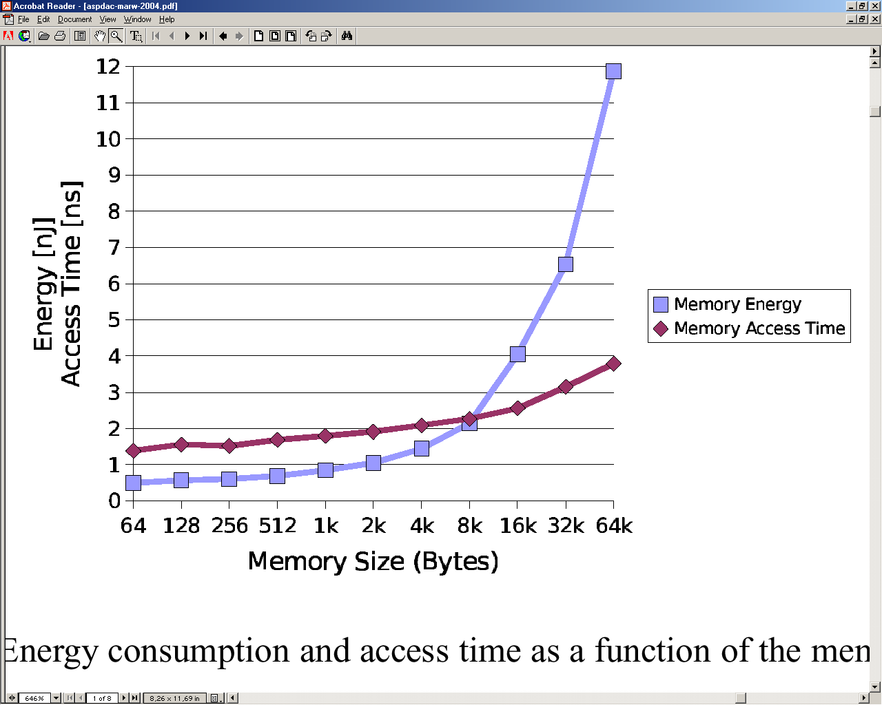
Properties of Today’s Memories (2)
With increasing size of a memory, a single memory access consumes disproportionately high energy.
With increasing size, memory accesses also take proportionally longer.
Fabrication technology of memories suggests to use small memories!

Slide 46
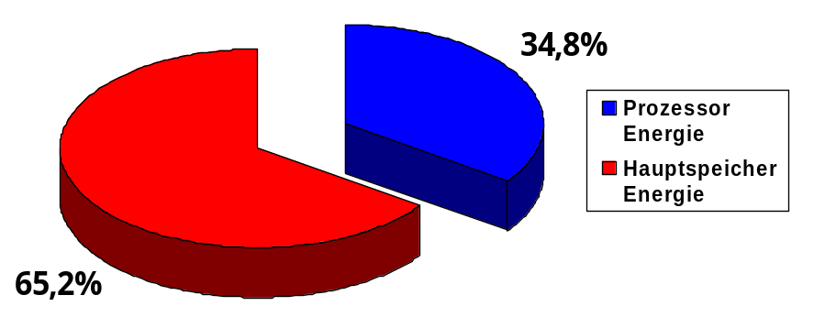
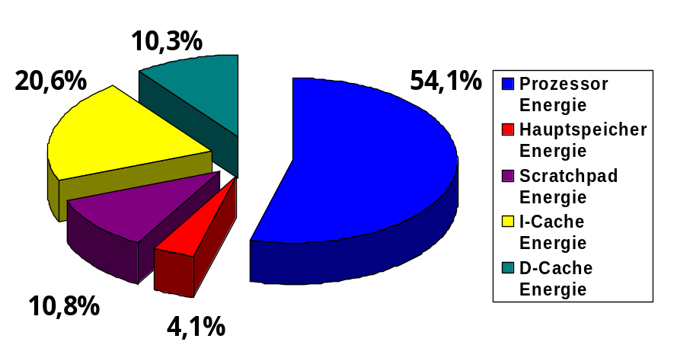
Properties of Today’s Memories (3)
ARM7 Mono-Core without Cache:
ARM7 Multi-Core with Caches:
Memory subsystem often consumes more than 50% of the entire system’s total energy budget.
Pie charts show averages over more than 160 different energy measurements each.
[M. Verma, P. Marwedel. Advanced Memory Optimization Techniques for Low-Power Embedded Processors. Springer, 2007]

Slide 47
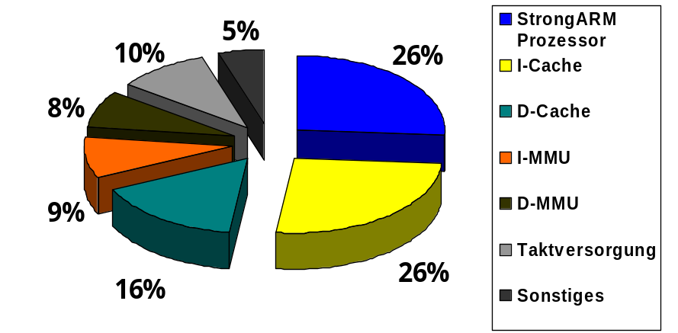
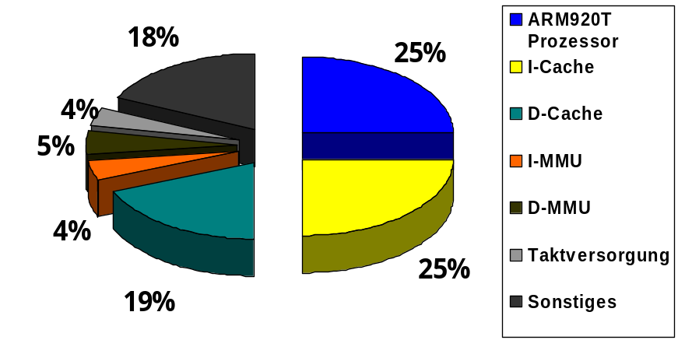
Properties of Today’s Memories (4)
[O. S. Unsal, I. Koren, C. M. Krishna, C. A. Moritz. University of Massachusetts, Amherst, 2001]
Orders of magnitudes for energy consumption of memories also confirmed by other independent groups from industry and academia.
[S. Segars (ARM Ltd.). Low power design techniques for microprocessors. ISSCC 2001]

Slide 48
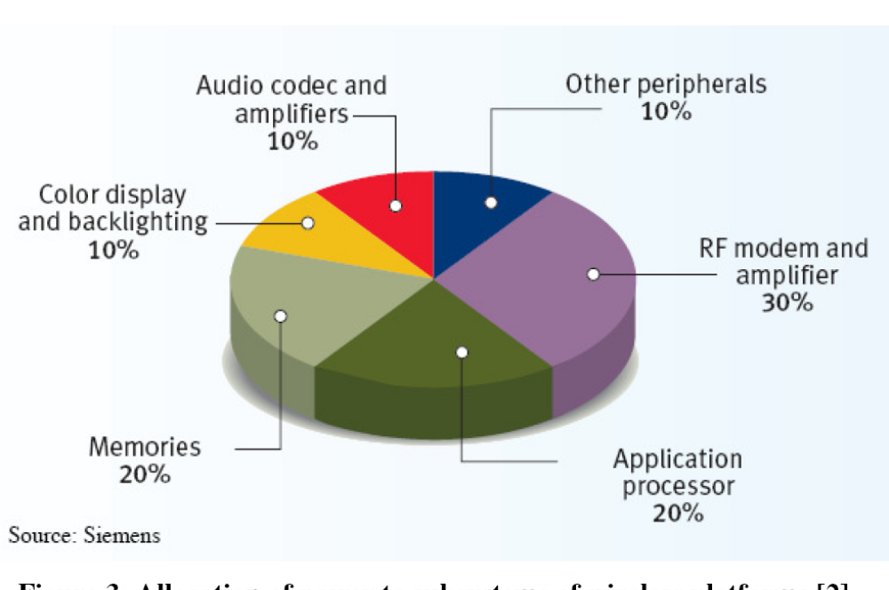
Properties of Today’s Memories (5)
Energy consumption of mobile devices
[O. Vargas (Infineon). Minimum power consumption in mobile-phone memory subsystems. Pennwell Portable Design, Sep. 2005]

Slide 49
Scratchpad Memories
Structure
Scratchpads (SPMs) are small, physically separate memories
They are mostly placed on the same chip as the processor (so-called on-chip memories)
Due to little size and on-chip placement: Extremely fast and energy-efficient memories
Are seamlessly mapped into the
processor’s address space:
Access by a simple address decoder that recognizes addresses on the bus from the SPM’s address region:
0x000…
Scratchpad Memory
select
SPM
0xFFF…

Slide 50
Recall: Structure of Set-Associative Caches
Address
Tag
Index
Way 0
Way 1
Tag
Memory
Data
Memory
Tag
Memory
Data
Memory
=
=
Data

Slide 51
Properties of Scratchpad Memories (1)
Predictability
Each SPM access takes only constant time, usually 1 clock cycle.
In contrast to this: A cache access takes a variable time, depending on whether it results in a cache hit or cache miss.
Run-time behavior of scratchpads is 100% predictable while behavior of caches is difficult to impossible to predict.
Caches are severely limited regarding real-time capabilities while SPMs are frequently used in the domain of hard real-time systems.

Slide 52
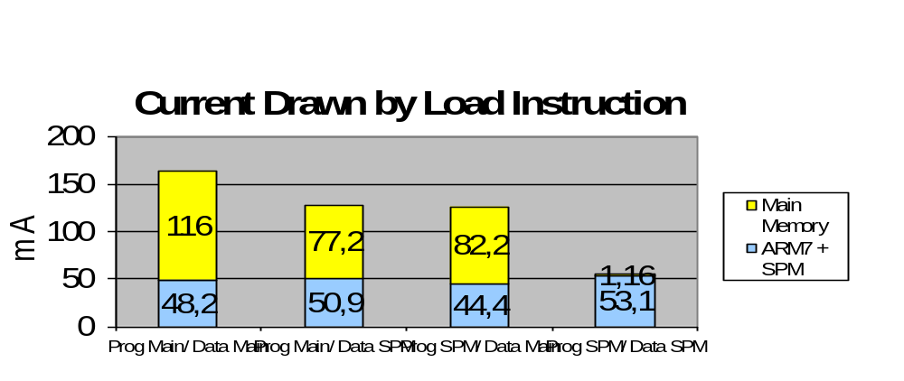
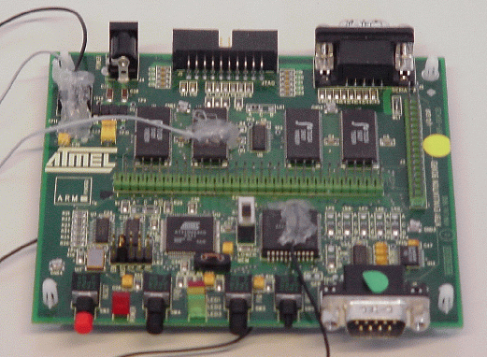
Properties of Scratchpad Memories (2)
Current Drain Compared to Main Memories
Measurements using real hardware (Atmel ARM7 evaluation board) show that, e.g., a load instruction draws a factor 3 less current if both the instruction and the data to be loaded reside in SPM instead of the off-chip main memory:

Slide 53
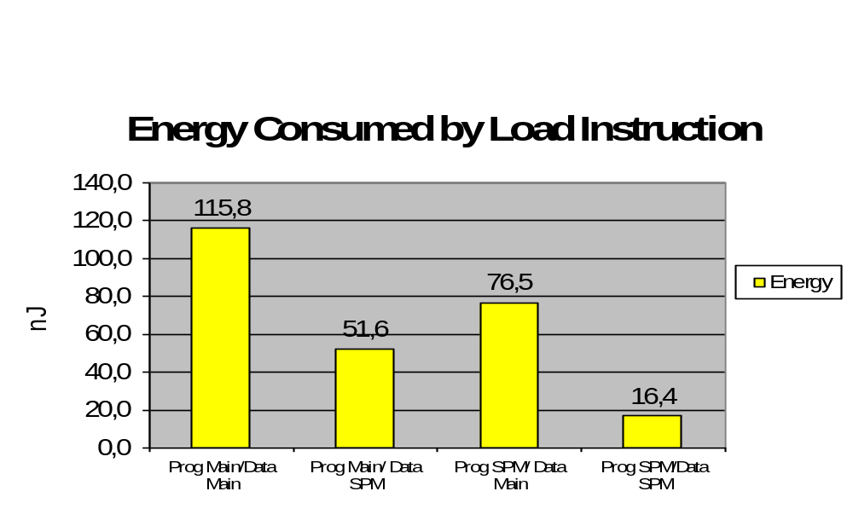
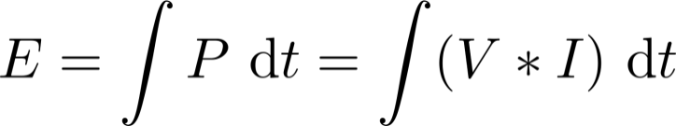

Properties of Scratchpad Memories (3)
Energy Consumption Compared to Main Memories
Similar measurements using the same hardware reveal that energy consumption of the load instruction can be reduced by factor of 7:
Recall:
Assumption: Supply
voltage is constant and drawn current does not vary too much over time

Slide 54
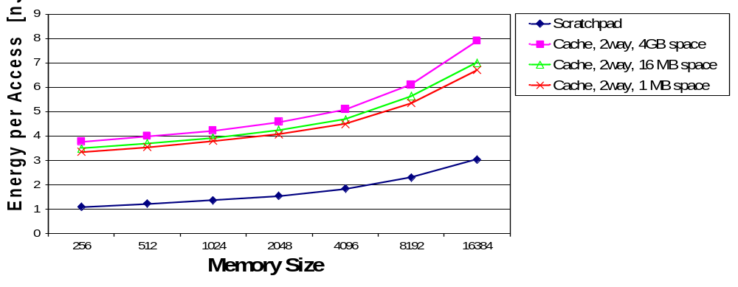
Properties of Scratchpad Memories (4)
Energy Consumption Compared to Caches
Size and number of tag memories, comparators and multiplexors depends on the size of the cached memory region.
Energy consumed by these hardware components considerable:
[R. Banakar. Comparison of Cache- and Scratch-Pad based Memory Systems... Technical Report #762, Universität Dortmund, Sep. 2001]

Slide 55
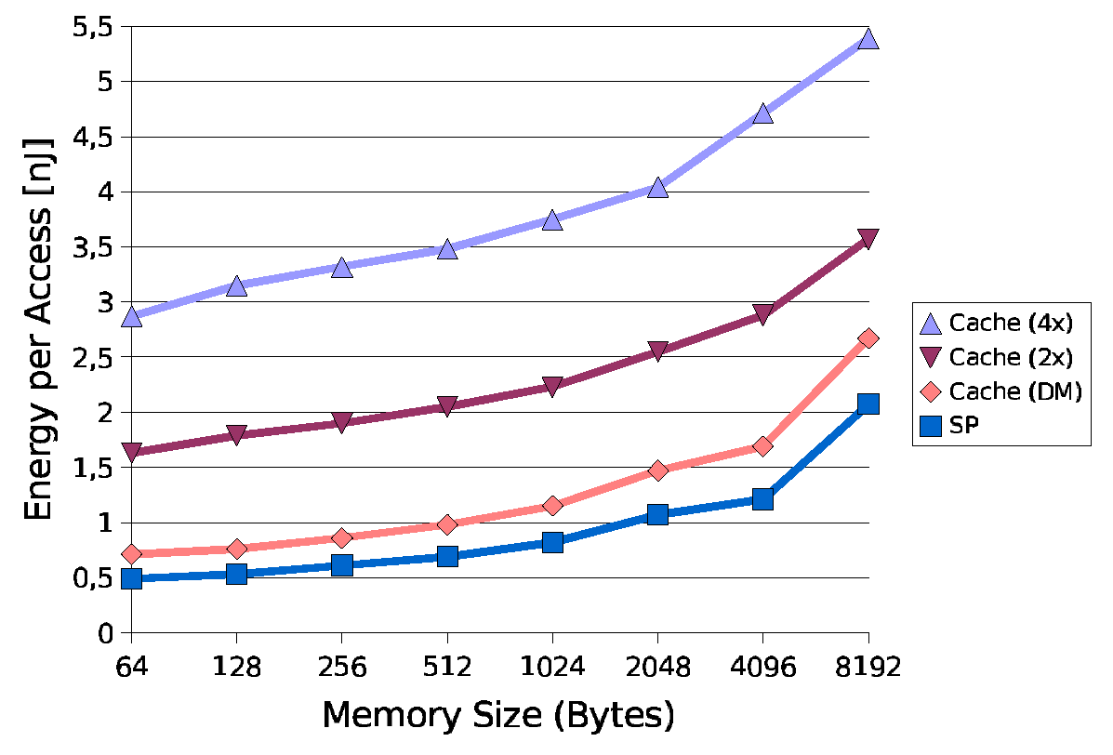
Properties of Scratchpad Memories (5)
Energy Consumption Compared to Caches
Energy consumption of caches additionally depends heavily on the degree of associativity:
Caution: Underlying
technology for this diagram
different to that from the
previous slide.
Thus, there are deviations in
the absolute values shown
here and on the previous
slide!

Slide 56




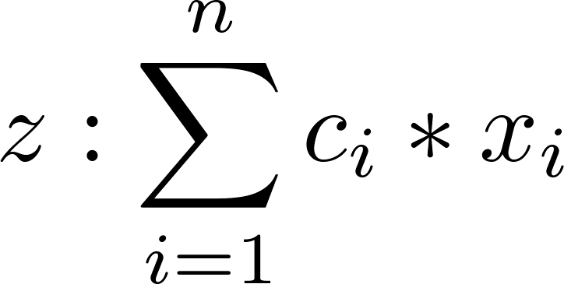
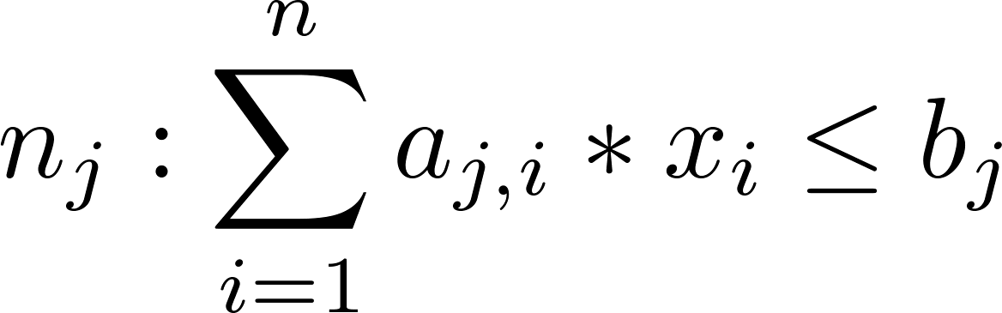


Integer-Linear Programming
Technique to Model Linear Optimization Problems
Optimization of an objective function under consideration of constraints
, ....,
Objective function and constraints are linear expressions of the integer decision variables , ...,
→ to be minimized or maximized
Constants
Variables
Optimal resolution of so-called ILPs (Integer Linear Programs) using standard ILP solvers (e.g., lp_solve, cplex)
Complexity: exponential in the worst case, but usually “OK”.

Slide 57
Fix SPM Allocation: Functions & Global Variables (1)
Goal
Allocation of the code of complete LIR functions and of global variables onto the SPM
(local variables usually lie on the stack and will not be considered here for this reason)
Compiler determines at compile-time which functions and global variables occupy the SPM.
This SPM allocation remains fix during run-time of the optimized program, i.e., the assignment of functions and variables to the SPM does not change at all during the entire run-time.

Slide 58









Fix SPM Allocation: Functions & Global Variables (2)
Definitions
Notation: Upper-case letters ≅ constants,
lower-case letters ≅ variables
Set of all memory objects to be considered
for SPM allocation, i.e., functions and
global variables , resp.
Size of the available SPM in bytes
Size of memory object in bytes
Energy that is saved if is moved from
main memory to SPM, per single execution
of or per single access to
, resp.

Slide 59





Fix SPM Allocation: Functions & Global Variables (3)
Definitions (ctd.)
Total amount of accesses or of executions to
Totally saved energy if is moved from
main memory to SPM for the overall
execution of the program to be optimized
Binary decision variable for
is moved onto SPM

Slide 60


Fix SPM Allocation: Functions & Global Variables (4)
Determination of Parameter Values
: Provided by user, constant
: Easy to determine using an LIR: Either the sum of the sizes of all machine instructions of a function, or the sum of the sizes of all sub-variables (e.g. for composed types like arrays or structs)
:
For : Energy model ( cf. chapter 3) provides difference
between access to main memory and SPM
For : Energy model provides difference between
instruction fetch from main memory or from SPM.
Simulation of the program to be optimized yields
amount of executed instructions for

Slide 61
Fix SPM Allocation: Functions & Global Variables (5)
Determination of Parameter Values (ctd.)
: Same simulation that provides can be used to obtain access and execution frequencies for
Prior to the scratchpad optimization of a program, a simulation run is performed in order to determine parameters required for the optimization
Such a simulation creates a run-time profile of the program to be optimized. Thus:
This simulation phase before an optimization is called Profiling.

Slide 62
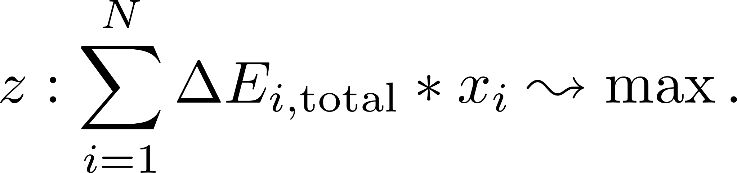
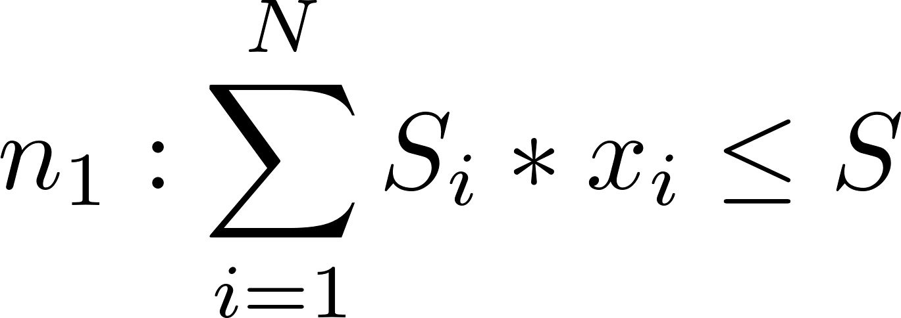
Fix SPM Allocation: Functions & Global Variables (6)
ILP Formulation
Objective function: Maximize energy savings for the whole program
Constraint: The SPM’s capacity must not be exceeded
[S. Steinke. Untersuchung des Energieeinsparungspotenzials in eingebetteten Systemen durch energieoptimierende Compilertechnik. Dortmund 2002]

Slide 63
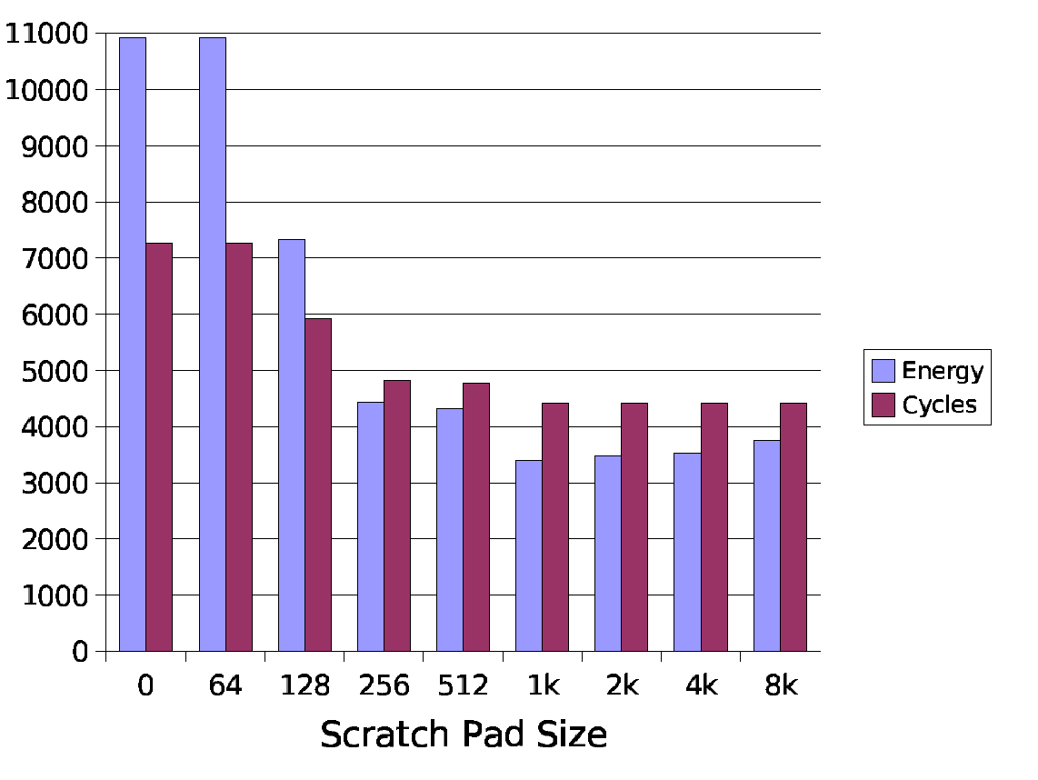
Fix SPM Allocation: Functions & Global Variables (7)
Results (MultiSort Benchmark)
64b SPM too small to hold global variables/functions.
Steady energy and run-time reductions until 1kB SPM due to allocation of more MOs to SPM.
From 2kB onwards minor degradations w.r.t. energy consumption since no more MOs can be allocated (all MOs already reside on SPM) but the energy consumption of larger SPMs increases for technological reasons.
Cycles [x100]
Energy (CPU + Memory) [µJ]

Slide 64
Fix SPM Allocation: Functions, Basic Blocks & Global Variables (1)
Motivation
Allocation of entire functions possibly disadvantageous:
Entire functions contain lots of code and occupy large space in the SPM
Parts of a function’s code (e.g., code outside loops) are executed rarely. They thus produce only very small energy savings but, however, occupy costly SPM capacity.
(Scarce resource) SPM capacity exploited only in a sub-optimal way.
Goal
Allocation of the code of complete LIR functions, of individual basic blocks and of global variables onto the SPM.

Slide 65
Fix SPM Allocation: Functions, Basic Blocks & Global Variables (2)
Problem when Moving Single Basic Blocks
Remember: A basic block b may contain a branch instruction only as very last instruction
If the branch at the end of b is conditional, b has two successors b1 and b2 in the CFG that are executed if the conditional branch is either taken or not taken:
b: ...
jnz %d_0, b2
b1: ...
b2: ...

Slide 66
Fix SPM Allocation: Functions, Basic Blocks & Global Variables (3)
Problem when Moving Single Basic Blocks
b1 is reached from b implicitly if the conditional branch is not taken, since
the program counter is incremented after the non-taken branch and thus points to the next following instruction, and
the code of b1 directly follows that of b in memory.
b: ...
jnz %d_0, b2
b1: ...
b2: ...

Slide 67
Fix SPM Allocation: Functions, Basic Blocks & Global Variables (4)
Problem when Moving Single Basic Blocks
What if b resides in SPM but b1 not (or vice versa)?
If the branch is not taken, the next instruction following b in the SPM will be executed.
Since b1 no longer follows b in the memory, incorrect code will be executed!
b: ...
jnz %d_0, b2
b1: ...
b2: ...

Slide 68
Fix SPM Allocation: Functions, Basic Blocks & Global Variables (5)
A Naive Solution
Extend all basic blocks b featuring such an implicit CFG edge by an unconditional branch to b1:
Disadvantage
Unconditional branch extremely inefficient (code size, run-time and energy consumption) if both b and b1 still reside in the same memory.
b: ...
jnz %d_0, b2
j b1
b1: ...
b2: ...

Slide 69



Fix SPM Allocation: Functions, Basic Blocks & Global Variables (6)
A Better Approach
Extension of a basic block b featuring such an implicit CFG edge by an unconditional branch only if b and b1 are actually allocated to different memories
Advantage
Unconditional branches are generated additionally only there where it is really necessary
Problem
Code size of b now depends on the decision variables and
that model the memory allocation of b in the ILP.
How to model a non-constant/variable parameter in the ILP?

Slide 70
Fix SPM Allocation: Functions, Basic Blocks & Global Variables (7)
Multi-Basic Blocks
Sets of basic blocks that are connected in the CFG.
Let G be the CFG of a function f, G’ be a connected sub-graph of G. The set of all basic blocks of G’ is a multi-basic block.
{b, b1}, {b, b2} and {b, b1, b2} are multi-basic blocks.
{b1, b2} is no multi-basic block: Its associated G’ is not connected.
b: ...
b1: ...
b2: ...

Slide 71




Fix SPM Allocation: Functions, Basic Blocks & Global Variables (8)
(Multi-) Basic Blocks in the ILP Formulation
ILP for SPM allocation optimizes memory objects from the sets of all functions , of all single basic blocks , of all multi-basic blocks and of all global variables .
is constructed by generating all possible connected sub-graphs G’ of the CFG.
Definitions
Set of all memory objects to be considered
for SPM allocation
Meaning of all other terms ( ) as before

Slide 72



Fix SPM Allocation: Functions, Basic Blocks & Global Variables (9)
Determination of Parameter Values
: For or : as before;
For : Size of all instructions of the basic block, plus the size
of an unconditional branch if has an implicit
successor in the CFG;
For : Size of all instructions of all basic blocks included in
, plus the size of k unconditional branches if
has k implicit successors outside in the CFG.
: as before, but now just analogously to under consideration
of the novel unconditional branches
: as before per profiling, now just also for all

Slide 73


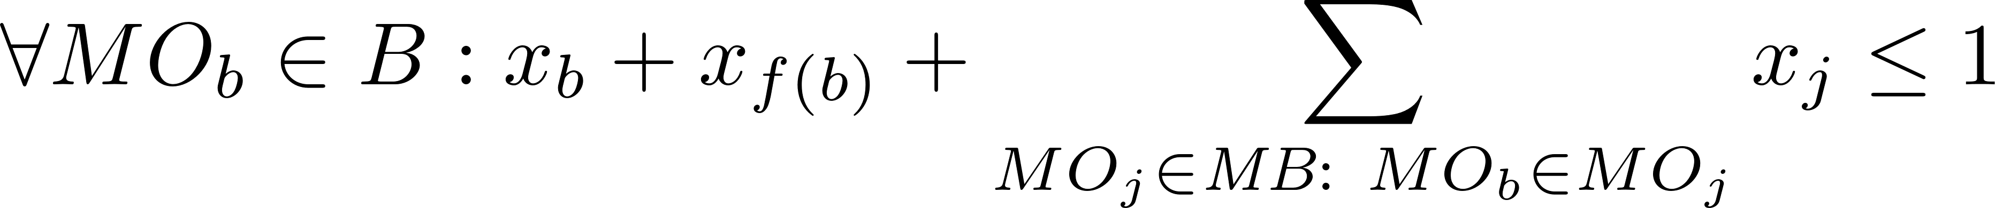
Fix SPM Allocation: Functions, Basic Blocks & Global Variables (10)
ILP Formulation
Objective function: Maximize energy savings for the whole program
Constraint 1: The SPM’s capacity must not be exceeded
Additional constraint per : may only be allocated to the SPM by at most one decision variable within the ILP (for b itself, for b´s function or for all multi-basic blocks that contain b)

Slide 74
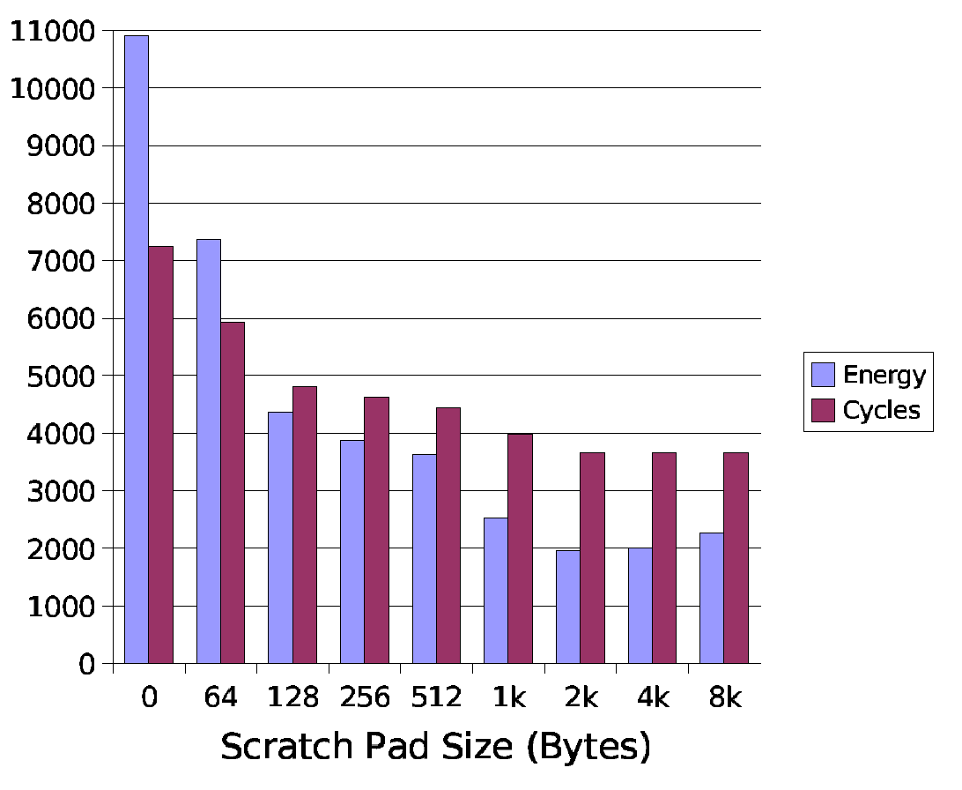
Fix SPM Allocation: Functions, Basic Blocks & Global Variables (11)
Results (MultiSort Benchmark)
64b SPM are now successfully exploited for the allocation of pieces of code.
Caution: The diagram here also features the allocation of the run-time stack onto the SPM. For this reason, this diagram cannot directly be compared with that from slide 63!
Cycles [x100]
Energy (CPU + Memory) [µJ]

Slide 75
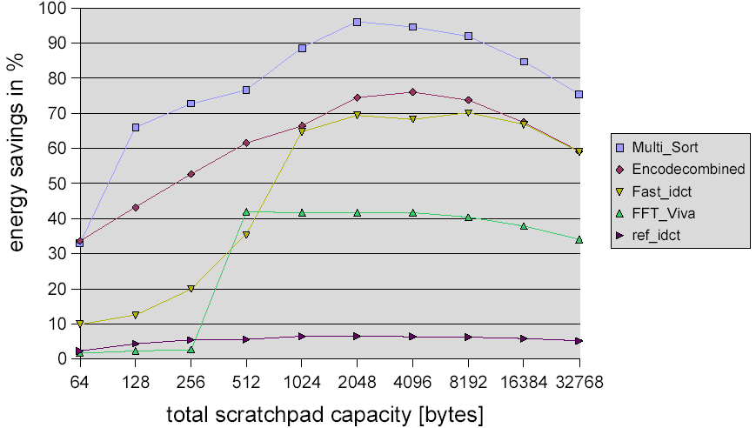
Fix SPM Allocation: Functions, Basic Blocks & Global Variables (12)
Detailed Results only for Memory Subsystem

Slide 76
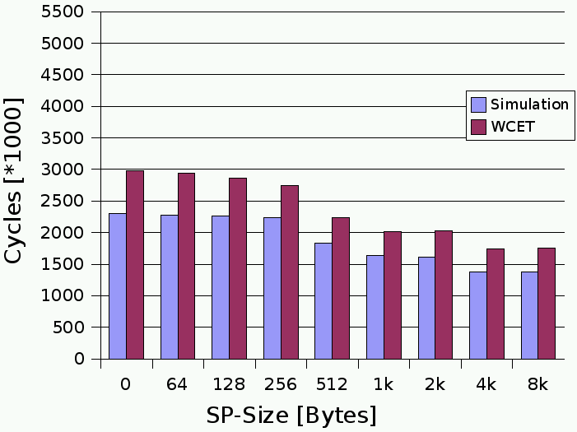
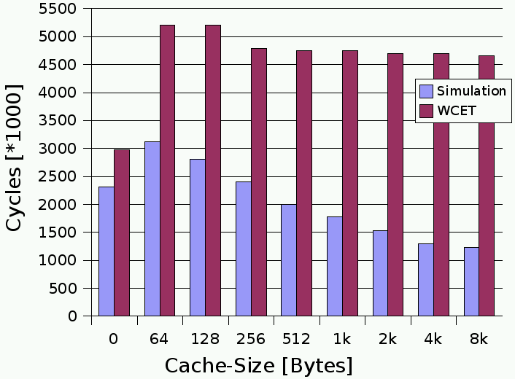
Fix SPM Allocation: Functions, Basic Blocks & Global Variables (13)
Comparison of ACET and WCET_{EST} for Scratchpads and Caches
SPMs are, in contrast to caches, perfectly predictable: WCET_{EST} scales nicely with ACETs
Only for larger memory sizes (beyond 2kB), caches outperform SPMs in terms of ACET

Slide 77
Multi-Process SPM Allocation: Partitioned SPM (1)
Process P₁
P₃
P₂
P₁
Process P₂
Time
Available SPM capacity is partitioned into disjoint areas during compile-time
Each process P_{i} obtains a dedicated SPM partition for functions, (multi-) BBs & global variables of P_{i}
Expectation: Good results for large SPMs
Process P₃
Scratchpad

Slide 78

Multi-Process SPM Allocation: Partitioned SPM (2)
Energy Arrays of Single Processes
Let P₁, ..., P_{N} be the processes of a multi-process application
S denotes the size of the available SPM capacity in bytes,
S’ < S is a user-provided parameter that cuts the SPM into slices of S’ bytes size each
For each process P_{i}, we will determine an energy array . denotes how much energy P_{i} consumes if P_{i} has x bytes of SPM at its disposal.
is pre-computed for all sizes x = S’, 2S’, 3S’, ... that are multiples of S’. This is achieved by repeated solution of the ILP for fix SPM allocation of functions, multi-BBs and global variables for each value of x above.

Slide 79



Multi-Process SPM Allocation: Partitioned SPM (3)
Energy Arrays for Multi-Process System and Partitioned SPM
For a complete multi-process system consisting of processes P₁, ..., P_{N}, its energy array has to be determined. denotes how much energy the entire multi-process system consumes if it has x bytes of SPM at its disposal.
for all those values of x, x₁, ..., x_{N} for which the individual are defined
For a fixed available SPM size S and a multi-process system, an SPM allocation yielding the minimal has to be determined.

Slide 80
Multi-Process SPM Allocation: Partitioned SPM (4)
The binmin Function
Example: A multi-process system consists of 3 processes P₁, P₂ and P₃.
binmin is a binary function that combines two energy arrays g and h and again computes an energy array:
Due to its associativity, computing the minimum over an N-fold sum in
can be reduced to the binary min in binmin.

Slide 81
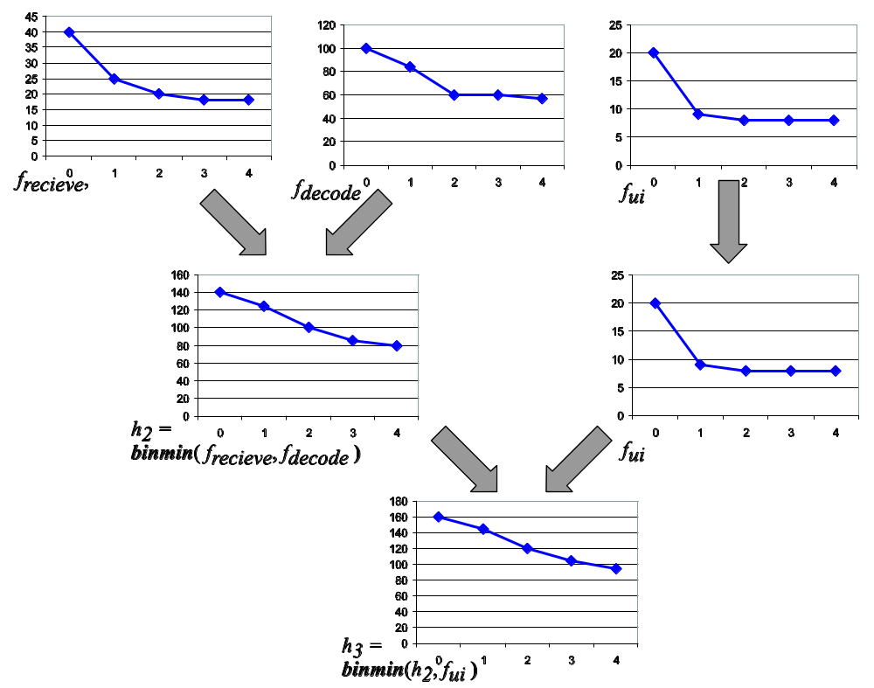
Multi-Process SPM Allocation: Partitioned SPM (5)
Example:
System with 3 processes (receive, decode, ui)

Slide 82
Multi-Process SPM Allocation: Partitioned SPM (6)
Algorithm to Compute binmin( g, h )
for ( x = 0; x <= S; x += S’ )
  int min = ∞;
  for ( tmp = 0; tmp <= x; tmp += S’ )
    if ( g[ tmp ] + h[ x – tmp ] < min )
    min = g[ tmp ] + h[ x – tmp ];
  b[ x ] = min;
return b;

Slide 83

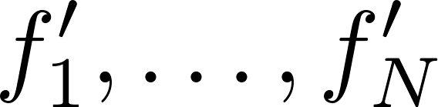

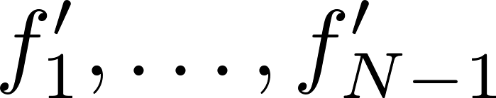



Multi-Process SPM Allocation: Partitioned SPM (7)
Algorithm to Compute
PartitionedSPM( )
if ( N > 2 )
  = PartitionedSPM( );
  = binmin( );
else
  = binmin( , );
return ;
binmin can easily be adapted such that it not only returns array b[ ], but also that value of tmp for which b[ x ] is minimal.
This way, the algorithm not only computes
but also the partition sizes x_{i} for all processes P_{i}.

Slide 84
Multi-Process SPM Allocation: Exclusive SPM (1)
Reload of
SPM Contents
P₃
P₂
Process P₁
P₁
Time
Each process P_{i} can freely and exclusively use the complete SPM for its functions, (multi-) BBs & global variables
During context switches, the SPM content must be stored and reloaded
Scratchpad

Slide 85
Multi-Process SPM Allocation: Exclusive SPM (1)
P₃
Process P₂
P₂
P₁
Time
Each process P_{i} can freely and exclusively use the complete SPM for its functions, (multi-) BBs & global variables
During context switches, the SPM content must be stored and reloaded
Scratchpad

Slide 86
Multi-Process SPM Allocation: Exclusive SPM (1)
P₃
P₂
Process P₃
P₁
Time
Each process P_{i} can freely and exclusively use the complete SPM for its functions, (multi-) BBs & global variables
During context switches, the SPM content must be stored and reloaded
Scratchpad

Slide 87
Multi-Process SPM Allocation: Exclusive SPM (1)
P₃
Process P₂
P₂
Process P₁
Process P₃
P₁
Time
Each process P_{i} can freely and exclusively use the complete SPM for its functions, (multi-) BBs & global variables
During context switches, the SPM content must be stored and reloaded
Expectation: Good results for small SPMs
Scratchpad

Slide 88

Multi-Process SPM Allocation: Exclusive SPM (2)
Energy Arrays of Single Processes
For each process P_{i}, s_{i} denotes its scheduling frequency. s_{i} is pre-computed using profiling.
For each process P_{i}, we will determine an energy array . denotes how much energy P_{i} consumes if P_{i} has x bytes of SPM at its disposal that need to be stored and reloaded during context switches.
is pre-computed analogously for all sizes x = S’, 2S’, 3S’, ...:
= Energy consumed during the execution of P_{i} using x Bytes SPM + additional energy used to copy x bytes from SPM to main memory and back (copy energy CE), multiplied by the frequency of context switches for P_{i}.

Slide 89

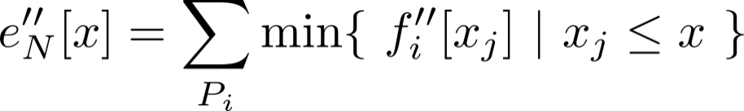


Multi-Process SPM Allocation: Exclusive SPM (3)
Energy Arrays for Multi-Process System and Exclusive SPM
For a complete multi-process system consisting of processes P₁, ..., P_{N}, its energy array has to be determined. denotes how much energy the entire multi-process system consumes if it has x bytes of SPM at its disposal that (partially) need to be reloaded during context switches.
for all those values of x and x_{j} for which the individual are defined
For a fixed available SPM size S and a multi-process system, an SPM allocation yielding the minimal has to be determined.

Slide 90


Multi-Process SPM Allocation: Exclusive SPM (4)
Algorithm to Compute
ExclusiveSPM( )
for ( <all processes P_{i}> )
  prev_min[ i ] = ∞;
for ( x = 0; x <= S; x += S’ )
  = 0;
  for ( <all processes P_{i}> )
    min[ i ] = ( < prev_min[ i ] ) ? : prev_min[ i ];
    += min[ i ];
    prev_min[ i ] = min[ i ];
return ;

Slide 91
Multi-Process SPM Allocation: Hybrid SPM (1)
Reload of the
exclusive SPM area
Process P₁
P₃
P₂
Process P₂
P₁
Process P₃
Time
SPM is grouped into a partitioned and an exclusive area.
Each process P_{i} can make use of the exclusive area and of a dedicated part of the partitioned area.
Process P₁
Scratchpad

Slide 92
Multi-Process SPM Allocation: Hybrid SPM (1)
Process P₁
P₃
P₂
Process P₂
P₁
Process P₃
Time
SPM is grouped into a partitioned and an exclusive area.
Each process P_{i} can make use of the exclusive area and of a dedicated part of the partitioned area.
Process P₂
Scratchpad

Slide 93
Multi-Process SPM Allocation: Hybrid SPM (1)
Process P₁
P₃
P₂
Process P₂
P₁
Process P₃
Time
SPM is grouped into a partitioned and an exclusive area.
Each process P_{i} can make use of the exclusive area and of a dedicated part of the partitioned area.
Process P₃
Scratchpad

Slide 94
Multi-Process SPM Allocation: Hybrid SPM (1)
Process P₁
P₃
P₂
Process P₂
P₁
Process P₃
Time
SPM is grouped into a partitioned and an exclusive area.
Each process P_{i} can make use of the exclusive area and of a dedicated part of the partitioned area.
Expectation: Good results for all kinds of SPMs
Process P₁
Process P₂
Process P₃
Scratchpad

Slide 95

Multi-Process SPM Allocation: Hybrid SPM (2)
Energy Arrays of Single Processes
For each process P_{i}, we will determine an energy array . denotes how much energy P_{i} consumes if P_{i} has x bytes of partitioned and y bytes of exclusive SPM to be reloaded during context switches at its disposal.
is again pre-computed for all sizes of x and y = S’, 2S’, 3S’, ... This is achieved by solving a special variant of the ILP for fix SPM allocation (not shown here) that supports two different SPMs of sizes x and y.

Slide 96



Multi-Process SPM Allocation: Hybrid SPM (3)
Energy Arrays for Multi-Process System and Hybrid SPM
For a complete multi-process system consisting of processes P₁, ..., P_{N}, its energy array has to be determined. denotes how much energy the entire multi-process system consumes if it has x bytes partitioned and y bytes exclusive SPM at its disposal.
for all those values of x₁, ..., x_{N}, y₁, ..., y_{N}, for which the individual are defined
For a fixed available SPM size S and a multi-process system, an SPM allocation yielding the minimal has to be determined such that
holds.

Slide 97
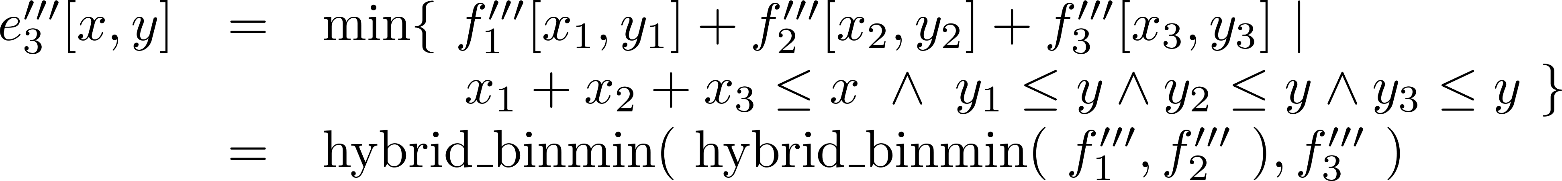
Multi-Process SPM Allocation: Hybrid SPM (4)
The hybrid_binmin Function
Example: A multi-process system consists of 3 processes P₁, P₂ and P₃.
hybrid_binmin is a binary function that combines two energy arrays g and h and again computes an energy array:
Due to its associativity, computing the minimum over an N-fold sum in
can be reduced to the binary min in hybrid_binmin.

Slide 98
Multi-Process SPM Allocation: Hybrid SPM (5)
Algorithm to Compute hybrid_binmin( g, h )
for ( y = 0; y <= S; y += S’ )
  int min = ∞;
  for ( x = 0; x <= S - y; x += S’ )
    for ( tmp = 0; tmp <= x; tmp += S’ )
      if ( g[ tmp, y ] + h[ x – tmp, y ] < min )
      min = g[ tmp, y ] + h[ x – tmp, y ];
  b[ x, y ] = min;
return b;

Slide 99



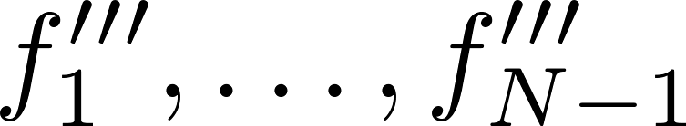



Multi-Process SPM Allocation: Hybrid SPM (6)
Algorithm to Compute
HybridSPM( )
if ( N > 2 )
  = HybridSPM( );
  = hybrid_binmin( );
else
  = hybrid_binmin( , );
return ;
Functionality in analogy to PartitionedSPM ( slide 83)

Slide 100
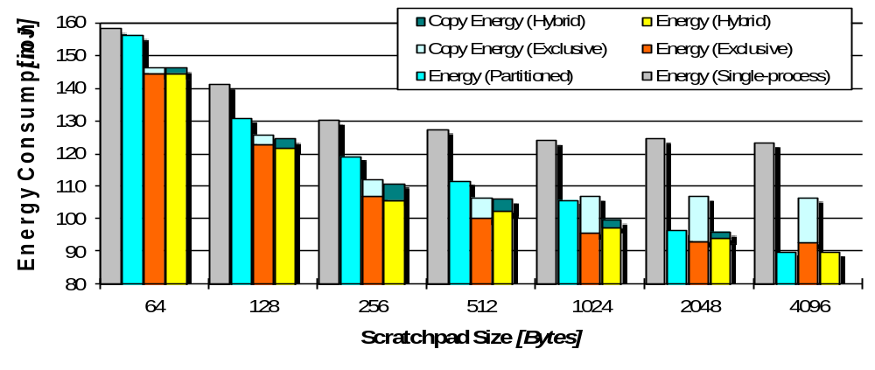
Multi-Process SPM Allocation: Results (1)
Here: Media application (processes adpcm, g721, mpeg4, edge detection)
Energy (single-process): SPM is completely assigned to that single process using fix SPM allocation that reduces energy consumption most.

Slide 101
Multi-Process SPM Allocation: Results (2)
Partitioned SPM: In fact beneficial for large memories
Partitioning of the SPM outperforms exclusive SPM allocation from 1kB SPM size on

Slide 102
Multi-Process SPM Allocation: Results (3)
Exclusive SPM: In fact beneficial for small memories
Exclusive SPM allocation including reloading of SPM content outperforms partitioned SPMs up to 512 bytes SPM size

Slide 103
Multi-Process SPM Allocation: Results (4)
Hybrid SPM: Is in fact the best allocation scheme for all SPM sizes
At 4kB SPM: 27% energy savings compared to bar “single-process”
Similar results also for “Video Phone” and “DSP” multi-process systems
27%

Slide 104
References (1)
Code Generation for Network Processors
J. Wagner. Retargierbare Ausnutzung von Spezialoperationen für Eingebettete Systeme mit Hilfe bitgenauer Wertflussanalyse. Dissertation, Dortmund 2006.

Slide 105
References (2)
Optimizations for Scratchpad Memories
S. Steinke. Untersuchung des Energieeinsparungspotenzials in eingebetteten Systemen durch energieoptimierende Compilertechnik. Dissertation, Dortmund 2002.
M. Verma, P. Marwedel. Advanced Memory Optimization Techniques for Low-Power Embedded Processors. Springer, 2007.
M. Verma, K. Petzold, L. Wehmeyer et al. Scratchpad Sharing Strategies for Multiprocess Embedded Systems: A first Approach. 3rd IEEE Workshop on Embedded Systems for Real-Time Multimedia (ESTIMedia), Jersey City, September 2005.

Slide 106
Summary
Generation of Bit-Packet Operations for NPUs
Conventional data flow analysis are not bit-true
Bit-true data and value flow analysis via forward and backward simulation
Detection of bit-Packets using values of the BDVFA
Optimizations for Scratchpad Memories
Scratchpads extremely beneficial regarding energy consumption, run-time and WCET_{EST}, as compared to caches and main memories
Integer-linear programming (ILP) as optimization approach
SPM contents: Functions, basic blocks and global variables
SPM allocation for single- and multi-process systems

