Slide 1
Compilers for Embedded Systems
Summer Term 2022
Heiko Falk
Institute of Embedded Systems
Electrical Engineering, Computer Science and Mathematics
Hamburg University of Technology

Slide 2
Chapter 9
WCET-Aware Compilation

Slide 3
Outline
Introduction & Motivation
Compilers for Embedded Systems – Requirements & Dependencies
Internal Structure of Compilers
Pre-Pass Optimizations
HIR Optimizations and Transformations
Code Generation
LIR Optimizations and Transformations
Register Allocation
WCET-Aware Compilation
Outlook

Slide 4
Chapter Contents
WCET-Aware Compilation
  Introduction
    Integration of a WCET Timing Model into a Compiler
    Challenges for WCET-Aware Optimization
  Procedure Cloning & Positioning
    WCET-Aware Procedure Cloning
    Procedure Positioning for Cache Miss Reduction
  Register Allocation
    Problem of Classical Graph Coloring
    WCET-Aware Graph Coloring
  Scratchpad Allocation of Data and Code
    Allocation of global Data
    Allocation of Basic Blocks

Slide 5
Software Design for Real-Time Systems
Current Industrial Practice (Automotive, Avionics)
Specification using graphical / high-level tools
Automatic generation of ANSI-C code
Compilation of binary machine code for a given processor architecture
Repeated executions / simulations of generated machine code, usage of “representative” input data
Time measurements provide “observed execution times”
Addition of safety margin (e.g., 20%) to greatest observed execution time: “observed Worst-Case Execution Time”
Observed WCET ≤ Real-time constraint? No: Go to 1

Slide 6
Problems of this Design Flow
Safety
No guarantee that observed WCET (even only approximately) matches the actual WCET
No guarantee that a real-time system always terminates in time
Design Time
How many iterations are required until step 7 successful?
Depends on in how far steps 2-3 lead to the effective acceleration of the generated code in the worst case
Try & Error until step 7 successful

Slide 7
Current State of the Art in Compiler Construction
Objective Function of Compiler Optimizations
Usually reduction of Average-Case Execution Times (ACET):
Accelerate a “typical” execution of a program using “typical” input data
No statements about the impact of optimizations on WCETs possible
Optimization Strategy
Naive: Current compilers lack precise ACET timing model
Application of an optimization if “promising”
ACET-related effects of optimizations unknown to compiler
ACET optimizations potentially increase WCETs – Compilers often invoked without any optimizations for real-time systems

Slide 8
Motivation
Design of a Compiler that
considers WCET_{EST} instead of average-case runtimes,
allows formal guarantees on worst-case properties, instead of relying on observed execution times,
applies fully automated optimizations to minimize WCET_{EST}
Approach
Integration of a WCET_{EST} timing model into compiler by coupling compiler back-end with static WCET analyzer.
Exploitation of WCET_{EST} timing model by novel optimizations explicitly aiming at WCET_{EST} minimization.

Slide 9
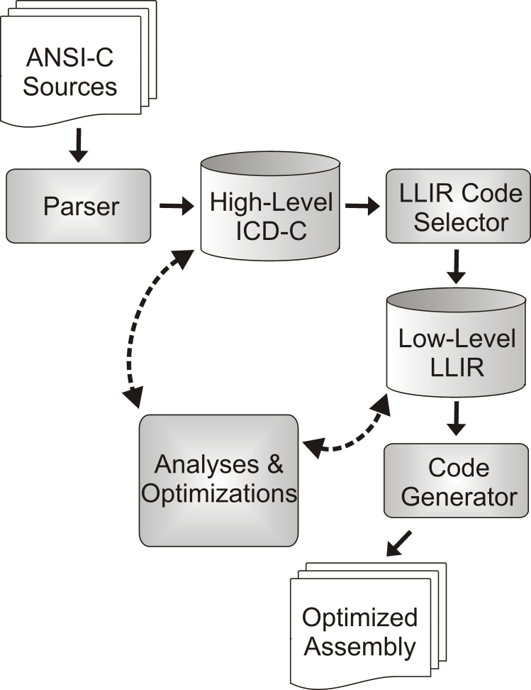
Integration of WCET_{EST} Model into Compiler (1)
Re-implementation of a WCET timing model in compiler makes no sense
Instead: Tight integration of aiT
( chapter 5)
Coupling inside processor-specific compiler back-end (LLIR)
Seamless exchange of information via translation LLIR ↔ CRL2
Transparent invocation of aiT inside the compiler
Import of WCET-related data into compiler back-end

Slide 10
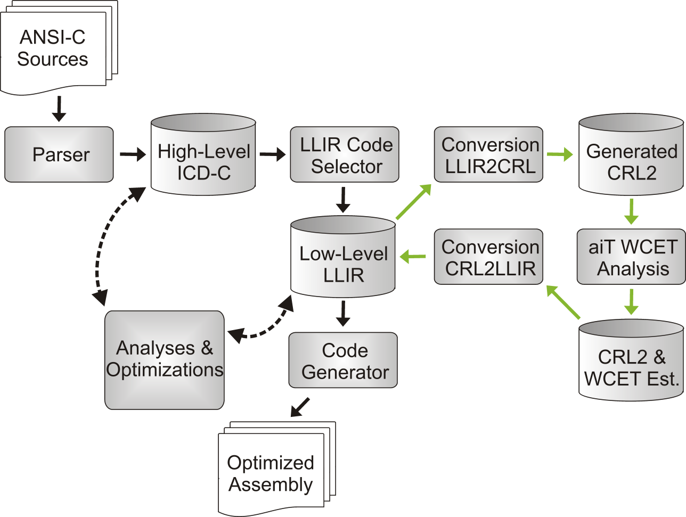
Integration of WCET_{EST} Model into Compiler (2)
Relevant WCET data:
WCET_{EST} of entire program, function or basic block
Worst-case execution frequency per function, basic block or CFG edge
Potential register contents
Cache Hits / Misses per basic block

Slide 11
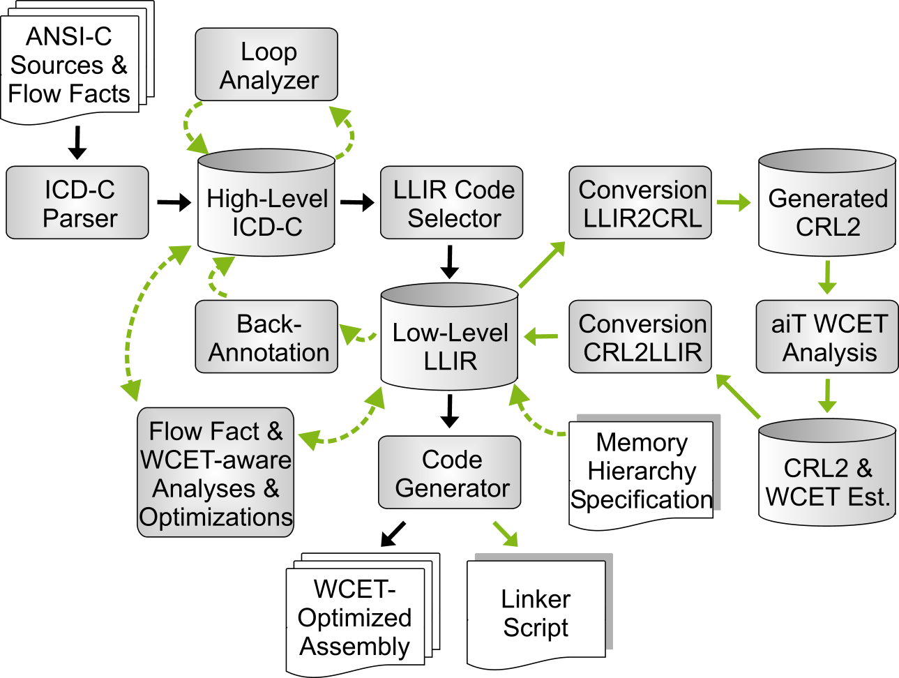
WCC – The WCET-aware C Compiler (1)
Flow Facts
WCET analysis: max. iteration counts & recursion depths
WCC: Annotation directly in C source code:
_Pragma( ”loopbound min 10 max 10” );
Automatic flow fact update during control flow-modifying optimizations

Slide 12
WCC – The WCET-aware C Compiler (2)
Loop Analyzer
Manual annotation of Flow Facts tedious and error-prone
WCC: Automated loop analysis that determines maximal iteration counts
Partially bases on polyhedral models ( chapter 4)

Slide 13
WCC – The WCET-aware C Compiler (3)
Back-Annotation
WCET_{EST} data of aiT only available in back-end
HIR optimizations have no accesses to WCET_{EST} data
WCET_{EST} minimization at HIR level impossible
WCC: Back-annotation translates WCET_{EST} data from LIR to HIR

Slide 14
WCC – The WCET-aware C Compiler (4)
Memory Hierarchy
aiT operates on binary code using physical addresses
WCC must provide correct physical addresses for code, data, branches and load/store operations to aiT
WCC requires detailed knowledge about memories

Slide 15
WCC – The WCET-aware C Compiler (5)
Memory Hierarchy
Memory regions, their start addresses, sizes, access latencies, access attributes (code, data, read-/writable, ...)
SPM allocations also require this information for their optimizations

Slide 16
WCC – The WCET-aware C Compiler (6)
Memory Hierarchy
WCC decides on memory layout of code and data but produces no binary code
Linker must generate binary code in strict compliance with WCC’s memory layout
WCC: Automatic generation of an adapted linker script
[http://www.tuhh.de/es/esd/research/wcc]

Slide 17
Challenges during WCET_{EST} Minimization
The Worst-Case Execution Path (WCEP)
WCET of a program = Length of the program’s longest execution path (WCEP)
WCET_{EST} minimization: Optimization of only those parts of a program lying on the WCEP
Code optimization apart the WCEP will not reduce WCET_{EST}
Optimizations minimizing WCET_{EST} require detailed knowledge of the WCEP!
WCET analyzer aiT provides such detailed information by means of execution frequencies of CFG edges.
But...

Slide 18
Instability of the WCEP (1)
WCET_{EST} of
basic block a
10 Cyc.
main
50 Cyc.
a
120 Cyc.
d
80 Cyc.
b
65 Cyc.
c
Example: Simple CFG with 5 basic blocks

Slide 19
Instability of the WCEP (2)
10 Cyc.
main
50 Cyc.
a
120 Cyc.
d
80 Cyc.
b
WCET_{EST} = 205 Cyc.
65 Cyc.
c
Initial WCEP: main, a, b, c
Length of WCEP = WCET_{EST} = 205
In the following: Optimization of b

Slide 20
Instability of the WCEP (3)
10 Cyc.
main
50 Cyc.
a
120 Cyc.
d
40
80 Cyc.
b
WCET_{EST} = 205 Cyc.
65 Cyc.
c
Initial WCEP: main, a, b, c
Length of WCEP = WCET_{EST} = 205
In the following: Optimization of b

Slide 21
Instability of the WCEP (4)
10 Cyc.
main
50 Cyc.
a
120 Cyc.
d
40
80 Cyc.
b
WCET_{EST} = 195 Cyc.
65 Cyc.
c
Novel WCEP: main, d, c
Novel WCET_{EST}: 195
WCEP has changed due to an optimization!

Slide 22
Consequences for Compiler Optimizations
WCET-Aware Optimizations...
... always have to be aware that the WCEP can change after each individual optimization decision.
... should take the decision where to optimize something not only based on local information, but should always consider the global effects of an optimization decision.
(The optimization of b in the previous example locally reduces the WCET_{EST} of b by 40 cycles. But globally, only 10 cycles were saved!)
☞ Challenge: To design novel compiler optimizations that fulfill the above requirements and that always consider the entire CFG and the current WCEP therein.

Slide 23
Chapter Contents
WCET-Aware Compilation
  Introduction
    Integration of a WCET Timing Model into a Compiler
    Challenges for WCET-Aware Optimization
  Procedure Cloning & Positioning
    WCET-Aware Procedure Cloning
    Procedure Positioning for Cache Miss Reduction
  Register Allocation
    Problem of Classical Graph Coloring
    WCET-Aware Graph Coloring
  Scratchpad Allocation of Data and Code
    Allocation of global Data
    Allocation of Basic Blocks

Slide 24
Why Procedure Cloning and WCET_{EST}?
Motivation ( cf. chapter 5)
Frequent occurrences of general-purpose functions in special-purpose contexts in embedded software
Loop bounds are particularly often controlled by function parameters
Loop bounds are particularly critical for WCET estimates
Procedure Cloning allows the extremely precise annotation of loop bounds for WCET analysis
[P. Lokuciejewski. Influence of Procedure Cloning on WCET Prediction. CODES+ISSS, Salzburg, 2007]

Slide 25


Results after Classical Cloning
WCET_{EST} improvements from 13% up to 95%!
Code size increases from 2% up to 325%!

Slide 26
Key Problems of Classical Cloning
WCET_{EST} of a program corresponds to length of WCEP
Classical Procedure Cloning is fully unaware of WCEP
Properties of functions that potentially yield WCET_{EST} reductions (parameter-dependent loops) are not considered by the classical standard optimization
Potential cloning of functions that do not lie on the WCEP
Potential cloning of functions that do not contribute to a WCET_{EST} reduction
Unnecessary code size increases without any benefit in terms of WCET_{EST} reduction

Slide 27
WCET-aware Cloning (1)
Input
Program P to be optimized, given in the form of an HIR
Float value maxFactor that denotes the maximally acceptable code size increase
Initialization
maxCodeSize = getCodeSize( P ) * maxFactor;
Phase 1 – Determination of the WCEP
Perform a WCET analysis of P;
Determine set F of all original functions lying on the WCEP of P;
wcet_{orig} = getWCET( P );
cs_{orig} = getCodeSize( P );

Slide 28
WCET-aware Cloning (2)
Phase 2 – Determination of WCET_{EST} Data per Function
for ( <all functions f ∈ F> )
if ( <f is called with constant value as some parameter p> &&
( <p is used as loop bound> ||
<p is used in a condition of an if-statement> ||
<p is argument in some other function call inside f> ) )
// Cloning of f eventually beneficial w.r.t. WCET_{EST}
HIR P’ = P.copy();
doCloning( P’, f ); // Try out cloning of f
updateLoopBounds( P’, f );
deleteRedundantIfStmts( P’, f );
Perform WCET analysis of P’;
wcet_{f} = getWCET( P’ );
cs_{f} = getCodeSize( P’ );

Slide 29
WCET-aware Cloning (3)
Phase 3 – Determination of that Function with highest Profit
for ( <all functions f ∈ F> )
profit_{f} = ( wcet_{orig} – wcet_{f} ) / ( cs_{f} – cs_{orig} );
Determine function f_{opt} with maximal profit_{f} AND
cs_{f} ≤ maxCodeSize;
if ( <f_{opt} exists> )
doCloning( P, f_{opt} );
goto <Phase 1>;
[P. Lokuciejewski. WCET-Driven, Code-Size Critical Procedure Cloning. SCOPES, Munich, 2008]

Slide 30
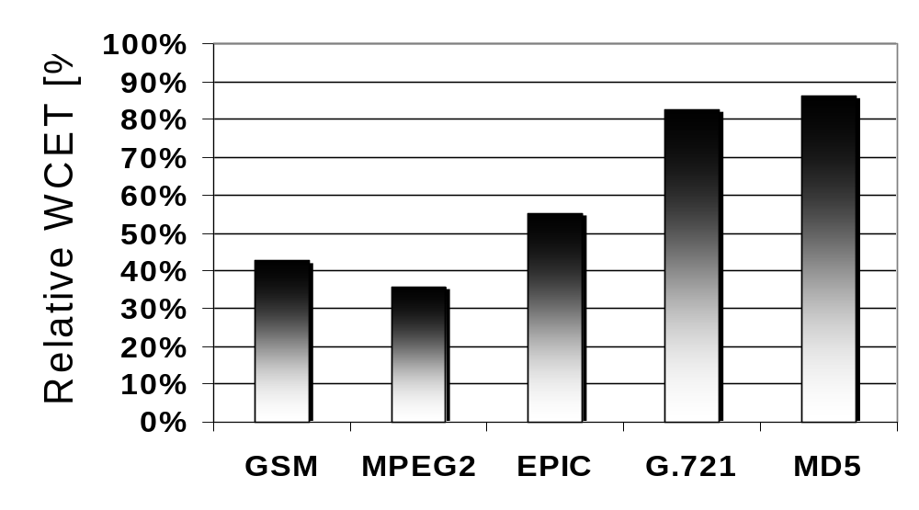
Relative WCET_{EST} after WCET-aware Cloning
100% = WCET_{EST} without any procedure cloning
WCET_{EST} reductions from 14% up to 64%!

Slide 31
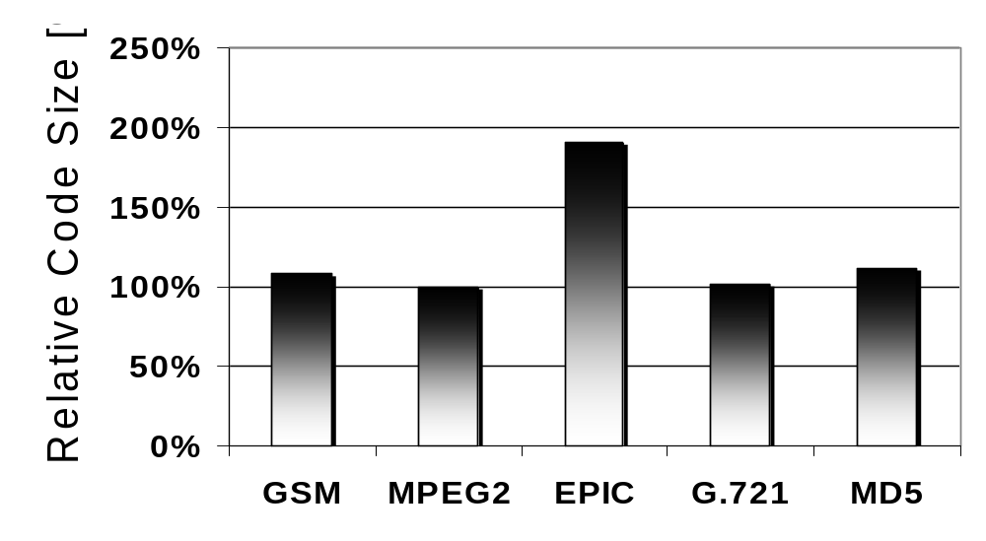
Relative Code Sizes after WCET-aware Cloning
100% = Code size without any procedure cloning
Code size increase of EPIC: 190% instead of 300%

Slide 32
Eviction of Code from Instruction Caches
Caches exploit locality of memory accesses
  Spatial Locality: Memory accesses target a spatially small memory region that should be kept in the cache completely
  Temporal Locality: In a short period of time, spatially scattered memory regions are accessed so that these regions should be kept in the cache
Poor layout of code (or data) in memory can lead to a bad cache performance if temporal locality is high:
Scattered memory regions with high temporal locality can, when arranged badly in memory, evict themselves repeatedly from the cache, thus yielding many cache misses – so-called conflict misses.

Slide 33
Example of I-Cache Evictions (1)
Set
I-Cache
Main Memory
Set
0
foo1
foo1
0
foo1
1
1
2
2
void foo1()
{
for (i=0; i<n; i++) {
foo2();
foo3();
// More Code
}
}
3
3
Way 0
4
4
5
5
6
...
...
...
S
S
foo2
0
foo2
1
2
0
3
1
4
2
5
3
...
...
Way 1
4
S
5
foo3
0
Here: 2-way set-associative
I-Cache
6
foo3
1
...
2
S
...

Slide 34
Example of I-Cache Evictions (2)
Set
I-Cache
Main Memory
Set
0
foo1
foo1
0
foo1
1
1
2
2
void foo1()
{
for (i=0; i<n; i++) {
foo2();
foo3();
// More Code
}
}
3
3
Way 0
4
4
5
5
6
...
...
...
S
S
foo2
0
foo2
1
2
0
foo2
3
1
4
2
5
3
...
...
Way 1
4
S
5
foo3
0
Here: 2-way set-associative
I-Cache
6
foo3
1
...
2
S
...

Slide 35
Example of I-Cache Evictions (3)
Set
I-Cache
Main Memory
Set
0
foo1
foo1
0
foo3
foo1
1
1
2
2
void foo1()
{
for (i=0; i<n; i++) {
foo2();
foo3();
// More Code
}
}
3
3
Way 0
4
4
5
5
6
...
...
...
S
S
foo2
0
foo2
1
2
0
foo2
3
1
4
2
5
3
...
...
Way 1
4
S
5
foo3
0
Here: 2-way set-associative
I-Cache
6
foo3
1
...
2
S
...

Slide 36
Example of I-Cache Evictions (4)
Set
I-Cache
Main Memory
Set
0
foo1
foo1
0
foo3
foo1
1
1
2
2
void foo1()
{
for (i=0; i<n; i++) {
foo2();
foo3();
// More Code
}
}
3
3
Way 0
4
4
5
5
6
...
...
...
S
S
foo2
0
foo2
1
2
0
foo2
3
1
4
2
5
3
...
...
Way 1
4
S
5
foo3
0
Here: 2-way set-associative
I-Cache
6
foo3
1
...
2
S
...

Slide 37
A better Memory Layout without Evictions (1)
Set
I-Cache
Main Memory
Set
0
foo1
foo1
0
foo1
1
1
2
2
void foo1()
{
for (i=0; i<n; i++) {
foo2();
foo3();
// More Code
}
}
3
3
Way 0
4
4
5
5
6
foo2
6
7
7
8
foo2
8
9
9
...
...
0
S
1
foo3
0
2
foo3
1
3
2
Way 1
4
...
5
Here: 2-way set-associative
I-Cache
6
...
S

Slide 38
A better Memory Layout without Evictions (2)
Set
I-Cache
Main Memory
Set
0
foo1
foo1
0
foo1
1
1
2
2
void foo1()
{
for (i=0; i<n; i++) {
foo2();
foo3();
// More Code
}
}
3
3
Way 0
4
4
5
5
6
foo2
foo2
6
7
7
8
foo2
8
9
9
...
...
0
S
1
foo3
0
2
foo3
1
3
2
Way 1
4
...
5
Here: 2-way set-associative
I-Cache
6
...
S

Slide 39
A better Memory Layout without Evictions (3)
Set
I-Cache
Main Memory
Set
0
foo1
foo1
0
foo1
1
1
2
2
void foo1()
{
for (i=0; i<n; i++) {
foo2();
foo3();
// More Code
}
}
3
3
Way 0
4
4
5
5
6
foo2
foo2
6
7
7
8
foo2
8
9
9
...
...
0
foo3
S
1
foo3
0
2
foo3
1
3
2
Way 1
4
...
5
Here: 2-way set-associative
I-Cache
6
...
S

Slide 40
A better Memory Layout without Evictions (4)
Set
I-Cache
Main Memory
Set
0
foo1
foo1
0
foo1
1
1
2
2
void foo1()
{
for (i=0; i<n; i++) {
foo2();
foo3();
// More Code
}
}
3
3
Way 0
4
4
5
5
6
foo2
foo2
6
7
7
8
foo2
8
9
9
...
...
0
foo3
S
1
foo3
0
2
foo3
1
3
2
Way 1
4
...
5
Here: 2-way set-associative
I-Cache
6
...
S

Slide 41
Procedure Positioning using Call Graphs
Definition (Call Graph):
The Call Graph is an undirected weighted graph G = (V, E, w) with
V contains a node v per function of a program
E contains an edge e = {v, w} if a function v calls function w
Each edge e = {v, w} is weighted with the frequency w(e) how often v and w call themselves
Concept of WCET-aware Procedure Positioning
Generate call graphs with edge weights equal to worst-case call frequencies as determined during static WCET analysis
Repeatedly place two functions with high edge weights consecutively in memory

Slide 42
WCET-aware Procedure Positioning (1)
Input
Program P to be optimized, given in the form of an LIR
Initialization
Perform a WCET analysis of P;
Generate call graph G_{orig} = (V_{orig}, E_{orig}, w_{orig}) of P based on WCET data;
Generate call graph G_{new} = (V_{new}, E_{new}, w_{new}) = G_{orig}.copy();
[P. Lokuciejewski et al. WCET-driven Cache-based Procedure Positioning Optimizations. ECRTS, Prague, 2008]

Slide 43
WCET-aware Procedure Positioning (2)
Optimization Loop
do
wcet_{current} = getWCET( P );
for ( <all edges e = {v, w} ∈ E_{new},
sorted in descending order w.r.t. w_{new}> )
if ( Positioning( e, G_{new}, G_{orig}, P, wcet_{current} ) == true )
// If contiguous placement of nodes v and w in memory reduces
// WCET_{EST}, terminate for-loop and continue with do-while-loop.
break;
while ( <P was modified during last iteration> );

Slide 44
WCET-aware Procedure Positioning (3)
Positioning( e = {v, w} ∈ E_{new}, G_{new}, G_{orig}, P, wcet_{current} )
Generate LIR P’ with v and w placed contiguously in memory;
Perform a WCET analysis of P’;
wcet_{new} = getWCET( P’ );
if ( wcet_{new} < wcet_{current} )
P = P’;
Merge nodes v and w in G_{new};
Update w_{new} based on novel WCET data;
return true;
else
return false;

Slide 45
Merging of Nodes
Contiguous Placement of merged Nodes in Memory
Problem: How shall (A, B) and (D, E) be placed in the next step?
G_{orig} reveals that A and D should be placed contiguously
Best placement is (B, A, D, E).
That’s why G_{orig} is kept throughout the positioning algorithm!
G_{orig}
C
C
C
G_{new}
4
1
4
1
4
1
B
2
D
A,B
5
D
A,B
5
D,E
8
6
6
3
A
E
E

Slide 46
Properties
Algorithm greedily places two nodes of the current graph G_{new} contiguously in memory in one iteration
Here, always those two nodes are considered which call themselves most frequently according to w_{new}
Instable WCEPs are considered by the algorithm, because a WCET analysis is done for each placement, and because the edge weights w_{new} are updated according to this novel WCET data
Since WCET-aware Procedure Cloning places the novel clones at the end of a program, it makes sense to combine WCET-aware Cloning and Positioning

Slide 47
Relative WCET_{EST} after WCET-Cloning & Positioning
Caution: Don’t compare this diagram with slide 30, since I-cache was disabled in slide 30!
100% = WCET_{EST} w/o Procedure Cloning and Positioning
I-Cache: 16kB, 2-way set-associative, LRU replacement
WCET-Positioning of clones: additional WCET_{EST} reduction by up to 7% compared to cloning w/o positioning

Slide 48
Conclusions
Comparison with Consequences for WCET_{EST} Optimizations
WCET-aware optimizations...
... mandatorily need detailed knowledge of the WCEP
WCET-Cloning and WCET-Positioning both consider the WCEP
... always have to be aware that the WCEP can change after each individual optimization decision
Both optimizations update the WCEP after each modification of the code
... should take the decision where to optimize something not only based on local information, but should always consider the global effects of an optimization decision
WCET-Cloning and WCET-Positioning are both greedy heuristics that are driven solely by local data per function

Slide 49
Chapter Contents
WCET-Aware Compilation
  Introduction
    Integration of a WCET Timing Model into a Compiler
    Challenges for WCET-Aware Optimization
  Procedure Cloning & Positioning
    WCET-Aware Procedure Cloning
    Procedure Positioning for Cache Miss Reduction
  Register Allocation
    Problem of Classical Graph Coloring
    WCET-Aware Graph Coloring
  Scratchpad Allocation of Data and Code
    Allocation of global Data
    Allocation of Basic Blocks

Slide 50
Register Allocation by Graph Coloring
Build: Create interference graph G = (V, E) with
V = {virtual registers} ∪ {K physical processor registers},
e = (v, w) ∈ E ⇔ VREGs v and w may never share the same PHREG,
i.e. v and w interfere
Simplify: Remove all nodes v ∈ V with degree < K
Spill: After step 2, each node of G has degree ≥ K. Select one node
v ∈ V; mark v as potential spill; remove v from G
Repeat Simplify and Spill until G = Ø
Select: Re-insert nodes v into G in reverse order; if there is a free color
k_{v}, color v; otherwise, mark v as actual spill
Generate Spill Code before/after actual spills; go to step 1 if
#VREGS > 0
[A. W. Appel. Modern compiler implementation in C. 2004]

Slide 51
Problem of Standard Graph Coloring
Spill: After step 2, each node of G has degree ≥ K. Select one node
v ∈ V; mark v as potential spill; remove v from G
Which node v should be selected as potential spill?
Common graph coloring implementations select ...
    ... the first node v according to the order in which VREGs were generated during code generation,
    ... the node with highest degree in the interference graph,
    ... a node with high degree, with few DEFs/USEs, not in some inner loop – maybe depending on profiling data.
Uncontrolled spill code generation – potentially along Worst-Case Execution Path (WCEP) defining the WCET!

Slide 52



A Chicken-Egg Problem
A WCET-aware Register Allocator...
... relies on WCET data provided by WCET analysis using aiT,
... but cannot obtain WCET data since code containing virtual registers is not executable and thus not analyzable!
The Way Out
Start by marking all VREGs as actual spill
☞ Code has lousy quality, but is fully analyzable
Perform WCET analysis, get WCEP P
Apply standard graph coloring to all VREGs of that basic block b ∈ P with most executions of spill code in the worst case
Re-evaluate novel WCEP

Slide 53
WCET-aware Graph Coloring (1)
LLIR WCET_GC_RA( LLIR P )
{
// Iterate until current WCEP is fully allocated.
while ( true )
{
// Copy P, spill all VREGs of P’ onto stack.
LLIR P’ = P.copy();
P’.spillAllVREGs();
// Compute Worst-Case Execution Path for fully spilled LIR.
set<basic_blocks> WCEP = computeWCEP( P’ );
// If there are no more VREGs, the allocation loop is over.
if ( getVREGs( WCEP ) == ∅ )
break;

Slide 54
WCET-aware Graph Coloring (2)
// Determine that block on the WCEP with highest product of
// Worst-Case Execution Count * spilling instructions.
basic_block b’ = getMaxSpillCodeBlock( WCEP );
basic_block b = getBlockOfOriginalP( b’ );
// Collect all VREGs of this most critical block.
list<virtualRegister> vregs = getVREGs( b );
// Sort VREGs by #occurrences, apply standard graph coloring.
vregs.sort( occurrences of VREG in b );
traditionalGraphColoring( P, vregs );
}
// Allocate all remaining VREGs not lying on the WCEP.
traditionalGraphColoring( P, getVREGs( P ) );
return P;
}

Slide 55
Properties (1)
Algorithm simultaneously handles a program P to be register allocated, and a copy P’ where all VREGs are completely spilled to memory in order to enable WCET analysis.
Register allocation is done basic block-wise along the WCEP.
After the allocation of one basic block, the WCEP in P’ is recomputed.
In one iteration of the algorithm: Allocation of all VREGs occurring in that basic block b that contains many spill instructions in P’ and that is executed very often.
The VREGs of this most timing-critical block b should be kept in PHREGs if possible.

Slide 56
Properties (2)
Spilling of VREGs in b cannot be avoided in general. If spilling is required in b, spill only those VREGs v of b that occur least frequently in b, since few occurrences of v in b imply few spill instructions inside b.
Register allocation itself, i.e., assigning colors to b’s VREGs, and spill code generation are handed over to standard graph coloring.
After the allocation loop, the WCEP is completely allocated. But there may still be some VREGs in blocks besides the WCEP.
One final run of standard graph coloring in order to catch all those remaining VREGs.
[H. Falk. WCET-aware Register Allocation based on Graph Coloring. DAC, San Francisco, 2009]

Slide 57
Relative WCET_{EST} after WCET-aware Graph Coloring
93%
66%
24%
100% = WCET_{EST} using Standard Graph Coloring (highest degree)

Slide 58
Relative ACET after WCET-aware Graph Coloring
-6% – -12%
100% = ACET using Standard Graph Coloring (highest degree)

Slide 59
Discussion
WCET_{EST} reductions from 6.9% up to 75.9%, on average 33.9%.
Allocation of all 46 benchmarks: total of 1,979 WCET analyses.
Run-time of WCET graph coloring: 12:15 hours for all 46 benchmarks
☞ 16 minutes per benchmark on average
ACET reductions of up to 47.9%, but decreases of up to 12.7%. On average, 15.2% ACET reduction.
Benchmarks behave very different w.r.t. WCET_{EST} and ACET:
gsm family: 51.5% – 66.2% WCET_{EST} reduction
6.8% – 12.7% ACET degradation
Reason: WCET graph coloring avoids spilling along WCEP but inserts spill code at other places in the CFG which are frequently executed in an average-case scenario.

Slide 60
Conclusions
Comparison with Consequences for WCET_{EST} Optimizations
WCET-aware optimizations...
... mandatorily need detailed knowledge of the WCEP
WCET graph coloring considers the WCEP
... always have to be aware that the WCEP can change after each individual optimization decision
WCET graph coloring updates the WCEP after each modification of the code
... should take the decision where to optimize something not only based on local information, but should always consider the global effects of an optimization decision
WCET graph coloring is greedy heuristic that is driven solely by local data per basic block

Slide 61
Chapter Contents
WCET-Aware Compilation
  Introduction
    Integration of a WCET Timing Model into a Compiler
    Challenges for WCET-Aware Optimization
  Procedure Cloning & Positioning
    WCET-Aware Procedure Cloning
    Procedure Positioning for Cache Miss Reduction
  Register Allocation
    Problem of Classical Graph Coloring
    WCET-Aware Graph Coloring
  Scratchpad Allocation of Data and Code
    Allocation of global Data
    Allocation of Basic Blocks

Slide 62
In the Following: Harvard Architectures
Processor
P-SPM
D-SPM
Main Code Memory
Main Data Memory
Separate busses and memories for code and data
Scratchpad allocation of code and data can be solved independently from each other
Two separate ILPs for these optimizations
Non-Harvard architectures with unified busses and memories for code and data: Straightforward combination of both ILPs

Slide 63
ILP for WCET-aware SPM Allocation of Data
Goal
Determine set of data objects (global variables or static local variables) to be allocated to the data SPM,
such that selected data objects lead to overall minimization of WCET_{EST}
under consideration of switching WCEPs.
Approach
Integer-linear programming (ILP)
Optimality of results
Notation: Upper-case letters ≅ constants,
lower-case letters ≅ variables

Slide 64
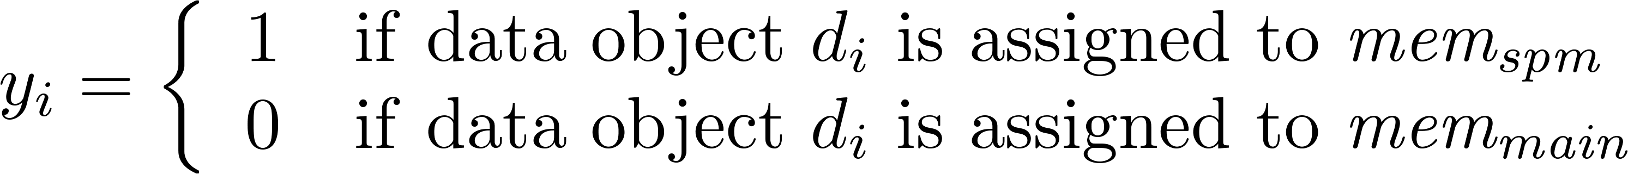
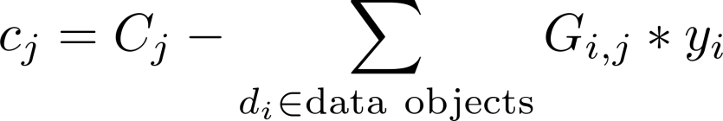
Decision Variables & Costs
Binary decision variables per data object:
Costs of basic block b_{j}:
c_{j} models the WCET_{EST} of b_{j}, depending on whether the data objects accessed by b_{j} are allocated to main memory or SPM, resp.
C_{j}: b_{j}’s WCET_{EST} if all data objects reside in main memory
G_{i,j}: WCET reduction of b_{j} if data object d_{i} is assigned to SPM

Slide 65
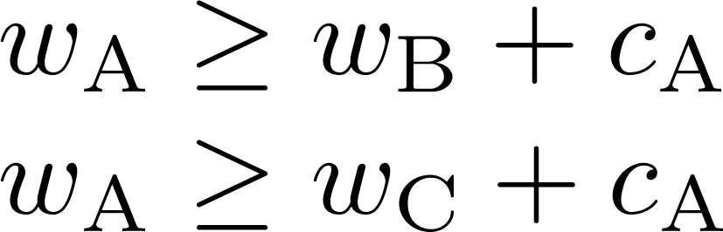

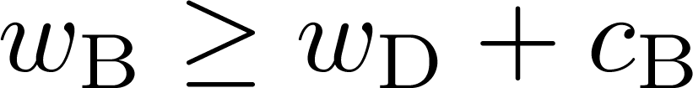





Intraprocedural Control Flow (1)
[V. Suhendra et al. WCET Centric Data Allocation to Scratchpad Memory. RTSS, Miami, 2005]
Modeling of a function’s control flow:
Acyclic sub-graphs:
(Reducible) Loops:
A
F
Treat body of inner-
most loop like acyclic sub-graph
Fold loop
Costs of :
Continue with next innermost loop
B
C
G
Loop L
G, H, I
D
H
E
I
J
= WCET of longest path
starting at A

Slide 66
Intraprocedural Control Flow (2)
Modeling of a function’s control flow:
  For sink nodes b_{j} of an acyclic sub-graph, w_{j} is set to the costs c_{j}
  For all other nodes b_{j} of an acyclic sub-graph, the WCET of the paths starting in b_{j} must be greater or equal than the WCET of each successor b_{succ}, PLUS the costs c_{j} of b_{j}
  For each successor b_{succ} of b_{j}, one constraint is created in the ILP
  Variable w_{j} actually models all paths starting in b_{j}. Due to the ≥ operator in the inequations, the maximum over all paths starting in w_{j} is modeled
  Potential changes of the WCEP from one successor b_{succ1} to another successor b_{succ2} of b_{j} are considered by construction

Slide 67
Intraprocedural Control Flow (3)
Modeling of a function’s control flow:
  Reducible loops L have exactly one entry basic block b^{L}_{entry}
  By “ignoring” of the back-edge of a reducible loop L, the CFG of the loop body becomes acyclic
  Create constraints for acyclic loop body as shown on slide 65 (left part)
  Variable w^{L}_{entry} models WCET_{EST} of the entire body of loop L if it is executed exactly once
  Multiplication of w^{L}_{entry} by the maximal number C^{L}_{max} of iterations of L provides WCET_{EST} for all executions of the loop
  Costs of L are equal to the WCET_{EST} of L for all executions

Slide 68





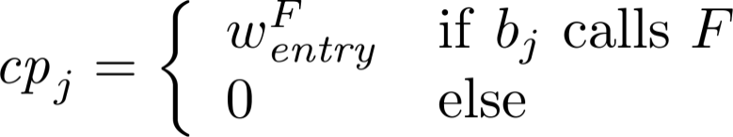
Interprocedural Control Flow
Modeling function calls:
  Each function has dedicated entry BB
  Variable models WCET_{EST} of the longest path in that starts in
  models WCET_{EST} of for exactly 1 execution of
  If calls function : Add to WCET_{EST} of
Function calls in basic block :
  “Call penalty” for
  calling basic block:
  ILP constraint
  per basic block:

Slide 69
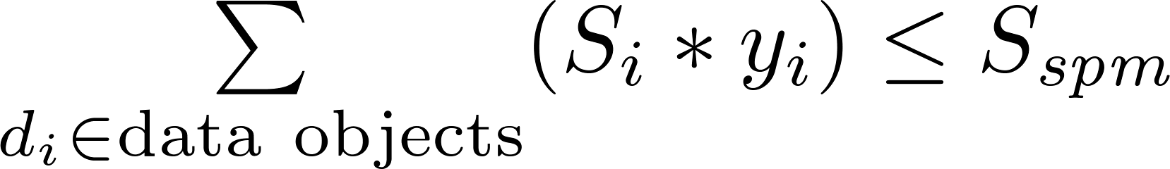

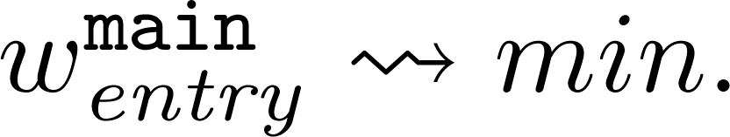
Scratchpad Capacity and Objective Function
Scratchpad capacity constraint:
The sum of the sizes of all data objects allocated onto the SPM is less than or equal to the totally available SPM capacity.
Objective function:
  models WCET_{EST} of if is executed exactly once
  Variable models WCET_{EST} of the entire program
  .
[F. Rotthowe. Scratchpad Allocation of Data for Worst-Case Execution Time Minimization (in German). Diploma Thesis, TU Dortmund, 2008]

Slide 70
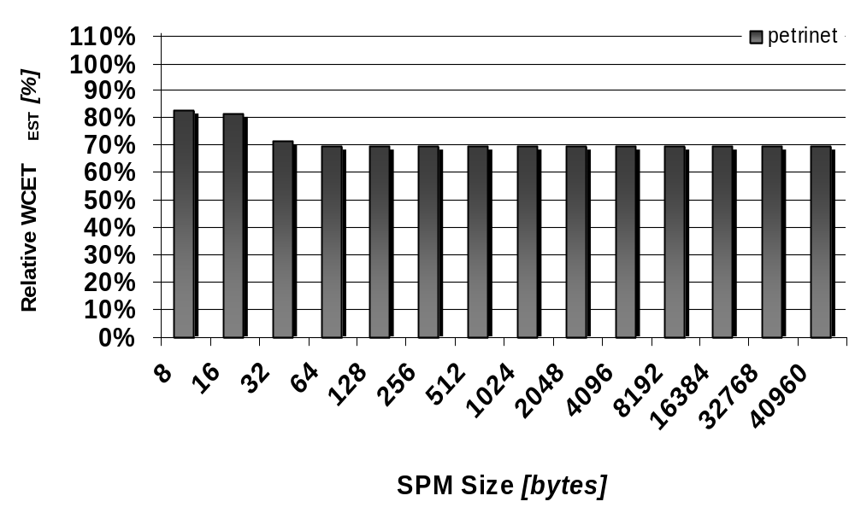
Rel. WCET_{EST} after D-SPM Allocation of petrinet
Notable WCET_{EST} reductions already for SPMs of only a few bytes
6 global variables of 72 bytes size in total
WCET_{EST} reductions by 28.6% for 32 bytes SPM
X-Axis: Absolute SPM sizes
Y-Axis: 100% = WCET_{EST} when not using SPM at all

Slide 71
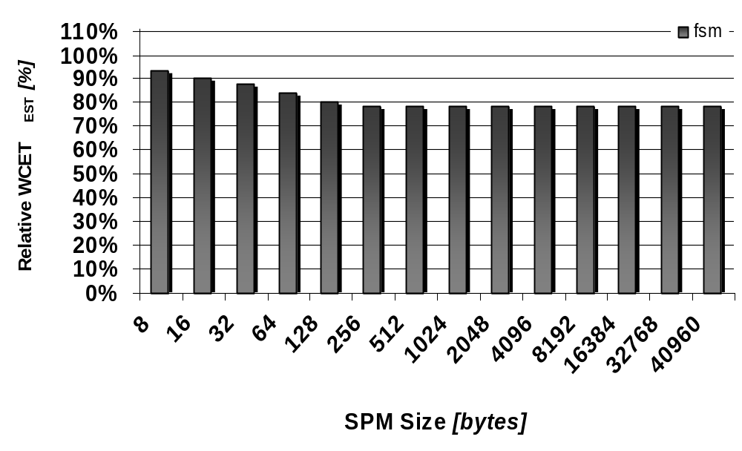
Rel. WCET_{EST} after D-SPM Allocation of fsm
More steady WCET_{EST} reductions for increasing SPM sizes
98 global variables à 4 bytes size each
WCET_{EST} reductions by 21.4% for 256 bytes SPM
X-Axis: Absolute SPM sizes
Y-Axis: 100% = WCET_{EST} when not using SPM at all

Slide 72
Rel. WCET_{EST} after D-SPM Allocation of 14 Benchmarks
Steady WCET_{EST} reductions for increasing SPM sizes
WCET_{EST} reductions from 2.7% – 20.6%
X-Axis: Absolute SPM sizes
Y-Axis: 100% = WCET_{EST} when not using SPM at all

Slide 73
ILP for WCET-aware SPM Allocation of Code
Goal
Determine set of basic blocks to be allocated to the SPM
such that selected basic blocks lead to overall minimization of WCET_{EST}
under consideration of switching WCEPs.
Approach
Integer-linear programming (ILP)
Optimality of results
Notation: Upper-case letters ≅ constants,
lower-case letters ≅ variables

Slide 74
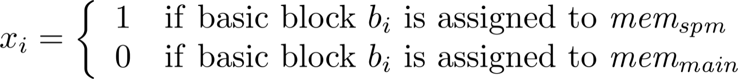


Decision Variables & Costs
Binary decision variables per basic block:
Costs of basic block b_{i}:
models the WCET_{EST} of if it is allocated to main memory or SPM, resp.
Modeling of the intraprocedural control flow:
As before in the WCET-aware SPM allocation of data

Slide 75
Cross-Memory Jumps
Allocation of consecutive basic blocks:
  Allocation of consecutive basic blocks in the CFG to different memories requires adaption/insertion of dedicated jumping code
  Cross-memory jumps are costly: Often need more than 1 instruction
  Jumping code: Variable overhead in terms of WCET_{EST} and code size, depending on decision variables ( cf. chapter 7)
Jump Scenarios:
b_{i}
b_{i}
b_{i}
b_{j}
b_{k}
b_{k}
b_{j}
b_{j}
a) Implicit
b) Unconditional
c) Conditional

Slide 76





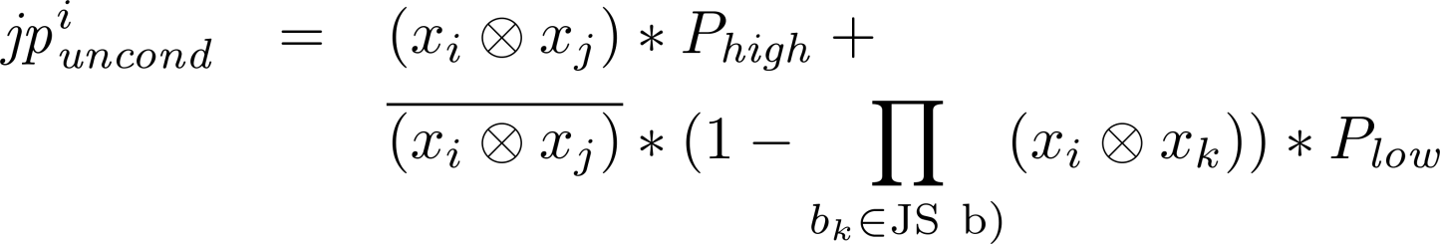
Penalties for Cross-Memory Jumps
Jump Penalty (⊗ ≅ Boolean XOR):
  Penalty for implicit jumps:
  High penalty if basic blocks i and j are placed in different memories
  Penalty for unconditional jumps:
    If b_{i} and b_{j} in different memories:
    If b_{i} and b_{j} adjacent in same memory: 0
    If b_{i} and b_{j} not adjacent in same memory:
  Conditional jumps: Obvious combination of and
b_{i}
b_{k}
b_{j}
b_{j}
b_{j}
b_{k}

Slide 77
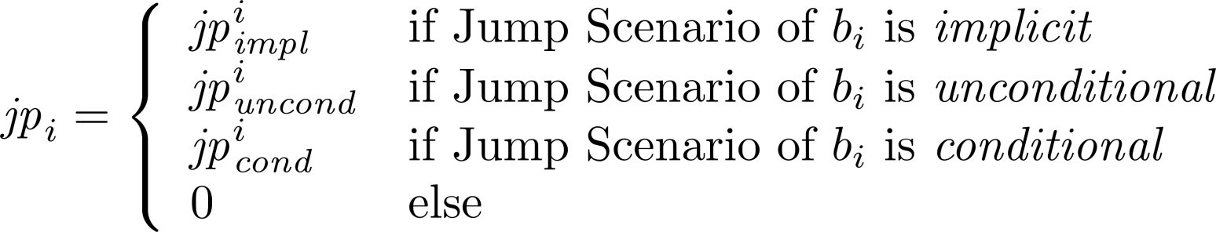
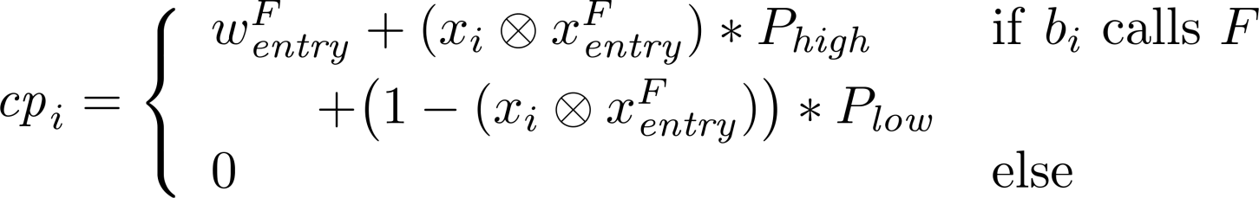

Jump Penalties and Interprocedural Control Flow
Jump penalties for basic block b_{i}:
Penalty for function calls for basic block b_{i}:
If block calls function : Add WCET_{EST} of to WCET_{EST} of
. Furthermore, add if function call is cross-memory call. If function call stays in the same memory, add only .

Slide 78
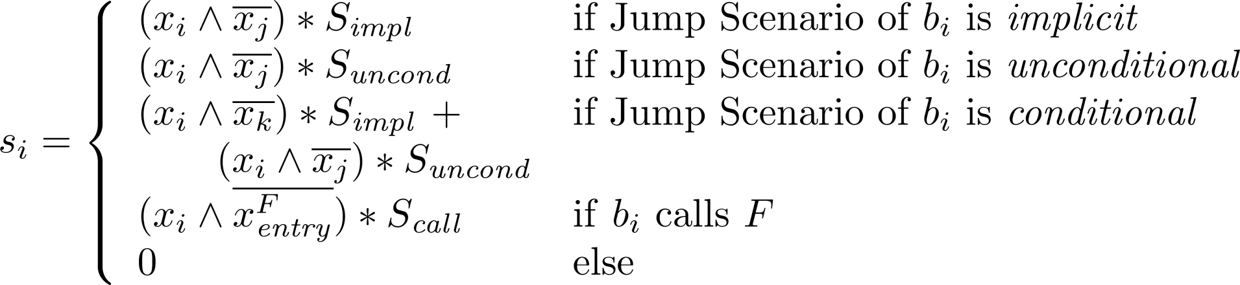
Sizes of Basic Blocks
Constraint for all successors b_{succ} of b_{i}:
Size of a basic block b_{i}:
  Size of b_{i} depends on actual jumping code for b_{i}
  Size of jumping code of b_{i} depends on jump scenario:
  Total size of basic block b_{i}:
  Size S_{i} of b_{i} without any jumping code plus
  Size s_{i} of b_{i}’s jumping code

Slide 79
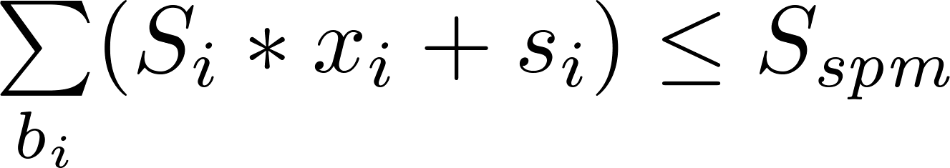
Scratchpad Capacity and Objective Function
Scratchpad capacity constraint:
The sum of the sizes of all basic blocks allocated onto the SPM without jumping code, plus the size of jumping code in b_{i} is less than or equal to the totally available SPM capacity.
Objective function:
[H. Falk, J. C. Kleinsorge. Optimal Static WCET-aware Scratchpad Allocation of Program Code. DAC, San Francisco, 2009]

Slide 80
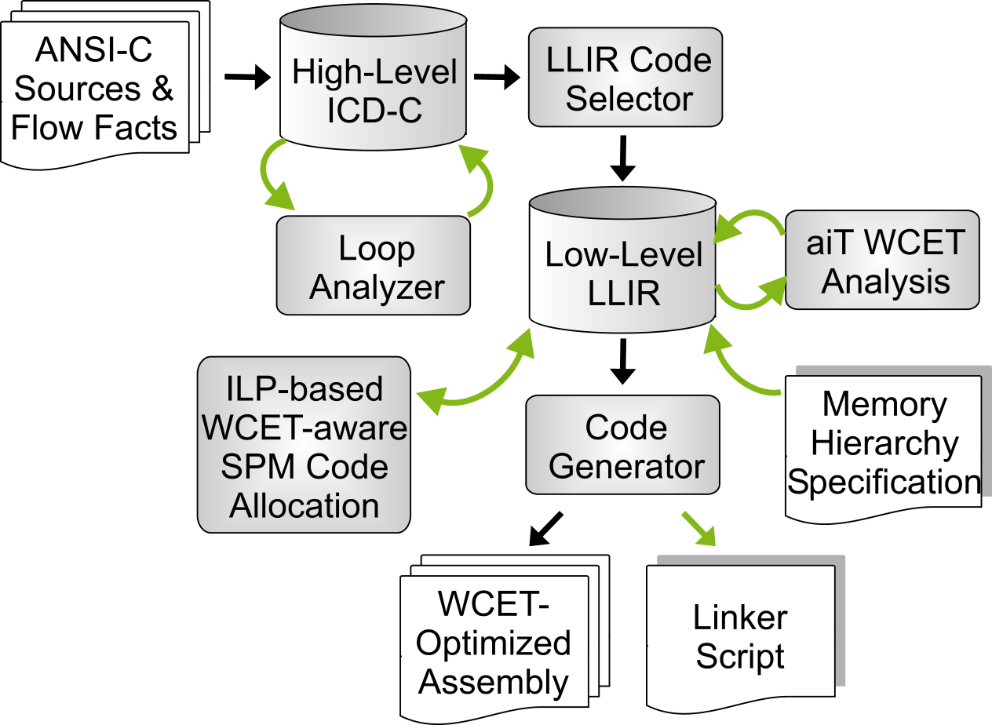







Determination of the Constants of the ILPs (1)
WCET_{EST} of BB
b_{i} for SPM and main memory:
,
Max. iteration count of loop L:
Size of BB b_{i}:
Other parameters hard-coded:
, , …
SPM size = 47 kB
SPM access = 1 cycle
Flash access = 6 cycles

Slide 81




Determination of the Constants of the ILPs (2)
WCET_{EST} , per basic block for both memories:
Determined by two WCET analyses, one in which all basic blocks lie in the SPM, one with all blocks in main memory.
Max. iteration count of loops :
Either annotated in the source code using flow facts, or determined by WCC’s automatic loop bound analysis.
Size of a basic block without jumping code:
By simple enumeration of all LIR operations
Size of the scratchpad:
Taken from WCC’s memory hierarchy specifications
Remaining parameters determined experimentally:
= 16 = 8
= = 10 = 12

Slide 82
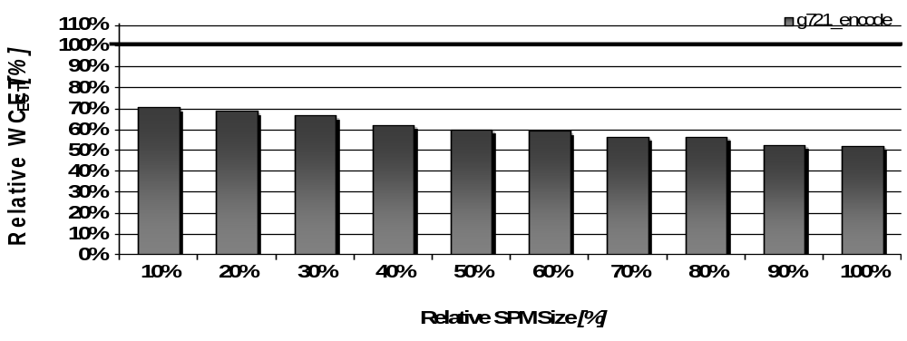
Rel. WCET_{EST} after P-SPM Allocation of g721_encode
Steady WCET_{EST} decreases for increasing SPM sizes
WCET_{EST} reductions from 29% – 48%
X-Axis: SPM size = x% of benchmark’s code size
Y-Axis: 100% = WCET_{EST} when not using SPM at all

Slide 83
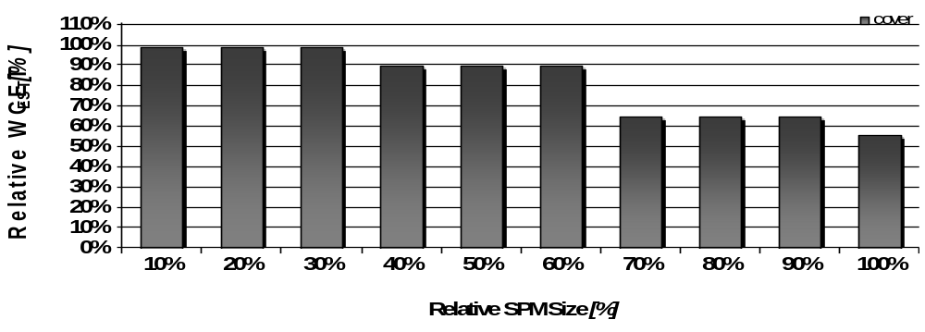
Rel. WCET_{EST} after P-SPM Allocation of cover
Stepwise WCET_{EST} decreases: Useful content allocated to SPM only at 40%, 70% and 100% relative SPM size
WCET_{EST} reductions of 10%, 35% and 44%
X-Axis: SPM size = x% of benchmark’s code size
Y-Axis: 100% = WCET_{EST} when not using SPM at all

Slide 84
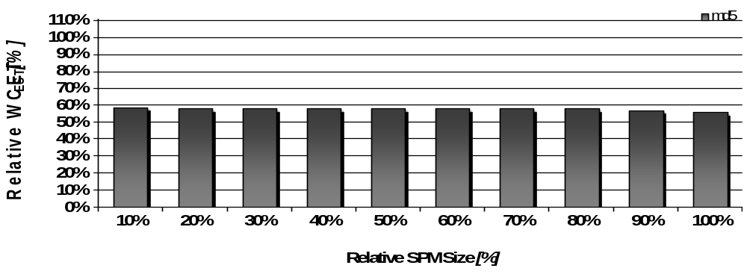
Rel. WCET_{EST} after P-SPM Allocation of md5
Almost invariable WCET_{EST} reductions for all SPM sizes: 40% - 44%
ILP clearly finds tiny but time-critical hot-spot of md5 and allocates it to SPM
X-Axis: SPM size = x% of benchmark’s code size
Y-Axis: 100% = WCET_{EST} when not using SPM at all

Slide 85
Rel. WCET_{EST} after P-SPM Allocation of 73 Benchmarks
Steady WCET_{EST} reductions for increasing SPM sizes
WCET_{EST} reductions from 8% – 41%
X-Axis: SPM size = x% of benchmark’s code size
Y-Axis: 100% = WCET_{EST} when not using SPM at all

Slide 86
Conclusions
Comparison with Consequences for WCET_{EST} Optimizations
WCET-aware optimizations...
... mandatorily need detailed knowledge of the WCEP
SPM allocations consider the WCEP
... always have to be aware that the WCEP can change after each individual optimization decision
SPM allocations inherently capture WCEP changes inside the ILP
... should take the decision where to optimize something not only based on local information, but should always consider the global effects of an optimization decision
Objective functions of the ILPs model the global WCET of a program that is subject to minimization.

Slide 87
References
WCC Compiler Infrastructure
H. Falk, P. Lokuciejewski. A compiler framework for the reduction of worst-case execution times. Springer Real-Time Systems 46(2), October 2010.

Slide 88
Summary
Compilers for WCET_{EST} Minimization
Integration of a formal WCET timing model into compiler
Challenge: To consider unstable WCEPs in the course of optimizations
WCET-aware Optimizations
Procedure Cloning & Positioning: Greedy heuristics that determine current WCEP via repeated WCET analyses
Register allocation: cyclic dependencies between register allocation and WCET analysis; graph coloring along the always current WCEP
Scratchpad allocations: Inherent modelling of WCEP in the ILPs; eliminates need for repeated WCET analyses during optimization

