Slide 1
Regaining
Audience
Attention
What does the largest mammal in the world have in common with an audience’s attention?
Notes:
Harshita

Slide 2
Emphasize Important Points
Presentation should not be polluted with small details
Easier to concentrate on the main message
Notes:
Harshita

Slide 3
The Elephant Figure Trick
Introducing a (seemingly) random object or action
Could be unrelated

Slide 4
Count the passes of the players in the white shirts!
Notes:
Michael

Slide 5
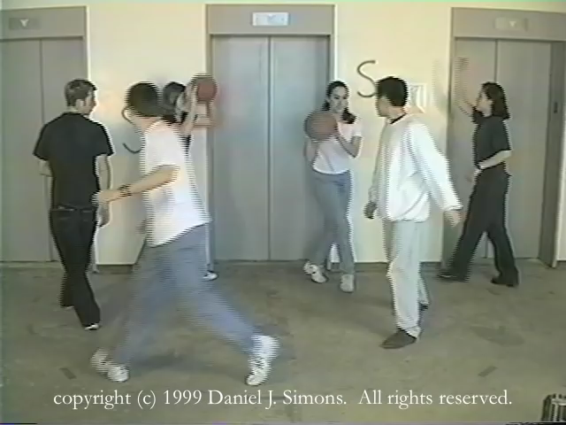

Slide 6
How many did you count?
Notes:
Cheng Wei

Slide 7
The Audience Vote Trick
Include audience in the presentation
Session becomes more interactive

Slide 8
The Video Trick
Live content requires more attention
Counting the number of passes was not important!
How many of you saw the monkey?
Notes:
Michael then Harsha

Slide 9
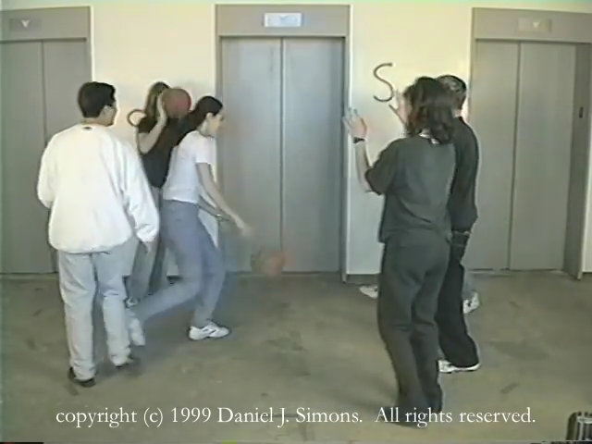

Slide 10
The Reference to the Past Trick
Talk about a cue from earlier
Observe content from a new perspective

Slide 11
The Curiosity Question Trick
Come back to the question from the start
Usually related to a conclusion
(But ours is just irrelevant)

Slide 12
Thanks for your Attention
Notes:
Cheng Wei

