Slide 1

.NET
A JSON:API consumer of the Stud.IP API for .NET applications
https://studip.cnml.de/

Slide 2
Project Goals
Provide an API interface for Stud.IP interactions
Retrieve Stud.IP files and folders
Long-Term: Provide a network VFS of Stud.IP folder structure

Slide 3
Software Architecture
Stud.IP
JSON:API
UI Frontend
API Interface
.NET Wrapper

Slide 4
Exposed File API
Physical File
/files
File Reference
/file-refs
Folder
/folders
More
Folders
/folders/{id}
Course
/courses
Flat folder structure
Add virtual API endpoint
Translate from relational to recursive

Slide 5



Library Use Cases
Virtual File Synchronization
Event Hooks
Calendar Synchronization

Slide 6
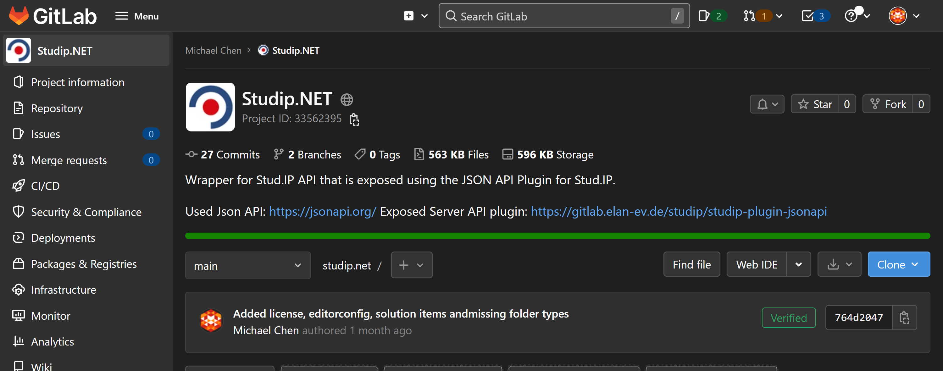
https://studip.cnml.de/
Project URL

