Slide 1
Security Requirements Engineering
Riccardo Scandariato
Institute of Software Security, TUHH, Germany
ric***do . scanda***to @ tuhh.de
Master Course “Secure Software Engineering”
Summer Semester 2022

Slide 2
Learning objectives
What are security goals and security requirements ?
Reading material about goals and requirements
Charles Haley, Robin Laney, Jonathan Moffett, Bashar Nuseibeh, Security Requirements Engineering: A Framework for Representation and Analysis," Transactions on Software Engineering, 2008
How to elicit security requirements with MUCs ?
Reading material about MUCs
Guttorm Sindre, Andreas Opdahl, Eliciting security requirements with misuse case, Requirements Engineering 10(1), 2005
How to prioritize security requirements ?

Slide 3
Software Requirements
Requirements:
Descriptions of what a system should do in terms of the services it must provide and constraints on its operation [Somerville 2011].
Conditions or capabilities the system must meet to satisfy a contract, standard, specification, or other formally imposed documents [IEEE].
Reflect the needs of different stakeholders (clients, customers, and end-users) for a system that must serve a certain purpose.
Requirements Engineering:
The process of capturing, analyzing, documenting and checking system requirements.
It is critical to the success of any major development project.

Slide 4
Functional and Non-Functional Requirements
Software system requirements can be classified into functional and non-functional:
Functional: Statements of what services the system should provide, how should it react to certain inputs, and how should it behave in specific situations.
  “The system shall be able to search the students for all lectures”.
  “The system shall generate a list of students attending to an exam”.
Non-Functional: Define constraints on the services or functions offered by a system
  Often referred as quality attributes.
  Examples: USABILITY, RELIABILITY, SAFETY, and SECURITY

Slide 5
Non-Functional Requirements
Non-functional requirements often apply to the system as a “whole” rather than individual features or services
  The system shall limit the access to specific authorized users (security)
A single non-functional requirement may generate many related functional requirements and restrict existing ones
Unlike functional requirements, non-functional ones are difficult to relate to individual system components (cross-cuttingness)
Non-functional requirements may affect the overall architecture of a system rather than its individual components
Non-functional requirements are often more critical than individual functional requirements!

Slide 6
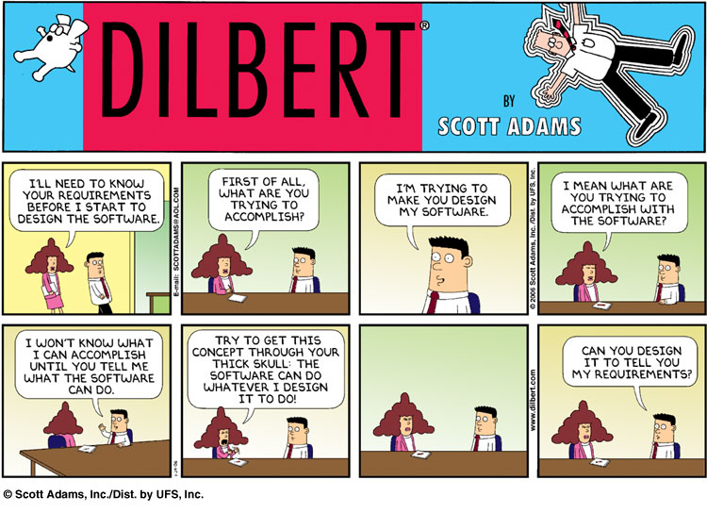
Sources of Security Flaws (i)

Slide 7
Ambiguous and Incomplete Requirements
Typical problems of requirement engineering:
Not including all relevant stakeholders at the elicitation phase.
Restrict the analysis to functional requirements only.
Lack of systematic and structured methodology.
Negative consequences:
Ambiguous requirements can lead to multiple interpretations that do not meet the stakeholder’s expectations.
Incomplete requirements can introduce delays and increase costs.
Imprecision in the specification of requirements is the cause of many software engineering problems including security flaws.

Slide 8
In case of security
Incomplete asset analysis (information, functionality)
  E.g., failing to identify the sensitivity of login data
Incomplete understanding and assessment of the threat/attack landscape
  E.g., not being aware of phishing attacks
Incomplete, wrong, weak selection of security countermeasures
  E.g., not specifying a two-factor authentication

Slide 9
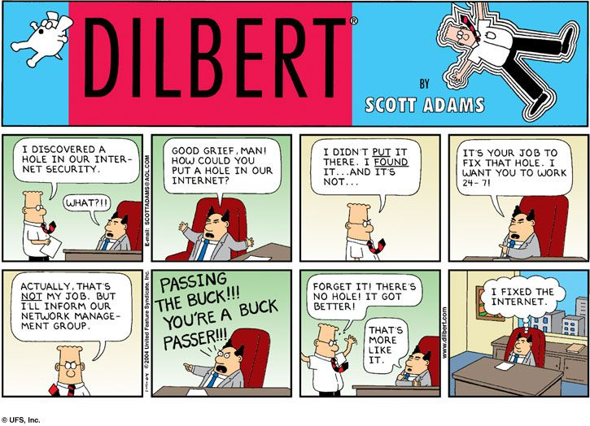
Sources of Security Flaws (ii)

Slide 10
Technical Debt and Security Debt
Compromising quality aspects of a software project can be seen as “borrowing money thinking you never have to pay it back”.
When not paid back promptly, interests on the debt can compromise the whole revenue of the project.
The term Technical Debt is used to describe the structural, long-term problems of software products caused by quality compromises.
Security Debt: A technical debt that entails a security risk.
Security work is generally under-prioritized (strict production deadlines).
Features and functionality, dubbed as “customer value”, are pushed for as early release as possible.
Security benefits are difficult to demonstrate and costs hard to justify.
Notes:
https://www.synopsys.com/blogs/software-security/security-debt/

Slide 11
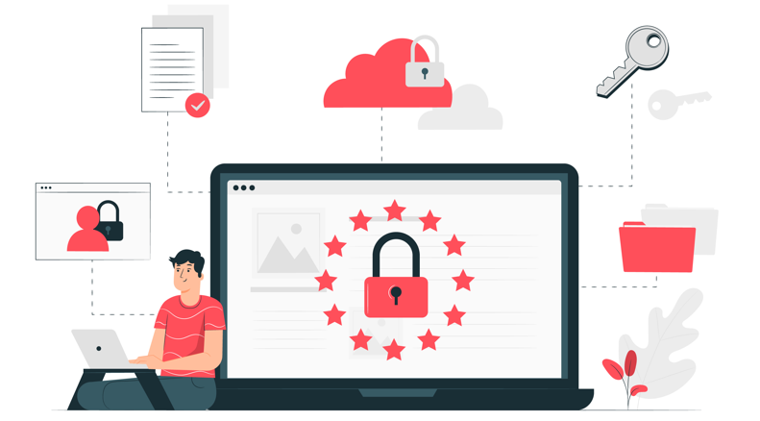
Security-by-design
Security should not be an “after though”, but an integral part of a software development project.
In order to systematically develop secure solutions, security must be emphasized throughout the whole software lifecycle.
  Security considerations should be integrated into the early stages of the development life cycle (i.e., the requirements phase).

Slide 12
Step 1. Assets and security goals

Slide 13
Assets
Technical assets are information (e.g., credit card data) or functionality (e.g., logging component) of value that must be properly protected
Assets can also live in the physical world (hw, sensors, devices). This is becoming more and more important in IoT and CPS
  IoT – Internet of Things
  CPS – Cyber-physical systems
Assets can also be non-technical (e.g, reputation, employees time, revenue from service)
Stakeholders
Attacker
Asset
value
interested in

Slide 14
Asset analysis
Identifying the assets in a system
  E.g., looking at business goals (white hat)
  However, attacker has interest too (black hat)
  Challenge: overlooking why things might be of interest to an attacker (e.g., in the case of privacy)
Assessing the value to us ($$$) in case they are compromised
(useful in risk assessment)
  Usually non-problematic for technical assets
Assessing the reason why they are valuable
(leading to goals)

Slide 15
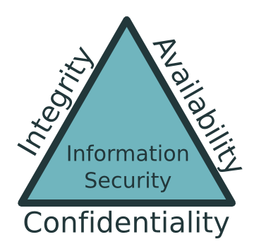
Security concern: CIA+
ISO/IEC 7498-2: Information Processing Systems - Open Systems Interconnection - Basic Reference Model - Part 2: Security Architecture
Confidentiality (C): Protection against unauthorized disclosure of stored, processed, or transferred information.
Integrity (I): Ensure the authenticity (e.g. origin/source) and accuracy of information. It entails restrictions for unauthorized data modification.
Availability (A): Ensure the access (for authorized parties) to the data, resources and services necessary for the proper functioning of the system
Access Control: only legitimate access is permitted (goal or mechanism?)
Accountability (& non-repudiation): prove that an entity was involved in some event
  Accountability: Ensure the recording of security relevant events and the user identities associated with these events
  Non-repudiation: Provide unforgeable evidence that a specific action occurred (e.g., sending and receiving a message)
+ Authenticity (not in the standard)
Notes:
Authenticity
Entity
Origin

Slide 16
Security goals
Concerns are abstract (taxonomical value)
Goals represent the perceived specific needs of one or more stakeholders
Security goals (primarily) entail the protection of an asset against a harm
  ACCIDENTAL HARM → SAFETY
  INTENTIONAL HARM → SECURITY
Application Business Goal
harms
Threat
elicited from
Asset
(Info or Svc)
value
Control principles
Security Goal
Stakeholders
mandated by

Slide 17
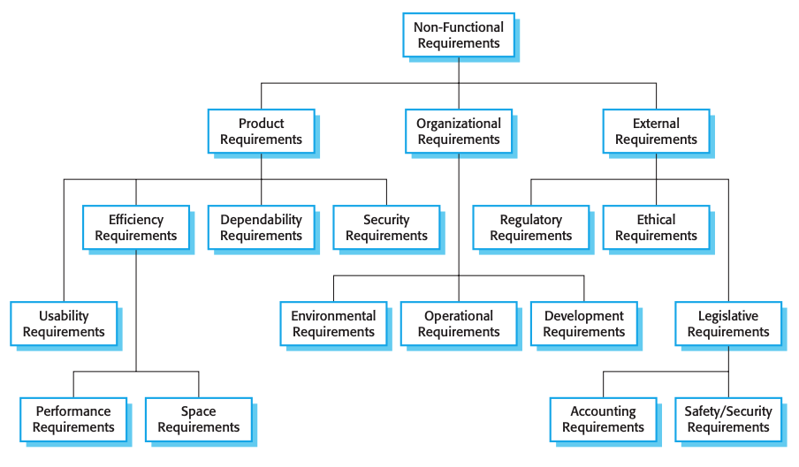
Non-Functional Requirements Revisited

Slide 18
Elicitation of security goals (i)
Sources of security requirements: the product (internal sources)
Security goals/requirements are dependent on business goals
  E.g., define those privileges that are needed for the application, then exclude those privileges that are not needed
Elicitation by conducting a harm analysis
CIA+ concerns
In general, harms can be recognized by negating security concerns →
“What harm could come to [asset here] from an action violating [concern here]?”
Security goals as “avoid” goals
“Avoid” goals can be expressed as a triple {action, asset, harm}
where action(s) on the asset(s) listed in threat descriptions should be avoided

Slide 19
Elicitation of security goals (ii)
Sources of security requirements: the product environment (extrernal sources)
Security goals may have been set elsewhere, especially when assets are covered by organization-wide policies
Generated by applying the management principles to the assets and business goals of the system
Apply globally throughout an organization
Provide constraints that would otherwise have to be derived repeatedly for each security risk analysis!
The result is a collection of “achieve” security goals such as “achieve separation of duties when paying invoices” or “audit all uses of account information”

Slide 20
Elicitation of security goals (ii) - Examples
Company policies
  E.g., “no administrative rights to employees”
  “audit all uses of account information”
  “achieve Separation of Duties when paying invoices”
Regulations and laws
  E.g., GDPR, compliance to HIPAA, etc.
Business rules
  E.g., registered user versus paying user

Slide 21
Step 2. concrete requirements

Slide 22
Goals, requirements, architecture
Goal (WHY): Something that any stakeholder wishes to achieve
Conflicts are possible and must be solved!
Requirement (WHAT): A detailed (i.e., more concrete) commitment for the system-to-be (e.g., behaviours and constraints)
They must be realistic → achievable and verifiable
Architecture (HOW): A description of the means needed for achieving the requirements, in terms of a configuration of interacting components
Strict separation not possible
(Twin Peaks → T. Heyman, et al.,
The security twin peaks, ESSoS, 2011)

Slide 23
Operatonalization of goals into requirements
Goal
Application Business Goal
elicited from
Asset
derived from
Security Goal
mandated by
Control principles
Req
operationalizes
operationalizes
Functional req
Constraint
How can we operationalize ???
Security Req
constraints

Slide 24
Operationalization of security
Why
What
How
Security concerns
Security solutions
Confidentiality
[Sym/asym] Cryptography
Security requirements
[RBAC/ABAC] Authentication
Integrity
[Token-based] Authorization
Availability
[White-list] Input Validation
Accountability and non-repudiation
Auditing
Monitoring
Authenticity
Sandboxing/Partitioning…

Slide 25
Reality check
Requirements often contain solution-oriented mechanisms (security building blocks, or even security solutions)
“Messages exchanged between A and B should be …”
  Confidential
  Encrypted with symmetric encryption
  Ecrypted with AES 256
Useful? Maybe too close to the goal
Too detailed ?

Slide 26
Type of security requirements
Study at home
Constraints
(on existing operation)
Obligations
(i.e., additional things to before/after operation)

Slide 27
Type of security requirements
Study at home
Simple constraint
  Predicates on the parameters of the operation, its originator and source
  “The system shall not provide Personnel Information except to members of Human Resources Department”
Temporal constraints
  “The system shall not provide Personnel Information outside normal office hours”
Complex constraints on traces
  “The system shall not provide information about an organization to any person who has previously accessed information about a competitor organization (the Chinese Wall Security Policy)”

Slide 28
Type of security requirements
Study at home
Constraint on response time (availability)
  “The system shall provide Personnel Information within 1 minute for 99% of requests”
This differs only in magnitude from a performance goal, which might use the same format to require a sub-second response time
  “Response always within milliseconds” vs “Degradation accepted and response within a minute at worse”

Slide 29
Type of security requirements
Study at home
Obligations (e.g., for auditability)
  “Invocation of a function should be logged securely before execution starts”

Slide 30
Security requirements revisited
Only for your info
Constraint-like* security requirements are preventative measures
  I.e., avoid attack altogether
What about mitigation** techniques?
  I.e., monitor for attack and take reactive actions
  It’s a relaxed (less stringent) version of the requirement due to feasibility reasons (technical, money)
* But remember, we have obligations too
** Mitigation: not avoiding the risk, but rather dealing with the aftermath
More about mitigation strategies when we talk about design

Slide 31

Share your opinion
Security Goal
operationalizes
How can we operationalize ???
Security Req
Notes:
34 63 80 0

Slide 32
How to discover security requirements ?

Slide 33
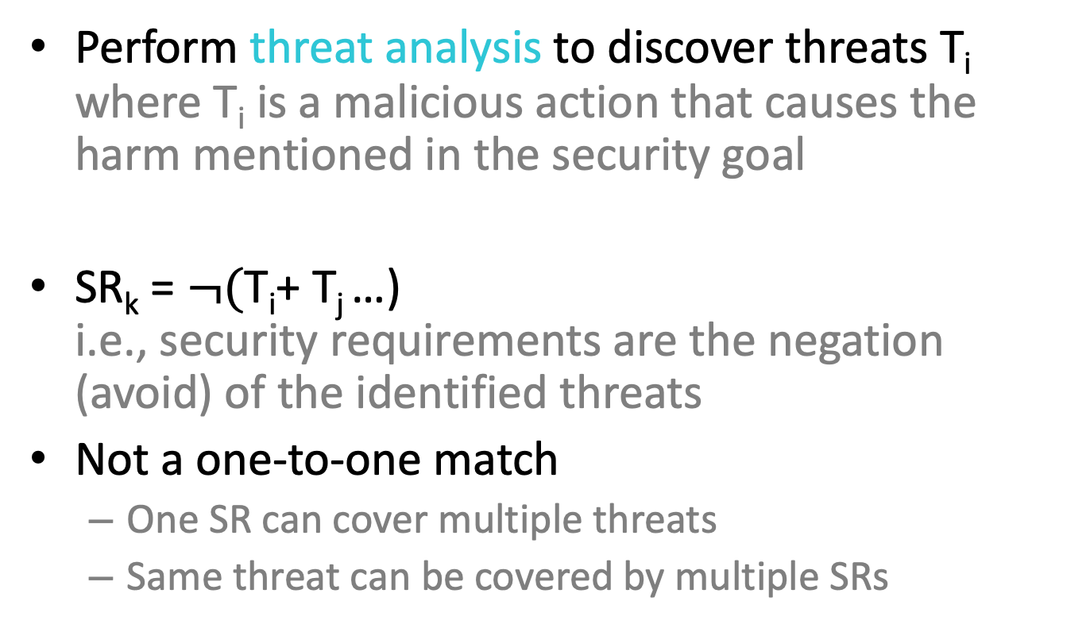
Approach
More on
threat analysis in upcoming lecture
Perform threat analysis to discover threats T_{i}
where T_{i} is a malicious action that causes the harm mentioned in the security goal
SR_{k} = $¬($T_{i}+ T_{j} …)
i.e., security requirements are the negation (avoid) of the identified threats
Not a one-to-one match
  One SR can cover multiple threats
  Same threat can be covered by multiple SRs

Slide 34
Harms, threats
Harm refers to the impact
  Attacker-neutral (mostly)
Threat refers to the causes
  Attacker-based (e.g. insider or outsider)
Attacker model
Intensions, Motivation, means
Difficulty
LIKELIHOOD
Requirements
Design
Implementation
Configuration
has
has
Attacker
poses
Threat
exploits
Weakness
FEASIBILITY
(i.e., assumptions)
harms
Loss of CIA+
Stakeholders
value
Asset
IMPACT

Slide 35
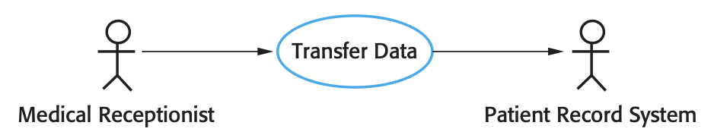
Misuse Cases
Way of performing threat analysis (at requirements level) by anticipating abnormal behaviour and deriving security requirements
Misuse Cases: They represent actions that systems should prevent
  Extension/adaptation of use-cases and the corresponding notation.
Use Cases: Identify the individual interactions between the system and its users or other systems. Documented through Use Case Diagrams:
  In its simplest form, a use case is shown as an ellipse with the actors involved in the use case represented as stick figures.
Notes:
Assets are things or entities of great value that must be properly secured.

Slide 36
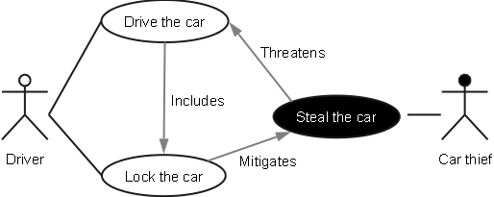
Misuse case (MUC)
A misactor is the inverse of an actor support
  An actor that the system should not
A misuse case is the inverse of a use case
  A misuse case threatens a system functionality, it’s a functionality that the system should not allow
  New functionality is introduced to mitigate the threat
Misactor
Misuse case
3

Slide 37
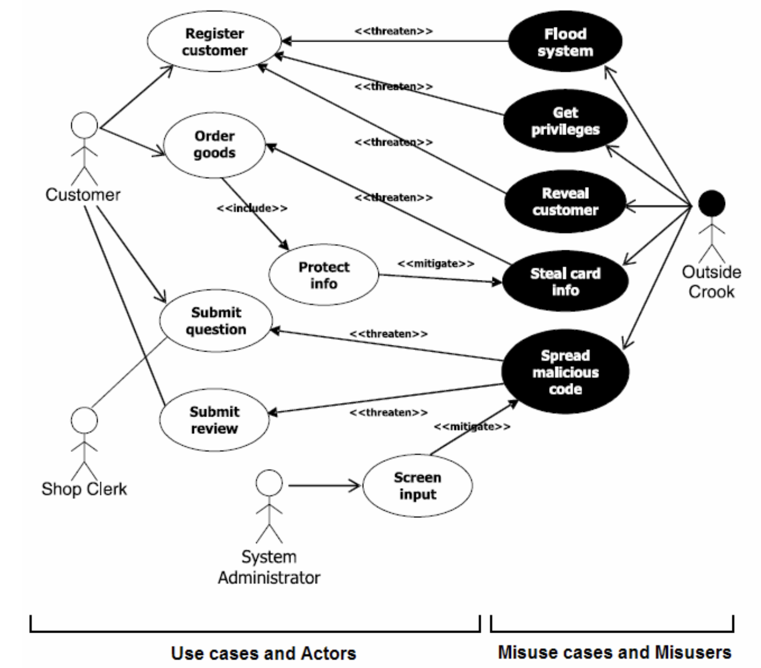
Misuse Cases
"Misuse Case" is an intentional violation of the system by a "Mis-Actor". Misuse Cases analyze user/actor threats to the system.
The association between a misuse case and a use case can
either be a threatens or a mitigates relationship.
Notes:
https://security.stackexchange.com/questions/57053/what-is-the-difference-between-misuse-and-abuse-cases-in-security
"misuse with malicious intent".

Slide 38
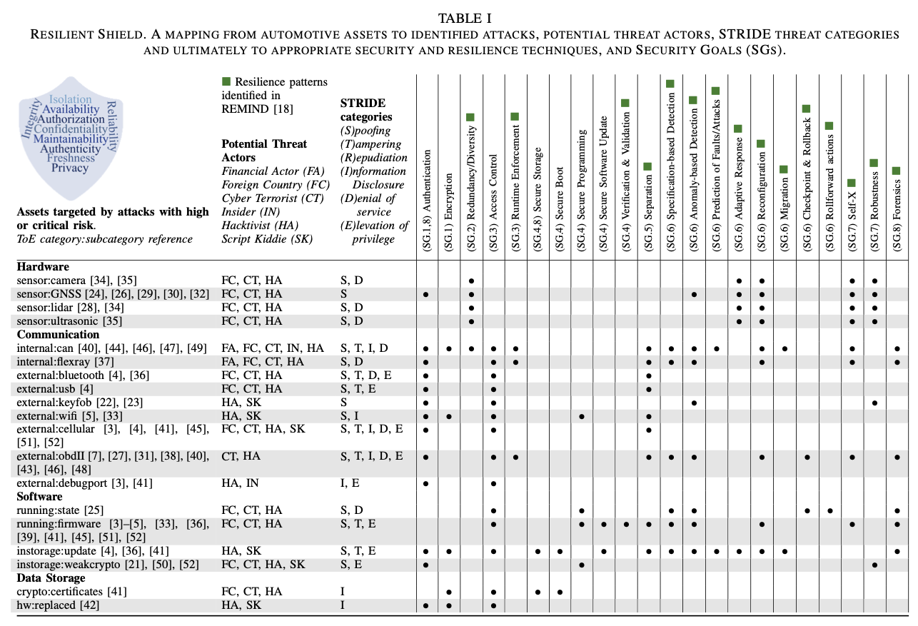
Alternative approach
Requirements
Choose from a menu ;)
(works for specific domains,
(this example is for automotive)
Assets
K. Strandberg, et al., Resilient Shield: Reinforcing the Resilience of Vehicles Against Security Threats

Slide 39

Example question
Study at home
What is the outcome of a threat analysis with MUCs?
Difference between threat analysis with MUCs and with STRIDE?
Can STRIDE threats be uses to derive SRs?
You need to study the lecture on STRIDE first ;)
Notes:
34 63 80 0

Slide 40
How to prioritize security requirements ?
Study at home

Slide 41


How to set priorities?
Study at home
Security requirements linked to threats
If we can attach an rank to the threats, we can prioritize the security requirements
Security Threats
prevent
Security Requirements
require
counter
Security Mechanisms

Slide 42
Ranking via risk assessment
Study at home
Ranking can be obtained via risk assessment
Upcoming lecture ☺

Slide 43
Learning objectives: checkpoint
What are security goals and security requirements ?
  Goal: protection of asset from harm
  Requirement: constraint or obligation to avoid threats
How to elicit security requirements ?
  Via threat analysis (e.g. via MUC)
How to prioritize security requirements ?
  Risk = Impact on assets x Likelihood of threats

