Slide 1
Threat and Risk Analysis
Riccardo Scandariato
Institute of Software Security, TUHH, Germany
ric***do . scanda***to @ tuhh.de
Master Course “Secure Software Engineering”
Summer Semester 2022

Slide 2
Learning objectives
Learning fundamentals/terminology of risk analysis
Introduction to STRIDE
Knowledge repositories of security attacks
Reading material
See project

Slide 3
What is risk?
Definition from ISO 31000 ISO (2018)
„Effect of uncertainty on objectives“
Objectives can have different aspects, and can be applied at different levels
An effect is a deviation from the expected
  Can be positive or negative (or both)
  Can result in opportunities and threats
Risk is usually expressed in terms of risk sources, potential events, their consequences and their likelihood

Slide 4
Key Terminology (for software security)
Asset: something to which a party assigns value and hence for which the party requires protection
Risk: the likelihood of an unwanted incident and its consequence for a specific asset
Threat: a potential cause of an unwanted incident
Unwanted Incident: an event that harms or reduces the value of an asset
Vulnerability: a weakness, flaw or deficiency that opens for, or may be exploited by, a threat to cause harm to or reduce the value of an asset

Slide 5
Risk Management (in secure software engineering)
Risk management is primarily concerned with (i) identifying and (ii) assessing the risks for the software system when in operation
As well as (iii) treating those risks to reduce their impact on the software and its environment
Questions
  (i) What can go wrong?
  (ii) What is the likelihood of it going wrong?
  (ii) What will the damage be?
  (iii) What can we do about it?
Risk management can be applied also to:
security risks for the IT infrastructure
security risks for the software development infrstructure (supply chain),
Etc…

Slide 6
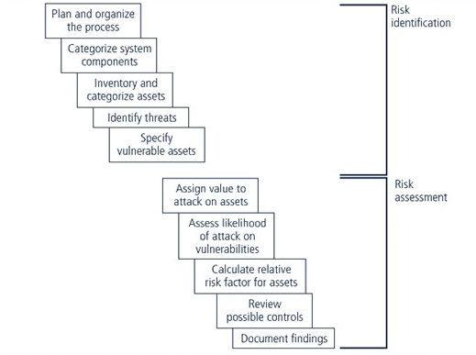
Components of Risk Management
Risk treatment
Whitman, Michael E., and Herbert J. Mattord. "Principles of Information Security." (2007).

Slide 7
Techniques for threat & risk identification

Slide 8
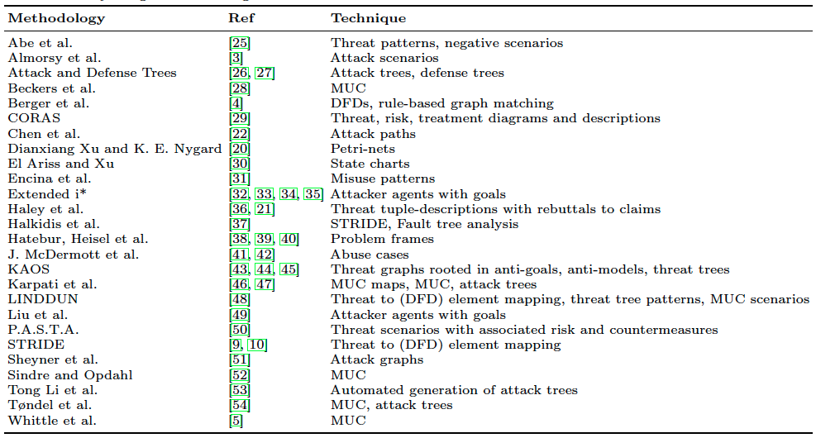
Several TARA techniques available
Katja Tuma, Gul Calikli, Riccardo Scandariato, Threat analysis of software systems: A systematic literature review, Journal of Systems and Software, 2018
38 papers grouped into 26 techniques
3 groups:
Risk centric
Software centric
Attack centric

Slide 9
Risk-centric (e.g., CORAS)
See next lecure
Focus on assets and their value to the organization
Higher-level model of the system (top-level functionality, assets)
Aim at estimating the financial loss for the organization in case of threat occurrence
And finding the appropriate mitigations to minimize it
Method: brainstorming sessions
Assets dictate the priority of elicited security requirements
https://stock.adobe.com/
M. S. Lund, B. Solhaug, K. Stlen, A guided tour of the coras method, in: Model-Driven Risk Analysis, Springer, 2011, pp. 23-43.
Notes:
Drawback: need to costantly update the threat DB

Slide 10
Software-centric (e.g., STRIDE)
Focus is the software system under analysis and its technical organization (components)
Architectural threat analysis
Important to include developers in the analysis for 2 reasons:
  Accurate model of the software
  Developers learn about assets, risk analysis
See later in this lecture
A. Shostack, Threat modeling: Designing for security, John Wiley & Sons, 2014.
Notes:
Drawback: level ob abstraction of the model, and its accuracy

Slide 11
Attack-centric (e.g. Abe et al.)
Focus the analysis around the hostility of the environment
Put emphasis on identifying attacker profiles and attack complexity for exploiting any system vulnerability
Main objectives
  Achieve high threat coverage
  identify appropriate threat migitations
https://stock.adobe.com/
T. Abe, S. Hayashi, M. Saeki, Modeling security threat patterns to derive negative scenarios, 20th Asia-Pacic Software Engineering Conference (APSEC), 2013

Slide 12
RISK & THREAT assessment and prioritization

Slide 13
Risk value (a.k.a. rating)
Goal: attach an importance value to risks
Why: can be used to prioritize risks and decide on treatment
Quantitative & qualitative methods for assessing risk, but in general:
Risk value = f(impact, likelihood)

Slide 14
Threats and risk analysis
ISO/IEC 15408 (Common Criteria)
Attacker model
Intensions, Motivation, means
Difficulty
LIKELIHOOD
Requirements
Design
Implementation
Configuration
has
has
Attacker
poses
Threat
exploits
Weakness
FEASIBILITY
(i.e., assumptions)
harms
Loss of CIA+
IMPACT
Stakeholders
value
Asset

Slide 15
Starting point: Impact and Likelihood
Impact
  How much value to the stakeholder is involved (e.g., loss of assets, harm of system mission, injury of humans)
  Loss of value due to a vulnerability/weakness and the resulting successful compromise
Likelihood
  How hard it is to mount the attack (nature of the weakness and existence and effectiveness of controls)
  How motivated and skillful the attacker is

Slide 16
Quantitative approaches (with examples)
Idea: Decompose risk into “parameters” and use a formula
Ranking with DREAD (from Microsoft)
Ranking → categorizing. E.g., “Threats with overall ratings between 100 and 50 are classified as high risk, between 50 and 10 are classified as medium risk and between 10 and 1 as low risk”
SP-800-30 -- Guide for Conducting Risk Assessments
risk = dp + r + e + a + di
Damage potential (dp)
  If the threat exploit is successful, how much damage will be caused?
Reproducibility (r)
  How easy is it to reproduce the threat exploit? What is the cost to the attacker once he has a working exploit for the problem?
Exploitability (e)
  What is needed to exploit the threat? What is the cost to develop an exploit for the problem?
Affected users (a)
  What users are actually affected if an exploit were to be widely available?
Discoverability (di)
  How easy is it to discover a threat?
Ranking with OCTAVE
risk =
  w_{r}∗ reputation +
  w_{f} * financialloss +
  w_{p}∗ productivity +
  w_{s} ∗ safety +
  w_{l} ∗ legalpenalties +
  w_{o} ∗ others
Focus on impact (probability is optional)
Where is the impact in DREAD?
Notes:
DREAD
The main focus of DREAD, as defined by Microsoft, is prioritization of threats during the development phase of an application.
DREAD defines the five key attributes to measure the criticality of a vulnerability
OWASP gives a more formal definition of the attributes, introduces weights, and gives a different value to each attribute. Risk is defined as the sum of the weighted attributes:
risk = wdp ∗ dp + wr ∗ r + we ∗ e + wa ∗ a + wdi ∗ di
OCTAVE
Impact consists of a selection of at least five weighted parameters:
reputation/customer confidence, financial loss, productivity, safety/health, fines/legal penalties, and self-defined criteria

Slide 17
Reflection: garbage in garbage out?
Subjectivity in the input parameters is still present
Sensitivity of the formula to the input parameters needs to be studied

Slide 18
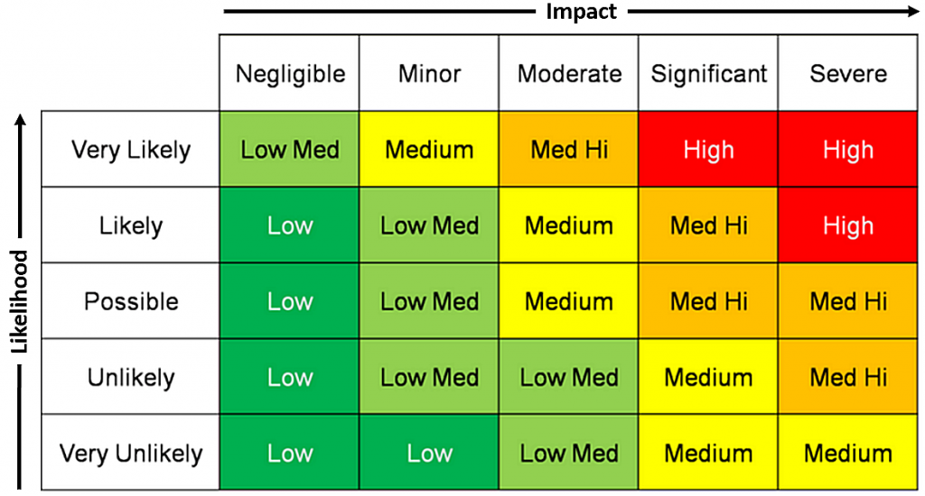
Qualitative methods based on „heat maps“
Risk Assessment Matrix - Example
Damage potential
Risk 2
Risk 1
Likelihood of occurrence
Risk 3

Slide 19
Qualitative Risk Assessment
Study at home
Risk is defined in more subjective and general terms such as high, medium, and low
Qualitative assessments depend more on the expertise, experience, and judgment of those conducting the assessment
Useful to adequately communicate the assessment to the organization’s management

Slide 20
Risk Assessment Matrix
Study at home
A risk assessment matrix or risk control matrix is a tool used during the risk assessment stage. It's used to identify and document the possibility of risks, as well as to assess the possible harm or disruption that such risks could create.
Risk assessment matrix is also a visual depiction of the risk analysis that categorises risks according to their likelihood, impact, and overall severity

Slide 21
Threat analysis with STRIDE

Slide 22
Threat Analysis (a.k.a. Modeling)
Threat Model: Process that reviews the security of any system, identifies problem areas, and determines the risk associated with each area
Threat Modeling is Iterative (continuous)

Slide 23
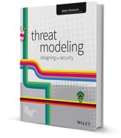
STRIDE
Security threat assessment
Systematic approach for threat identification
Threats are organized into categories, it terms of what attacker is trying to achieve
STRIDE is a mnemonic
  Spoofing (e.g., impersonate legit user)
  Tampering (e.g., defacing web site)
  Repudiation (e.g., it wasn’t me)
  Information disclosure (e.g., Heartbleed)
  Denial of service (e.g., flooding)
  Elevation of privilege (e.g., running as root)
A. Shostack, Threat Modeling : Designing for Security, Wiley 2014

Slide 24
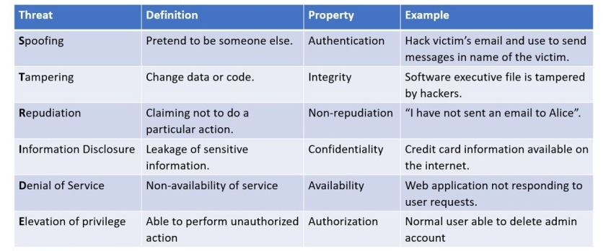
STRIDE categories
Threat ➔ Property ➔ Countermeasure

Slide 25
Methodology
Define users and realistic use scenarios
Gather assumptions
Model the system w/ DFD diagram (assets)
Map STRIDE to DFD element types
Refine threats via threat tree patterns
Document the threats (e.g., as MUCs)
Assign priority via risk analysis (to counter threat explosion problem)
Draft mitigation associated to threats
Model-based
Knowledge-based

Slide 26
Profiling the Application
Where will the application be deployed
DMZ/Internal – complete end to end scenarios
Who will be the Users (Actors)?
Customers, sales agents, public users, administrators, DBAs
What are the Data Elements?
User account data, credit card info, patient information
What rights will the actors have?
Create, Read, Update, Delete
What Technologies will be used?
OS, Web/App Servers, Databases, Architectures (SOA/EJB)
Programming Language?
What security mechanisms applied?

Slide 27
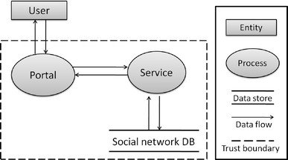
Data Flow Diagram (DFD)
A data-flow diagram is a way of representing a flow of data through a process or a system.
DFDs also provide information about the outputs and inputs of each entity and the process itself.
Shows all relevant steps data goes through
DFD of a Social Network application (1)
Deng, M., Wuyts, K., Scandariato, R., Preneel, B., & Joosen, W. (2011). A privacy threat analysis framework: supporting the elicitation and fulfillment of privacy requirements. Requirements Engineering, 16(1), 3-32.

Slide 28
DFD Elements
Study at home
Process
  A process is a unit of work that operates on the data
Data flow
  A data flow is a named flow of data through a system of processes
Data store
  A data store is a logical repository of data
External entity
  An external agent is a source or destination of data

Slide 29
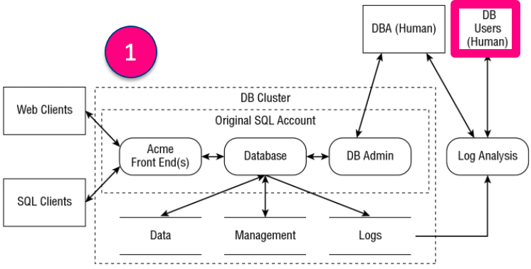

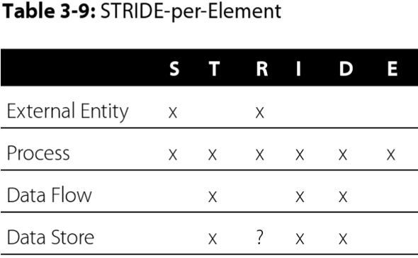
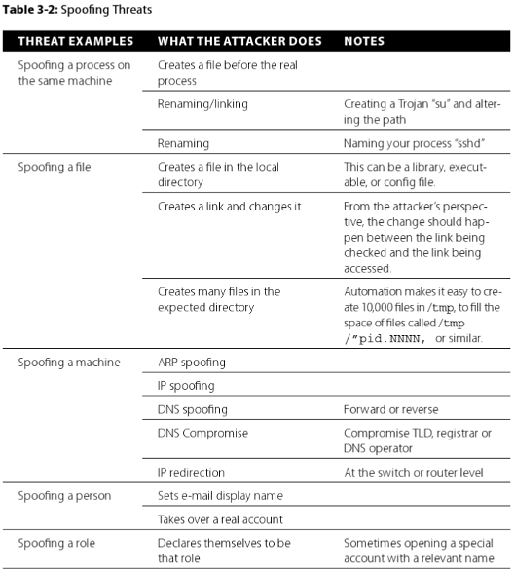

STRIDE in Action
Spoofing Threats

Slide 30
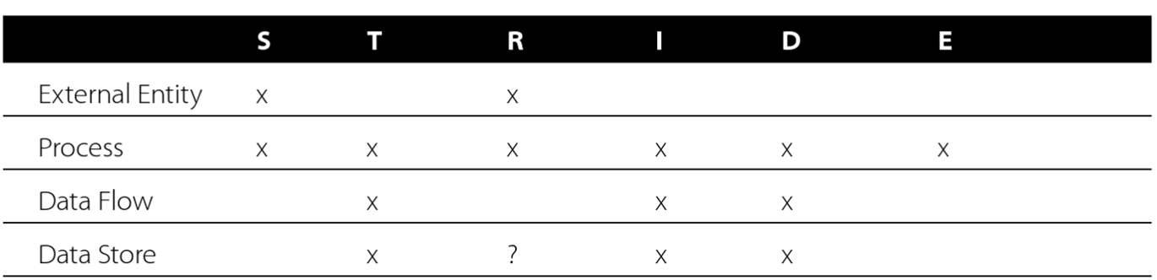
DFD Elements to Threat Categories
Study at home
Only a subset of threat categories are relevant
Not “everything” can go wrong
(unless it’s a process)

Slide 31
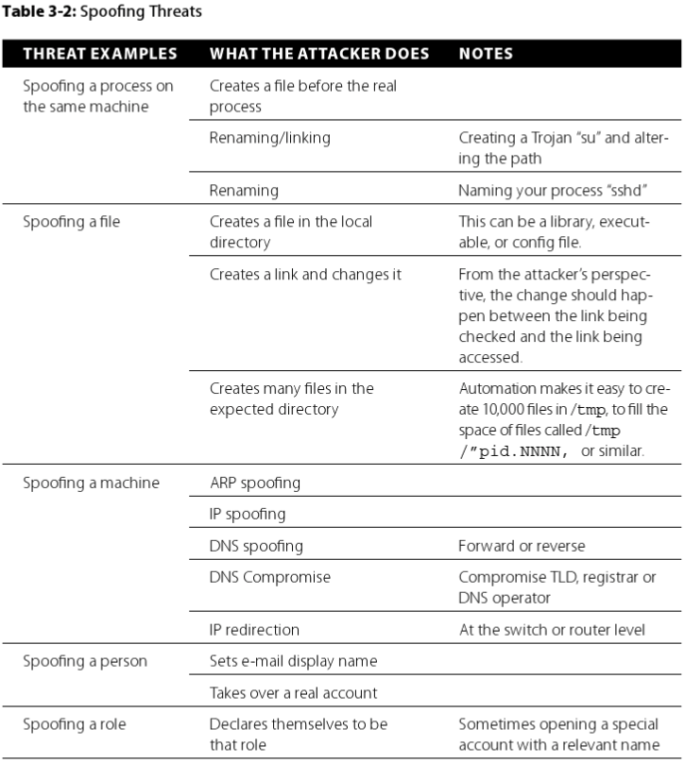
Spoofing threats – Examples
Study at home
Given by the methodology to get the novice analyst started

Slide 32
Tool support
Microsoft Threat Modeling Tool
  Draw DFD
  Add a lot of properties to the DFD elements
  Tool generates threats
  Your mileage may vary!
OWASP Threat Dragon
  Open source version

Slide 33
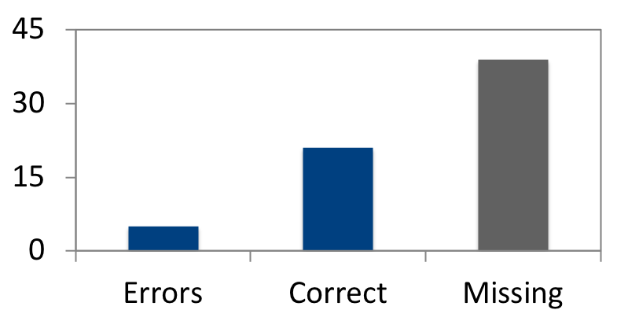
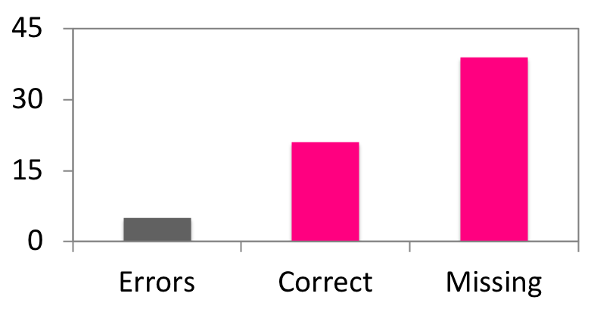
Is STRIDE effective?
R. Scandariato, K. Wuyts, W. Joosen, A descriptive study of Microsoft’s threat modeling technique, Requirements Engineering), 2015
81 %
☺
Avg. # threats
REPORTED
Correctness
Good guidance
EXISTING
36 %
☹
Avg. # threats
Completeness
Problem of threat explosion

Slide 34
Knowledge Repositories of Security Attack

Slide 35
Thinking to threat scenarios is hard
Especially for novices (non security experts)
Knowledge of “what attackers can do” is needed
  Adversary tactics, techniques and procedures
  Knowledge of vulnerabilities and how they can be exploited
This helps finding threats more efficiently
Collections of attack types are available
  To provide inspiration (mainly for novices)
  When performing a gap analysis (also for experts)
Known ones: ATT&K, CAPEC (both from MITRE)

Slide 36
MITRE‘s CAPEC
Common Attack Pattern Enumerations and Classifications
CAPEC “is a comprehensive dictionary and classification taxonomy of known attacks that can be used by analysts, developers, testers, and educators to advance community understanding and enhance defenses”[1]
CAPEC provides a publicly available catalog of common attack patterns (with quite some focus on software security) that helps users understand how adversaries exploit weaknesses in applications (i.e., ideal for application threat modeling)

Slide 37
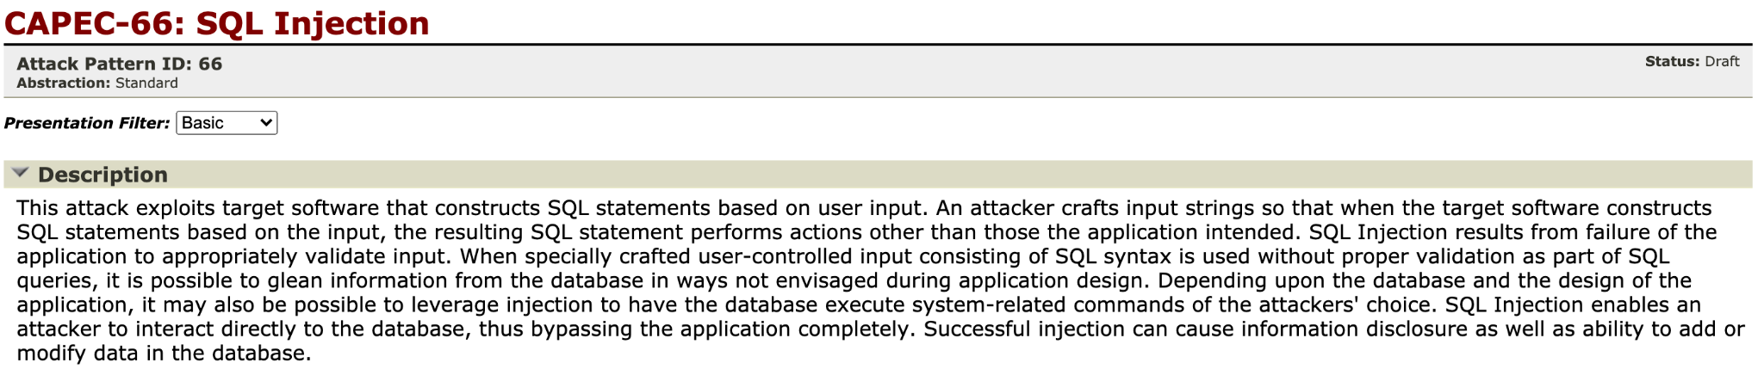
CAPEC Attack Patterns
Descriptions of the common approaches employed by adversaries to exploit known weaknesses in cyber-enabled systems
Captures knowledge about how specific parts of an attack are designed and executed, and gives guidance on ways to mitigate the attack's effectiveness
Contain an “execution flow” — step-by-step instructions for an adversary to explore for potential targets, experiment with their assets and defensive mechanisms, if any, and then to carry out the exploit
Source: https://capec.mitre.org/data/definitions/66.html

Slide 38
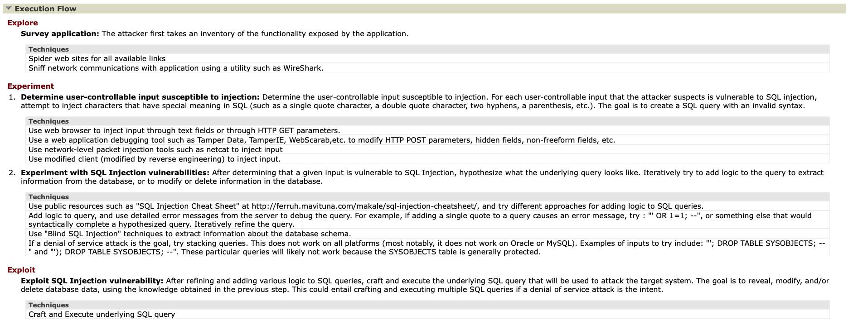
Execution flow – Example for SQL Injection
Source: https://capec.mitre.org/data/definitions/66.html

Slide 39

Example question
Study at home
How is CAPEC related to CWE?
Have a look at examples in CWE
  CWE-89: SQL Injection
  https://cwe.mitre.org/data/definitions/89.html
And CAPEC
  CAPEC-66: SQL Injection
  https://capec.mitre.org/data/definitions/66.html
Notes:
34 63 80 0

Slide 40
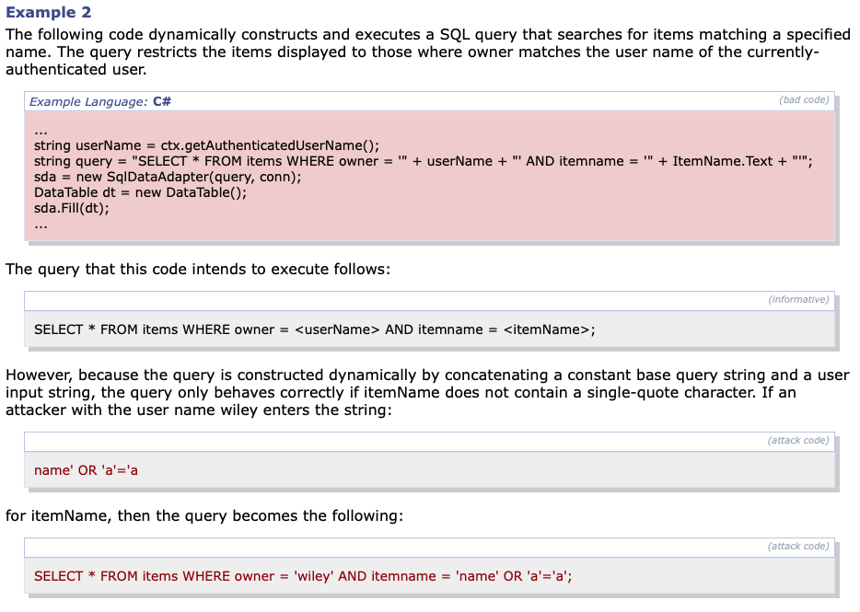
The weakness(es) that the attack pattern is exploiting (CWEs) are listed in CAPEC-66, in the “Related Weaknesses” section
Description in CWE-89

Slide 41
CAPEC Attack Pattern & CWE
Common Weakness Enumeration (CWE) is a community-developed list of software (and hardware) weakness types
  CWE serves as a common language and as a baseline for weakness identification. As well as a measuring stick for security tools
A CAPEC attack pattern is typically a method of leveraging a CWE to execute an attack

