Slide 1
Security Analysis of Software Design
Riccardo Scandariato
Institute of Software Security, TUHH, Germany
ric***do . scanda***to @ tuhh.de
Master Course “Secure Software Engineering”
Summer Semester 2022

Slide 2
Learning objectives
What are architectural weaknesses?
  CAWE
How to find architectural weaknesses with model-based security analysis?
  Manual inspection vs automated checking (UMLsec)
Reading material
1) Mehdi Mirakhorli, Common Architecture Weakness Enumeration (CAWE), http://blog.ieeesoftware.org/2016/04/common-architecture-weakness.html
2) And also https://cwe.mitre.org/data/definitions/1008.html
Reading material
Jan Jürjens, Model-Based Security Engineering with UML,
Chapter 4 of the book “Secure Systems Development with UML”
Link: https://link.springer.com/chapter/10.1007/3-540-26494-9_4

Slide 3
Goals of model-based security analysis
Discover security/privacy issues early on, even before developing the code
(forward engineering case)
Certification of a system (also existing one)
  Evidence that risks are identified
  Evidence that ‘reasonable’ security mechanisms are in place

Slide 4
Model Based Security Analysis
Why security analysis at the architecture level? Aren‘t security tests on the implementation enough?
A different type of issues (than, e.g., implementation vulnerabilities)
  Using Weak Authentication (e.g., “API keys”)
  Unprotected Storage of Credentials
  Permission Re-delegation
  Download code without integrity checking or origin authN
  …
Late detection and fixing of these flaws can be difficult / expensive (e.g., require refactoring)

Slide 5
Architectural Flaws
Flaws of Omission. Such design flaws result from ignoring a security requirement or potential threats.
Flaws of Commission. Such design flaws refer to the design decisions which were made and could lead to undesirable consequences.
Flaws of Realization. The design decision is correct but the implementation of that suffers from a coding mistake. Code vulnerabilities TERRITORY
Common Architecture Weakness Enumeration (CAWE)
By Mehdi Mirakhorli
http://blog.ieeesoftware.org/2016/04/common-architecture-weakness.html

Slide 6

Share your opinion
What is wrong in the next slide?

Slide 7
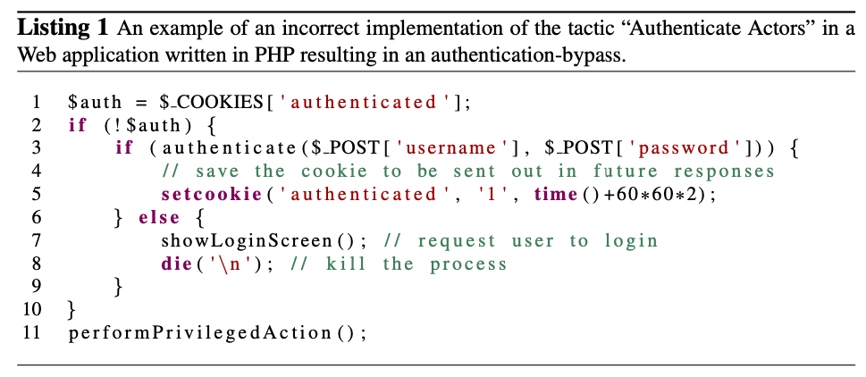
An example

Slide 8
Share your opinion
Trust that the client will not add a bogus “authenticated” cookie
Is that reasonable?
Client-side authentication is very easy to break
CAWE > Authenticate Actors - (1010) > Use of Client-Side Authentication - (603)

Slide 9
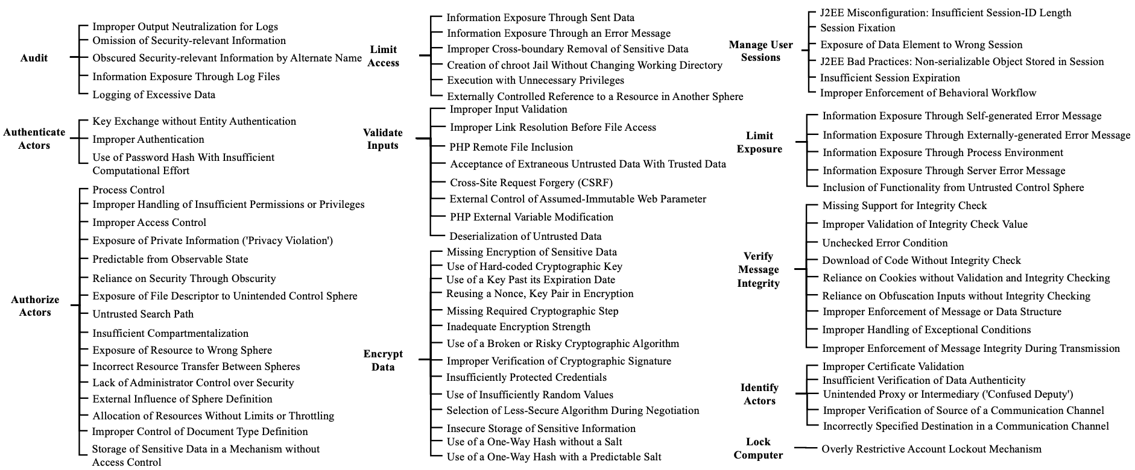
CAWE
Common Architectural Weakness Enumeration
Accepted as a “view” in CWE
Pls, look at this
https://cwe.mitre.org/data/definitions/1008.html

Slide 10
Model-based security analysis
Inspection guidelines
Algorithmically
(e.g., model checking, pattern matching, etc.)
Threat and risk analysis → Later in this course ;)

Slide 11
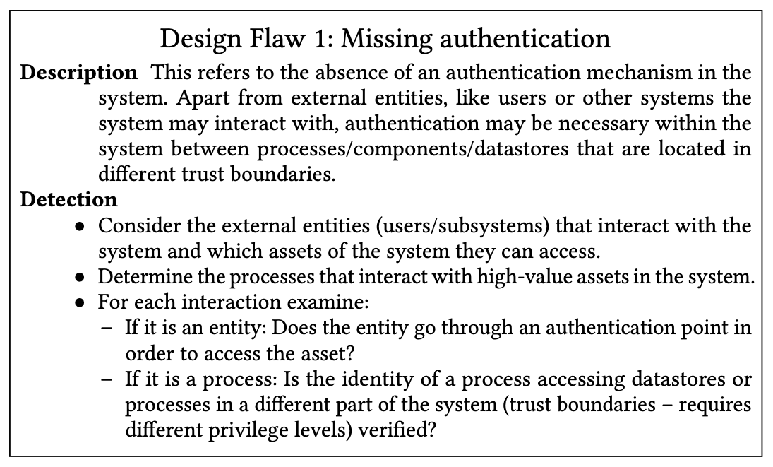
Types of model-based security analysis
Inspection guidelines
(performed manually, possibly tool assisted)
Benchmark is a ‘trendier’ term
(see CIS – Center for Internet Security)
  Also more focus on tool support for the rules
K. Tuma et al., Automating the Early Detection of Security Design Flaws, MODELS 2020

Slide 12
Manual vs Automated Model Analysis
Accessing the software design/software architecture for detection of flaws
Analysis | Advantages | Disadvantages
Manual | Interpretation of improper representation of models Fewer false positives | Time consuming Requires expertise No completeness guarantee
Automated | Faster Easily re-executed if model changes | Specific model with precise notation is required Effort to add additional info to models

Slide 13
UMLSec

Slide 14
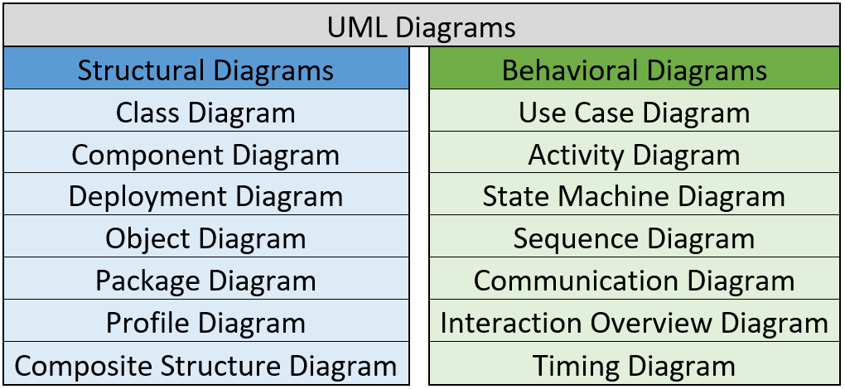
Unified Modeling Language (UML)
UML: Industry standard object oriented modeling technique
Relatively precisely defined
Widely adopted and accepted
UML Diagrams
Rich set of diagrams, covering a spectrum of abstractions
(more/less detailed descriptions)
Visual representation of the architecture and detailed design of complex software systems

Slide 15
UMLsec – Phylosophy
Annotate design diagrams with various recurring security requirements (secrecy, integrity, authenticity…) and security assumptions
Annotations as
  Stereotypes
  Tags
Goal
  Documentation / keep track of info
  Formal semantics → tool-supported analysis

Slide 16
UMLSec Extension Mechanisms
UML profile collects the relevant definitions of stereotypes, tagged values, and constraints
Stereotypes Define new sub-types of modelling elements, hence extending the UML metamodel. Stereotype definition can include zero or more tags
  Example: <<guarded>> can only be used on Objects
Tagged values: Name-value pair that add properties to model elements. Can be used in the context of a stereotypes that defines them
  Example: {guard = obj} identifies the guard object
Constraints Define the formal semantics of a model element (e.g., written in first-order logic). That is, the desired security property.
  Example: “guarded objects only accessible via guard object”
Foo Boolean values, {tag} means {tag = true}

Slide 17
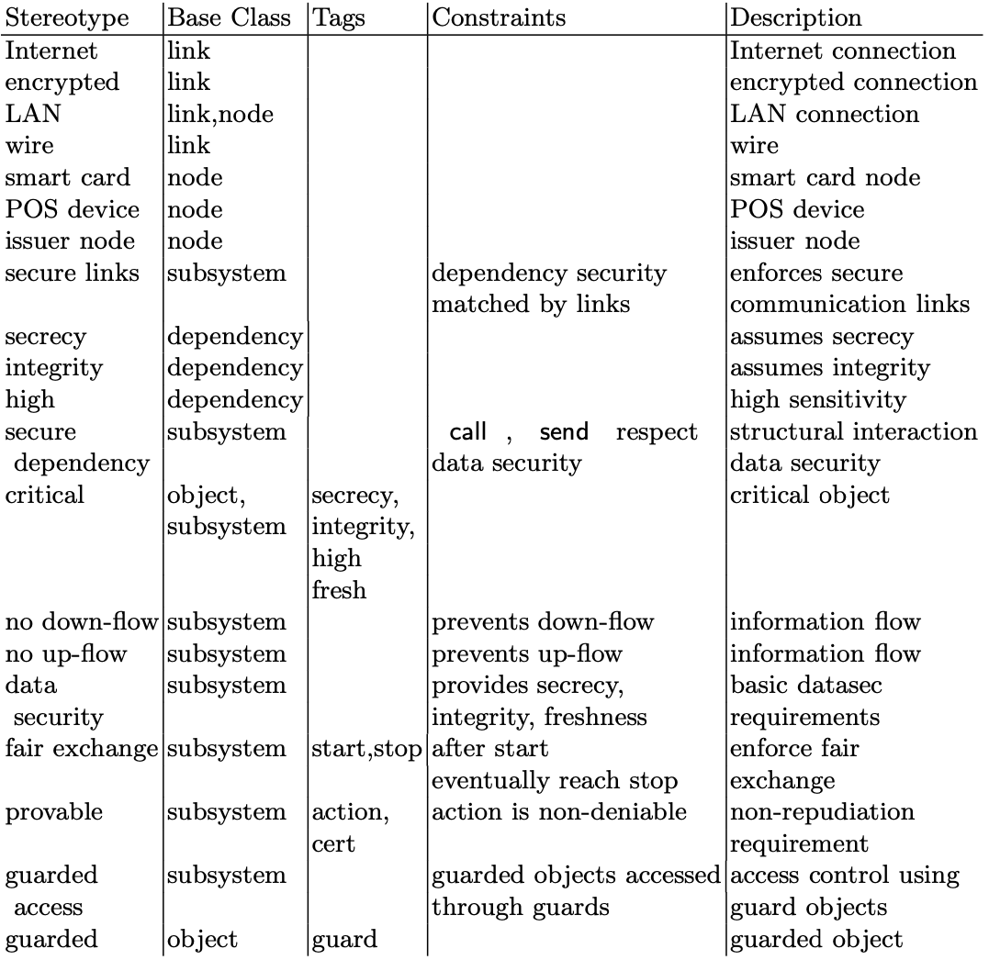
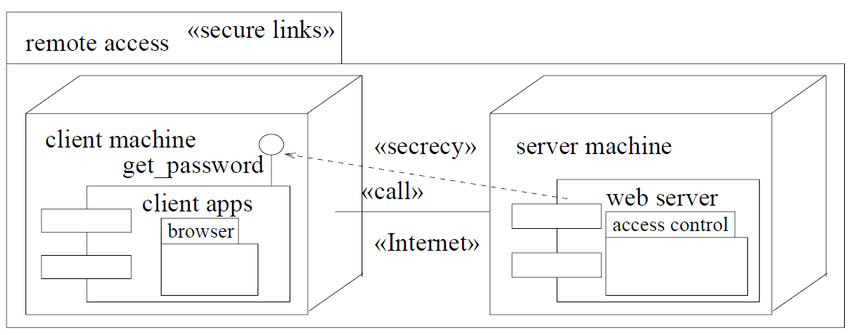
Example
Deployment diagram with
Subsystem (think of package)
Integrate the information between the different kinds of diagrams and between different parts of the system specification
Security annotations
Dependency
(between components)
Node
Component
Link
(between nodes)

Slide 18
UMLSec: usage scenarios
(from more abstract to more concrete)

Slide 19
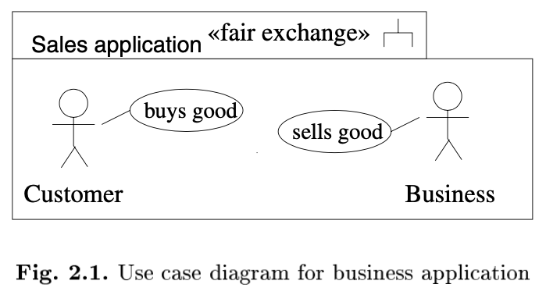
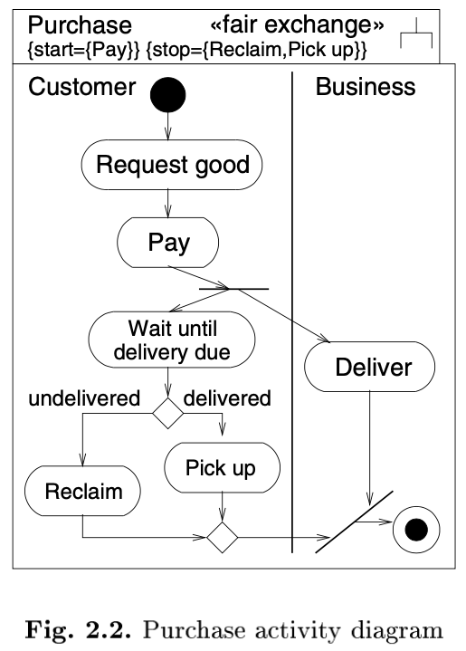
Usecase diagrams
Seen before
In UMLsec: Capture security requirements
Activity diagrams
Specify the control flow between several components within the system, usually at a higher degree of abstraction than statecharts and sequence diagrams. They can be used to put objects or components in the context of overall system behaviour or to explain use cases in more detail.
In UMLsec: Define secure business processes
Notes:
If strat is executed, eventually stop is reached (liveness)

Slide 20
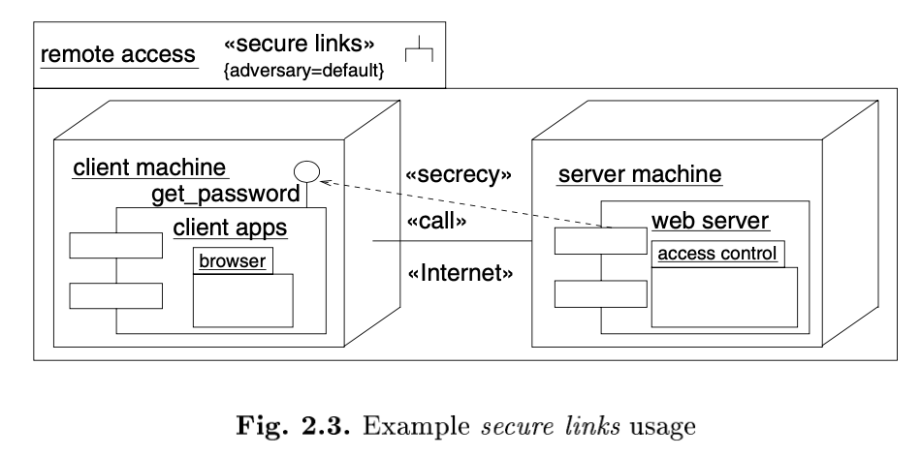
Deployment diagrams
Describe the physical layer on which the system is to be implemented.
In UMLsec: Check physical security

Slide 21
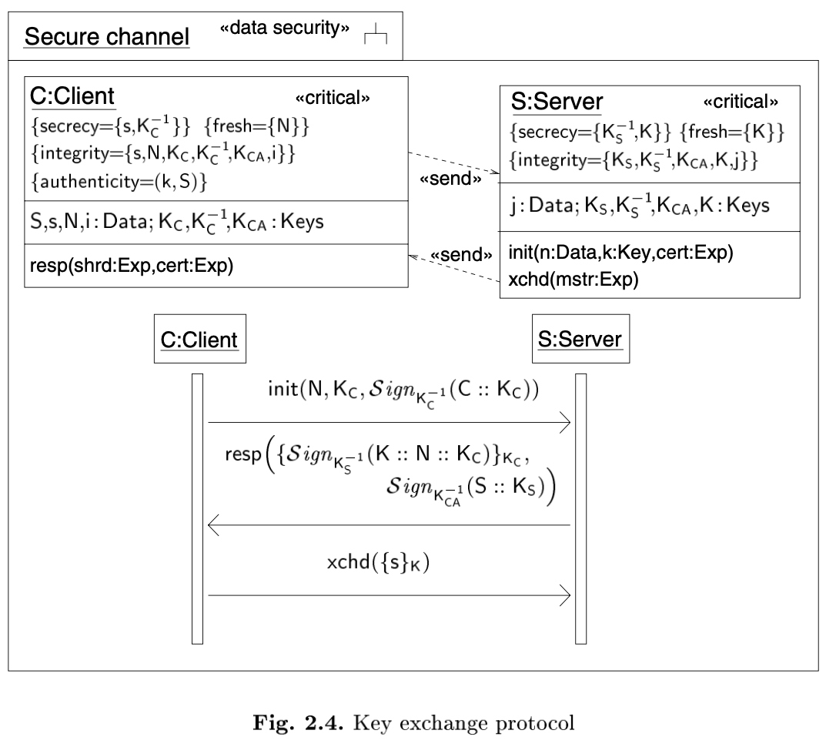
Sequence diagrams
Describe interaction between objects arranged in time sequence and also sequence of the messages exchanged.
Class diagrams
Define the static class structure of the system: classes with attributes, operations, and signals and relationships between classes. On the instance level, the corresponding diagrams are called object diagrams.
In UMLsec: Define security critical interactions

Slide 22
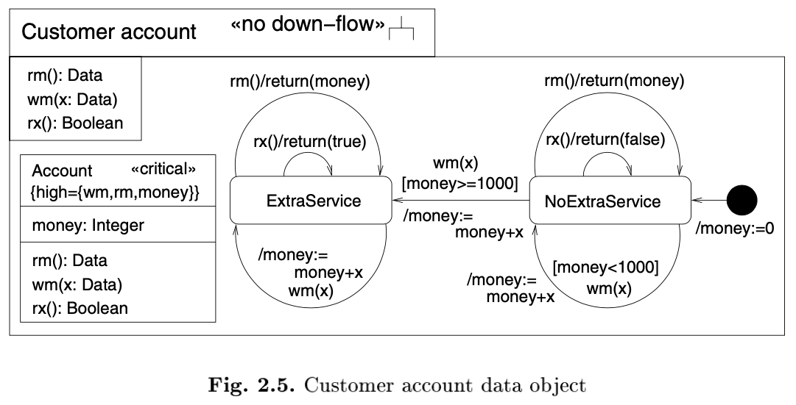
Statechart diagrams
Give the dynamic behaviour of an individual object or component: events may cause a change in state or an execution of actions.
In UMLsec: Information flow analysis
Notes:
A computer has the noninterference property if and only if any sequence of low inputs will produce the same low outputs, regardless of what the high level inputs are.
Rx() leaks information about money

Slide 23
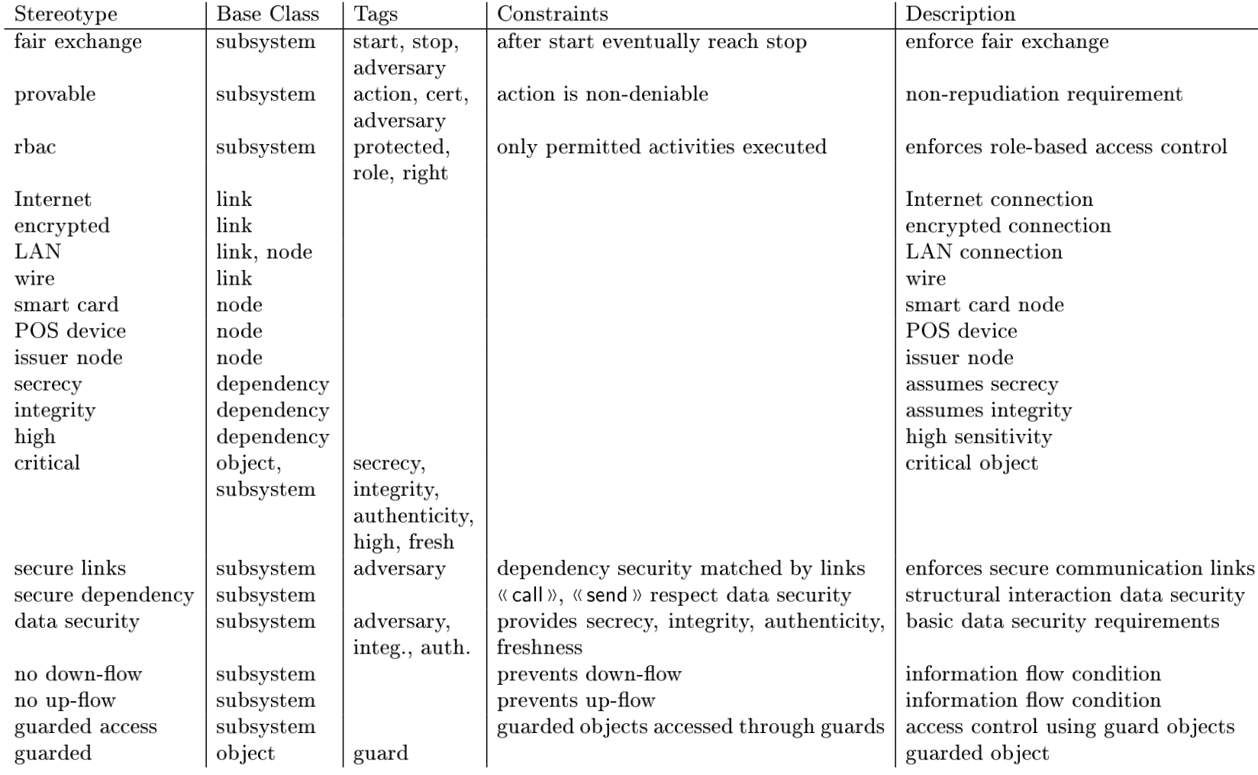
UMLsec profile at a glance
Study at home

Slide 24
Stereotypes 1/3
Study at home
Internet, encrypted LAN: Denote communication links- Stereotypes on links in deployment diagrams denote the corresponding requirements on communication links nodes. Each link or node carries at most one of these stereotypes.
Secure Dependency
This stereotype, used to label subsystems containing object diagrams or static structure diagrams, ensures <<call>> or <<send>> dependencies respect the security requirements on the data that may be communicated along them, as given by the tags secrecy, integrity and high of the stereotype <<critical>>
Secrecy, integrity, high
Stereotypes denote dependencies in static structure or component diagrams that provide security requirement for the data that is sent as arguments or return values of operations or signals.

Slide 25
Stereotypes 2/3
Study at home
Secrecy
<<call>> or <<send>> dependencies in object or component diagrams stereotyped <<secrecy>> provide security requirement for the data that is sent as arguments or return values of operations or signals
Both are used in the constraint of the stereotype <<secure links>>
Critical
This stereotype labels objects or subsystem instances containing
data that is critical in some way, which is specified in more detail using
the tags secrecy, integrity, fresh and high.
No down flow
This stereotype of subsystems enforces secure information flow by making use of the associated tag high. According to the <<no-down flow>> constraint, the stereotyped subsystem prevents down-flow wrt messages and their return messages specified as high

Slide 26
Stereotypes 3/3
Study at home
Fair exchange
Tags start and stop whenever a start state in the activity diagram is reached, then eventually corresponding stop state will be reached.
Provable
Tags action and cert whenever a start state in the activity diagram is reached, then eventually corresponding stop state will be reached.
Guarded Access
Each object in the subsystem that is <<guarded>> can only be accessed through the objects specified by the tag guard attached
to <<guarded>> object.
Guarded
Labels objects (in particular in the scope of the stereotype <<guarded access>> above) that are supposed to be guarded. It has a tagged value guard which defines the name of the corresponding guard object.

Slide 27
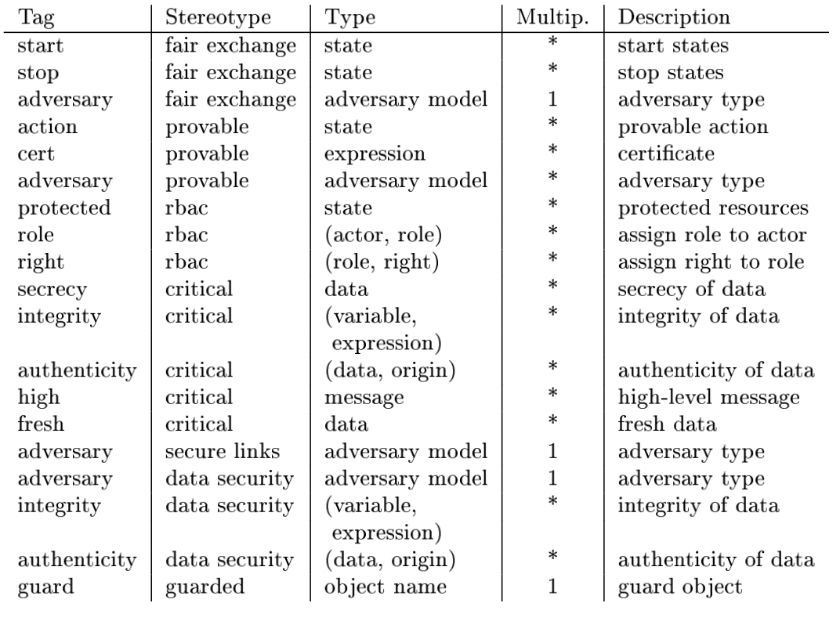
Summary of UMLsec tags
Only for your info

Slide 28
Key security requirements
Non-repudiation of actions
Coarse-grain access control
Confidentiality & integrity of communications
Information flow properties
Architectural access control

Slide 29
UMLsec: Supported Security Requirements
Study at home
Fair Exchange- This requirement postulates that the trade is performed in a way that prevents both parties from cheating
Non-Repudiation- An action cannot subsequently be denied successfully. That is, the action is provable, usually wrt. some trusted third party
Secure Logging- The auditing data is at each point during the transaction of the system consistent with the actual state of the transaction (to avoid the possibility of fraud by interrupting the transaction)
Message Authenticity or Data origin Authenticity- Allows to identify the original source of data in the past
Entity Authenticity- Allows to identify active participation of a participant in a particular protocol at that time
Guarded Access- Access control ensures that only legitimate parties have access to a security-relevant part of the system. Access control can be enforced by guards.

Slide 30
UMLsec: Supported Security Requirements
Study at home
Freshness- A message is fresh if it is created under the current execution round of the system under consideration and cannot replay an older message by the attacker
Secure Information Flow- This requirement is to ensure there is no indirect leakage of sensitive information from a trusted to an untrusted part. Trusted parts of a system are often marked as high, untrusted parts as low
Secrecy and Integrity- These are main data security requirements. A subsystem S preserves the secrecy (a.k.a.confidentiality) of an expression E from adversary A if E never appears in the knowledge set K of A during execution of S. Integrity means that some information can be modified only by legitimate parties.
Secure Communication Link- Sensitive communication between different
parts of a system needs to be protected. The relevant requirement of a secure
communication link is here assumed to provide secrecy and integrity for the
data in transit.

Slide 31
UMLSec: model analysis

Slide 32
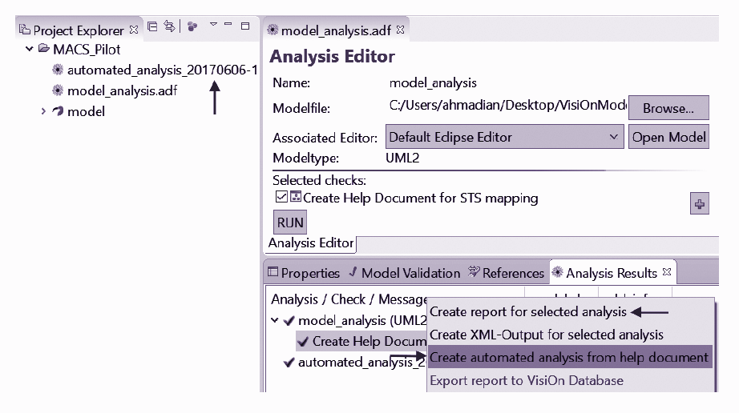
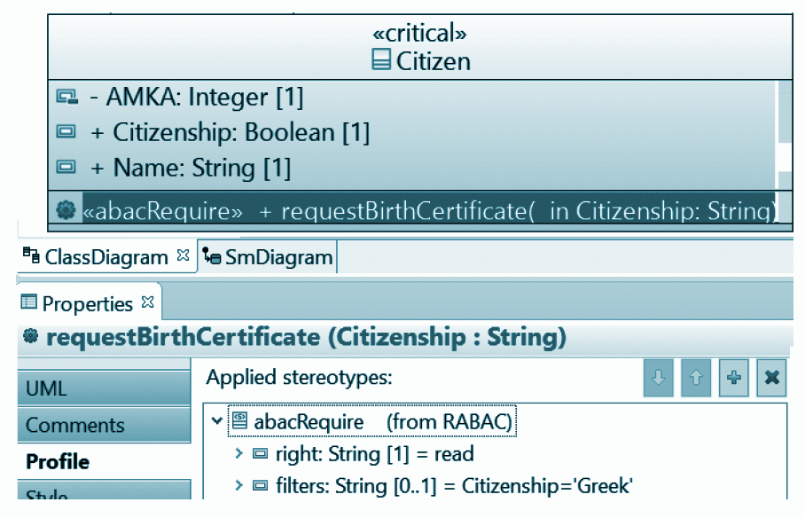
UML Model Analysis with CARiSMA
Analyse security requirements based on the information from
  (i) formal semantics
  (ii) adversary behaviour
UMLsec diagrams are converted to first-order logic formulas (including epistemic constructs)
Analysis of the diagrams using automated first-order logic theorem provers (e.g., e-SETHEO or SPASS)
Automatic
analysis
Class Diagram annotated
More information about CARiSMA:
https://rgse.uni-koblenz.de/carisma/
https://youtu.be/b5zeHig3ARw

Slide 33
Adversary in UMLsec

Slide 34
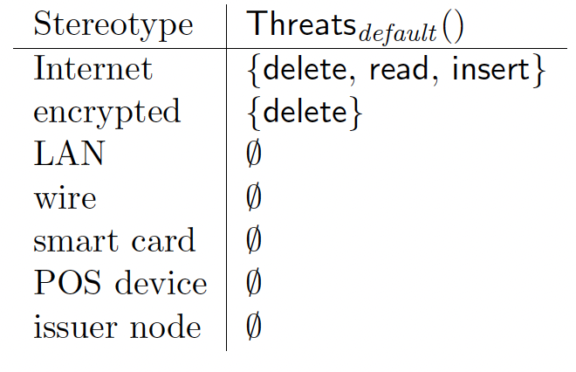
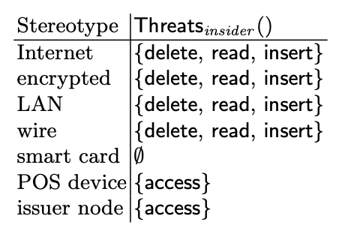
Adversary in UMLsec
Type of adversary can be specified in the UML diagram
If not specified, capability of default attacker is used
Threats from default attacker
Threats from insider attacker

Slide 35
Security analysis for Secure Links
The model does not meet the secure requirements against the default adversary:
  In the model, the call dependency is label with the <<secrecy>> constraint
  The link is labeled as <<Internet>>
  The default attacker has delete, read and insert capability
An attacker can read messages on an Internet link
Internet connections do not provide secrecy against attacker
Constraint is violated
<<LAN>>

Slide 36
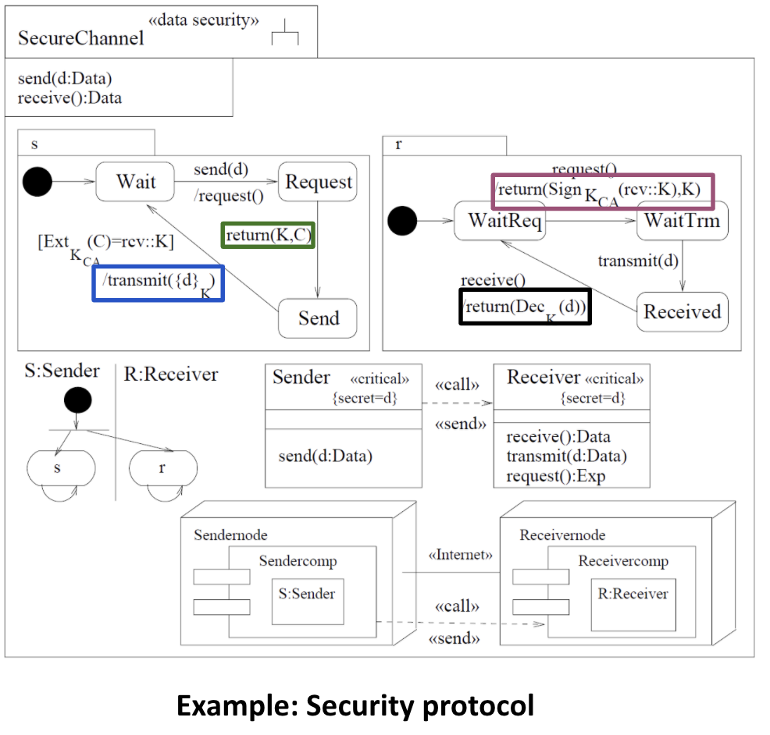
Security analysis for Data Security
Example is a simple security protocol.
The sender requests the public key K together with the certificate to certify authenticity of the key from the receiver
Receiver sends certificate and the public key to the sender
Sender then sends the data back encrypted using K to the receiver
Receiver decrypts the ciphertext from the sender using K
The sender and receiver components can interact with each other because of provided <<call>> and <<send>>
An internet connection <<internet>> is established between the sender and the receiver
Secrecy of d is preserved

Slide 37
Other approaches

Slide 38
Analysis based on Formalized Signatures
Detailed model describing the system
System descrition model
  Component-based model
  (components, interface funcions)
  Deployment model (components in nodes)
Security specification model
  Security objectives (e.g., a component is critical)
  Security controls
  (e.g., component enforces user authentication)
  (e.g., node in trusted zone)
M. Almorsy, et al., Automated Software Architecture Security Risk Analysis using Formalized Signatures, ICSE 2013

Slide 39
Attack scenario as OCL signature
context System inv Man-in-the-Middle Attack:
self.components->select(C1 |
C1.DeploymentZone = 'Untrusted' and
self.components.exists(C2 |
C2.Channels->exists(Ch |
Ch.TargetComponent = C1 and
Ch.Encryption = false)
…
)
Model query
Graph navigation

Slide 40
Security metric as OCL signature
context System inv AttackSurface:
self.components
->select(C1 |
C1.DeploymentZone = 'Untrusted‘)
->collect(C2 |
C2.Functions)
->size()

Slide 41
Analysis based on Formalized Signatures
How does it work
OCL signatures are provided
(16 in total, more can be added)
Tool runs the checks on the models
(model queries and graph navigation)
Report of results

