Slide 1
Secure Software Engineering: Intro
Riccardo Scandariato
Institute of Software Security, TUHH, Germany
ric***do . scanda***to @ tuhh.de
MSc Course Secure Software Engineering – Summer Semester 2022

Slide 2
Learning objectives
What are security software processes?
What are security maturity models?
Reading material
1) https://www.microsoft.com/en-us/securityengineering/sdl/practices
2) B. De Win, et al., On the secure software development process: CLASP, SDL and Touchpoints compared, IST, 2009

Slide 3
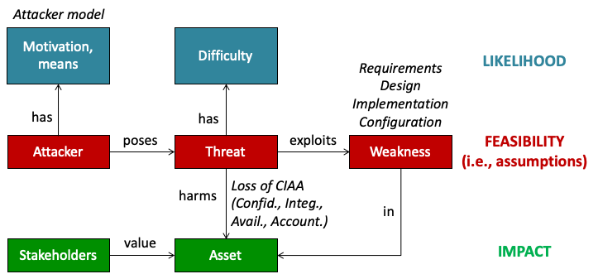
Security flaws
ISO/IEC 15408 (Common Criteria)
Loss of CIA+
CIA+ Confidentiality, Integrity, Availability, Accountability & Non-repudiation, Authenticity

Slide 4

Code-level vulnerabilities
Examples
  Stack overflow
  Command injection
  SQL injection
  Cross-site scripting (XSS)
  Cross-site request forgery (CSRF)
  …
MSc course ”Software Security” in Winter Semester

Slide 5
Not just functional code
Upcoming lecture
Lots of configuration code
  Container config – Docker, K8s
  (Scanning tools: Aqua, Trivy, Snyk…)
  Cloud deployment scripts (IaC) – Terraform, Ansible
  (Scanning tools: Snyk, Checov, Terrafirma, TFlint…)
Configuration vulnerabilites as the new frontier
(cf. A. Rahman et al., The seven sins: security smells in IaC scripts, ICSE 2019)
IaC = Infrastructure-as-Code

Slide 6
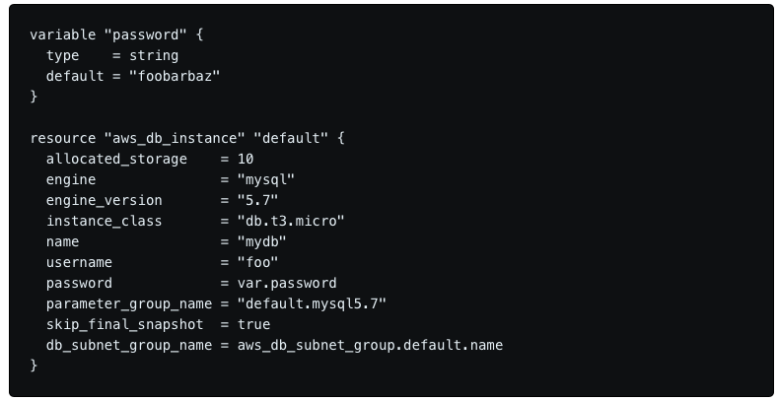

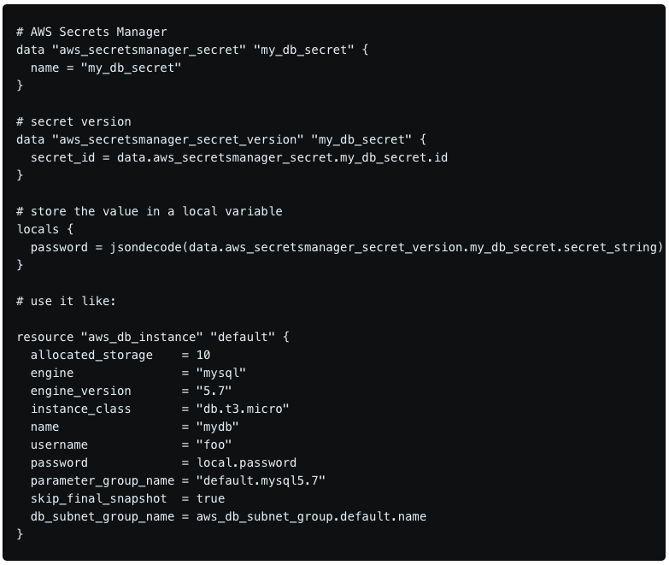

Terraform scripting language

Slide 7
Above the implementation/ops level
Is the architectural design right?
Are the software requirements right?

Slide 8
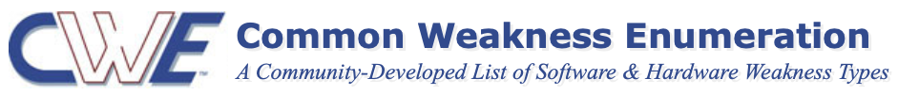
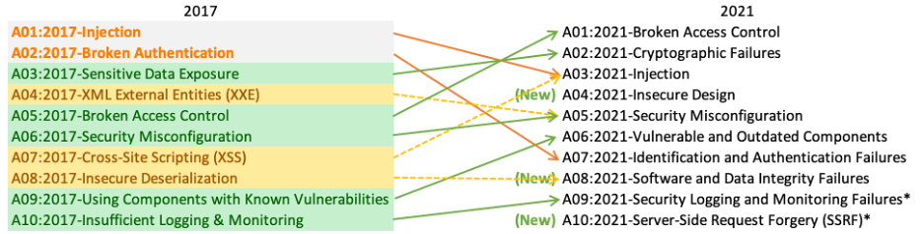
Architectural security issues
Security weaknesses due to wrong design choices
Upcoming lectures
Using Weak Authentication (e.g., “API keys”)
Trust Boundary Violation (e.g., input validation)
Unprotected Storage of Credentials
Permission Re-delegation
…
OWASP Top 10

Slide 9
But also…
Upcoming lectures
Wrong / missing security assumptions
  Traffic is not accessible (CAN-bus ?)
  Traffic is always encrypted (until it isn’t)
Wrong perception of risks
  Low likelihood of malicious internal user
  Phisical access in IoT systems
Wrong / missing security requirements
  In safety-critical systems, ppl focus on integrity over confidentiality
  (what is asset contains personal data?)

Slide 10
Processes

Slide 11
“Shift Left” Paradigm
Old days: deal with security at the end (patching, incident handling)
New paradigm, start early in the dev process, and deal with security continuously
  Security-by-design
Beyond processes and activities?
(wait for last slide…)

Slide 12
Secure Development Life-Cycle (SDL)
Security is not an add-on feature
You don’t write software and then make it “secure” by adding a few security features (authentication, etc)
You don’t write software and then make it “secure” by removing vulnerabilities either (buffer overflow, etc)
Security is an ongoing concern throughout the software life cycle
  Security requirements, Secure design, Secure development – deployment – maintenance (patching, new releases, …)

Slide 13
Microsoft SDL: Historical note
Bill Gates launched the Trustworthy Computing initiative on January 15, 2002
Email sent to every full-time employee at Microsoft
Emphasis on security in the company's strategy
  “However, even more important than any of these new capabilities is the fact that it is designed from the ground up to deliver Trustworthy Computing.”
Likely, a reaction to the string of malware that had affected Windows (Code Red, Nimda, Slammer...)
https://www.wired.com/2002/01/bill-gates-trustworthy-computing/

Slide 14
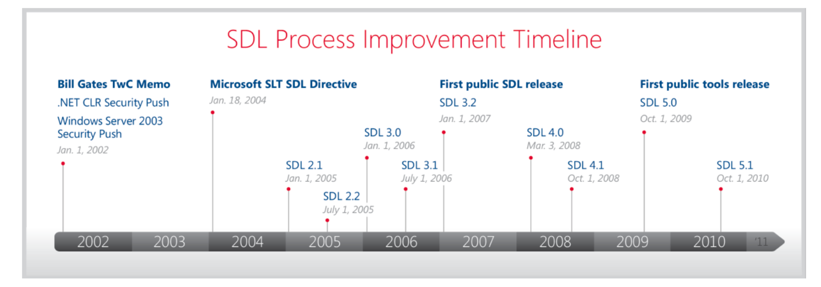
MS SDL evolution
Only for your info
The SDL Progress Report – Progress reducing software vulnerabilities and developing threat mitigations at Microsoft (2004 – 2010)
Latest version was 5.2 (2012)

Slide 15
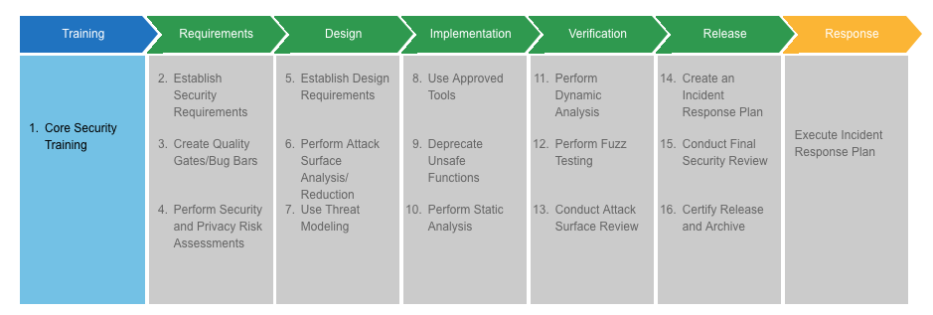
Microsoft SDL
Reading material
https://www.microsoft.com/en-us/securityengineering/sdl/practices

Slide 16

Example question
Study at home
What is a secure software process, in general? What objectives does it pursuit? What activities are central? An example?

Slide 17
Did it work ?
☺
MS SDL FAQ
Has the SDL improved the security of Microsoft products?
As a company-wide initiative and a mandatory policy at Microsoft since 2004, the SDL has played a critical role in embedding security and privacy in Microsoft’s culture and software. The SDL has proven to be effective at reducing vulnerability counts of flagship Microsoft products after release.
  From “The SDL Progress Report – Progress reducing software vulnerabilities and developing threat mitigations at Microsoft (2004 – 2010)”

Slide 18
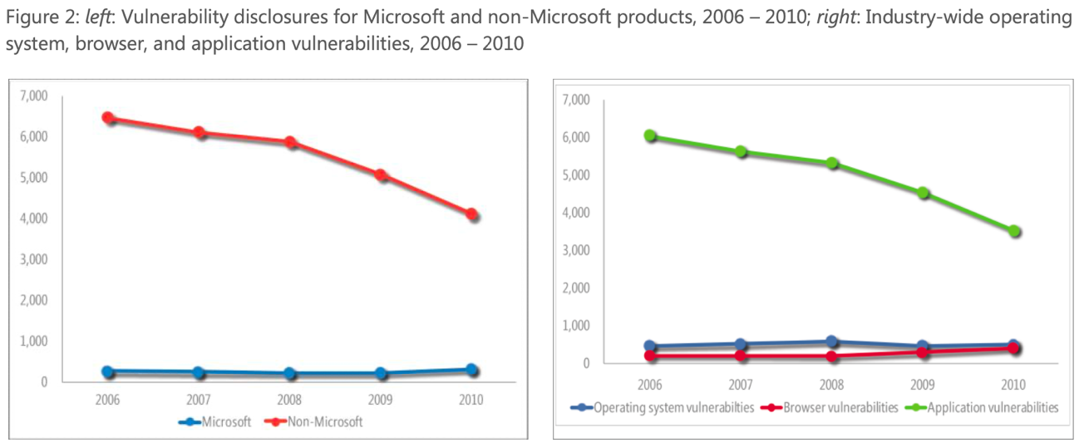
Did it work ?
The SDL Progress Report – Progress reducing software vulnerabilities and developing threat mitigations at Microsoft (2004 – 2010)

Slide 19
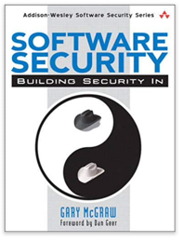
Historical note
Study at home
OWASP CLASP – Comprehensive, Lightweight Application Security Process
  Many “open” resources provided to incentivize and simplify adoption
Gary McGraw (famous security consultant) – Touchpoints
  “Focus on threat modelling and
  static analysis” (prioritize quick wins)
Reading material
B. De Win, et al., On the secure software development process: CLASP, SDL and Touchpoints compared, 2009

Slide 20
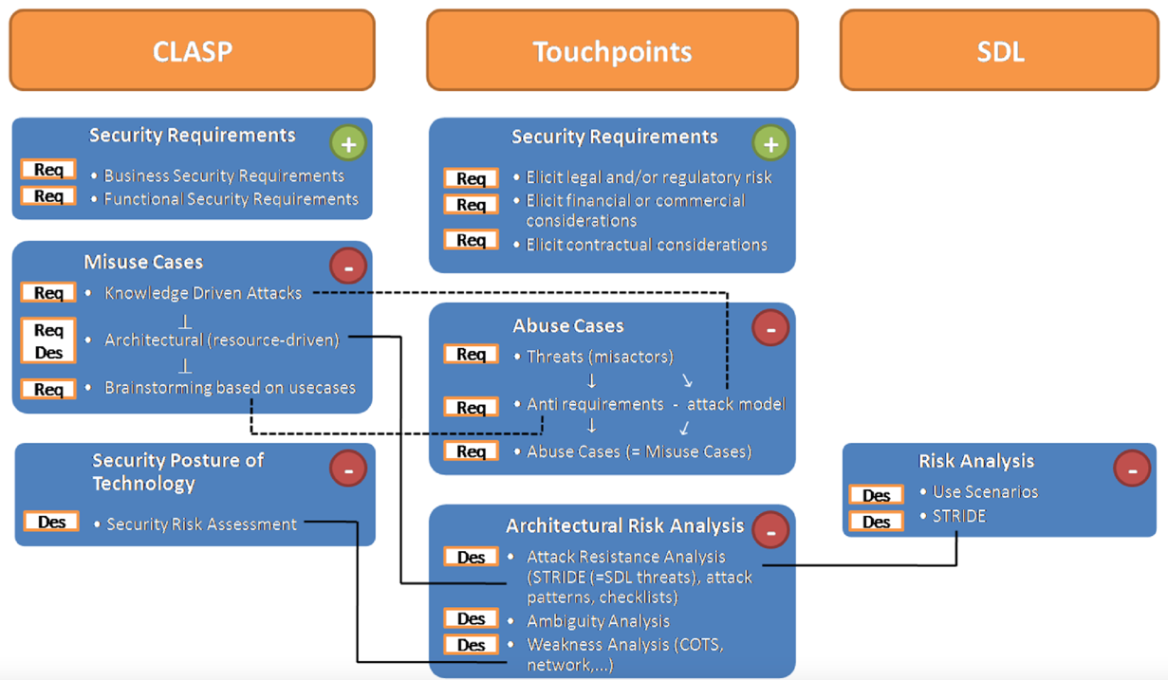
CLASP/Touchpoints vs MS SDL
Study at home
Shift left
Source: Bart De Win (https://owasp.org/www-pdf-archive/OWASPDay2007Belgium_BartDeWin.pdf)
Notes:
More focus on Risk
More focus on Requirements

Slide 21
Criticism on secure software processes
Linear processes are rare (agility)
Hard to integrate SDL into existing processes
  Company has to figure it out
  Some info where made available (limited)
Compliance requires a big investment, no „growing into it“

Slide 22
Later trend: Maturity Models
Instead of prescribing a process…
(sequence of activities and roles who perform them)
… suggesting areas of intervention and security activities
McGraw’S Touchpoints → Cigital BSIMM
  https://www.bsimm.com
OWASP CLASP → SAMM
  YouTube channel for SAMM: https://www.youtube.com/channel/UCEZDbvQrj5APg5cEET49A_g
SDL also evolved towards 12 security practices (simplified SDL)

Slide 23
Maturity models
Activities can be performed with a varying degree of
  thoroughness, automation, quality assurance, …
Company can decide in which area to start / invest more, depending on context, goals, regulatory frameworks, etc.

Slide 24

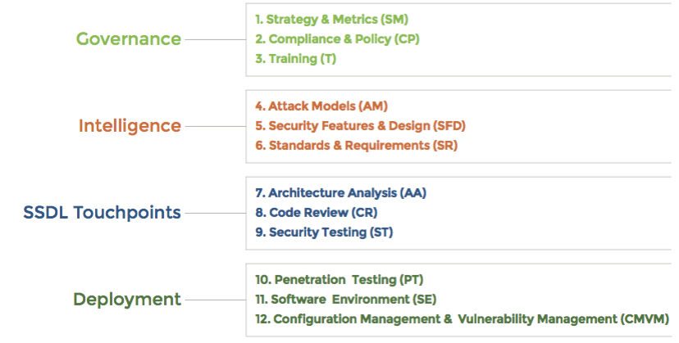
BSIMM
Practices
https://www.bsimm.com
Domains

Slide 25
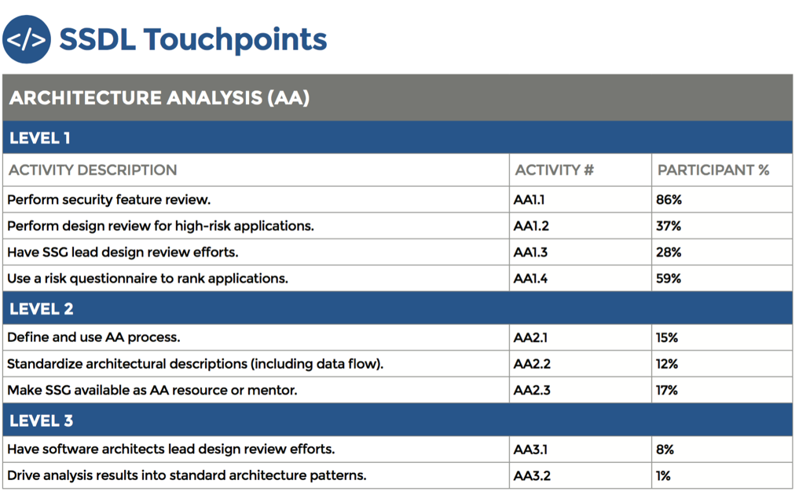
Meaning of “Levels of assurance”
More activities, more thoroughly

Slide 26

Domain: Governance
Study at home
Practices help to organise, manage and measure a Software Security Initiatives (SII)
Strategy & Metrics
Compliance & Policy
Training

Slide 27
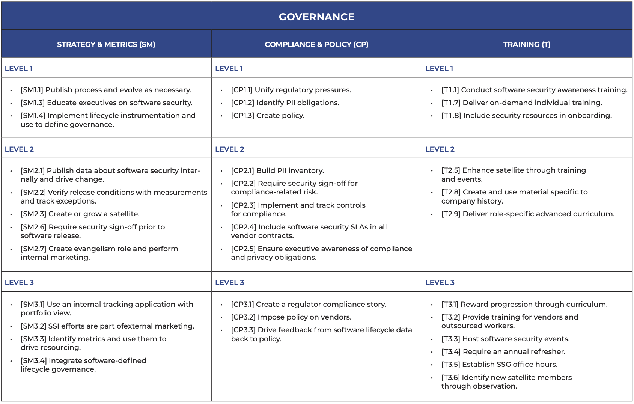
Only for your info

Slide 28
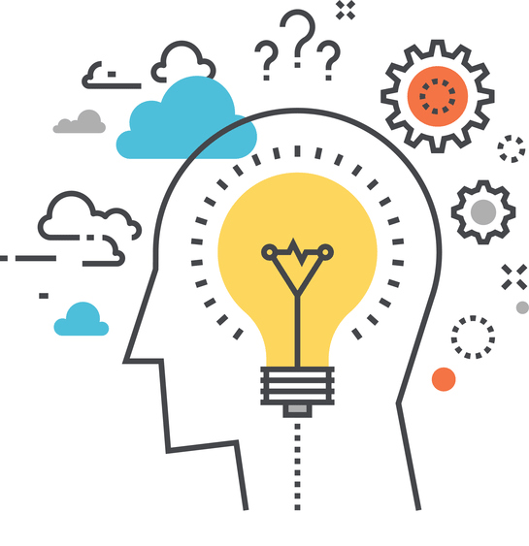
Domain: Intelligence
Study at home
Practices result in collection and identification of corporate intelligence related with SSI
Attack Models
Security Features & Design
Standards & Requirements

Slide 29
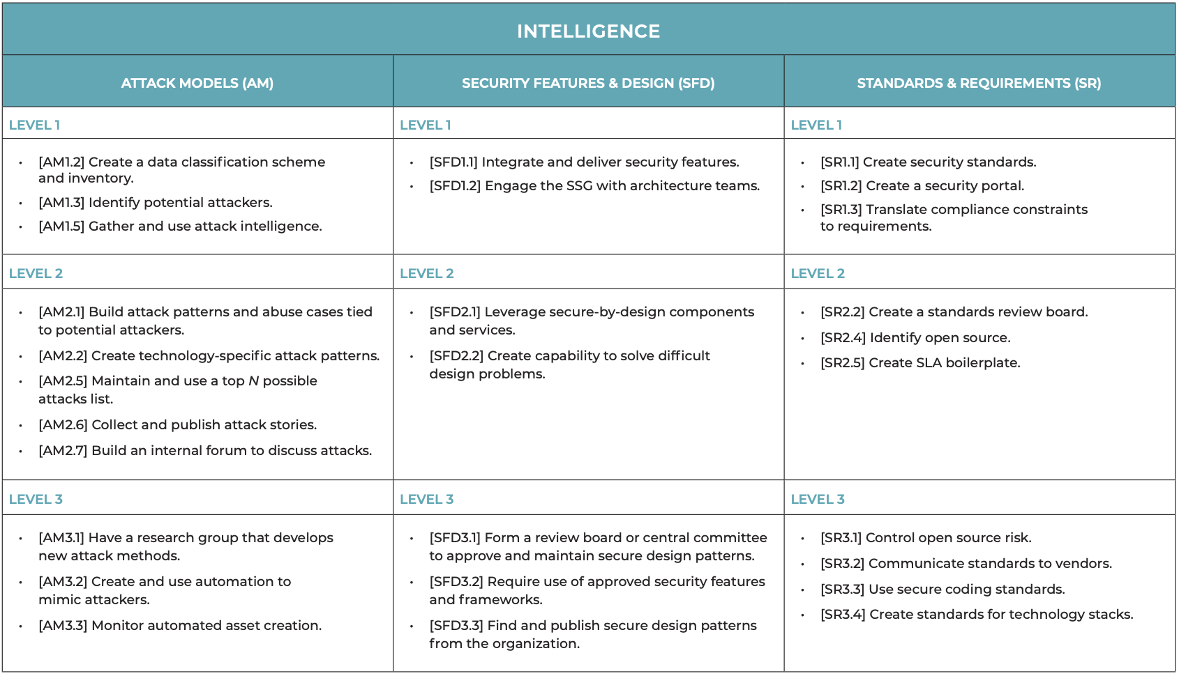
Only for your info

Slide 30

Domain: SSDL Touchpoints
Study at home
Essential security best practices required in Software development phases (SDLC)
Architecture Analysis
Code Review
Security Testing

Slide 31
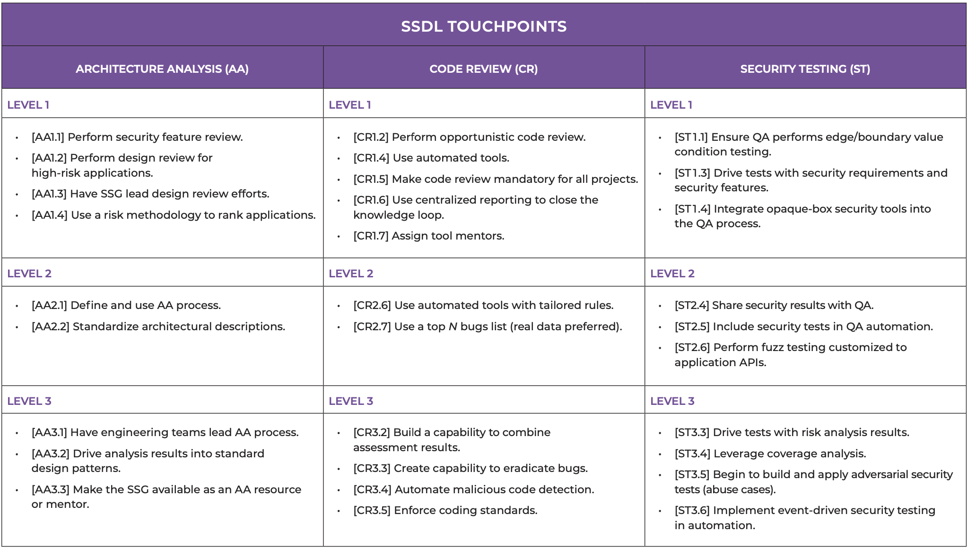
Only for your info

Slide 32

Domain: Deployment
Study at home
Practices that deals with network security and software maintenance requirements
Penetration Testing
Software Environments
Configuration Management & Vulnerability Management

Slide 33
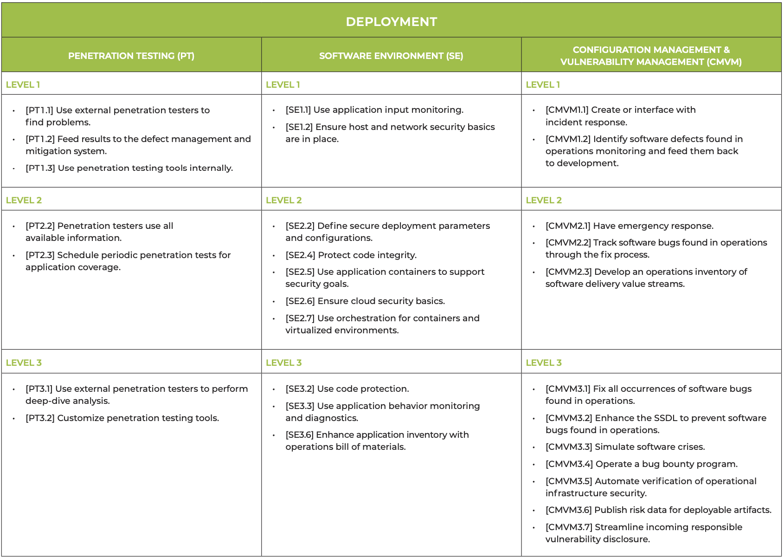
Only for your info

Slide 34
Example question
Study at home
Difference in the practices described by SDL and BSIMM? Philosophical difference between SDL and BSIMM?

Slide 35
Benchmarking
Study at home
Data from 128 of companies
  Not disclosed !
  Not independently validated !
SAMM is creating a similar initiative
https://owaspsamm.org/benchmarking/

Slide 36
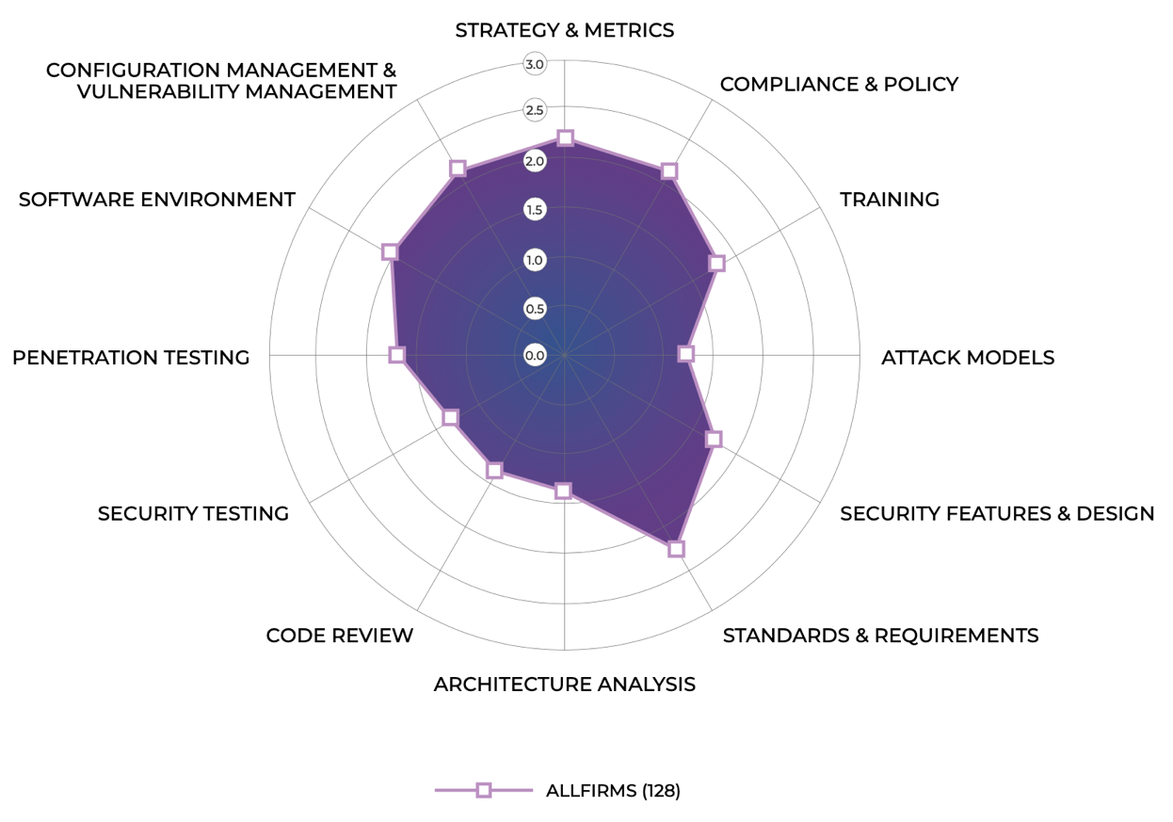
Benchmarking (all companies)
Long way to go ☹

Slide 37
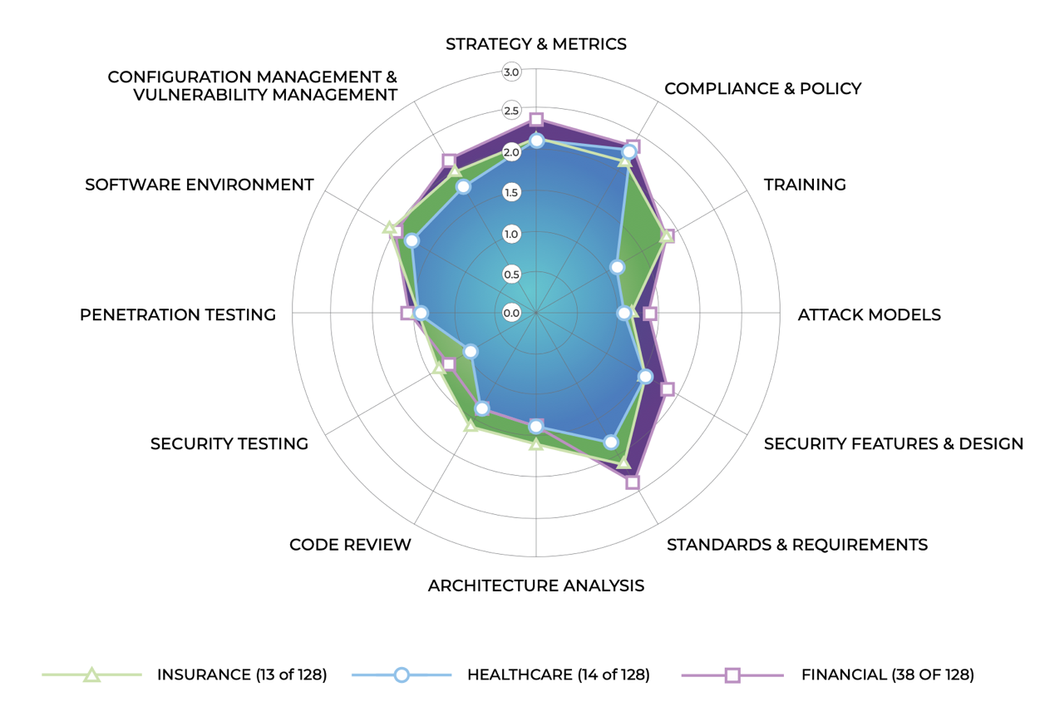
Benchmarking (per domain)
Study at home

Slide 38
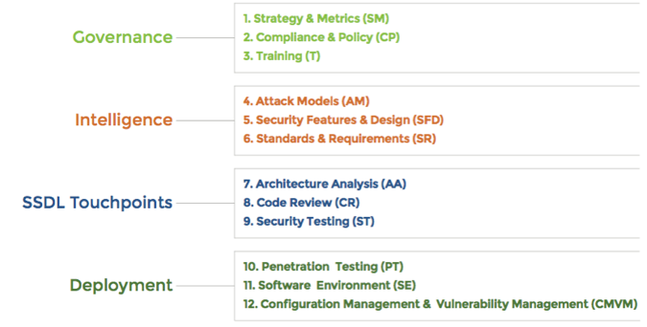
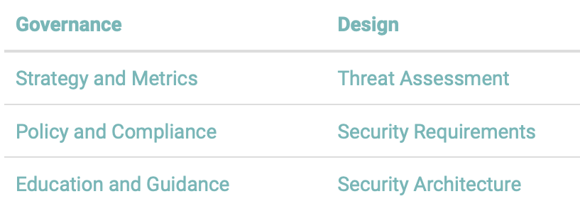
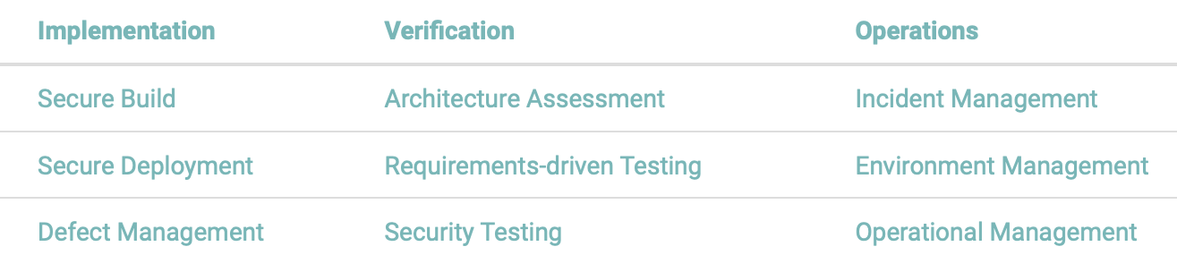
SAMM
Only for your info
BSIMM

Slide 39
Beyond processes
Prior idea: “certifying” the process, as a way to provide security assurance
  Core Infreastructure Initiative (CII*) follows the same principle but makes it more lightweight (badges for best practices)
  Badges: Passing, Silver, Gold
  The security part of the badge is rather product-focussed
  https://bestpractices.coreinfrastructure.org/en/criteria/0
Different focus: product/service and its development artifacts
  Common Criteria had this right ;)
Security Assurance Cases
  Product-focuss and evidence-based
Upcoming lecture
*CII now replaced by OpenSSF (Open Source Security Foundation)

Slide 40
Latest trend: certification
Regulation (EU) 2019/881 (Cybersecurity Act)
  EU Cybersecurity Certification Framework
EU Cybersecurity Certification scheme
  Developed by ENISA (UE Agency for Cybersecurity)
  Based on Common Criteria (and ISO standards)
  Version V.1.1.1 (candidate)
  300 pages ☺
Notes:
ISO/IEC 15408-1:2009
Information technology — Security techniques — Evaluation criteria for IT security

Slide 41
Learning objectives: checkpoint
What are security software processes?
  Set of additional security-centric activities that are added to the phases of the software process (plus focus on training)
What are security maturity models?
  Areas of intervention that describe increasingly more thorough security activities to be carried out in an organization (focus on software development)

