Slide 1
Secure Software Engineering:
Course structure and rules
Riccardo Scandariato
Institute of Software Security, TUHH, Germany
ric***do . scanda***to @ tuhh.de
MSc Course Secure Software Engineering – Summer Semester 2022

Slide 2
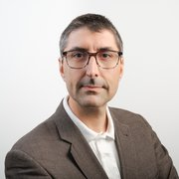
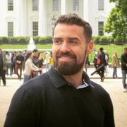

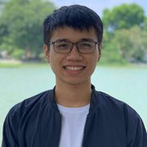
People
Riccardo Scandariato
Lecturer
scandariato@tuhh.de
Nicolas Diaz Ferreyra
Lecturer, lab coordinator
nicolas.diaz-ferreyra@tuhh.de
Catherine Tony
Lab assistant
catherine.tony@tuhh.de
Cuong Bui
Lab assistant
cuong.bui@tuhh.de

Slide 3
Lectures and structure
01 Intro + Software process
02 Introduction to Security Requirements
03 Goal-Oriented Security Requirements
04 Secure Software Design: Fundamentals
05 Secure Software Design: Analysis Techniques
06 Fundamentals of Security Risk Analysis
07 Tools and Methods for Risk Assessment (Guest)

Slide 4
Lectures and structure
08 Secure Infrastructure and Code Quality
09 Fundamentals of Privacy Engineering (Nicolas)
10 Privacy as Contextual Integrity (Nicolas)
11 Human Factors in Cybersecurity (Nicolas)
12 Risk and Vulnerability Management at Airbus (Guest)
13 Security assurance cases in Automotive (Guest)
14 Wrap-up and exam preparation

Slide 5
Material
Exam is based on slides / lectures / labs
Additional articles mentioned in lecture slides

Slide 6
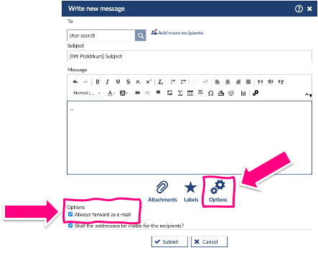
I do not answer messages on Stud.IP
Always forward as email !!!
I must be able to see your full name in the mail !
Say what course the mail is about !

Slide 7
Wiki on Stud.IP
Wiki contains the list of lectures and labs
Lectures availabe as „preview“ before class
Replaced by official PPT/PDF after the lecture
→ study material for the exam

Slide 8
Stud.IP
Files on Stud.IP
Slides
Project assignments
Announcements on Stud.IP
The way we (TAs, Nico, me) communicate with you for management issues

Slide 9
Organization
The labs are organized around 6 knowledge areas:
Lab-1: Security requirements
Lab-2: Secure software design
Lab-3: Risk assessment
Lab-4: Secure infrastructure and code quality
Lab-5: Privacy engineering
Lab-6: Human factors in cybersecurity (*)
All labs have follow-up sessions:
We start with the tasks/exercises in session 1.
We complete the tasks/exercises in the follow-up session.
Except for Lab-6, all labs start on week N and finalize on week N+1.

Slide 10
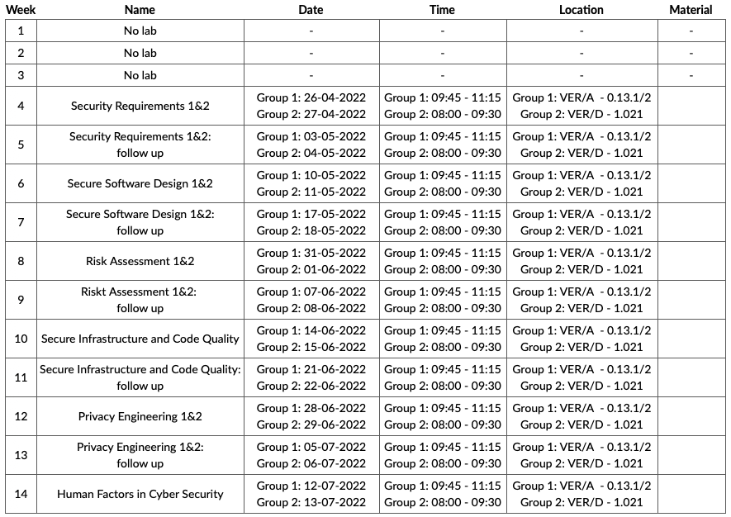
Schedule
TWO GROUPS

Slide 11

Training material and technical requirements
The exercise sheets of each lab will be available on Stud.IP
Set of tasks
Supplementary material:
  Scientific papers.
  Documentation templates.
  Docker images.
  Software for system modeling and analysis (links).
Case study: Privacy and security in the “Metaverse”
  Goals, requirements, tactics, patterns …
  Threat and risk analysis …
  Secure design …
Remember to bring your laptops to the lab! ☺

