Slide 1
Fundamentals of Privacy Engineering
Riccardo Scandariato
Institute of Software Security, TUHH, Germany
ric***do . scanda***to @ tuhh.de
Master Course “Secure Software Engineering”
Summer Semester 2022

Slide 2
Agenda
Privacy and Security
Privacy by Design
Privacy Engineering
LINDDUN
Privacy Design Strategies
Privacy-Enhancing Technologies
Notes:
https://www.cs.ru.nl/~jhh/publications/pds-booklet.pdf
https://link.springer.com/content/pdf/10.1007%2F978-3-030-29053-5_14.pdf
http://pripareproject.eu
NEXT LECTURE: Privacy Impact Assessment??

Slide 3
Privacy or Security?
Hypothetical Scenario:
You download an app in your smartphone.
You agree on the privacy policy and grant the app access to certain information stored in your phone:
  Contacts, Location, Photos, Videos …
SCN-1: Imagine that the app developer turns around you and sells your information to 3rd parties without your permission!
SCN-2: Now imagine that the company developing the app suffers a breach, exposing your information to cybercriminals!
Are these scenarios describing privacy or security violations?
What is the difference? Is there even a difference?

Slide 4
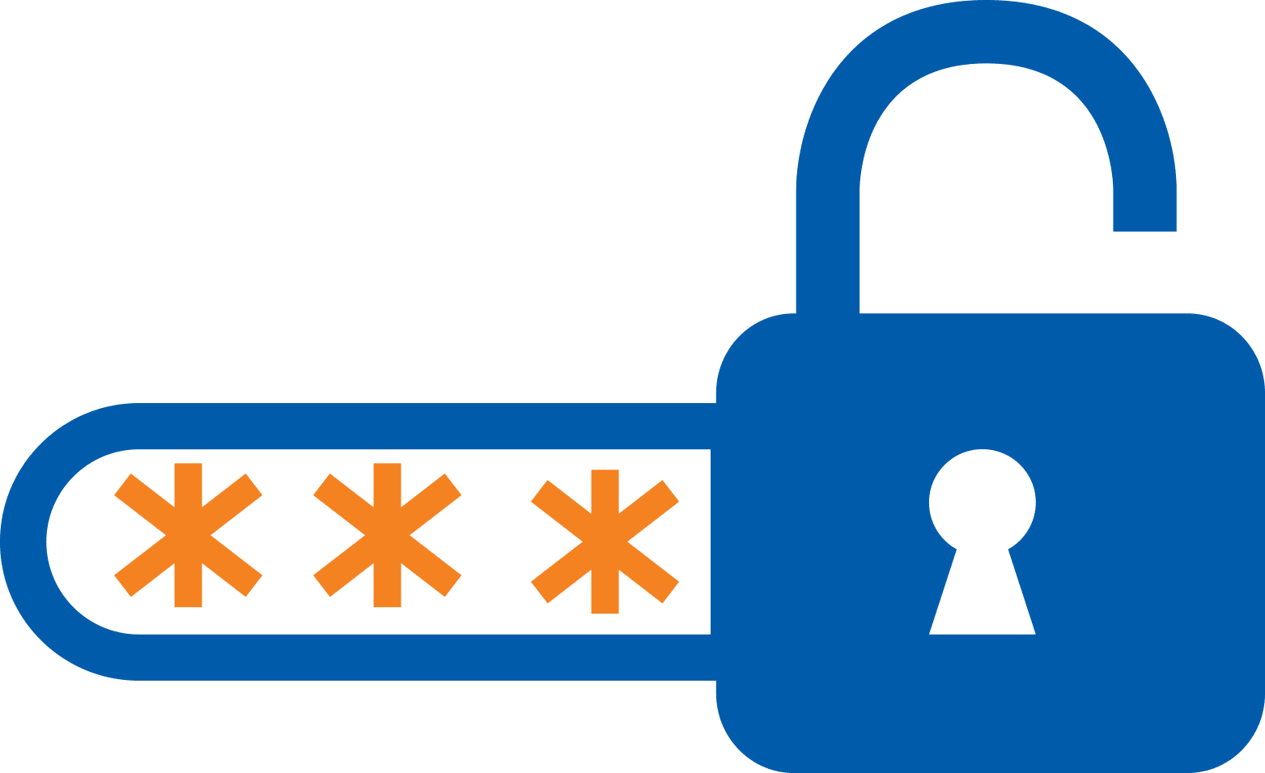
Security
Security and privacy are two closely related concepts. However, there are some key differences:
Security is a broader concept. It is concerned with the protection of assets against malicious attackers.
  Preventing unauthorized access to assets via breaches or leaks regardless of who the unauthorized party is.
Assets can be critical infrastructure, money, or private information.
Security measures (e.g., firewalls, user authentication, network) are implemented to deter unauthorized access.
Notes:
https://www.tokenex.com/blog/data-privacy-vs-security

Slide 5
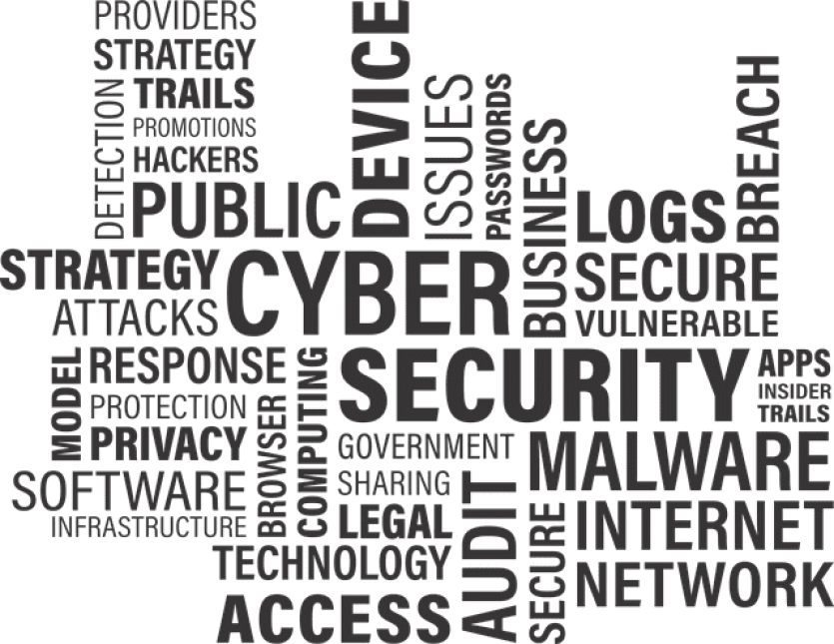
Security
Notes:
https://www.tokenex.com/blog/data-privacy-vs-security

Slide 6
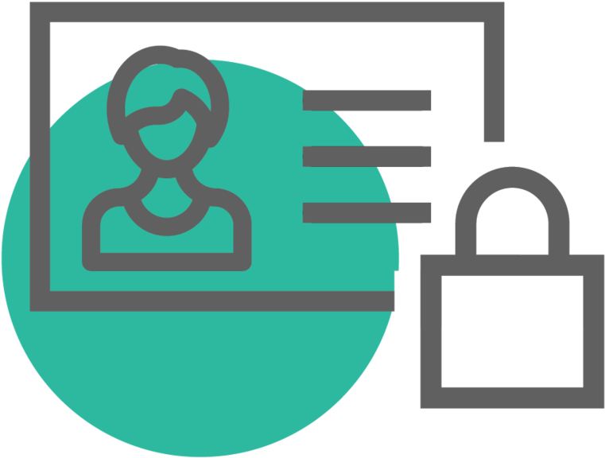
Privacy
Privacy is more concerned with the responsible use of personal data:
Ensure that data is processed, stored, and shared in compliance with a set of data protection mandates, principles, and rights:
  confidentiality
  integrity
  transparency
  right to be informed, access, rectification, “to be forgotten” …
Privacy, unlike security, cannot stand on its own:
  Privacy is achieved in the practice through security controls.
  In short, we cannot have privacy without security!
Notes:
https://www.tokenex.com/blog/data-privacy-vs-security

Slide 7
Privacy or Security?
Let’s go back to the hypothetical scenarios…
SCN-1: Imagine that the app developer turns around you and sells your information to 3rd parties without your permission!
  This is a privacy violation
SCN-2: Now imagine that the company developing the app suffers a breach, exposing your information to cybercriminals!
  This is again a privacy violation
  But it is also a security failure
In both cases, the developer failed
to protect your privacy
Notes:
https://www.tokenex.com/blog/data-privacy-vs-security

Slide 8
Privacy by Design
Like security, privacy is also seen as a quality attribute of software.
It is often an “after thought” instead of a priority!
At its core, Privacy-by-Design (PbD) consists of incorporating privacy into networked data systems and technologies by default:
An organizational priority.
Embedded into every standard, protocol, and process.
PbD is translated into 7 foundational principles:
Proactive, not reactive; preventive not remedial: Anticipate, identify, and prevent invasive events before they happen. Do not wait for risks to materialize!
Notes:
https://www2.deloitte.com/content/dam/Deloitte/ca/Documents/risk/ca-en-ers-privacy-by-design-brochure.PDF

Slide 9
Privacy by Design
Privacy as the default setting: Ensure personal data is automatically protected in all information systems or business processes, without requiring any further action.
Privacy embedded into design: Privacy mechanisms should not be add-ons, but fully integrated components of a system.
Full functionality – Positive-Sum, not Zero-Sum: Privacy and security should not compete against other legitimate interests and design objectives. They should be embedded into the system without impairing its full functionality.
End-to-end security – Full lifecycle protection: All data should be securely retained as needed and destroyed when no longer needed.
Notes:
Proactive, not reactive; preventive not remedial.
Privacy as the default setting.
Privacy embedded into design.
Full functionality – Positive-Sum, not Zero-Sum.
End-to-end security – Full lifecycle protection.
Visibility and transparency – keep it open.
Respect for user privacy – Keep it user-centric.

Slide 10
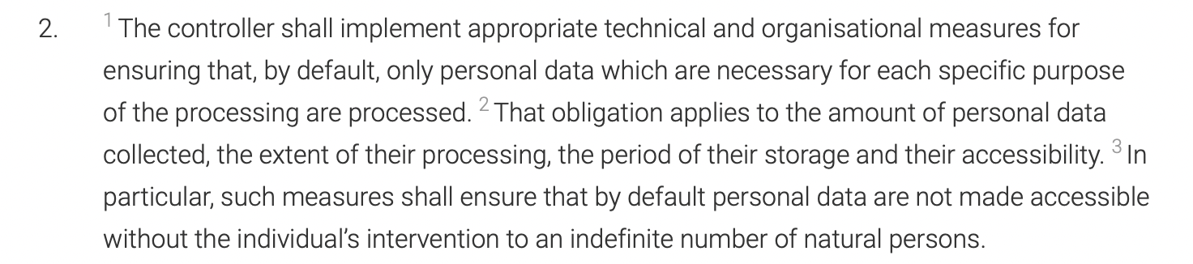
Privacy by Design
Visibility and transparency – keep it open: Assure stakeholders that business practices and technologies are operating according to objectives and subjects to independent verification.
Respect for user privacy – keep it user-centric: Individual privacy interests must be supported by strong privacy defaults, appropriate notice, and user-friendly options.
Many of these principles are embedded in the EU GDPR/DSGVO ⚖️
[General Data Protection Regulation (GDPR) - Article 25]
Notes:
Proactive, not reactive; preventive not remedial.
Privacy as the default setting.
Privacy embedded into design.
Full functionality – Positive-Sum, not Zero-Sum.
End-to-end security – Full lifecycle protection.
Visibility and transparency – keep it open.
Respect for user privacy – Keep it user-centric.

Slide 11
Privacy Engineering
It is a field of study concerned with the systematic elicitation and implementation of privacy requirements in socio-technical systems.
PbD = “what to do” ⇒ privacy engineering = “how” to do it.
Engineers are key players since they are responsible for devising the technical architecture of the system and creating the code.
Typical sources of privacy requirements are:
Accepted privacy definitions: For different authors, privacy may be a matter of non-intrusion, seclusion, limitation, control, etc.
  Different theories provide different conceptual frameworks.
User concerns: Activities such as data transfer, storage, and processing can trigger privacy concerns among the stakeholders.
Notes:
A Metamodel for Privacy Engineering Methods
LINDUN for privacy requirements engineering
Privacy Tactics to satisfy the requirements! ☺

Slide 12
LUNDDUN
There are several PE methods defining activities that introduce privacy at different stages of software development life cycle:
ProPAn, PRIPARE, STRAP, QTMM, LINDDUN…
Overall, these PE methods define steps and a collection of software artifacts that support them (e.g., DFDs, threat catalogs, etc.).
LINDUNN is a systematic framework that employs threat modeling for assessing the privacy of information systems:
Consists of 6 steps. The first 3 steps are problem-oriented as they aid the identification of threats.
The last 3 steps are solution-oriented as they seek to translate threats into mitigation actions and strategies.
Can be applied multiple times at different stages of the life cycle.
Notes:
A Metamodel for Privacy Engineering Methods
LINDUN for privacy requirements engineering
Privacy Tactics to satisfy the requirements! ☺

Slide 13
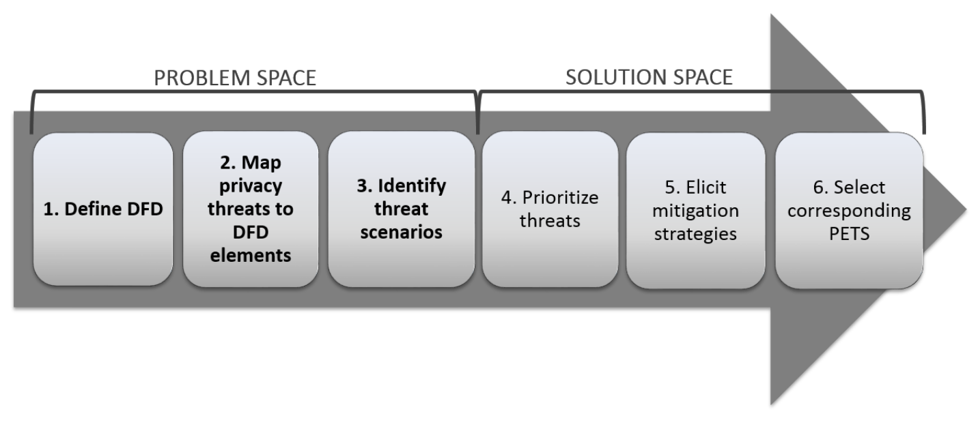
LUNDDUN
LINDDUN is model-based ⇒ Uses DFDs for representation and analysis
Each element of the DFD is thoroughly examined for privacy threats.
LINDDUN is knowledge-based ⇒ Provides a threat catalog
Contains common attack paths for a set of privacy threat categories: Linkability, Identifiability, Non-repudiation, Detectability, Disclosure of information, Unawareness, Non-compliance ⇒ LINDDUN
Notes:
A Metamodel for Privacy Engineering Methods
LINDUN for privacy requirements engineering
Privacy Tactics to satisfy the requirements! ☺

Slide 14
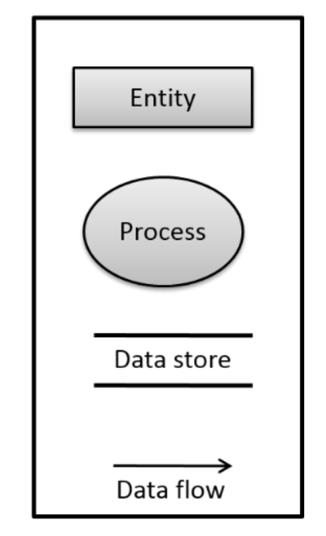
Step 1: Define DFD
A DFD is describes how information moves across the system using 4 types of building blocks:
Process (P): a unit of work that operates the data.
Data flow (DF): a named flow of data through a system of processes.
Data store (DS): a logical repository of data (passive container).
External entity (E): a source or destination of data, such as a system, users, or third-party services.
Optionally, trust boundaries can be added to the DFD to indicate places in which parties with different privileges interact.
Notes:
A Metamodel for Privacy Engineering Methods
LINDUN for privacy requirements engineering
Privacy Tactics to satisfy the requirements! ☺

Slide 15
Step 1: Define DFD
Guidelines for DFD elaboration from requirements:
Start with a “level 0” DFD:
  One main process representing the system.
  Connect this process to the actors/users of the system and the external entities (e.g., 3rd-party services and components).
Decompose the process into one or more data stores and internal processes:
  Processes communicating to external entities (facades, portals, websites).
  Processes responsible for the databases like repository processes (Remember: databases are passive containers).
  The internal operation of the system will require multiple processes in order to represent its complexity.
Add dataflows to connect all the above DFD elements.
Notes:
A Metamodel for Privacy Engineering Methods
LINDUN for privacy requirements engineering
Privacy Tactics to satisfy the requirements! ☺

Slide 16
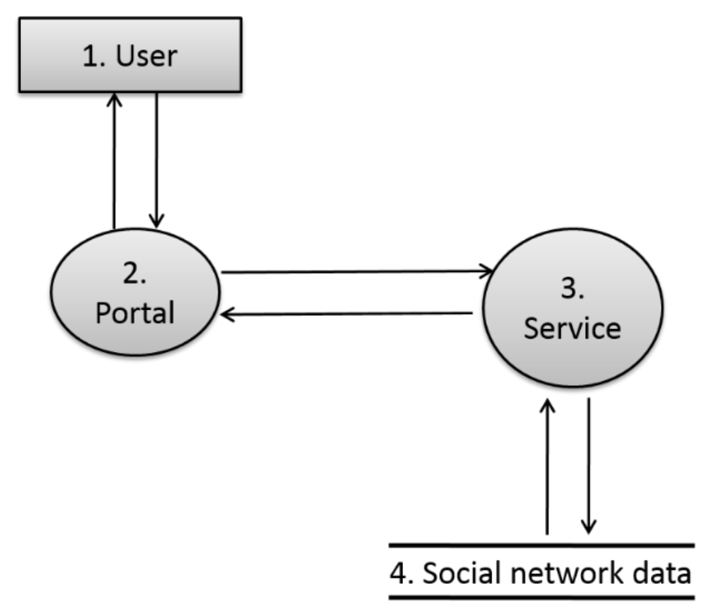
Step 1: Define DFD
Example: A social network platform in which users interact through a web portal. The portal forwards the users’ requests (e.g., add friends, share content, etc.) to a service that manages them. Eventually, such a service stores the necessary information inside a database.
Notes:
A Metamodel for Privacy Engineering Methods
LINDUN for privacy requirements engineering
Privacy Tactics to satisfy the requirements! ☺

Slide 17
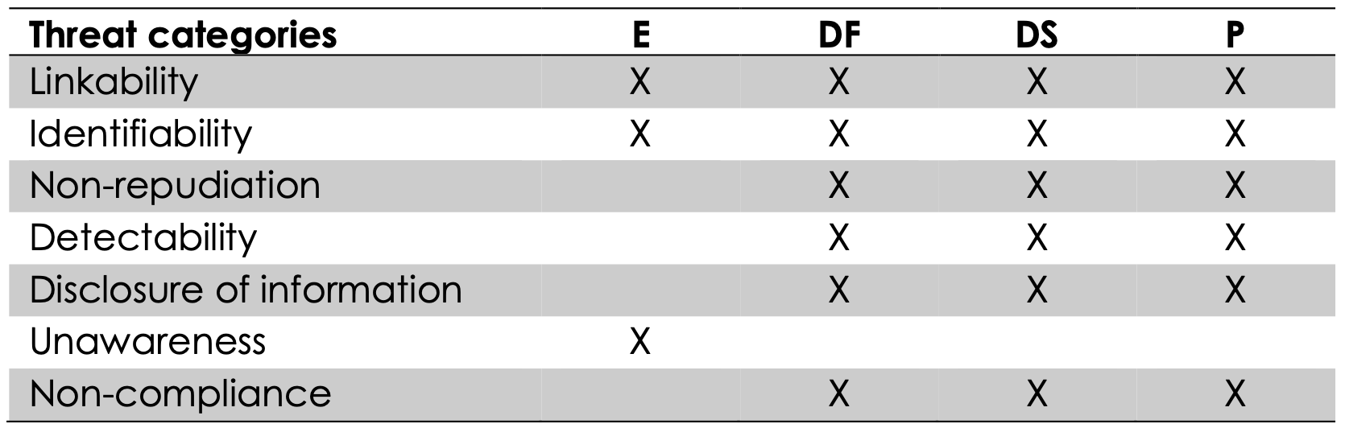
Step 2: Mapping the DFD to LINDUNN threat categories
In LINDDUN, each DFD element type is potentially subject to specific privacy threats grouped around 7 high-level categories.
Mapping Template
Each DFD element is subject to certain privacy threats, and the nature of the potential privacy threat is determined by the DFD element type.
Can “unawareness” be a threat to a datastore?
Why? Why not?
Notes:
Only external entities like users can threaten the system due to lack of awareness. For instance, by introducing highly sensitive information on it.

Slide 18
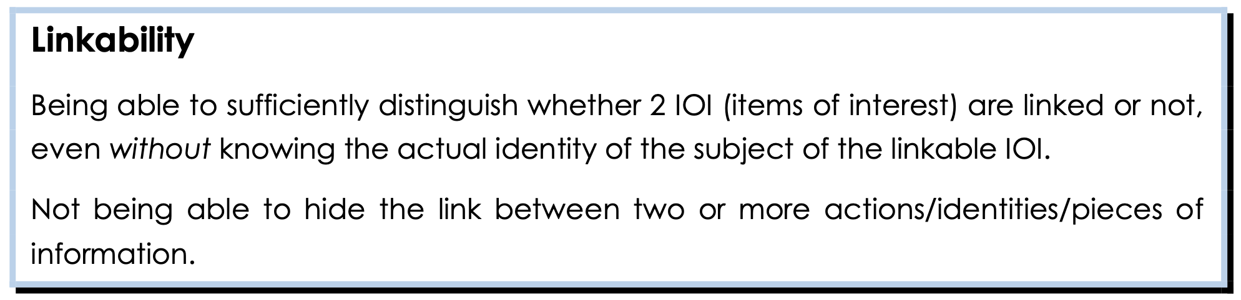
Step 2: Mapping the DFD to LINDUNN threat categories
Linkability can result in severe privacy issues only when linkable data leads to identification or inference:
Identification: A data subject can be recognized by linking several (pseudo-)anonymous data (e.g., street name + gender + age).
Inference: We can deduce relationships from certain related properties leading to severe cases of discrimination (e.g., people living in a certain neighborhood are prone to particular diseases).
Notes:
Only external entities like users can threaten the system due to lack of awareness. For instance, by introducing highly sensitive information on it.

Slide 19
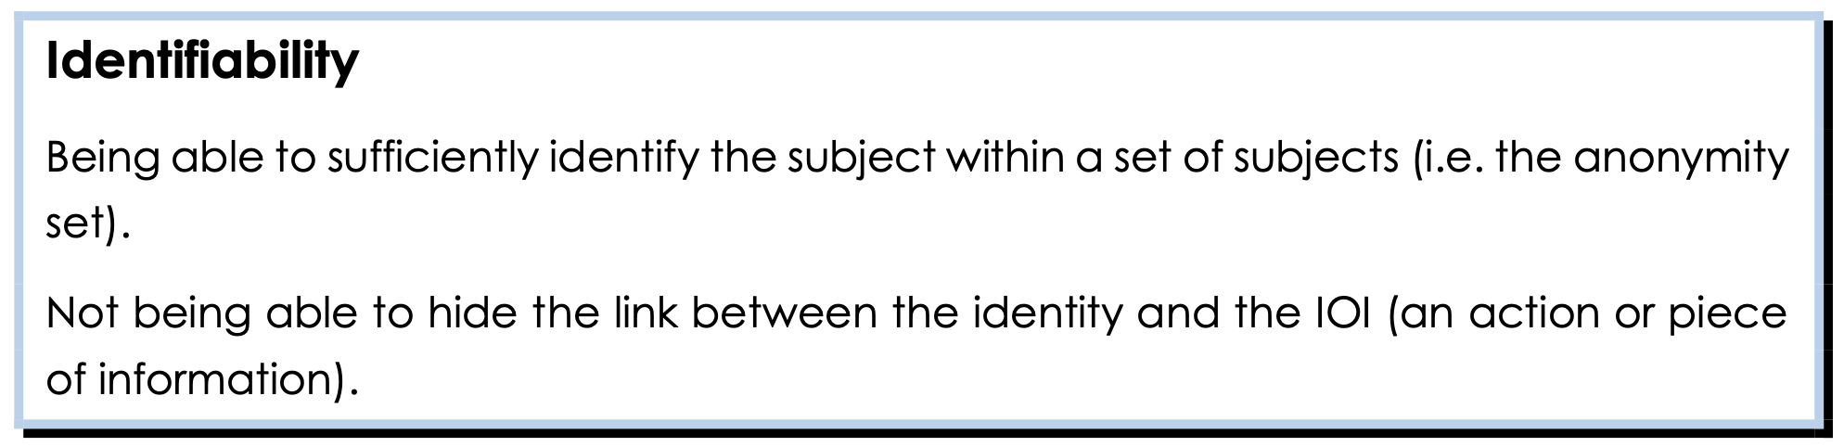
Step 2: Mapping the DFD to LINDUNN threat categories
Identifiability is often a consequence of linking data to the same subject:
Data are considered de-identified when no identifiers (e.g., social security number, full name and address, birth date) are stored.
Pseudo-identifiers (e.g., birth year (instead of birthdate), city (instead of full address), etc.) can also lead to an identification.
⇒ The more information is linked together, the smaller the anonymity set will be. Can ratings of a song/movie lead to identifiability?
Notes:
Pattern matching may come in many forms. Examples include the now infamous Netflix release of movie viewing habits which was matched against Internet Movie Database (IMDB) posts to identify some users based on their review history34 or the potential use of a small set of mobile phone locations to identity people.35

Slide 20
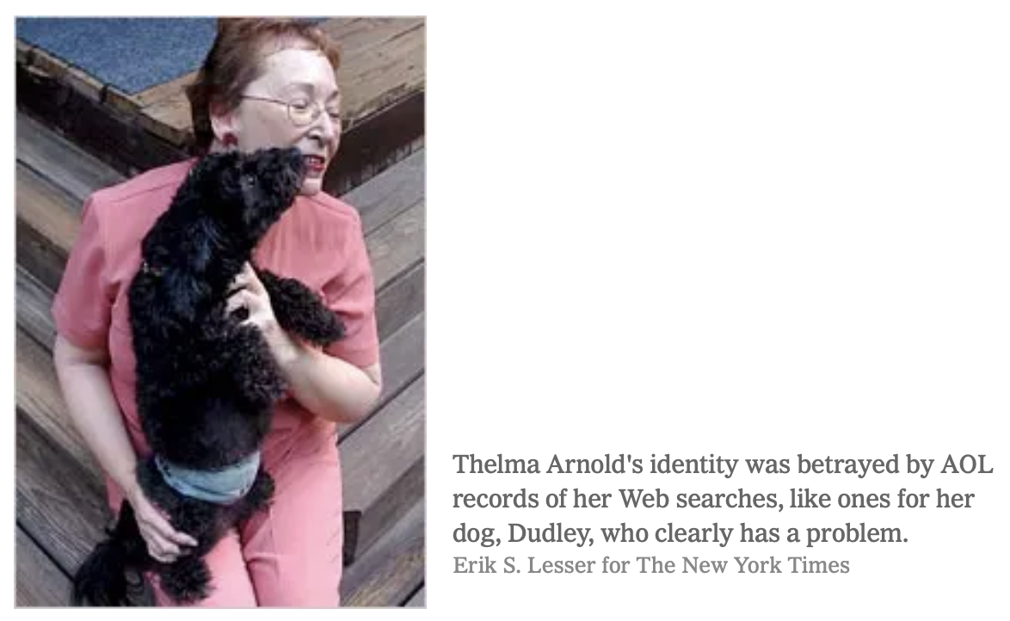
Step 2: Mapping the DFD to LINDUNN threat categories
“No. 4417749 conducted hundreds of searches over a three-month period on topics ranging from “numb fingers” to “60 single men” to “dog that urinates on everything.”
“…search by search, click by click, the identity of AOL user No. 4417749 became easier to discern.”
“…AOL removed the search data from its site over the weekend and apologized for its release.” ☺
https://www.nytimes.com/2006/08/09/technology/09aol.html
Internet users can be easily identified by compiling their search queries.
Notes:
Only external entities like users can threaten the system due to lack of awareness. For instance, by introducing highly sensitive information on it.

Slide 21
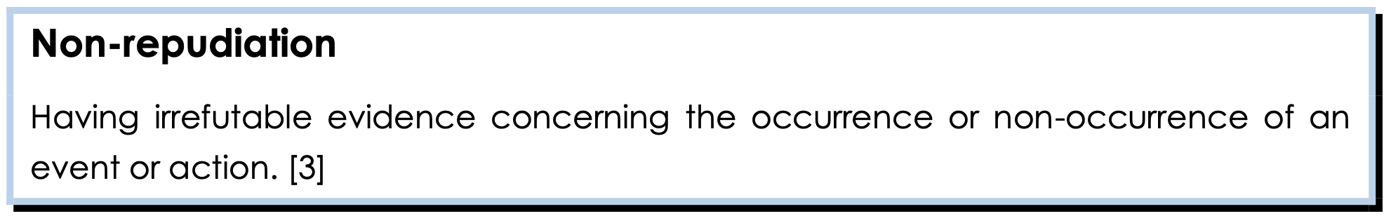
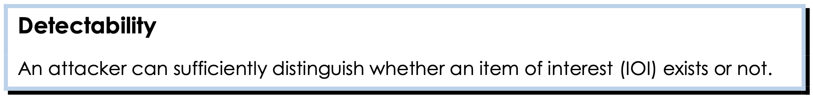

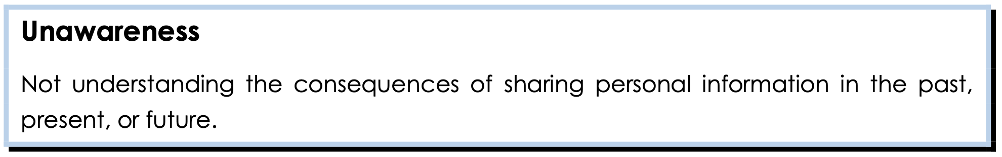
Step 2: Mapping the DFD to LINDUNN threat categories
*
*An attacker may be interested on demonstrating that a user has said, done, or knows something. This threat is a security goal as well.

Slide 22
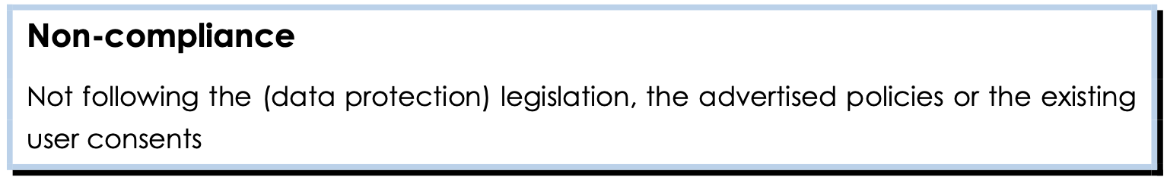
Step 2: Mapping the DFD to LINDUNN threat categories
The system as a data controller must determine the purposes for which and the means by which personal data is processed ⇒ privacy policy
A policy specifies a set of rules with respect to data protection. These are general rules determined by the systems’ stakeholders.
The system should allow users to grant or revoke permissions over the collection and processing of their personal data
It is very important to ensure that policies are properly implemented, and users’ consent is acknowledged and respected.
This threat is closely related to legislation. LINDDUN alone cannot guarantee full compliance. Regulatory threats should be analyzed by legal experts!

Slide 23
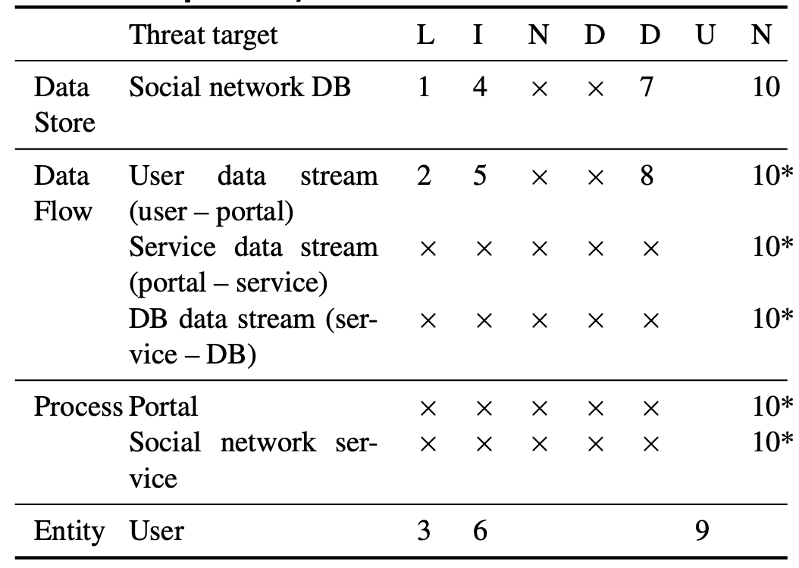
Step 2: Mapping the DFD to LINDUNN threat categories
Example: We compute a list of generic threats to the modelled system using (i) LINDUNN mapping template, and (ii) the system’s DFD elements. We mark with gray those threats deemed as irrelevant.
Computed Threats
The threats we will take into consideration are marked with a number. We use 10* to indicate noncompliance threats affecting the whole system.

Slide 24
Step 3: Elicit + document threats
This is the core execution step in LINDDUN but also the most tedious and it is thus divided into three sub-activities.
3.1 Refining threats via threat tree patterns
For each ‘X’ in the mapping table (see step 2), LINDDUN provides a list of concrete threats (organized into trees) that need to be considered.
The tree shows the specific preconditions (vulnerabilities) for a given threat category that can be exploited in a privacy-attack scenario.
We will examine the branches of the trees corresponding to the threats computed in Step 2 to identify potential privacy violations.
LINDDUN provides a threat tree catalog on its
website for supporting this step
Notes:
A Metamodel for Privacy Engineering Methods
LINDUN for privacy requirements engineering
Privacy Tactics to satisfy the requirements! ☺

Slide 25
Step 3: Elicit + document threats
3.2 Documenting assumptions
Certain leaf nodes (or even entire branches) may not be deemed relevant to the system under analysis and will thus not be considered.
Assumptions are explicit or implicit choices to trust an element of the system (e.g., human, piece of software) to behave as expected.
Assumptions should be documented for instance as a free text linked to the corresponding misuse case (see next) for traceability purposes.
3.3 Documenting threats using a threat template
Applicable threats (i.e., those deemed relevant for the system under analysis) should be documented as misuse cases.
Misuse case: A use case from the misactor’s point of view.
LINDUNN provides a template for this purpose.
Notes:
A Metamodel for Privacy Engineering Methods
LINDUN for privacy requirements engineering
Privacy Tactics to satisfy the requirements! ☺

Slide 26
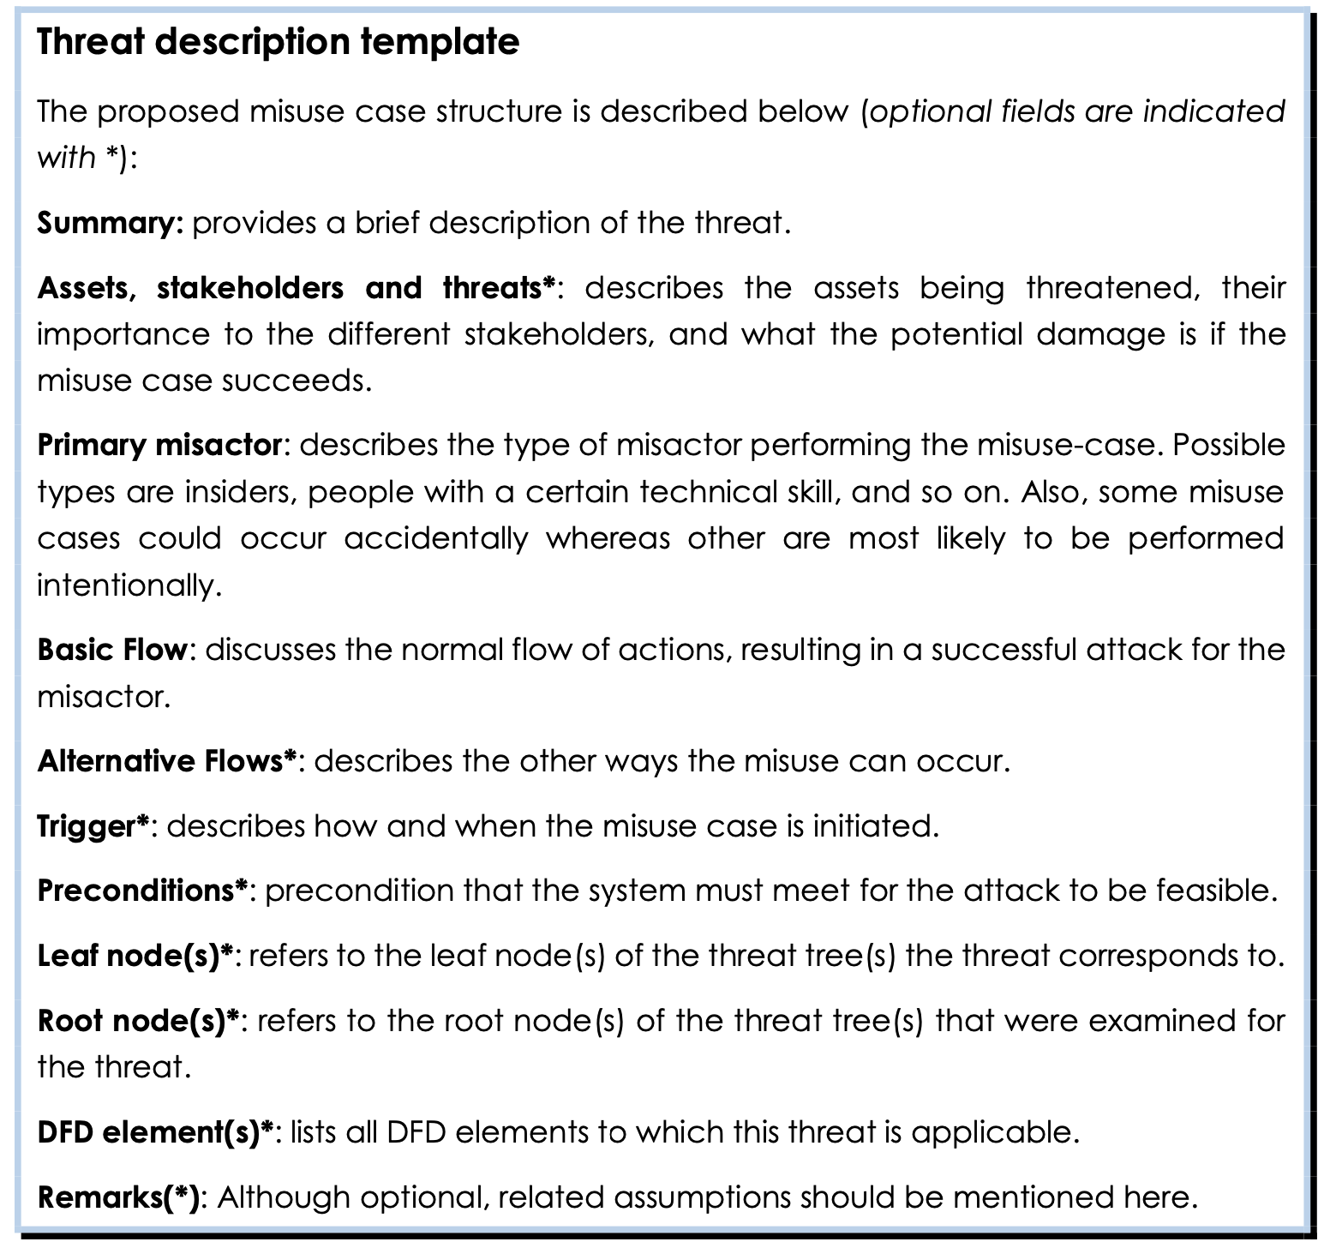
Notes:
A Metamodel for Privacy Engineering Methods
LINDUN for privacy requirements engineering
Privacy Tactics to satisfy the requirements! ☺

Slide 27
Step 3: Elicit + document threats
MUC 1 – Linkability of social network database (data store)
Summary: Data entries can be linked to the same person (without necessarily revealing the persons identity).
Assets, stakeholders, threats: The user’s Personal Identifiable Information (PII)
Data entries can be linked to each other revealing the persons identity.
The misactor can build a profile of a user’s online activities (interests, actives time, comments, updates, etc.).
Primary misactor: skilled insider/skilled outsider.
Basic Flow:
The misactor gains access to the database.
The misactor can link the data entries together and possibly re-identify the data subject from the data content.
Notes:
A Metamodel for Privacy Engineering Methods
LINDUN for privacy requirements engineering
Privacy Tactics to satisfy the requirements! ☺

Slide 28
Step 3: Elicit + document threats
MUC 1 – Linkability of social network database (data store)
Alternative Flow:
The misactor gains access to the database.
Each data entry is linked to a pseudonym.
The misactor can link the different pseudonyms together (linkability of entity).
Based on the pseudonyms, the misactor can link the different data entries.
Trigger: by misactor, can always happen.
Preconditions:
No or insufficient protection of the data store.
No or insufficient data anonymization techniques or strong data mining applied.
Notes:
A Metamodel for Privacy Engineering Methods
LINDUN for privacy requirements engineering
Privacy Tactics to satisfy the requirements! ☺

Slide 29
Step 4: Prioritization of threats (risk assessment)
Before moving forward and looking for suitable mitigation actions, the identified threats must be prioritized.
Time and budget limitations make treating all threats unfeasible.
Only the most important ones will be addressed in the requirements specification and in the design of the solution.
Risk assessment techniques provide support for this stage.
In general, risk is calculated as a function of the likelihood of the attack scenario and its impact (or consequence level).
The LINDDUN framework is independent from the risk assessment technique that is used.
The analyst is free to pick the technique of choice (e.g., OWASP).
Notes:
A Metamodel for Privacy Engineering Methods
LINDUN for privacy requirements engineering
Privacy Tactics to satisfy the requirements! ☺

Slide 30
Step 5: Elicit mitigation strategies | Step 6: PETs
Misuse cases can help extracting a set of (positive) system requirements:
Some requirements are “straight-forward” and correspond to a set of elementary privacy objectives.
  LINDDUN provides a mapping table supporting this task.
More detailed mitigation strategies may be necessary in the practice
  LINDDUN provides a taxonomy of mitigation strategies along with their corresponding requirements and solutions.
⇒ Mitigation strategies (or tactics) capture a high-level view of common techniques used in the practice to prevent privacy threats.
At the final step (Step 6), privacy strategies are translated into a set of Privacy Enhancing Technologies (PETs)
Notes:
A Metamodel for Privacy Engineering Methods
LINDUN for privacy requirements engineering
Privacy Tactics to satisfy the requirements! ☺

Slide 31
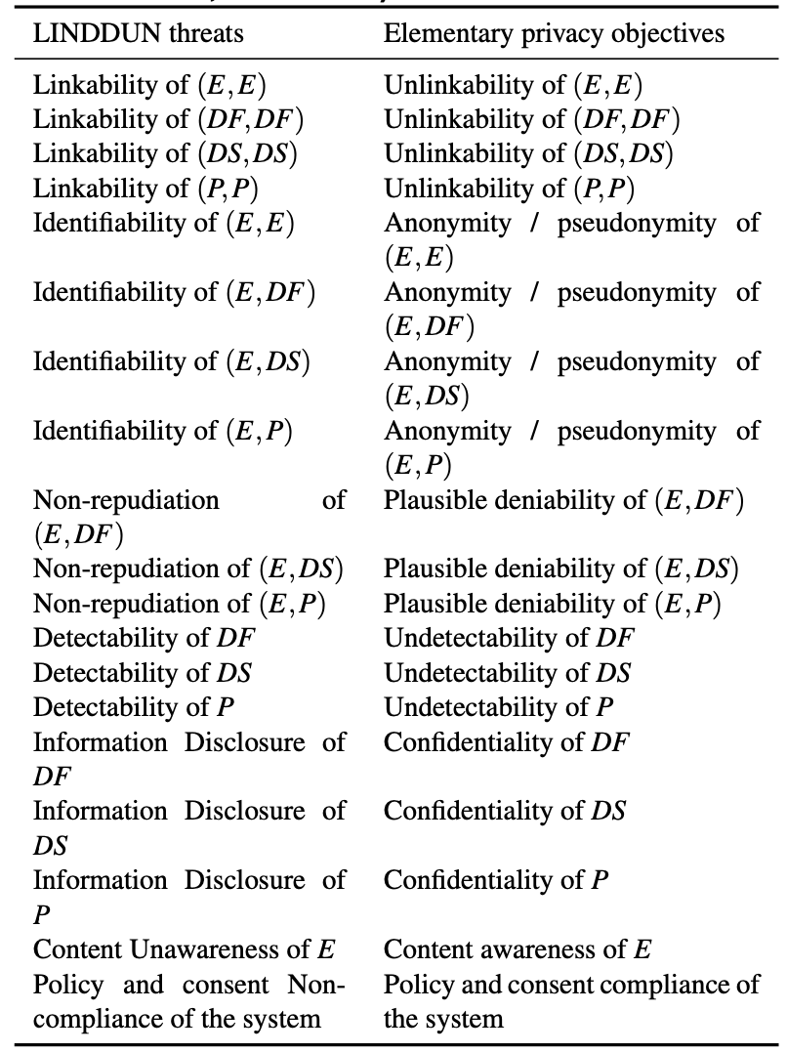
Step 5: Elicit mitigation strategies | Step 6: PETs
Straight-forward
Requirements
Notes:
A Metamodel for Privacy Engineering Methods
LINDUN for privacy requirements engineering
Privacy Tactics to satisfy the requirements! ☺

Slide 32


Privacy Design Strategies
Privacy and data protection by design can be achieved through a set of design strategies:
Minimize: System designers should ensure that only the minimal necessary personal info is collected.
Hide: Confidentiality of the data is ensured either by encrypting, pseudonymizing or anonymizing data in transit or storage.
Notes:
https://link.springer.com/content/pdf/10.1007/978-3-030-29053-5_14.pdf
https://link.springer.com/content/pdf/10.1007/978-3-642-55415-5_38.pdf

Slide 33
Privacy Design strategies
Separate: Personal data should be stored and processed in a distributed way.
Aggregate: Storage of individualized data should be restricted as much as possible and replaced by aggregates when possible.
Inform: Respondents should be made informed what information about them is being collected and processed for which reasons.
Control: Respondents should be able to consult, modify and delete the information about them.
Enforce: Privacy policies should be put in place and enforced.
Demonstrate: Data controllers ought to document all collection and analysis processes conducted on personal information.

Slide 34
Example: Data Minimization
A recruiter, Rob, calls a potential employee, Ed, for a job interview:
Rob wants to know whether Ed is willing to work for the salary Rob’s company is offering.
However, Ed does not want to reveal his true salary requirements!!!
Sally, a consultant, is the intermediary between Ed and Bob. She will be in charge of answering Rob’s and Ed’s salary questions.
Solution: Ed and Bob give Sally the salary offer and requirements. She makes the comparison and reports the result to them.
Question: Is this solution correct? Can you spot any issues?

Slide 35
Example: Data Minimization
The proposed solution has the following issues:
Sally could judge Ed’s salary (“oh is he earning THAT much?!”).
She could also sell the information of Rob’s offer to his competitor.
⇒ Therefore, Ed and Rob are reluctant to give their data to Sally ☹
Solution 2: Sally does not need to know the actual figures, but just which of them is larger.
Sally generates a random number “rnd” and gives it to Rob.
Rob add the offer amount to “rnd” and passes it to Ed.
Ed subtracts his salary requirement and passes the result to Sally.
Sally compares the number from Ed against the original “rnd”.
  If larger, the offer is bigger ☺
  If not, then is smaller ☹

Slide 36
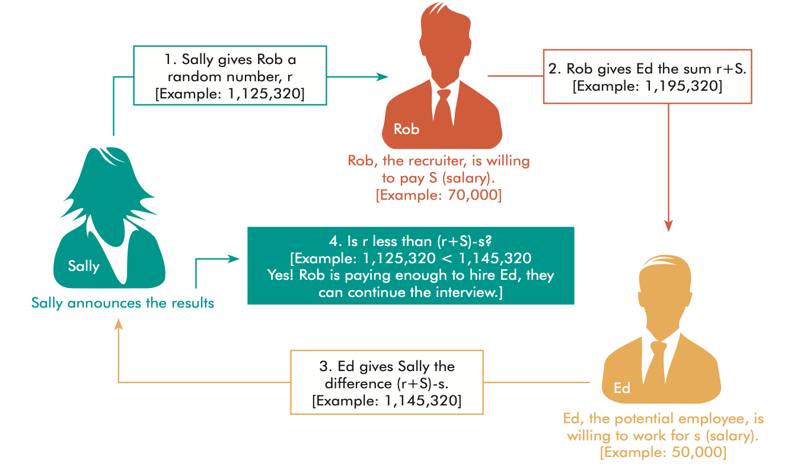
Example: Data Minimization

Slide 37
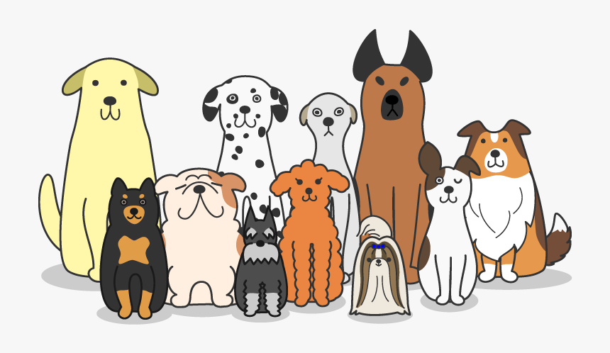
Privacy Enhancing Techniques (PETs)
Privacy strategies are sometimes not enough on their own:
Often too broad and vague.
Must be refined to be effectively used in practice.
Although PETs allow a many interpretations, they can be described as:
Technologies that make use of privacy design strategies.
Implement privacy design patterns or consider protection goals.
Notes:
https://dl.acm.org/doi/pdf/10.1145/3267323.3268957

Slide 38
Example: K-Anonymity
Problem: How to publicly release a database without compromising individual privacy?
Remove unique identifiers (e.g., name, social security number)? ☺
The triple <birthdate, gender, zip code> suffices to uniquely identify at least 87% of US citizens in publicly available databases ☹
K-Anonymity: Attributes are suppressed or generalized until each row is identical to K-1 other rows ⇒ k-anonymous Dataset
In the worse case, the released dataset narrows-down an individual entry to a group of k individuals.
- Method 1: Suppression (replace individual attributes with a *).
- Method 2: Generalization (replace attributes with a broader category).
Notes:
https://dl.acm.org/doi/pdf/10.1145/3267323.3268957

Slide 39
PETs: K-Anonymity
First name | Last Name | Age | Race
Harry | Stone | 34 | African-American
John | Kane | 36 | Caucasian
Beatrice | Stone | 34 | African-American
John | Delgado | 22 | Hispanic
This database an be 2-Anonymized with suppression:
First name | Last Name | Age | Race
* | Stone | 34 | African-American
John | * | * | *
* | Stone | 34 | African-American
John | * | * | *
Notes:
https://dl.acm.org/doi/pdf/10.1145/3267323.3268957

Slide 40
PETs: K-Anonymity
Overall, we can guarantee k-anonymity by replacing every cell with an *:
This renders the database useless!!!
The cost of a K-Anonymous solution is the number of *’s introduced.
A minimum cost k-anonymity solution suppresses the fewest number of cells necessary to guarantee k-anonymity.
Notes:
https://dl.acm.org/doi/pdf/10.1145/3267323.3268957

Slide 41

Share your opinion
Go to menti.com – xxxx yyyy
Notes:
34 63 80 0

Slide 42


Questions ?
More questions at a later time?
ric***do . scanda***to @ tuhh.de

