Slide 1
Human Factors in Cybersecurity
Riccardo Scandariato
Institute of Software Security, TUHH, Germany
ric***do . scanda***to @ tuhh.de
Master Course “Secure Software Engineering”
Summer Semester 2022 – Lecturer: Nicolás E. Díaz Ferreyra

Slide 2
Agenda
Social Engineering
Online Self-Disclosure
Privacy Nudges
Multiparty Privacy Conflicts
Ethics

Slide 3
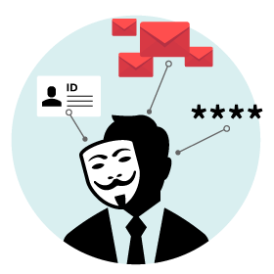
Social Engineering: Definitions
“The ‘art’ of influencing people to divulge sensitive information”
“The science of using social interaction to persuade an individual to comply with a specific malicious request” [Mouton, 2016]
The request, the persuasion, or the social interaction involve a computer-related entity.

Slide 4
Social Engineering (SE)
SE refers to a BROAD range of malicious activities accomplished through simple human interaction and a fair amount of deception:
People are the weakest security link of an organization.
  It’s often easier for cybercriminals to manipulate a human than a computer network or system.
  Attacks can be relatively low-tech, low-cost, and easy to execute.
Attackers use psychological manipulation to trick employees into making security mistakes or giving away sensitive information.
No one is immune! Many smart and careful people can fall victim to a social engineering attack without even realizing it until it is too late.
Social Engineering can have severe consequences for businesses, financial institutions, and population as a whole.

Slide 5
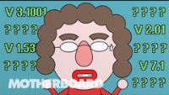
Getting Motorola’s Source Code?

Slide 6
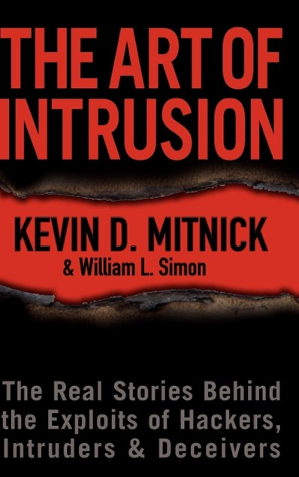
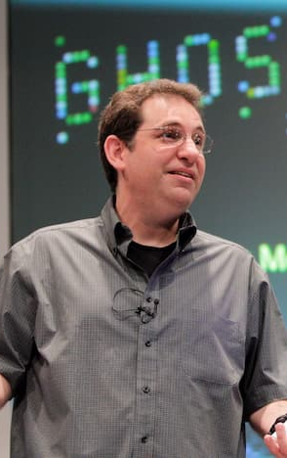
Social Engineering
Kevin Mitnick is often considered the original master of social engineering. There are even books about (and authored by) him.

Slide 7
Common Social Engineering Techniques
Pretexting: The attacker creates a scenario where the victim feels compelled to comply under false pretenses.
Phishing: The attacker sends fraudulent emails, claiming to be from a trustworthy source.
Vishing and Smishing: Same as phishing but using voice calls and text messages, respectively.
Shoulder Surfing: Use direct observation techniques to get information, such as looking over someone's shoulder at their screen or keyboard.
Waterholing: The attacker infects specific websites with malware and expect that some of their target companies' employees will visit them.
Baiting: Making false promises to users in order to lure them into revealing personal information or installing malware on the system.

Slide 8
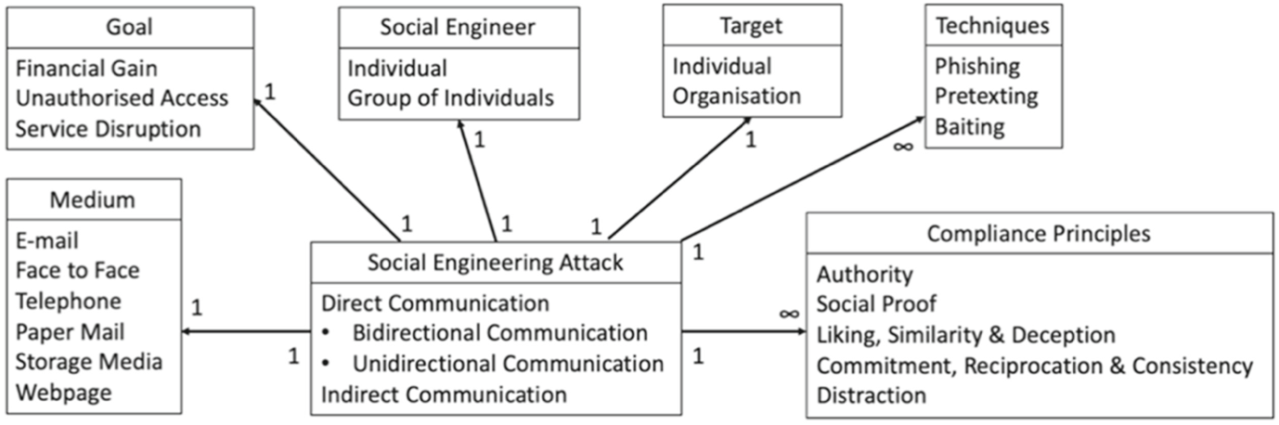
Social Engineering Attack Vector
At its core, a SE attack consists of a Medium, a Goal, a Social Engineer, a Target, plus one (or more) Techniques and Compliance Principles.

Slide 9
Social Engineering Attack Cycle
The Social Engineering attack cycle comprises the following stages:
Attack formulation: Identify the goal of the attack (e.g., financial gain) and the right target (e.g., individual).
Information gathering: Collect information about the potential target and everything related to the attack.
  The sources can be anything or anyone with access to the information required for the attack.
  Dumpster diving: Scan trash items for personal information.
Preparation: The social engineer analyzes the information and develop an action plan (i.e., an attack vector) to approach the target.
A target is more likely to share information with the attacker if a relationship exists between the two.

Slide 10
Social Engineering Attack Cycle
Develop a relationship: The social engineer establishes a line of communication with the target and begin to build a relationship.
  If trust cannot be established, the required information is unlikely to be elicited from the target!! A good pretext simplifies this step ☺
Exploit the relationship: The attacker employs manipulation tactics to get the target in a desired emotional state (e.g., as feeling sad or happy)
  The goal of emotional priming is making the target to feel comfortable about giving out information (and not guilty about it).
  Once the target is in the desired emotional state, she can be exploited to obtain the necessary information (e.g., password).
Debrief: The social engineer stays connected with the victim for a while, so she does not get alarmed/suspicious and contact the authorities.
Notes:
Channels??

Slide 11
Desired Emotional States
Emotional State | Example
Fear | You receive a notification that you’re under investigation for tax fraud and you must pay an immediate fee to the BZSt.
Greed | Someone convinces you that a mere $10.00 investment will pocket you $10,000 or more.
Curiosity | Someone sends you a voucher for trying a software that (in theory) is not yet on the market
Helpfulness | Playing on the basic desire of humans to trust and help one another – collecting charity and donations for a false cause
Urgency | You receive an email from a vendor you use indicating that they need to confirm your credit card information ASAP
How to reach a particular emotional state? Through manipulation
Notes:
Channels??

Slide 12
Manipulation Tactics
Social engineers often draw on one or several compliance techniques to effectively manipulate their victims:
Friendship or liking: People comply easier when the request comes from a friend or someone they like. Social engineers will seek common ground and establish a friendship to get the target to comply with their request.
Commitment or consistency: . Once the target has complied with the first request, they are much more likely to agree to the rest. In social engineering, this could mean asking for a simple, easy thing first, and then slowly continuing with more detailed and personal requests.
Scarcity: People are more likely to agree to a request if they feel the offer is scarce or will only be available for a short period of time. Social engineering uses this technique to use the target’s fear of missing out against them.

Slide 13
Manipulation Tactics
Reciprocity: People are likelier to comply with a request if they have been treated well by the person making the request. For example, the social engineer could have done the target a small favor, in order to use their need for reciprocity against them.
Social validation: People are more likely to comply with a request if they consider it the socially correct thing to do. The social engineering attack could be framed as a socially-expected request, such as participating in a donation or joint effort.
Authority: Many people are especially trusting towards official authorities inside of an organization such as IT Support, Management, or Security. If a social engineer camouflages as an authority or a legitimate entity, the target is more likely to comply with the request.
Which method works better?

Slide 14
Myers-Briggs Type Indicator (MBTI)
Not all individuals are susceptible to the same attack, but instead each of us is likely to succumb to a different type of manipulation tactic.
Different personalities will be susceptible to different types of tactics.
The MBTI is a preference model that defines 16 personality types derived from 4 dimensions, each of which is a dichotomy:
Extroversion-Introversion: Refers to the way people focus their attention.
Sensing-Intuition: Relates to the way people gathers information.
Thinking-Feeling: Intends to show how people primarily make judgments.
Judging-Perceiving: How people interact in general with the outer world.
From each dimension, a person can have one of the either-or characteristics.

Slide 15
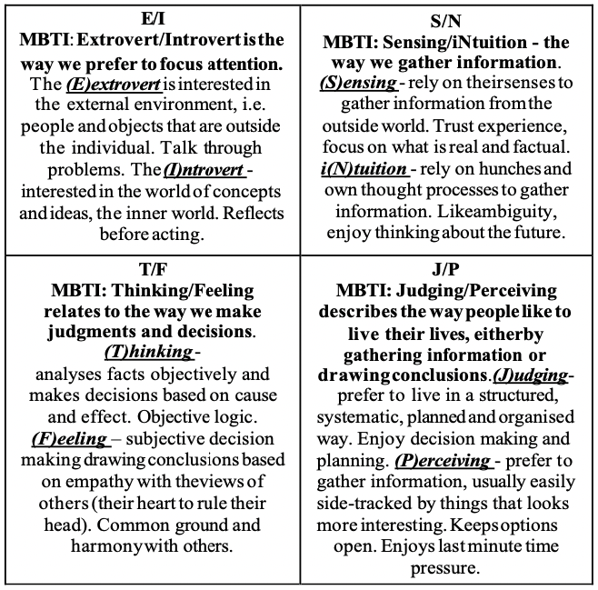
Myers-Briggs Type Indicator (MBTI)

Slide 16
Mapping Tactics to MBPI
(E)xtrovert/(I)ntrovert
Extrovert → Liking/Similarity
Introvert → N/A
(S)ensing/I(N)tuition
Sensing → Commitment/Consistency
Intuition → N/A
(T)hinking/(F)eeling
Thinking → Authority
Feeling → Social Proof
(J)udging/(P)erceiving
Judging → Reciprocation
Perceiving → Distraction
Perform targeted training based on the type of attack the individual is susceptible to ☺ → ongoing research

Slide 17

Privacy in Online Social Networks (OSNs)
OSNs are the perfect gateways for social engineering practices:
OSNs affordances can be easily leveraged to deceive other users (e.g., anonymity, impersonation).
Attackers can reach within seconds a wide range of potential victims through the communication channels of OSNs.
OSNs are spaces where people make their private life public!
Personal information disclosed in OSNs help attackers to create a profile of their potential victims.

Slide 18
Online Self-Disclosure
Users are not aware about the risks of unrestrained self-disclosure practices in OSNs (e.g., social engineering, harassment, etc.).
Problem: Social media platforms lack risk cues inside both, their layouts and privacy policies!
Privacy calculus: Performing a (rational) assessment of the risk and benefits linked to personal information disclosure.
Problem: Privacy decisions are mostly driven by cognitive heuristics instead of rational risk estimations.
Perceived Benefits
Intention to disclose information
Perceived Risks
Privacy Concern
Actual information disclosure

Slide 19
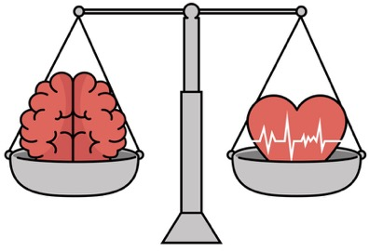
Cognitive Biases and Heuristics
Heuristics (or rules of thumb) are short-cuts in decision making:
Individuals use heuristics when bounded rationality prevents the exploration of all possible outcomes.
Cognitive Biases: Systematic errors in judgements and behaviors:
They do not necessarily imply odd or “wrong” behavior (they are deviations from rational choices).
Biases are the resulting gaps between normative behavior and the heuristically determined behavior.

Slide 20
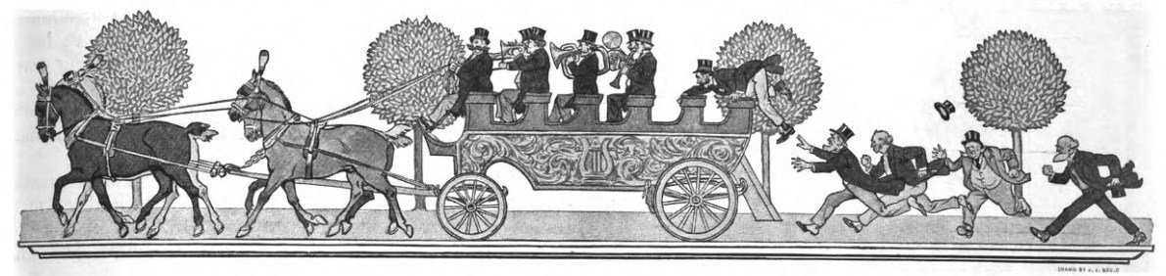
Cognitive Biases and Heuristics
The Bandwagon Effect (anchoring or social compliance):
When deciding what to post on OSNs, one may be vastly affected by what others post, and set that as an anchor.
People tend to take the example of their trusted peers as a reference point for what is appropriate to post and emulate them.

Slide 21
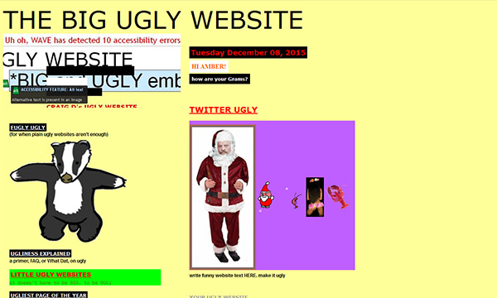
Cognitive Biases and Heuristics
Expectancy violation:
Consists of diminishing the amount of self-disclosure if the credibility of the platform is perceived as low (e.g., http://thebiguglywebsite.com)
Graphical interfaces can have a large credibility impact.

Slide 22
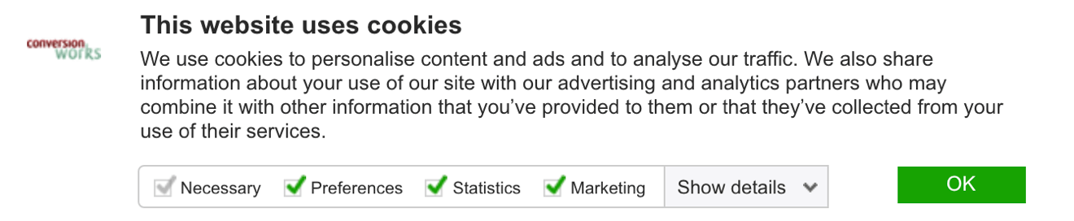
Cognitive Biases and Heuristics
Status Quo:
Refers to individuals’ affinity for default choices.
Users usually assume that the default configurations of privacy tools protect them, without reviewing the settings.

Slide 23

Cognitive Biases and Heuristics
Heuristics can be “positive” or “negative” depending whether they promote information disclosure or not:
Social compliance is a positive heuristic, whereas expectancy violation is a negative one.
Cognitive heuristics are mainly triggered by cues.
OSNs render cues that mainly trigger positive heuristics!!! ⇒ People share their data despite the consequences

Slide 24

Privacy Nudges
When aiming to improve people’s cybersecurity choices, we must con- sider that users are subjected to different cognitive biases:
Biases need to be mitigated to prevent unintended outcomes.
Biases can be leveraged to encourage beneficial behavior.
Nudges: Introduction of small changes in a choice architecture with the purpose of encouraging (persuade) a certain user behavior.
Scholars have elaborated on several nudging solutions to support users’ privacy and security decisions inside and outside OSNs.

Slide 25
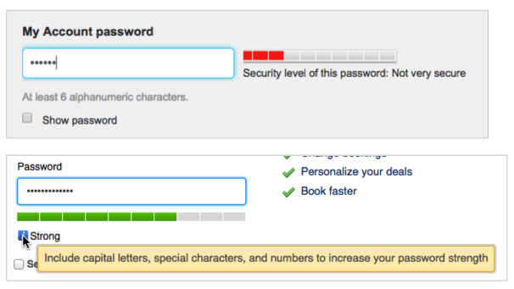
Privacy Nudges: Examples
Information provision aims to counteract the negative effects of availability and overconfidence biases:
Overconfidence: Underestimation of the chances that one might be subject to a negative event.
Availability: Influence of salient cues that may not be effective signals of possible adverse events.

Slide 26
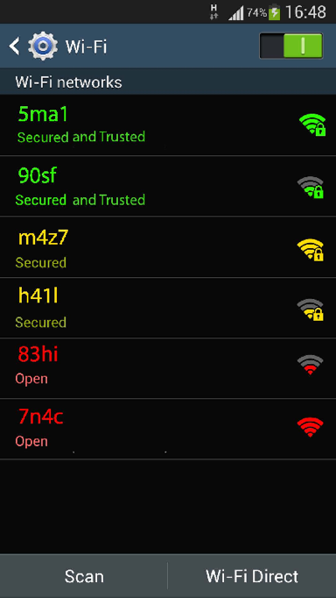
Privacy Nudges: Examples
WiFi scanners aim to encourage secure networks selection.

Slide 27
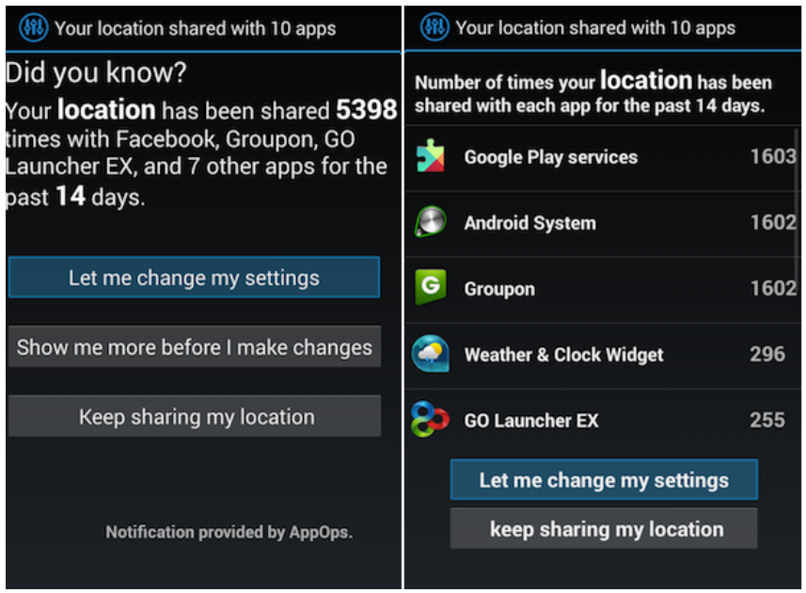
Privacy Nudges: Examples
Privacy nudge for location sharing control in Android apps

Slide 28
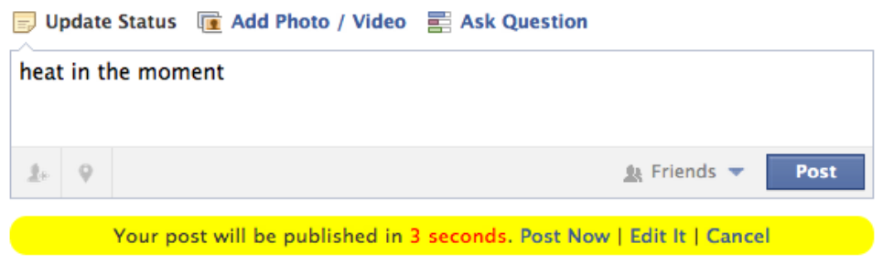
Privacy Nudges: Examples
Nudge for promoting safer textual publications in OSNs

Slide 29
Nudges v.s. Recommender Systems
Recommender systems provide suggestions for items that are most likely of interest to a particular user.
Suggest items that are within the user’s current interest area.
Examples: Netflix, Amazon, YouTube...
Nudges aim to provide recommendations that, in some respects, are outside the users’ primary interests or requirements:
The nudging goal might not match the original interests or requirements of the user.
Nudges are rather about making the user stretch, to achieve something in line with the nudging goal.
The goal is to change users’ behavior for the common good.

Slide 30
Issues and Improvement Areas
The purpose of the intervention is not completely clear.
The same warning message is shown to all the users.
No countermeasure or protective action is recommended.
When possible, nudging solutions should:
Target individuals’ reflective reasoning ⇒ risk cues!
Adapt to each user’s goals/expectations ⇒ personalization!
Recommend coping mechanisms ⇒ audience management!

Slide 31
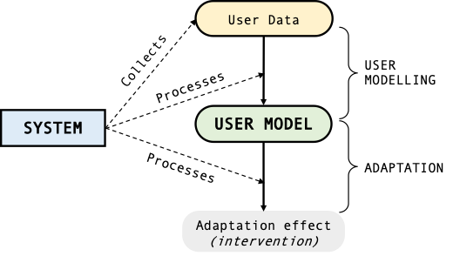
Privacy Nudges
Personalized nudging solutions employ Artificial Intelligence (AI) to understand and anticipate the (privacy) needs of each user:
User Model: A set of adaptation variables that guide the personalization of behavioral interventions (e.g., privacy attitudes).
User models can be generated either explicitly (e.g., set-up questionnaire) or implicitly (e.g., behavioral data)

Slide 32
Privacy Nudges
Personalized nudging solutions employ Artificial Intelligence (AI) to understand and anticipate the (privacy) needs of each user:
User Model: A set of adaptation variables that guide the personalization of behavioral interventions (e.g., privacy attitudes).
User models can be generated either explicitly (e.g., set-up questionnaire) or implicitly (e.g., behavioral data)

Slide 33

Privacy Attitudes (Westin)
People’s privacy attitudes can be identified using a questionnaire:
Unconcerned users are the less privacy protective.
Fundamentalists seek actively for privacy and data protection.
Pragmatists are in an intermediate position.
Example: Fundamentalists should only be informed on very-high privacy risks, whereas pragmatists also about low risks.

Slide 34
Privacy Attitudes (Westin)
Indicate how much do you agree/disagree with the following statements:
Q1: “Consumers have lost all control over how personal information is collected and used by social media platforms”.
Q2: “Most platforms handle the personal information they collect about consumers in a proper and confidential way”.
Q3: “Existing laws and software development practices provide a reasonable level of protection for consumer privacy today”.
Answering options: strongly agree, somewhat agree, somewhat disagree, strongly disagree, don’t know
Fundamentalists agree (strongly or somewhat) to Q1 and disagree (strongly or somewhat) to Q2 and Q3.
Unconcerned disagree (strongly or somewhat) with Q1 and agree (strongly or somewhat) with Q2 and Q3.
Pragmatists are those with any other pattern of responses.

Slide 35
Multiparty Privacy Conflicts
Overall, current preventative nudges focus on individual self-disclosure risks:
They do not consider unwanted incidents that may occur when sharing content that also compromises the privacy of others.
Situations in which personal information of others is unintentionally exposed to the public are frequent:
People sharing pictures of their friends without consent.
People tagging others in publications without taking their individual privacy preferences into account.
⇒ Multiparty Privacy (MP) takes a collective view on the norms and boundaries of information disclosure.
MP elaborates on the conflicting privacy preferences among the
co-owners of particular data items.

Slide 36
Methods and Strategies
Overall, current methods and strategies for counteracting MP conflicts in OSNs can be classified into:
Dissuasive: “...aim to make uploaders reflect on the implications of sharing a given item and raise awareness about the consequences of unilateral decisions”.
Precautionary: “...automate collaborative practices and force uploaders to collaborate with data subjects or otherwise limit the shared content”.
Precautionary mechanisms can be further divided into:
Audience modification: Mechanisms that modify an item’s audience (e.g., who can see a photo).
Item modification: Mechanisms that obfuscate the item to be shared (e.g., blurring faces in a photo).

Slide 37
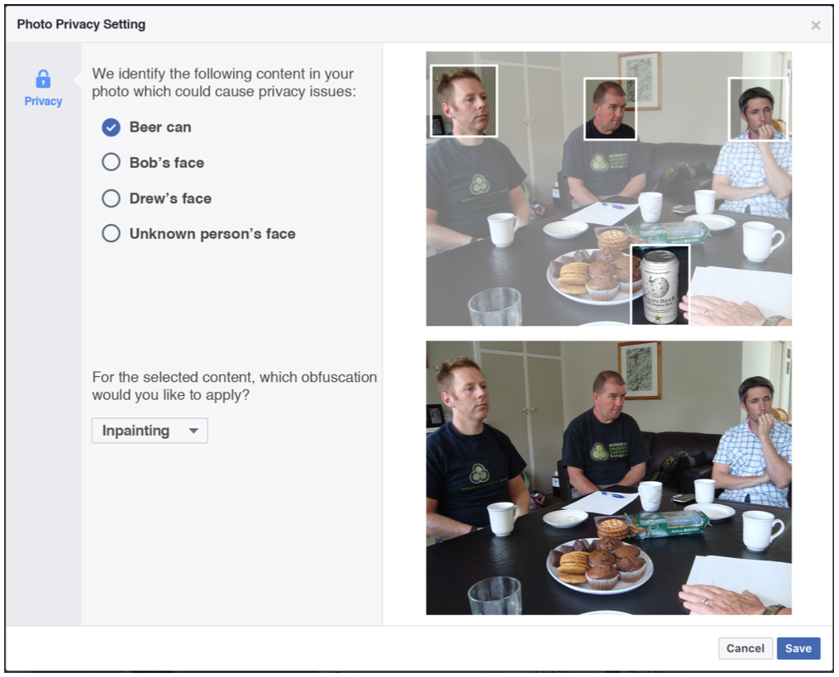
Precautionary: Item Modification

Slide 38
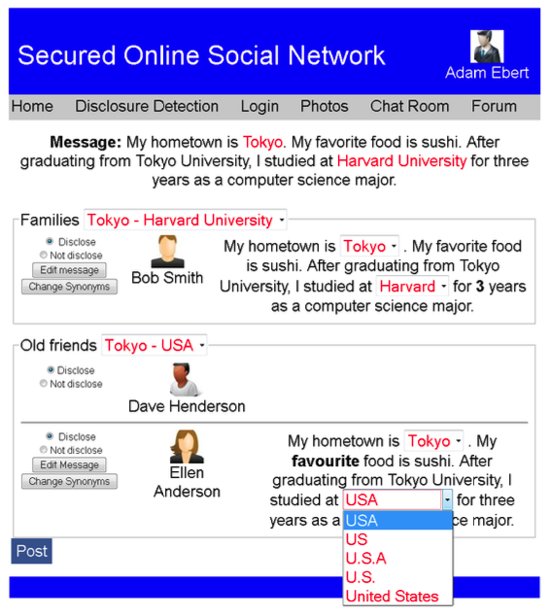
Precautionary: Item Modification

Slide 39
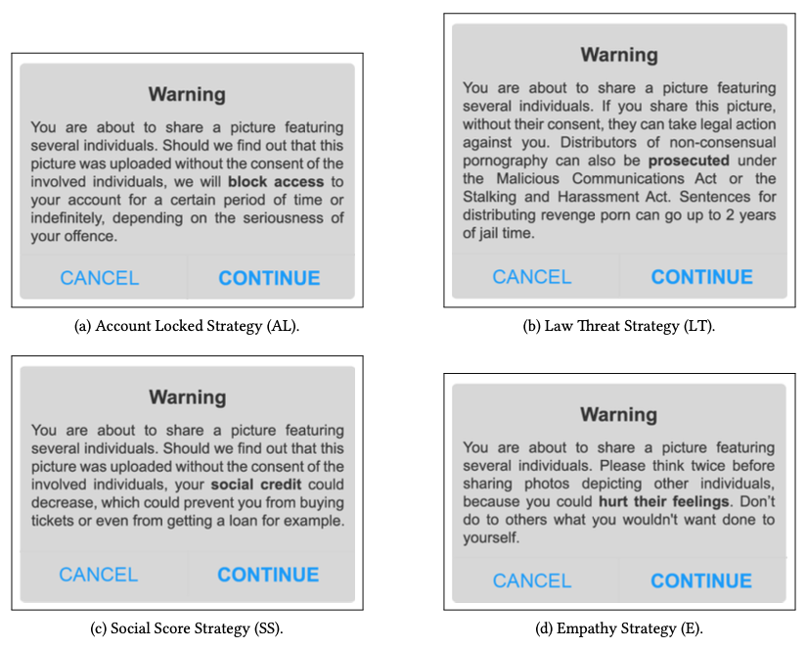
Dissuasive

Slide 40
Ethical Challenges
As personalization in nudges increases, so do concerns related to transparency, fairness, explanability, algorithmic biases.
Inherited from the underlying principles of AI technologies!
There are also challenges related to the impact on people’s individual and collective behavior:
Nudges may not necessarily contribute to users’ welfare.
Could even be used for questionable and unethical purposes.
User models and adaptation mechanisms should be scrutable for
preventing inaccurate, unfair, biased, or discriminatory interventions.
A fine line between persuasion, manipulation and coercion!

Slide 41
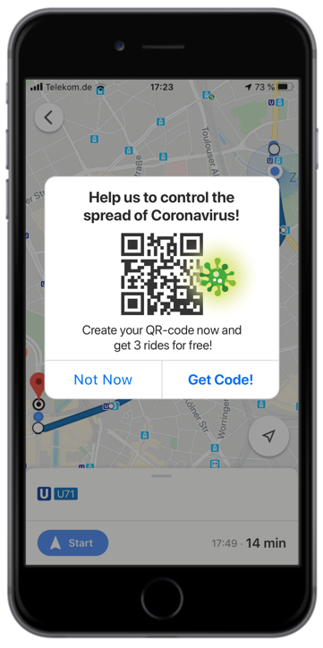
Ethical Challenges
Example: Nudge to incentive the use of COVID-19 tracing mechanisms.
The argument:
Encourage people to provide their location and body temperature on behalf of public safety.
The real purpose:
Another attempt to increase mass surveillance.
Ethical Questions:
Who should benefit from nudges?
Should users be always informed about the presence of a nudge?
How nudges should (not) influence the users?

Slide 42
Ethical Guidelines
Persuasive means target primarily people’s automatic and subconscious processing system:
This can compromise users’ agency and autonomy since they may not be aware of the presence of a nudge.
Check-lists can be employed to verify whether a nudging solution comply with principles of justice, beneficence, and respect:
To preserve user’s autonomy, we must ensure that all the original options of a choice architecture are made available.
Users should always be nudged towards behaviors that maximize their welfare rather than the interests of others.
Nudges should target, when possible, individuals’ reflective reasoning (e.g., through risk cues) to avoid potential manipulation effects.

Slide 43

Questions ?

