Slide 1
Security Assurance Cases
Mazen Mohamad
Chalmers | University of Gothenburg, Sweden
mazenm@chalmers.se
Master Course “Secure Software Engineering”
Summer Semester 2022

Slide 2
Learning objectives
The emerging importance of security assurance and the driving forces
Structure of Security Assurance Cases (SAC)
Reading material about Security Assurance Cases
R. Alexander, R. Hawkins, T. Kelly, “Security Assurance Cases: Motivation and the State of the Art”, The University of York, 2011
Reading material about how to build Security Assurance Cases
M.Mohamad, Ö.Askerdal ,R.Jolak, J,Steghöfer, R.Scandariato, “Asset-driven Security Assurance Cases with Built-in Quality Assurance”, IEEE/ACM 2nd International Workshop on Engineering and Cybersecurity of Critical Systems 2021
, 2021
Usage of SAC
SOTA and SOP

Slide 3
Security Assurance - What?
https://csrc.nist.gov/glossary/term/security_assurance
Measure of confidence that the security features, practices, procedures, and architecture of an information system accurately mediates and enforces the security policy. NIST SP 800-39
The grounds for confidence that the set of intended security controls in an information system are effective in their application. NISTIR 7298

Slide 4
Security Assurance - What?
https://csrc.nist.gov/glossary/term/security_assurance
Measure of confidence that the security features, practices, procedures, and architecture of an information system accurately mediates and enforces the security policy. NIST SP 800-39
The grounds for confidence that the set of intended security controls in an information system are effective in their application. NISTIR 7298
Goal
Target
Context

Slide 5


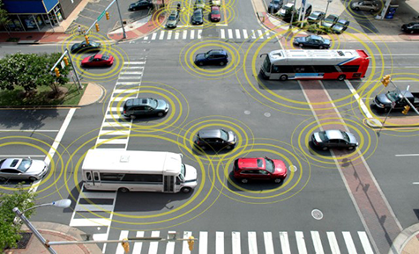
Security Assurance - Why?

Slide 6


Security Assurance - Why?

Slide 7
Security Assurance - How?
There are multiple frameworks and approaches for security assurance, e.g., Common Criteria.
What we are going to focus on is called Security Assurance Cases (SAC).

Slide 8
Security Assurance Cases
• “An assurance case is a structured argument, supported by evidence, intended to justify that a system is acceptably assured relative to a concern in the intended operating environment.”
[Handbook of System Safety and Security, 2017]
In our context the concern is cybersecurity.

Slide 9
Security Assurance Cases
Supported by
Evidence
Sub-claim
Sub-claim
Strategy
Context
Evidence
Sub-claim
Supported by
In context of
Claim
Strategy
Sub-claim
Supported by
Evidence
In context of
Supported by
Assumption
Sub-claim
Argument
Evidence
Goal Structuring Notation [Kelly 2004]

Slide 10
SAC - Claims’ types
Claim
Claiming confidence in the achieved level of security in a specific context. Takes the form: X is acceptably / adequately secure. Where X is an asset / function / sub-system… etc
Example: The auto parking function is acceptably secure
Negating the possibility of realizing a harm or threat on a certain asset.
Example: It is not possible to tamper with the data sent to the steering wheel module.
Sub-claim

Slide 11
SAC - Evidence types
Evidence
Reports from test cases
Code reviews
Peer review reports
SME reviews
.
.
.

Slide 12
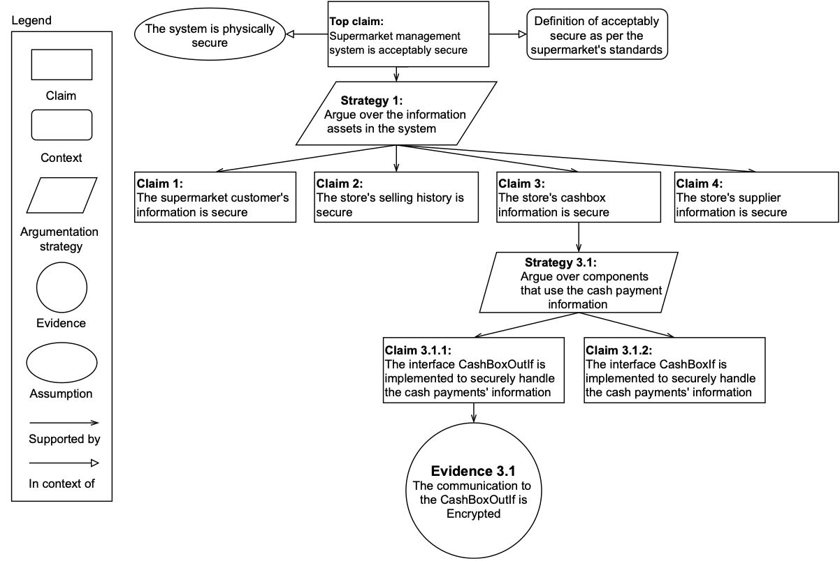
Security Assurance Cases

Slide 13
SAC - Driving forces
External and Internal forces.
Current and upcoming standards and regulations in industries. Examples:
  ISO/SAE 21434 - Road vehicles cybersecurity
  UNECE 115 - Cyber security and cyber security management system
Potential for many usage scenarios.
Proven approach from safety.

Slide 14

How do you think SAC can be used in practice?
Go to menti.com – xxxx yyyy
Notes:
34 63 80 0

Slide 15
Usage Scenarios
Many usage scenarios identified in industry.
The top ones are:
Prove conformance / compliance with security standards and regulations by the compliance team
Assess the security quality of a product by product owners
Use as evidence in court by lawyers
Use to communicate with suppliers by the purchasing team
Support security informed go / no go decisions by project managers

Slide 16
SAC - Knowledge Transfer
Differences between the domains of safety and security.
Theoretical differences:
  Presence of intelligent adversary
  High level of uncertainty about attackers’ behaviour - hence taking measures that are not responses to specific threats
  Security-critical software often has to adapt quickly as attack patterns change
Practical differences:
  Process maturity of security critical practices
  Safety has more problems with requirements, whereas security with low-level defects in implementation
  Safety standards are way more elaborated than security ones in terms of development practices
Security Assurance Cases: Motivation and the State of the Art - Rob Alexander et al. 2011

Slide 17

How to build SAC
SACs can be build in different ways. There are two main strategies

Slide 18
How to build SAC
Top-down strategy:
Starting from the top claim and working our ways down to the evidence
This is the most common approach
Bottom-up strategy:
Works by looking at the artifacts and evidence we have, and build the arguments based on them.
More common for systems that are already built

Slide 19
How to build SAC
Literature includes many approaches, e.g.,
Argumentation strategies
  Standard based
  Security requirements
  Software components … etc
Structures:
  Layered-based
  Document retrieval

Slide 20
How to build SAC
Limitations:
•Wide variety of approaches.. But
Cover both process and product
•Lack of quality assurance
Actively assessing the quality of SAC
•Imbalance in coverage
The challenging nature of working with SAC

Slide 21
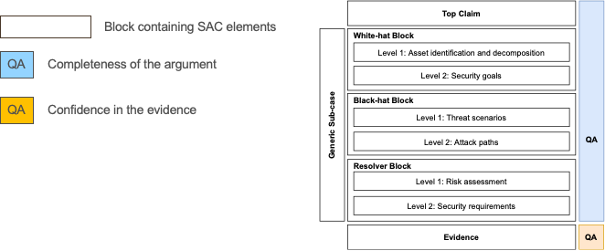
CASCADE

Slide 22
CASCADE
CASCADE is an asset-driven approach which provides a block-based structure for creating the arguments of a security assurance case.
It is asset-driven, as the arguments start from the identification of assets which exist in the system.
The blocks in CASCADE include elements of SACs.

Slide 23
CASCADE
Quality assurance:
Completeness of the argument : To make sure that the arguments are complete within the given scope documented in the context and assumption nodes.
Confidence in the evidence: indicates the level of certainty that a claim is fulfilled based on the provided evidence

Slide 24
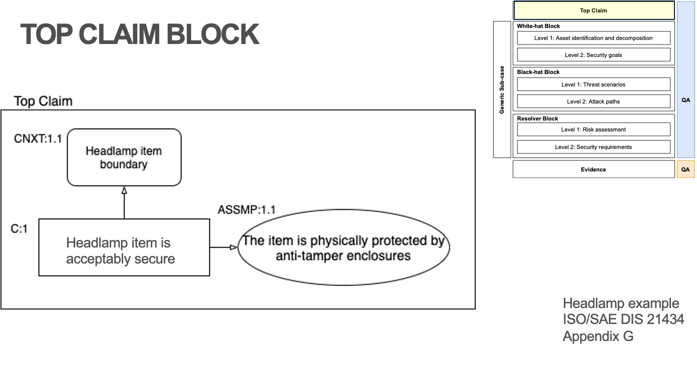
CASCADE - Top Claim
The top claim block includes the top claim, its context, and the assumptions we make on the highest level of the argument.
The top claim decides the abstraction level of the SAC, e.g., whole product, end-user function, component… etc.
The context in the top claim block decides the scope of the whole argument with the support of assumptions.

Slide 25
CASCADE

Slide 26
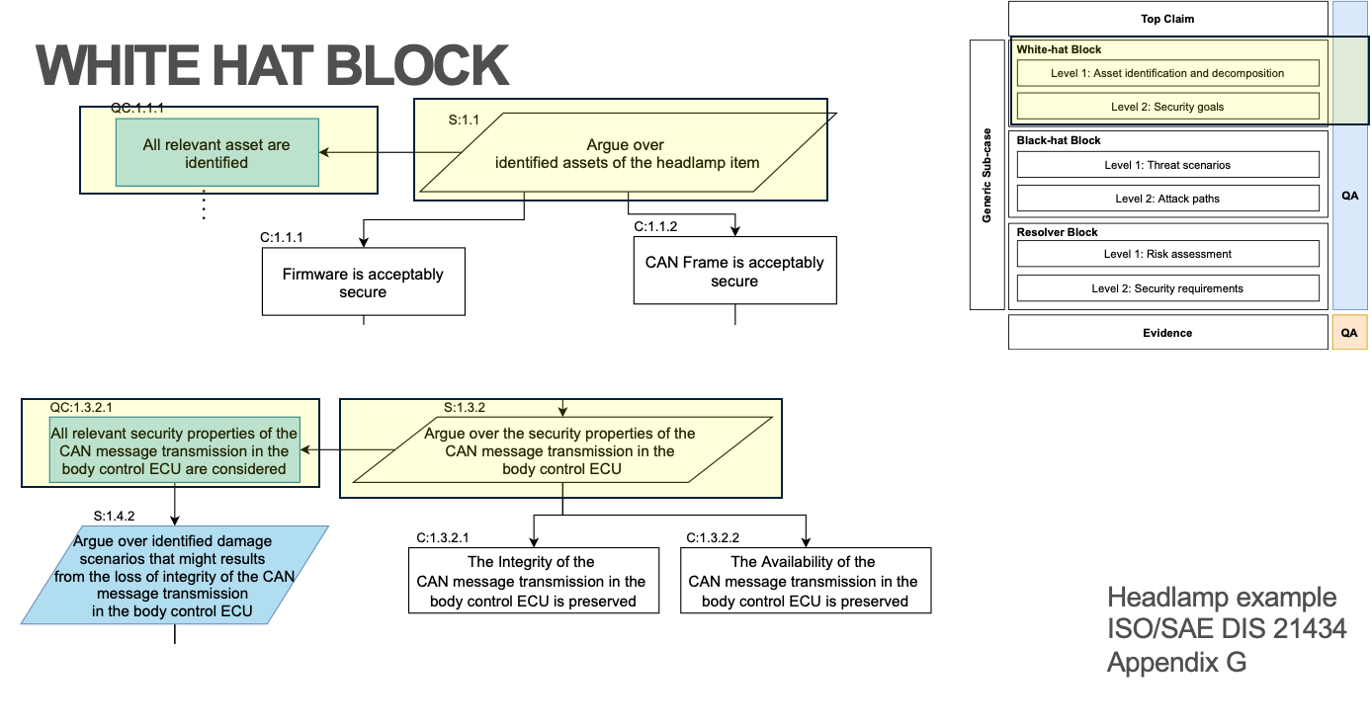
CASCADE - White-hat
This block has two levels:
Identification of assets: this is done by conducting an analysis to find the artefacts of the system that are likely to be subject to an attack, then creating claims about the security of these assets
Security goals: done by identifying relevant security properties for each asset, and then creating claims about preserving these properties for each asset.

Slide 27
CASCADE

Slide 28
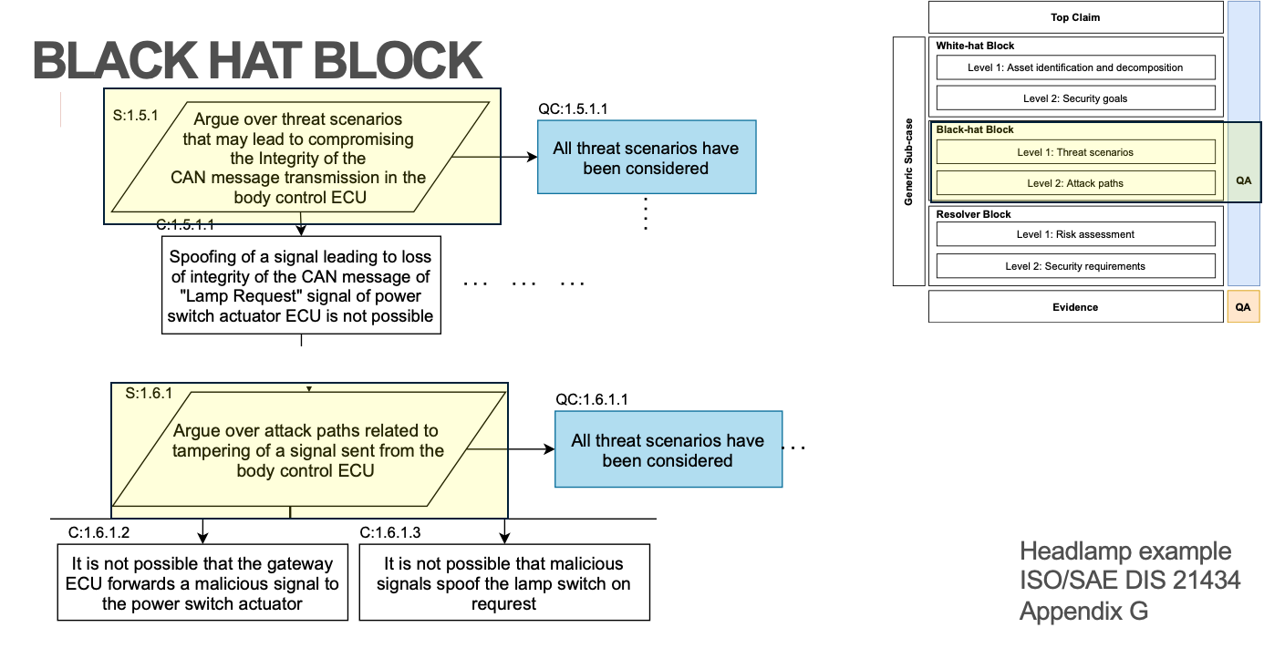
CASCADE - Black-hat
This block has two levels:
Threat scenarios: this is done by identifying the threats that might compromise the security goals identified in the white-hat block - security goals level. Then we create claims negating the possibility of these threats.
Attack paths: done by identifying ways in which an attacker can realize the threats we identified in the earlier level. We then create claims negating the possibility of these attack paths taking place.

Slide 29
CASCADE

Slide 30
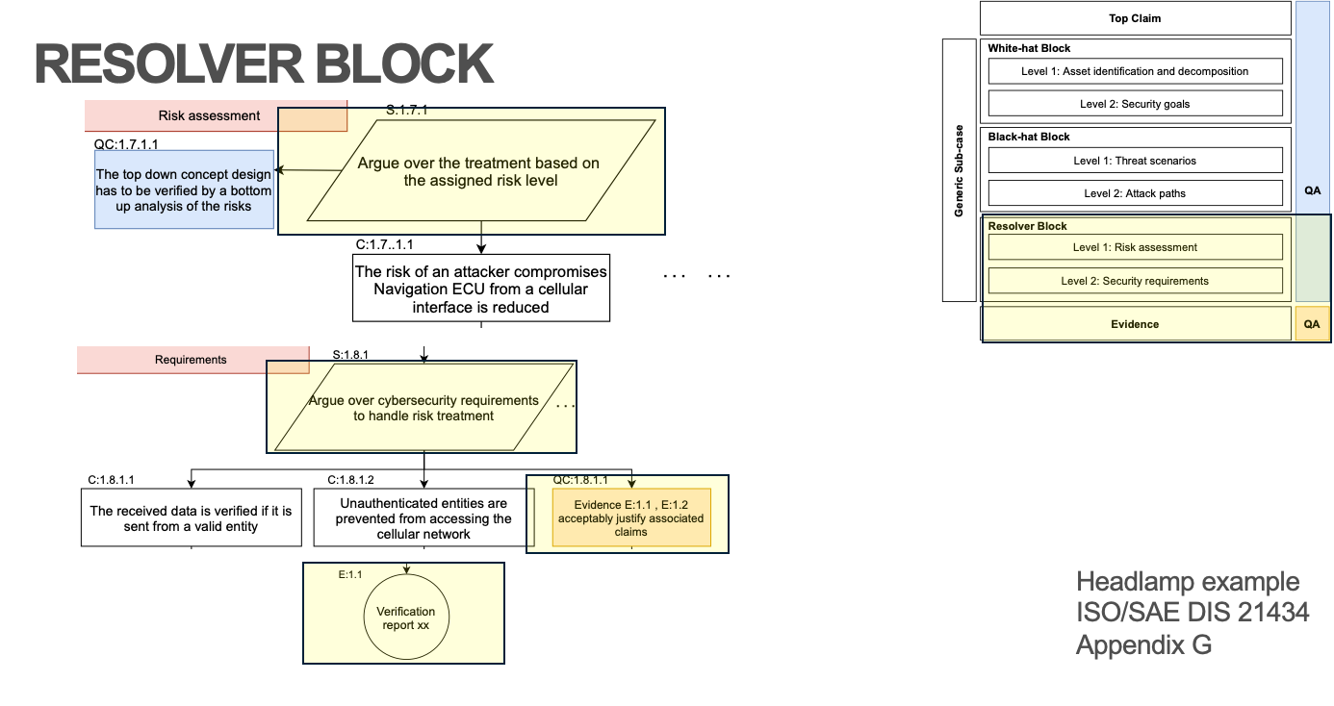
CASCADE - Resolver and Evidence
This block has two levels:
Risk assessment: In this level, we assess the risk of the identified attack paths. Based on the risk level, the creators of the SAC create claims to treat the risk by, e.g., accepting, mitigating, or transferring it.
Requirements: At this point, requirements of risk treatments identified in the previous level are to be expressed as claims.
Evidence: When claims about the security requirements are identified, we assign evidence to justify / solve these claims

Slide 31
CASCADE

Slide 32
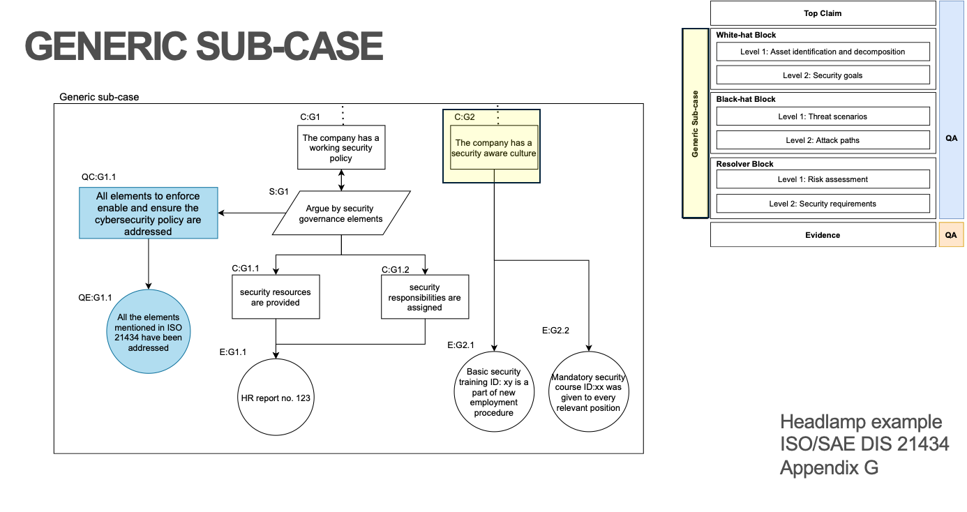
CASCADE - Generic Sub-case
This block contains a sub-case that is applicable not only to the artefact for which the SAC is being created but instead to a larger context. For example, if a company defines a cybersecurity policy, enforced by cybersecurity rules and processes, then the policy can be used in security claims for all its products. These claims can be re-used when creating SAC for individual artefacts.

Slide 33
CASCADE

Slide 34
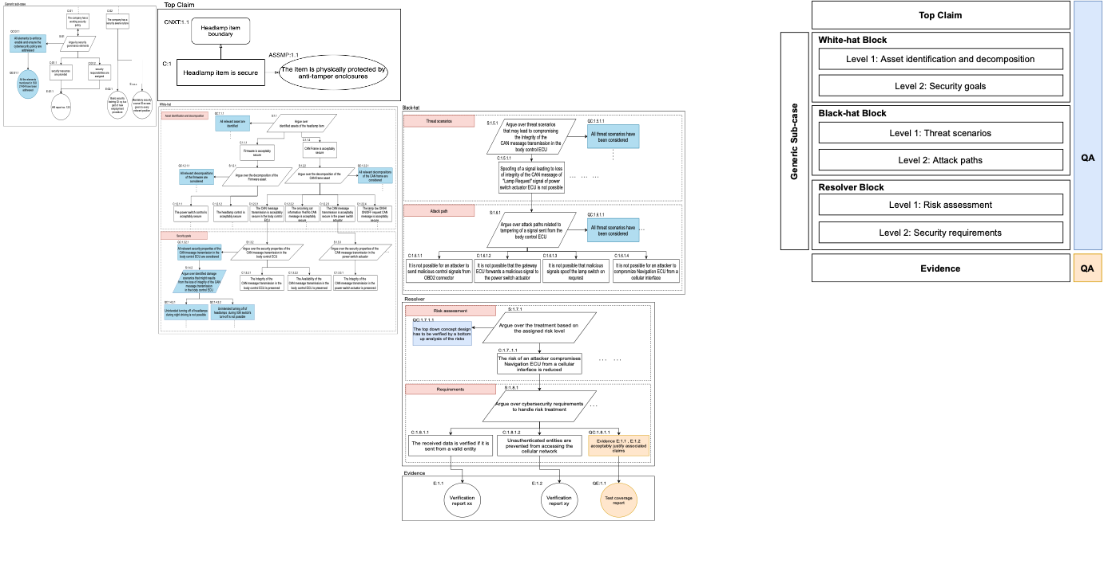
CASCADE

Slide 35

State of Practice - Automotive
Creating patterns of arguments to be reused
Notes:
Patterns

Slide 36

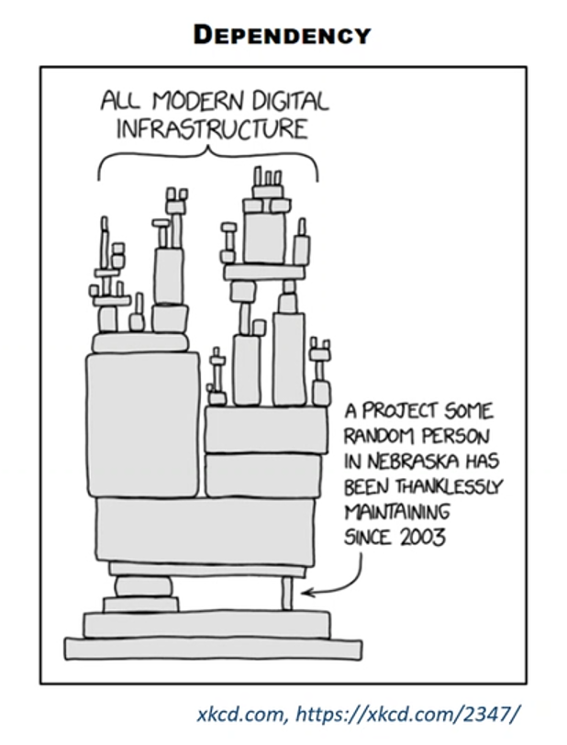
State of Practice - Automotive
Handling the complexity of automotive products
and processes.
For example the level of dependency among the
systems
https://tomorrowtodayglobal.com/2017/09/05/tuesday-tip-simplify-2-ways-deal-complexity/
Notes:
Complexity!!

Slide 37
Research areas
Compositionality
Automation
End user assurance
And many more
Applying to other domains (health care)

Slide 38
Is it an impediment?
Go to menti.com – xxxx yyyy
Notes:
34 63 80 0

Slide 39


Questions ?
More questions at a later time?
mazenm@chalmers.se

