Slide 1
Goal-oriented requirements with KAOS
Riccardo Scandariato
Institute of Software Security, TUHH, Germany
ric***do . scanda***to @ tuhh.de
Secure Software Engineering – SoSe 22

Slide 2
Learning objectives
What is goal-oriented requirements engineering?
How to formalize security goals via security specification patterns?
What are anti-goals and threat analysis at requirements level
Reading material
Axel van Lamsweerde, Elaborating Security Requirements by Construction of Intentional Anti-Models, International Conference on Software Engineering, 2004

Slide 3
Goal-oriented requirements

Slide 4
What are goals?
A goal is a prescriptive statement of intent that the system should satisfy through the cooperation of its agents
An agent is an active system component playing a specific role in the goal satisfaction
  Human such as operator and users
  Devices such as sensors, actuators, communication media, measurement instruments
  Existing SW components such as legacy, off-the-shelf or foreign
  New SW components forming the software to be

Slide 5
What are agents?
A system component playing a role in goal satisfaction
  Role rather than individual
Active object
  Responsibilities (goals)
  Capabilities (monitor/control)
  Behavior (performs operations)
To play such role, agents need to restrict their behavior by adequate control of system items

Slide 6
Capabilities and responsibilities
Capabilities are the monitoring links and control links to objects
  Attributes (get or set values)
  Associations (check or create/delete)
Responsible for a goal if its instances are the only ones required to restrict their behavior, through adequate setting of their behavior, so to satisfy the goal
Monitored variable:
Speed
Responsibility
DoorsClosedWhileNonZeroSpeed
Train
Controller
Train
Controlled variables:
DoorsState
Goal
Agent
Object
Notes:
For safety: Speed=/=0 -> DoreClosed=true

Slide 7
What are goals? And what they are not!
Meetings shall be scheduled so as to maximize the attendance of invited participants
  Participants, initiator (in the environment)
  Scheduler (in the software-to-be)
Make user happy
  Out of reach
To initiate the meeting, the initiator needs to prompt the scheduler, authenticate, fill in a form and then confirm the request
  Not prescriptive statement of intent (declarative vs operational)

Slide 8
Statements
Statement
Prescriptive
(prescribe agent behavior)
Descriptive
(environment)
Multi-agent goal
Single-agent goal
Domain property
(immutable)
Domain hypothesis
(subject to change)
A train is moving
if and only if its
speed is non-null
All train tracks
are in good
conditions
Requirement
(software-to-be)
Expectation
(environment)
Acceleration commands
shall be sent to train
every 3 sec
Passengers get
out of the train
when the doors are
open at destination
Environment assumptions
Notes:
Requirements = software req
Goal might correspond to a system requirement or not, depending on which system agents are involved (software-to-be must be involved)
Expectation = goal under the responsibility of an env agent
Environment assumptions =statements to be satisfied by the environment
Domain properties are invariants: known to hold in all states
Hypotheses: often assumed to hold in specific states

Slide 9
Goal granularity
Study at home
High-level: strategic objectives
  Larger cooperation needed
  Ex: Meetings shall be scheduled so as to maximize the attendance of invited participants
Low-level: technical objectives
  Fewer agents
  Ex: Reminders for upcoming meetings shall be issued

Slide 10
Goal refinement in KAOS
G
AND-refinement
  ‘Necessary’ to achieve G
  Complete refinement
    ‘Sufficient’ to achieve G
    Often uses domain properties
    and hypotheses
G₁
G₂
G
G₁
Dom₁

Slide 11
Alternatives in KAOS
OR-refinement
  Goal refinement
  Goal assignment
Generally result in different system designs
Avoid [TrainCollisions]
FastRunToNextBlock if GoSignal
Avoid [Trains
OnSameBlock]
Maintain [Worst
CaseStopping
Distance]
Train
Driver
Train
Controller
Notes:
Soft goals used to chose alt

Slide 12
Building goal models
Early discovery
  Analysis of current system
  Search for intentional and prescriptive keywords in documents
Later discovery
  By abstraction (“Why?”, bottom-up)
    Until boundary of system capabilities is reached (system scope!)
  By refinement (“How?”, top-down)
    Until assignable to single agent as requirement or expectation

Slide 13
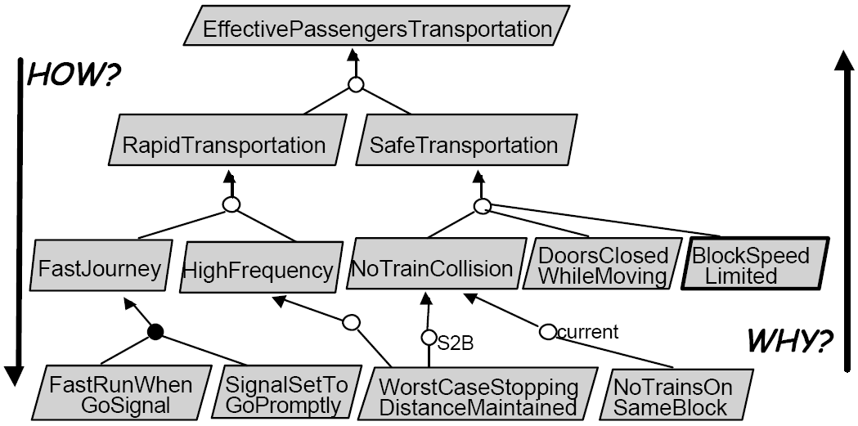
Building the goal model

Slide 14
Behavioral goals
Achieve [TargetCondition]
  [if CurrentCondition then] sooner-or-later TargetCondition
  if a train is at some platform then within 5 minutes the train is at the next platform
Cease [TargetCondition]
  [if CurrentCondition then] sooner-or-later not TargetCondition
◊ “in some future state”

Slide 15
Behavioral goals
Maintain [GoodCondition]
  [if CurrentCondition then] always GoodCondition
Maintain [DoorsClosedWhileMoving]
  always (if a train is moving then its doors are closed)
Avoid [BadCondition]
  [if CurrentCondition then] always not BadCondition
Avoid [TrainsOnSameBlock]
  always not (more than one train at one block)
□ “in every future state”

Slide 16
Some Linear Temporal Logic
Only for your info
Future
Past
o P P shall hold in the next state
◇ P P shall hold in some future state (sooner or later)
□ P P shall hold in every future state (always)
P U N P shall hold until N becomes true (always until)
(N will eventually become true)
P W N P shall hold unless N becomes true (always unless)
(N might not become true)
• P
◆P
￭ P
P S N
P B N
Other
□_{≤d} P P shall hold in every future state up to deadline d
◇_{≤d} P P shall hold within deadline d
P ⇒ Q □ ( P → Q)
(entailment)
@P • ( ¬ P) ∧ P (‘P just became true in the current state’)
Notes:
U: Until
W: Weak until
S: Since
B: Back to
d = deadline (distance between states in history)
p586

Slide 17
Soft goals
Improve [TargetCondition]
Increase/Reduce [TargetQuantity]
Maximize/Minimize [ObjectiveFunction]

Slide 18
Goal types and categories
Behavioral
  Clear cut sense (in isolation)
Soft goals
  Preferences among alternatives
Functional
  Intent underpinning a system service
Non functional
  Quality or constraint on service provisioning or development
Pragmatic difference
TYPE
Soft
Semantic difference
Behavioral
CATEGORY
Functional
Non-functional

Slide 19
Security goals

Slide 20
Application-level security analysis in KAOS
A threat is the possibility of an asset in the system going unprotected against unintended behavior
  Obstacle analysis: unintentional threats
  Threat analysis: intentional threats
Unintentional obstruction: possibility of inadvertent violation of a security goal
Intentional obstruction: possibility of proactive violation of a security goal by exploitation of unprotected data and system knowledge acquired through malicious behaviors, calculations, deductive inferences, etc.
KAOS terminology

Slide 21
Identify security goals
  Two complementary methods
  Security specification patterns
  Threat analysis and anti-goals (i.e., converse of asset-related achieve goals)

Slide 22
Security specification patterns (1/2)
Confidentiality
Goal Avoid [SensitiveInfoKnownByUnauthorizedAgent]
FormalSpec ∀ ag: Agent, ob: Object
¬ Authorized (ag, ob.info) ⇒ ¬ KnowsV_{ag} (ob.info)
Agent knowledge must be modeled. LTL extended with epistemic operator
Knows_{ag} (P) ≡ Belief_{ag} (P) ∧ P (knows property)
KnowsV_{ag} (x) ≡ ∃ v: Knows_{ag} (x=v) (knows value)
“P is in ag’s local memory”
state variable
Notes:
Local memory in which facts a bout its environment are maintained

Slide 23
Security specification patterns (2/2)
Confidentiality
Goal Avoid [SensitiveInfoKnownByUnauthorizedAgent]
FormalSpec ∀ ag: Agent, ob: Object
¬ Authorized (ag, ob.info) ⇒ ¬ KnowsV_{ag} (ob.info)
Authorized is generic predicate and needs to be instantiated through a domain-specific definition. E.g.
∀ ag: Agent, acc: Account
Authorized (ag, acc) ≡ Owner (ag, acc) ∨ Proxy (ag, acc) ∨ Manager (ag, acc)

Slide 24
Spec patterns for other security properties
Study at home
Privacy
Goal Maintain[PrivateInfoKnownOnlyIfConsentedByOwner]
FormalSpec ∀ ag, ag’: Agent, ob: Object
KnowsV_{ag} (ob.info) ∧ OwnedBy (ob.info, ag’) ∧ ag ≠ ag’
⇒ Consent (ag, ob.info, ag’)
Integrity
Goal Maintain[ObjectInfoChangeOnlyIfCorrectAndAuthorized]
FormalSpec ∀ ag: Agent, ob: Object, v: Value
ob.info = v ∧ o (ob.info ≠ v) ∧ UnderControl (ob.info, ag)
⇒ Authorized (ag, ob.info) ∧ o Integrity (ob.info)
“in the next state”
Availability
Goal Achieve[ObjectInfoUsableWhenNeededAndAuthorized]
FormalSpec ∀ ag: Agent, ob: Object
Needs (ag, ob.info) ∧ Authorized (ag, ob.info)
⇒ ◊_{≤d} Using (ag, ob.info)
“soner or later before the deadline d”

Slide 25
Instantiate pattern
Study at home
Confidentiality
Goal Avoid [SensitiveInfoKnownByUnauthorizedAgent]
FormalSpec ∀ ag: Agent, ob: Object
¬ Authorized (ag, ob.info) ⇒ ¬ KnowsV_{ag} (ob.info)
Examples
Agent …
Object …
Authorized …
Goal Avoid [AccountNumber&PinDisclosedToUnauthorized]
FormalSpec ∀ p: Person, acc: Account
¬ ( Owner (p, acc) ∨ Proxy (p, acc) ∨ Manager (p, acc) )
⇒ ¬ ( KnowsV_{p} (acc.Acc#) ∧ KnowsV_{p} (acc.PIN) )
Goal Avoid [ePurseBalanceDisclosedtoUnauthorized]
FormalSpec ∀ p: Person, ep: ePurse
¬ Owner (p, ep) ⇒ ¬ KnowsV_{p} (ep.Balance)

Slide 26
Instantiate pattern
Study at home
Instantiating
meta-classes (such as Object, Agent) and
generic attributes (such as Info)
to application-specific sensitive classes, attributes and associations in the object model
Specializing
predicates (such as Authorized, UnderControl)
through substitution by application-specific definitions

Slide 27
Threat analysis

Slide 28
Starting point: anti-goals
Check converse of asset-related Achieve goals
Example
PreCondition ⇒ ◊ TargetCondition (Achieve goal)
has converse
TargetCondition ⇒ PreCondition (Maintain goal)
negation
ItemOrderedByBuyer ⇒ ◊_{≤7d} ItemReceivedByBuyer
Anti-goal
converse
ItemSent ⇒
ItemPaid
◇ ItemSent ∧ ¬ ItemPaid
ItemOrdered ⇒
◊_{≤2d} ItemPaid
ItemSent ⇒
◊_{≤3d} ItemReceived
ItemPaid ⇒
◊_{≤2d} ItemSent
ShippingCo
Notes:
=> entails
(always holds in every future state)

Slide 29
Threat analysis
Get initial anti-goals to be refined/abstracted
Identify attackers wishing them and their capabilities
Build threat graph
Derive new security goals as countermeasures

Slide 30
1. Initial anti-goals
  AG ⇔ ¬ SG
Anti goal
Security goal
Notes:
Negation of security goals

Slide 31
1. Initial anti-goals
Security goal
Avoid[AccountNumber&PinDisclosedToUnauthorized]
p: Person, acc: Account
￢ [Owner(p, acc) ∨ Proxy(p, acc) ∨ Manager(p, acc)]
⇒ ¬ [KnowsV_{p}(acc.Acc#) ∧ KnowsV_{p}(acc.PIN)]
Negate goal
Achieve[AccountNumber&PinDisclosedToUnauthorized]
◇ ∃ p: Person, acc: Account
￢ Authorized(p, acc) ∧ KnowsV_{p}(acc.Acc#) ∧ KnowsV_{p}(acc.PIN)
Who would benefit from this?

Slide 32
2. Identify attackers and capabilities
Who might benefit from satisfaction of anti-goal
  Agent classes (insider/outside, hacker, thief, terrorist)
What atomic conditions from the goal model the attacker can monitor/control

Slide 33
Anti-agent
Attacker (malicious agent) has objectives
  Anti-goals (threats as goals)
Attacker has capabilities
  Conditions he can monitor and control
Attacker has system knowledge (anti-Dom)
  Domain properties and goal model (“most knowledgeable attacker” assumption)
  Software-to-be as part of anti-environment
  Anti-domain properties include requirements and vulnerabilities
Notes:
MKA (most knowledgeable attacker):
This assumption leads to more complete analysis
Attacker is the req engineer (he knows the model) looking for missing countermeasures

Slide 34
3. Build threat graph
For each (initial anti-goal, attacker) build anti-goal refinement/abstraction graph
Techniques
  HOW questions to refine, WHY questions to find missing anti-goals
  (Refinement patterns)
  (Regression)
We do not cover these

Slide 35
Threat graph
Refinement of anti-goals ⇒ threat graph
Terminal condition
  Leaf anti-goals realizable by attacker agents (anti-requirements) with their capabilities, given their knowledge
  Properties of the anti-domain (vulnerabilities of the attackee)
Vulnerability
  Anti-goal pre-condition to be satisfied by the attacked software-to-be and its environment

Slide 36
Threat graph
AccountNumber&PinKnown
PinKnown&
MatchingAccountFound
AccountKnown&
MatchingPinFound
Pin Selected
Matching
Account#Found
Account# Selected
Matching
PinFound
realizable
…
Account#Checked
ForPinMatch
CheckIteratedOnOther
Account#IfNoMatch
Check
Repeatable
Domain property
realizable
realizable
monitorable vulnerability

Slide 37
Threat graph (another example)
Study at home
◇ ItemSent ∧ ¬ ItemPaid
Attacker goal
□ ¬ ItemPaid
◇ ItemSent
◇ Belief_{S} (ItemPaid)
◇ NotificationReceived
realizable
◇ (fake)NotificationSent
Notes:
Ask “what are sufficient conditions for this goal?”

Slide 38
4. Countermeasures
Avoid vulnerability (or anti-goal): add a new goal requiring the software vulnerability condition (or anti-goal) to be avoided
New goals must be further refined
A new cycle of threat analysis may be needed for these new goals !!!

