Slide 1
Security at Architectural Design Level
Riccardo Scandariato
Institute of Software Security, TUHH, Germany
ric***do . scanda***to @ tuhh.de
Put name of event HERE

Slide 2
Learning objectives
What models are interesting for security? And what properties are represented?
What can I do with models?
  Analysis, testing, generation, …
How to build a secure software architecture?
  Principles, tactics, patterns
Reading material on Security Tactics
Joanna Santos, et al., An Empirical Study of Tactical Vulnerabilities, JSS, 2019

Slide 3
Software model
Provides an abstraction of the system
Software engineering perspective
  Parts/components and interfaces
  Funcionality/logic …

Slide 4
We focus on architectural design
"The software architecture of a computing system is the structure of the system, which comprise software components, the externally visible properties of those components, and the relationships among them”
Len Bass
“The fundamental concepts and properties of a system in its environment embodied in its elements, relationships, and in the principles of its design and evolution.”
ISO/IEC/IEEE 42010
http://www.iso-architecture.org/ieee-1471/defining-architecture.html
The set of design decisions that determine the quality properties of a system
Jan Bosch

Slide 5
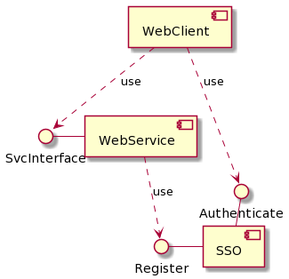
Security – Commonly used models
UML Component Diagram

Slide 6
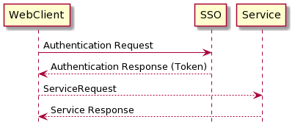
Security – Commonly used models
UML Sequence Diagram

Slide 7
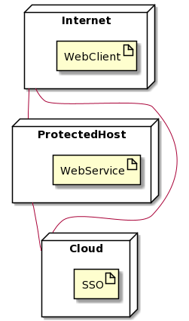
Security – Commonly used models
UML Deployment Diagram
<<http>>
<<http>>
<<REST>>

Slide 8
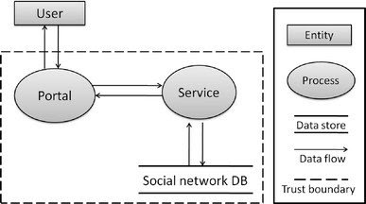
Security – Commonly used models
Data Flow Diagram
We’ll see this later (cf. Threat analysis)

Slide 9
Security model
Provides an abstraction of the system
Software engineering perspective
  Parts/components and interfaces
  Funcionality/logic …
Security engineering perspective
  Data/assets, their sensitivities
  Information flows
  Security mechanisms
  Security assumptions/expectetions ...

Slide 10
Security engineering perspective
Examples
user age : PII
Authenticated
Session
<<Web Application FW>>
PII : personally identifiable information
<<encrypted>>
<<integrity>>
The problem of semantics ☺

Slide 11
Model, where from?
Top-down, as an up-front blueprint
  “Security concept” developed in safety-critical domains (automotive, aviation, medical)
Bottom-up, reconstructed by experts
  Common case when security analysis starts
  E.g., most web-based systems
Bottom-up, automatically extracted from code
  Research field (ArchSec, Gravity, etc)

Slide 12
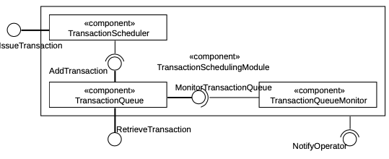
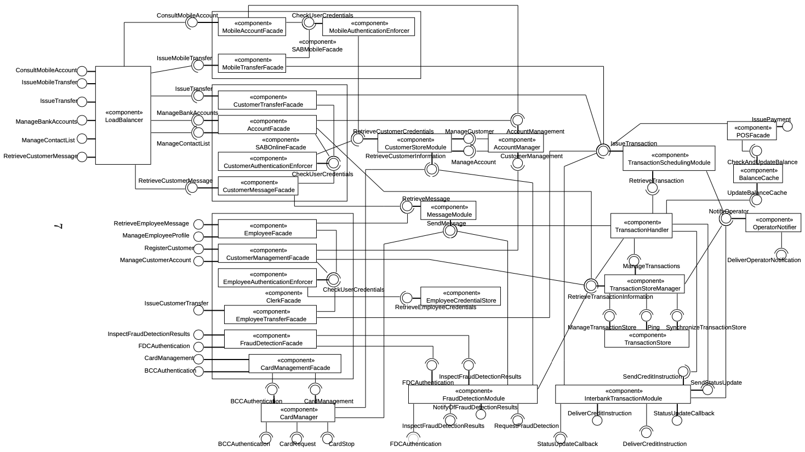
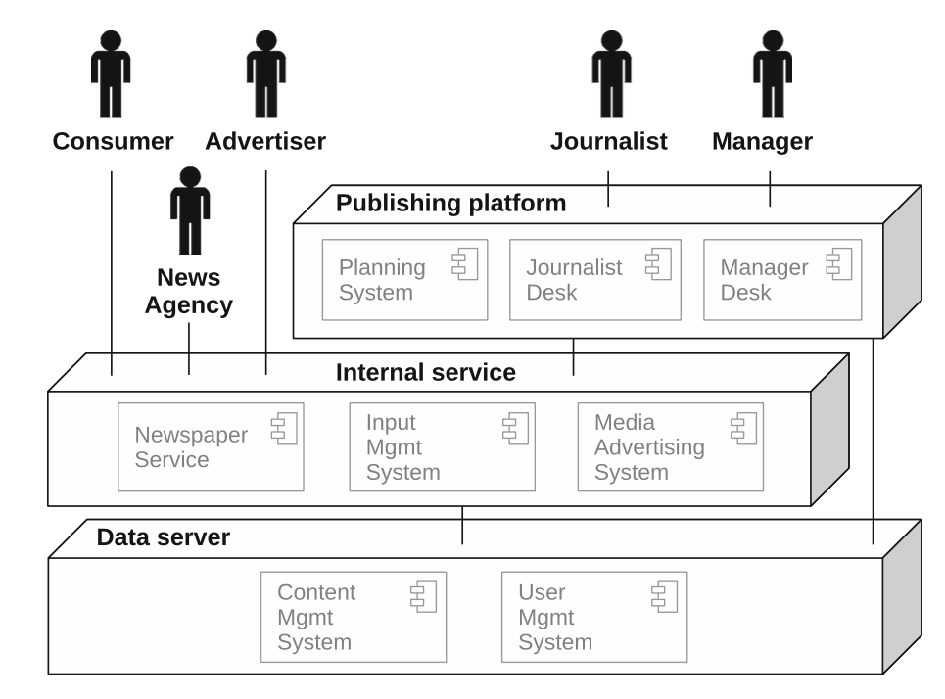
Architectural documentation
Only for your info
Academic dream
Hirarchical decomposition
Component diagram
Deployment diagram
Notes:
Multiple views

Slide 13
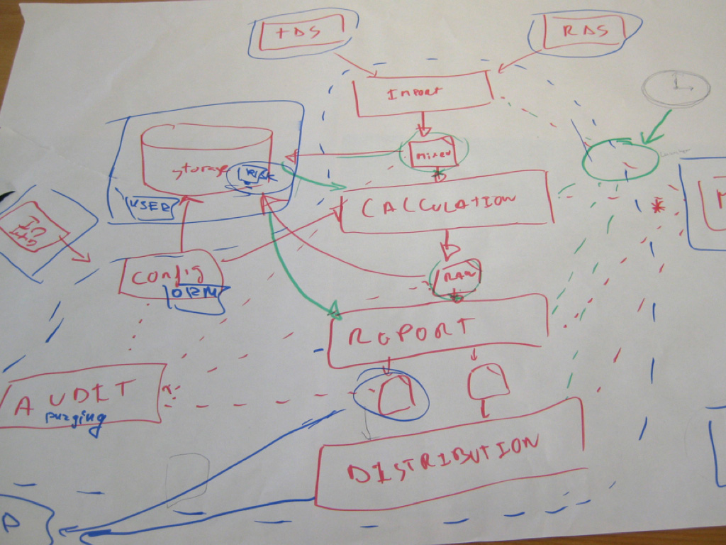

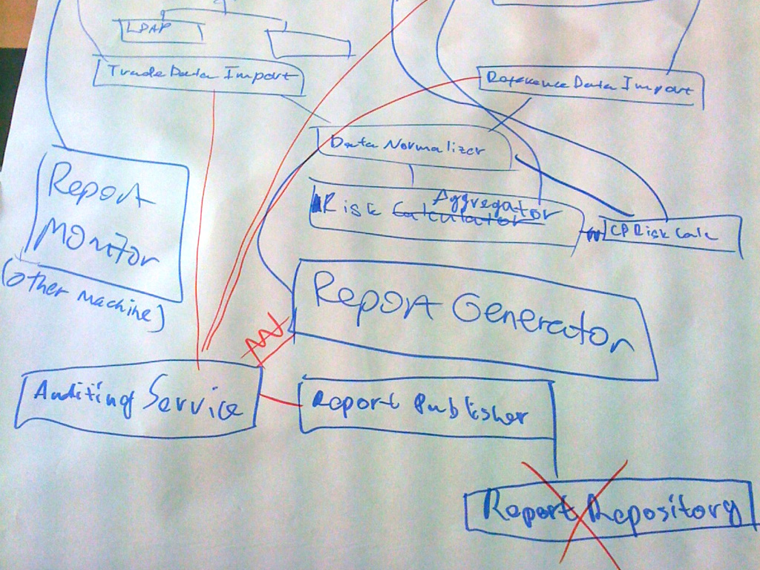
Architectural documentation
Only for your info
Real life
Credit: https://c4model.com

Slide 14
Models, what for?
Next week
Model analysis
Code generation
Model-based code generation
More (e.g., monitoring, metrics…)

Slide 15
Model-based code generation
Derive (draft) implementation code and configuration
E.g., code: Authorization pattern → Security aspect woven in code
E.g., config: access control policy
  derive roles from context/component diagrams
  derive permissions from use cases, workflows, etc.

Slide 16
Model-based test generarion
Functional security testing
  E.g., test rules in a firewall, given the components that are present in the model
  E.g., test access control rules, provided the roles in the model
Security vulnerability testing (penetration)
  Generate attack sequences using the system topology
  Model-based fuzzing (e.g., alter order of messages in a protocol), from a sequence diagram

Slide 17
Other uses
Model-based runtime monitoring
  Monitoring the security assumptions made in the model
  E.g., communication is encrypted, communication is only allowed between A and B, …
Model-to-model transformations
  Hardening the model by adding security countermeasures
  Making the functionality more GDPR compliant
Compute security metrics
  Mostly for for certification, but also prediction, etc

Slide 18
Building Security-Aware Architectural Design

Slide 19
Secure architectural design
Identify the assets of interest (by interacting with the stakeholders)
Understand the relationship asset ↔ functionality
Identify threats and their importance (impact, likelihood)
Implement constraints (i.e., countermeasures) to deal with threats
Hence achieving the security goals
Threat analysis and risk analysis (TARA)
Secure design
constraint
Countermeasures
counters
causes
Threat
Functionality
Threat
Stakeholders
related to
Harm
value
Asset
Asset
may occur to

Slide 20
In the toolbox
Previous slide has a “magic” step ☺
  “Implement constraints (i.e., countermeasures) to deal with threats”
What security knowledge do we use?
  Security principles
  Security tactics
  Security patterns / security solutions

Slide 21
Security Design principles

Slide 22
Security Meta Principles
Simplicity
  Fewer components and cases to fail
  Fewer possible inconsistencies
  Easy to understand
Restriction
  Minimize access and inhibit communication
Minimal assumptions
  Avoid trust
Notes:
The design principles are rooted in simplicity and restrictiveness.
Simplicity lies on many levels. The basic idea is that simpler things have fewer components, so less can go wrong. Further, there are fewer interfaces, so there are fewer entities communicating through the interfaces that can be inconsistent. Finally, they are easier to check, since the mechanism is not complex, and therefore easier to understand. There is also less to check.
Restriction minimizes the number and types of interactions between the entity and other entities. In some circles, an example is the “need to know” principle: only give the entity the information it needs to complete its task. It also should only be able to release information when required to by the goals of the entity. Note this includes writing (integrity), because by altering other entities, the writer can communicate information.

Slide 23
Security Design Principles
Least Privilege
Fail-Safe Defaults
Economy of Mechanism
Complete Mediation
Open Design
Separation of Privilege
Least Common Mechanism
Psychological Acceptability
(VERY old)
J. Saltzer , D. Schroeder, The Protection of Information in Computer Systems, Proceedings of the IEEE 63(9), 1975

Slide 24
1. Least Privilege
Study at home
A subject/process should be given only those privileges necessary to complete its task
  Function, not identity, controls
  Rights added as needed, discarded after use
Architecture: component only has privileges to interact with other appropriate components
Common violation:
  Browsing the Internet while logged as administrator or root
Notes:
This is an example of restriction. Key concepts are:
Function: what is the task, and what is the minimal set of rights needed? “Minimal” here means that if the right is not present, the task cannot be performed. A good example is a UNIX network server that needs access to a port below 1024 (this access requires root).
Rights being added, discarded: if the task requires privileges for only one action, then the privileges should be added before the action and then removed. Going back to the UNIX network server, if the server need not act as root (for example, an SMTP server), then drop the root privileges immediately after the port is opened.

Slide 25
2. Fail-Safe Defaults
Study at home
Default action is to deny access
When an action fails, system must be restored to a state as secure as the state it was in when it started the action
Example
  Card looked up in vendor database to check for stolen cards
  If no connectivity, no authentication, but transaction is logged -> NO!
Notes:
The first is well-known. Add rights explicitly; set everything to deny, and add back. This follows the Principle of Least Privilege. You see a variation when writing code that has security considerations. If you take untrusted data (such as input) that may contain meta-characters. The rule of thumb is to specify the LEGAL characters, and discard all others, rather than to specify the ILLEGAL characters and discard them. More on this in chapter 29 …
The second is often overlooked, but goes to the meaning of “fail safe”: if something fails, the system is still safe. Failure should never change the security state of the system. Hence, if an action fails, the system should be as secure as if the action never took place.
Credit card system defaults to manual process if it cannot phone in to check validity. Manual process insecure. Counterpoint: risk management—cheaper to accept loss than to refuse valid transactions when line is down.

Slide 26
3. Economy of Mechanism
Study at home
Keep it as simple as possible (KISS)
  Use the simplest solution that works.
  Fewer cases and components to fail.
  Minimal retained state (harder for program to get ‘confused’)
Reuse known secure solutions
  i.e., don’t write your own cryptography.
Notes:
Simplicity refers to all dimensions: design, implementation, operation, interaction with other components, even in specification. The toolkit philosophy of the UNIX system is excellent here; each tool is designed and implemented to perform a single task. The tools are then put together. This allows the checking of each component, and then their interfaces. It is conceptually much less complex than examining the unit as a whole. The key, though, is to define all interfaces completely (for example, environment variables and global variables as well as parameter lists).

Slide 27
4. Open Design
Study at home
Security should not depend on secrecy of design or implementation
  No “Security through obscurity”
  Refers to security policy and mechanism
  (not secrets like passwords and crypto keys)
E.g., do not rely on obfuscation
Notes:
Note that source code need not be available to meet this principle. It simply says that your security cannot depend upon your design being a secret. Secrecy can enhance the security, but if the design becomes exposed, the security of the mechanism cannot be affected.
The problem is that people are very good at finding out what secrets protect you. They may figure it out from the way the system works, or from reverse engineering the interface or system, or by more prosaic techniques such as dumpster diving.
This principle does not speak to secrets not involving design or implementation. For example, you can keep crypto keys and passwords secret.
deCSS: alleged purpose—stop piracy; actual purposes—region coding, nonskippable commercials. Algorithm weak, easily reverse engineered. The “secret” key must be stored on firmware of every DVD player.

Slide 28
5. Complete Mediation
Study at home
Check every access
Usually checked once, on first access:
  UNIX: File ACL checked on open(), but not on subsequent accesses to file
If permissions change after initial access, unauthorized access may be permitted
Also important for auditing!
Notes:
The reason for relaxing this one is efficiency: if you do lots of accesses, the checks will slow you down substantially. It’s not clear if that is really true, though.
Exercise: Have a process open a UNIX file for reading. From the shell, delete the read permissions that allow the process to read the file. Then have the process read from the open file. The process can do so. This shows the check is done at the open. If you want to be sure, have the process close the file. Then have the process try to reopen the file for reading. This open will fail.
Note that UNIX systems fail to enforce this principle to any degree on a superuser process, where access permissions are not even checked for an open! This is why people create management accounts (more properly, role accounts) like bin or mail: by restricting processes to those accounts, so access control checking applies. It also is an application of the principle of least privilege.

Slide 29
6. Separation of Privilege
Study at home
Require multiple conditions to grant access
  Separation of duty
  Compartmentalization
  Defense in depth (or multiple layers of security)
Notes:
You need to meet more than one condition to gain access. Separation of duty says that the one who signs the checks cannot be the one who prints the checks because then a single person could steal money. To make that more difficult, the thief must compromise two people, not one.
This also provides a finer-grained control over a resource than a single condition.
The analogy with non-computer security mechanisms is that of “defense in depth.” To get into a castle, you need to cross the moat, scale the walls, and drop down over the walls before you can get in. That is three barriers (conditions) that must be overcome (met).
Openssh: separate app into monitor and child processes; child processes are not privileged and must ask monitor to perform privileged ops on its behalf; user interaction only with unprivileged children

Slide 30
Separation of Duty
Study at home
Functions are divided so that one entity does not have control over all parts of a transaction.
Example:
  Different persons must initiate a purchase and authorize a purchase.
  Two different people may be required to arm and fire a nuclear missile.

Slide 31
Compartmentalization
Study at home
Problem: A security violation in one process should not affect others.
Solution: isolate components in deployment
  Physically
  Through virtual machines
Also: Self-limit consumption of resources
Also: Divide system into parts which are limited to the specific privileges they require in order to perform a specific task (privilege separation)

Slide 32
Defense in Depth
Study at home
Diverse defensive strategies
  Different types of defenses
  (protection, detection, reaction)
  Different implementations of defenses (variety)
  If one layer pierced, next layer may stop
  Avoid “crunchy on the outside, chewy on the inside” security
Contradicts “Economy of Mechanism”
  Think hard about more than 2 layers
Notes:
Firewall: what about insiders?
Bank: auto cameras, security guard, vault requiring multiple locks + codes, dye bills

Slide 33
7. Least Common Mechanism
Study at home
Mechanisms used to access different resources should not be shared
  Error or compromises of the mechanism while accessing one resource allow compromise of all other resources
  Use separate machines, separate networks
  All data in a blackboard mediated by a blackboard component?
Contradicts “Economy of Mechanism”?
Notes:
Isolation prevents communication, and communication with something—another process or a resource—is necessary for a breach of security. Limit the communication, and you limit the damage. Works with “separation of privilege” openssh example.
Covert channels: if two processes share a resource, by coordinating access, they can communicate by modulating access to the entire resource.
Examples: percent of CPU used. To send a 1 bit, the first process uses 75% of the CPU; to send a 0 bit, it uses 25% of the CPU. The other process sees how much of the CPU it can get and from that can tell what the first process used, and hence is sending. Variations include filling disks, creating files with fixed names, and so forth.
Approaches to implementing this principle: isolate each process, via virtual machines or sandboxes (a sandbox is like a VM, but the isolation is not complete).

Slide 34
8. Psychological Acceptability
Study at home
Security mechanisms should not add to the difficulty of accessing a resource
Human factors are critical here
  Hide complexity introduced by security mechanisms
  Make system secure in default configuration
Security vs Usability
Upcoming lecture on this topic
Notes:
This recognizes the human element. General rules are:
Be clear in error messages. You don’t need to be detailed (e.g., did the user mistype the password or login name) but you do need to state the rules for using the mechanism (in the example, that the user must supply both password and login name).
This is usually interpreted as meaning the mechanism must not impose an onerous burden. Strictly speaking, passwords violate this rule (because it’s not as easy to access a resource by giving a password as accessing the resource without a password), but the password is considered a minimal burden.

Slide 35
Security tactics

Slide 36
Tactics for secure design
More on this in your lab !
Security
Preventive controls
Detective/reactive controls
Corrective controls
Resist attacks
Detect attacks
React to attacks
Recover from attacks
System detects, resists, reacts or recovers
Identify actors
Validate Inputs
Manage User Sessions
Authenticate actors
Authorize actors
Limit access
Limit exposure
Encrypt data
Separate entities
Change default settings
Detect intrusion
Detect service denial
Verify massage integrity
Detect message delay
Revoke access
Lock computer
Inform actors
Maintain audit trail
Restore
Attack
See availability

Slide 37
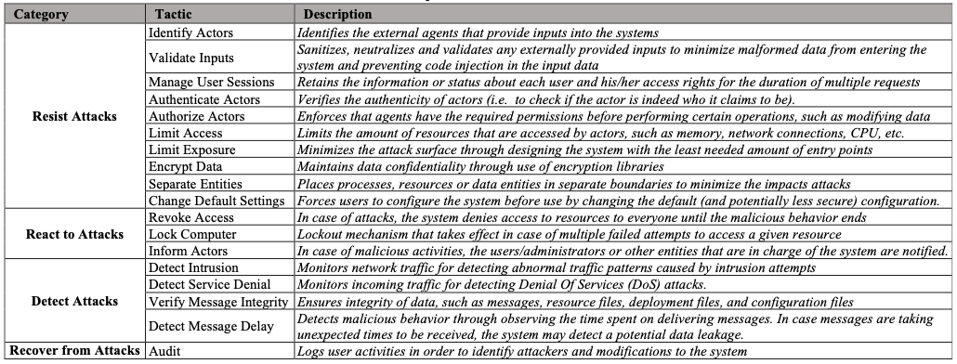
Tactics for secure design

Slide 38
Risk-aware design
Preventive: avoid incidents before they occur
  E.g., access control to avoid disclosure
Detective/Reactive: respond to incidents while they occur
  E.g., detect anomalous activity and lock down the network
Corrective: handle incidents after they have occurred (cf. resilience)
  E.g., restore correct state from backup
  E.g., First line of defense
  E.g., Second line of defense
  E.g., Third line of defense

Slide 39
Security Design Patterns

Slide 40
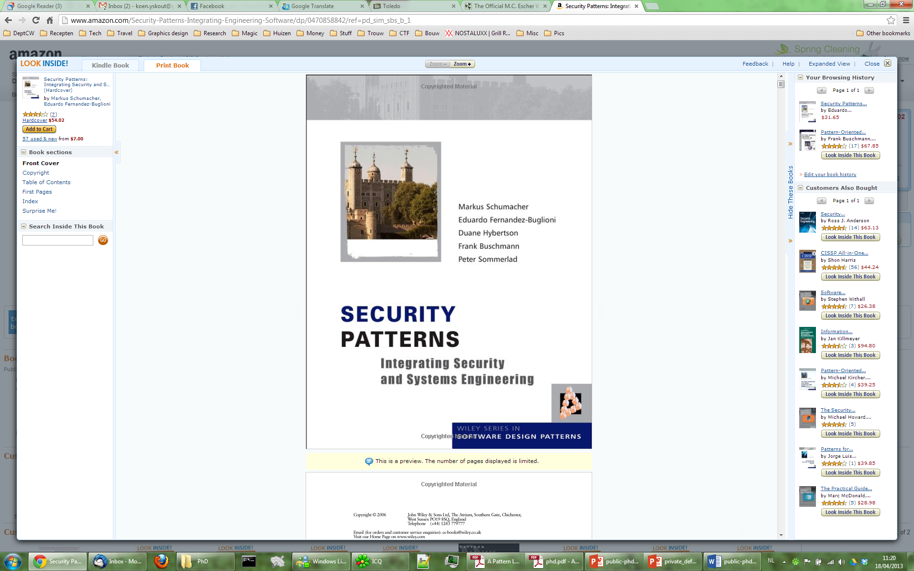
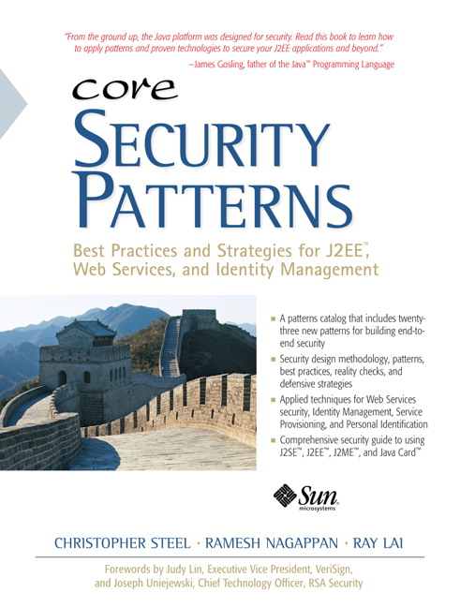
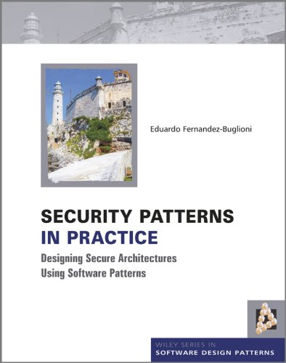
Security patterns – Fashion items ?

Slide 41
Single Access Point
More on this in your lab !
Example
Problem
A security model is difficult to validate when it has multiple “front doors”, “back doors”, and “side doors” for entering the application
Solution
Reduce the attack surface by setting up only one way to get into the system and if necessary, create a mechanism to decide which sub-application to launch.
Known Uses. UNIX telnet and Windows NT login applications use Single Access Point for logging into the system.
Source: Wiley Book

Slide 42
Single Access Point
Participants
User
Single access point
Application
<<use>>
Decision point

Slide 43
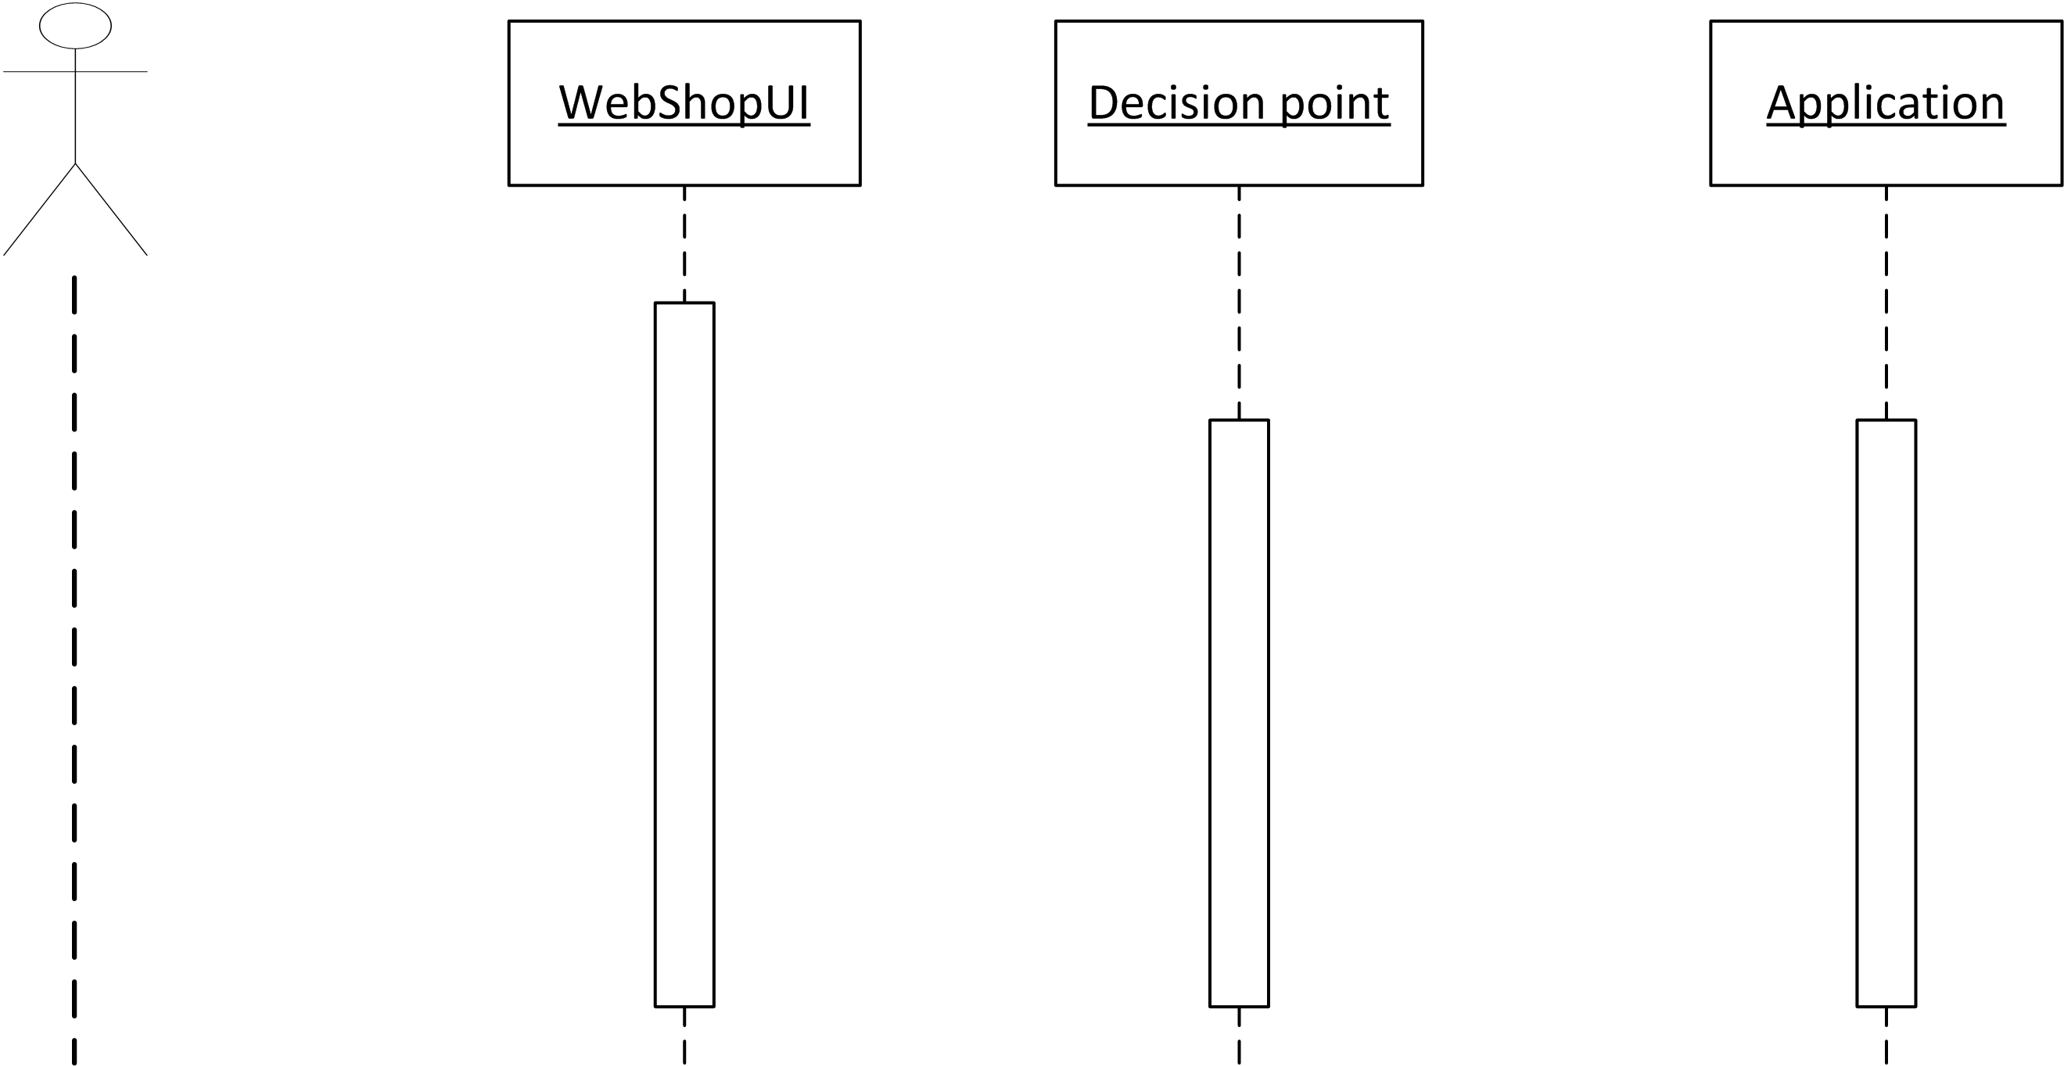
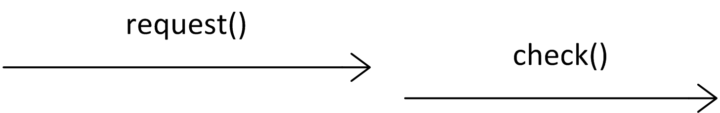
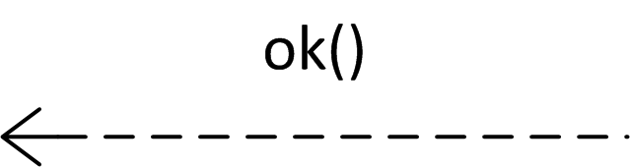
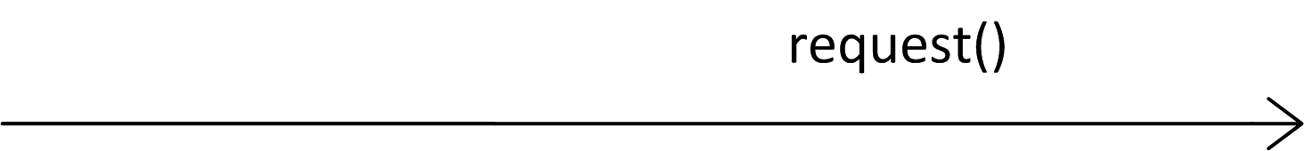
Single Access Point
Collaborations
Single
access point

Slide 44
Some “theoretical” underpinning
What is a (security) design pattern?
Single
access
point
New components
Decision point
Added to the design to fulfill new security functionality
Roles
Client
Connect generic solution (pattern) to specific design. Wire the newly added components to existing ones
Application
Expectations
  Impose constraints on the rest of the design (assumptions!). Need to either modify existing components (or “wires”) to satisfy expectations, or modify design “at large” (e.g., the account creation functionality, so that a good password is chosen)
“Make
credentials
hard to forge”
T. Heyman, et al, The security twin peaks, ESSoS 2011

Slide 45
Instantiating a pattern
Single Access Point
Role
(Client ➞ Admin Desk)
Role
(Application ➞ Pet Shop)
New components
Admin
Desk
Single
access point
Pet Shop
Expectation:
no
eavesdropping
Expectation:
no
back-doors
Wiring
Wiring

