Slide 1
Code Quality
Riccardo Scandariato
Institute of Software Security, TUHH, Germany
ric***do . scanda***to @ tuhh.de
MSc Course ”Secure Software Engineering”

Slide 2
Learning objectives
Understand code review activities for security
Understand emerging techniques (APR) to fix security bugs automatically in source code
Reading material
Michael Howard, A Process for Performing Security Code Reviews, IEEE Security & Privacy, July 2006

Slide 3
Security Code Review

Slide 4
Apple ‘goto fail;’ vulnerability
static OSStatus
SSLVerifySignedServerKeyExchange(SSLContext *ctx, bool isRsa, SSLBuffer signedParams,uint8_t *signature, UInt16 signatureLen)
{
...
if ((err = ReadyHash(&SSLHashSHA1, &hashCtx)) != 0)
goto fail;
if ((err = SSLHashSHA1.update(&hashCtx, &clientRandom)) != 0)
goto fail;
if ((err = SSLHashSHA1.update(&hashCtx, &serverRandom)) != 0)
goto fail;
if ((err = SSLHashSHA1.update(&hashCtx, &signedParams)) != 0)
goto fail;
goto fail;
if ((err = SSLHashSHA1.final(&hashCtx, &hashOut)) != 0)
goto fail;
...
fail:
SSLFreeBuffer(&signedHashes);
SSLFreeBuffer(&hashCtx);
return err;
...
https://nvd.nist.gov/vuln/detail/CVE-2014-1266
https://opensource.apple.com/source/Security/Security-55471/libsecurity_ssl/lib/sslKeyExchange.c
Notes:
https://www.synopsys.com/blogs/software-security/understanding-apple-goto-fail-vulnerability-2/

Slide 5
Apple ‘goto fail;’ vulnerability
Problem: two consecutive goto fail;
  Indentation makes us think both statements run only when the if-predicate is true
  err is returned with the value of zero
  The caller will believe no error occurs while verifying the signature
if ((err = SSLHashSHA1.update(&hashCtx, &signedParams)) != 0)
goto fail;
goto fail;
...
fail:
SSLFreeBuffer(&signedHashes);
SSLFreeBuffer(&hashCtx);
return err;
Could be identified easily by Code Review!

Slide 6
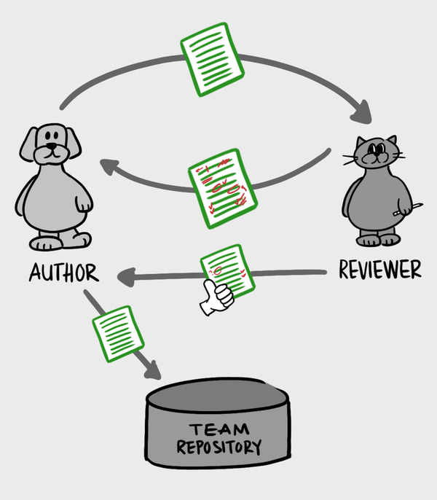
Security Code Review
Security Code Review: convene people (reviewer) to find faults in source code written by someone else (author)
Early finding faults, quickly generating fixes
Reduce testing effort

Slide 7
But also…
Security code reviews also performed for compliance reasons
E.g., Requirement 6.3.2 in Payment Card Industry Data Security Standard (PCI-DSS) mandates a code review of custom code

Slide 8
Code Review Types
Manual Code Review w/ Experts
  Allow to use the knowledge from reviewer
  Takes time, expertise and effort
Code Review w/ Static Analysis Tools
  Automated, could be very useful for large projects
  Could produce many false positives
→ Use both for better results

Slide 9
Static Analysis
Inspect code without running it to find bugs (common case!) or to gain confidence about bugs absence (i.e., reason about the program’s correctness)
Provide security warnings about (common) mistakes
(e.g., Buffer overflow, API misuse,...)
E.g., SonarQube, Checkmarx, Veracode, SpotBugs, etc..

Slide 10
Why using Static Analysis for Code Review?
Manual code review usually requires expertise in secure coding
  Scarcity, cost
Static Analysis could be integrated into CI/CD to run automatically
Humans are imperfect and could miss faults (FN)
Static Analysis is covered in the Software Security course :)

Slide 11

Humans or machines ?
Track taint
Find credentials in code or config file
Correct use of Crypto API
Handle sensitive data with care

Slide 12
Humans vs machines ;)
Tool
Track taint
  SAST tool effective
  Too complex for human?
Find credentials in code or config file
  All SAST tools have this rule
  Human can do that too (but useful?)
Correct use of Crypto API
  Only specialized tools exist (academic)
  Human
Handle sensitive data with care
  Tool: def of sensitive?
  Human
Expert

Slide 13
Manual Code Review

Slide 14
Code Review Guidelines
IEEE Standard for Software Reviews and Audits, IEEE Std 1028-2008 [1]
  Not specific to security
  Def of terms and roles
OWASP Code Review Guideline [2]
  Focus on reviewing code for security Top 10 vulnerabilities (220 pages !!!)
[1] https://standards.ieee.org/standard/1028-2008.html
[2] https://owasp.org/www-project-code-review-guide

Slide 15
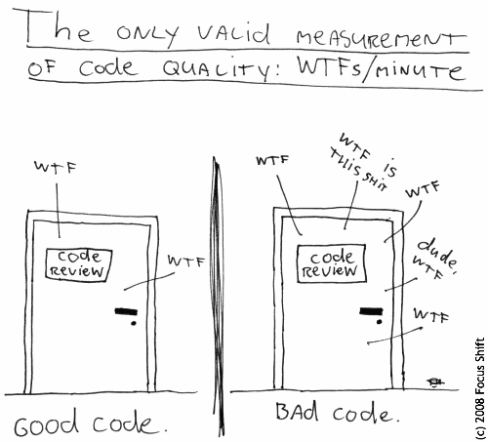
Roles in Code Review
Author (who writes code)
  Can answer any specific questions, or reveal blind spots
Reader (reviewer, not the author)
  Leads through the review
Scribe/Recorder
  Documents faults, actions, decisions made in the meeting
Inspection Leader/Moderator
  Planning and organizational tasks
  Moderate review meeting
  Organize follow-up on issues
IEEE Standard for Software Reviews and Audits, IEEE Std 1028-2008

Slide 16
Code Reviewers
IEEE standard: People with readability, but objectivity
  e.g. system architect
  e.g. developer working on the same project, but different team
The above is not valid for security !!!
  You need people experienced with security, e.g., consultants, experienced developers
Including more than four generally slows the process
  People tend to argue
  Getting side-tracked on unrelated issues

Slide 17
Code Review Process
Code review processes vary widely in their formality
e.g., Inspection – most formal process
  Separated roles
  Usage of Checklists
  Formal collection of defect metrics
e.g., Walkthrough – less formal process
  Author (also acting as Moderator) and Reader
  Driven by author’s goals
Anything in between

Slide 18
Checklists for Code Review
Identify relevant aspects
Walk through the functionality of the code
  Look for too much complexity, functionality
  Look for common defensive coding mistakes
  Look for Common Vulnerabilities

Slide 19
Example: Checklist for crypto issue
// Simple Java code to encrypt/decrypt data
private static byte[] encrypt(byte[] raw, byte[] clear) throws Exception {
SecretKeySpec skeySpec = new SecretKeySpec(raw, "AES");
Cipher cipher = Cipher.getInstance("AES");
cipher.init(Cipher.ENCRYPT_MODE, skeySpec);
byte[] encrypted = cipher.doFinal(clear);
return encrypted;
}
private static byte[] decrypt(byte[] raw, byte[] encrypted) throws Exception {
SecretKeySpec skeySpec = new SecretKeySpec(raw, "AES");
Cipher cipher = Cipher.getInstance("AES");
cipher.init(Cipher.DECRYPT_MODE, skeySpec);
byte[] decrypted = cipher.doFinal(encrypted);
return decrypted;
}
Using AES in CBC mode (default) is insecure

Slide 20
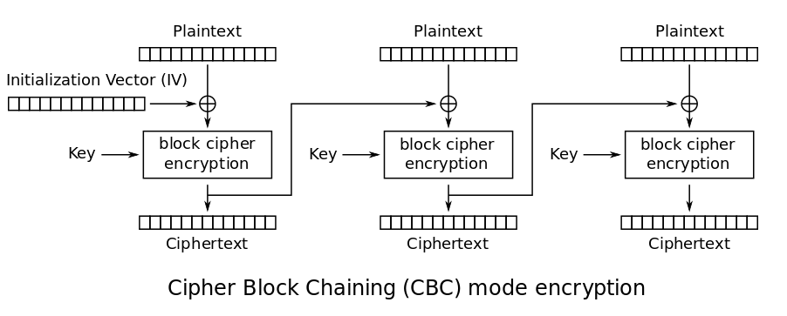
CBC
Only for your info

Slide 21
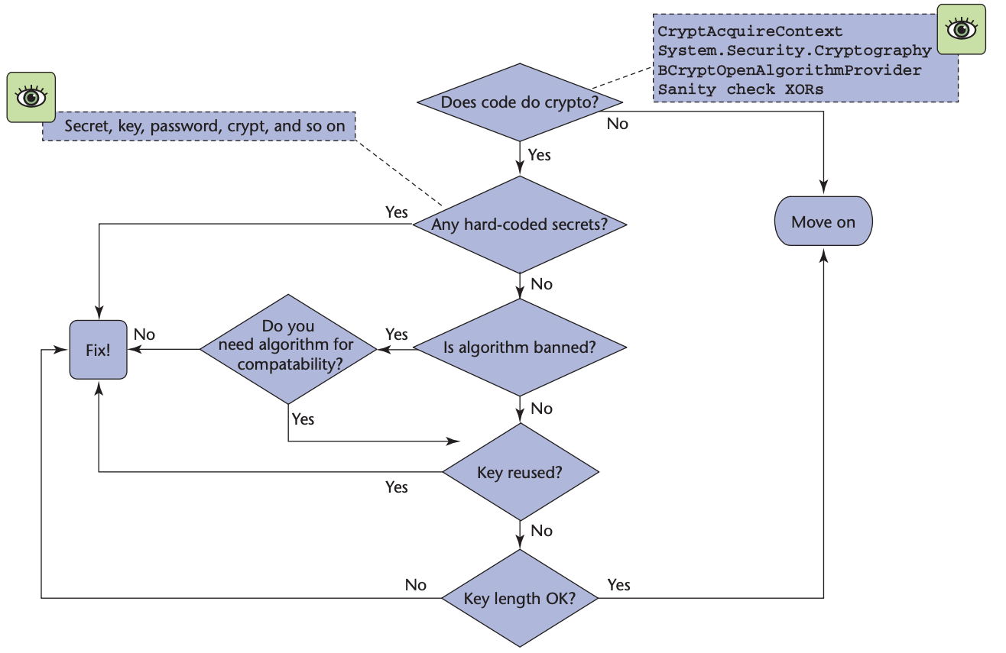
Example: Checklist for crypto issue
Michael Howard, “A Process for Performing Security Code Reviews”. IEEE Security & Privacy.

Slide 22
Example: OWASP checklist for SQLi
Review all code that calls EXECUTE, EXEC, any SQL calls that can call outside resources or command line
  Always validate user input by testing type, length, format, and range
  Test the content of string variables and accept only expected values
  Never build SQL statements directly from user input
  Use SQL API provided by platform. i.e. Parameterized Statements
  …
OWASP Code Review Guideline
https://owasp.org/www-project-code-review-guide

Slide 23
Fatigue
In this type of activity, people get tired quickly
  Sessions of max 2 hours
  Max 2 sessions per day
What to do in case of larger apps?
  Set priorities!

Slide 24
Priorities: where to start?
Code listening on a globally accessible network interface
Code that runs with elevated privileges
Code that handles sensitive data
Old/unmaintained code
Code with a history of vulnerabilities
Complex code
Code that changes frequently
Security considerations
Software engineering considerations

Slide 25
Code review effective?
Study at home
How important are these activities (code review) to assure the code quality?
Recent research found a huge change in development process of an open-source project [1]
  After a vulnerability scandal
[1] James Walden. The Impact of a Major Security Event on an Open Source Project: The Case of OpenSSL. MSR 2020.

Slide 26

OpenSSL & Heartbleed Vulnerability
Study at home
OpenSSL
  One of most common used libraries
  Secure communications over internet
Heartbleed
  Discovered in 2014
  Exploited a buffer over-read vulnerability
  in the cryptography library of OpenSSL
  Two-thirds of https-enabled websites worldwide were affected

Slide 27
OpenSSL responses after the Heartbleed
Study at home
Sep 2014 | Publication of security policy on vulnerability handling
2015 | Code commits require review before merged
Feb 2015 | All code base are reformatted to follow one coding style
Mar 2016 | Add tools (directory /fuzz) for supporting easy fuzzing
Aug 2016, Sep 2018 | Release new versions: remove old algorithms/protocols (3DES, RC4, SSLv2), support for TLS 1.3, SHA3
James Walden. The Impact of a Major Security Event on an Open Source Project: The Case of OpenSSL. MSR 2020.

Slide 28
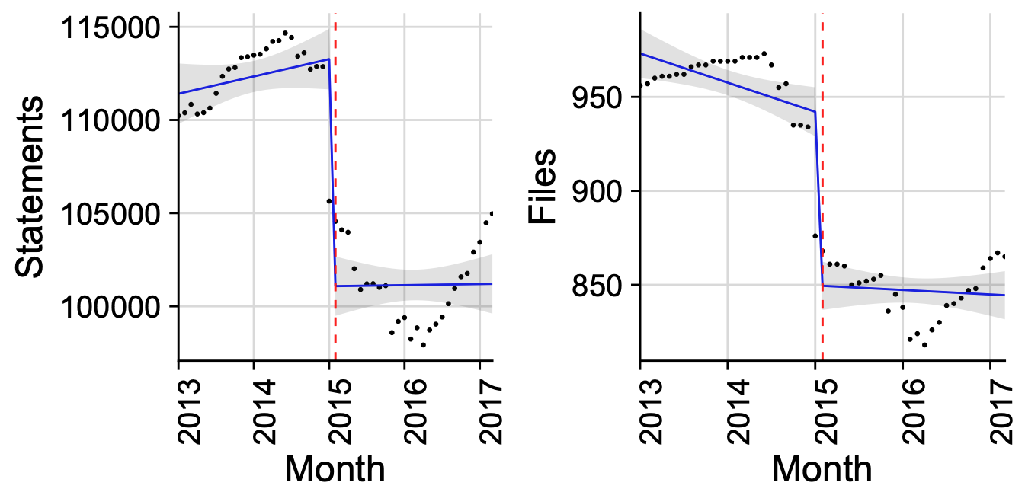
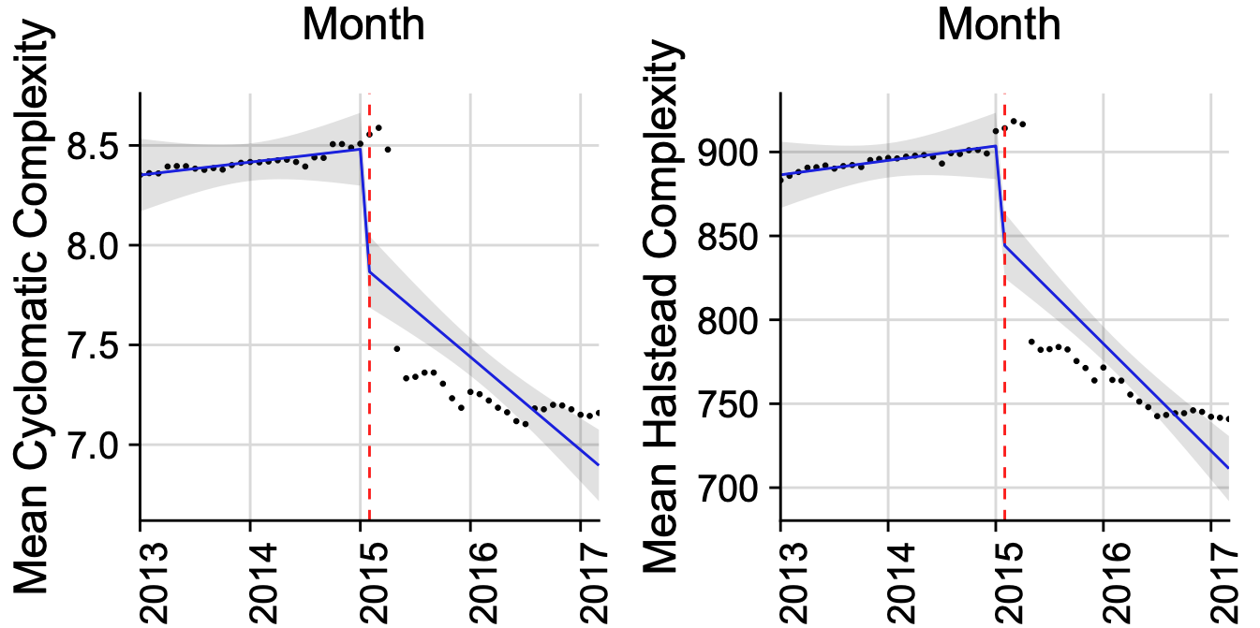
OpenSSL metrics after the Heartbleed
Study at home
Code Size and Complexity
Project size decreases significantly then increases slowly (with new features TLS 1.3, SHA3)
Code complexity decreases significantly and remains low
→ Results of refactoring and reformatting code
James Walden. The Impact of a Major Security Event on an Open Source Project: The Case of OpenSSL. MSR 2020.

Slide 29
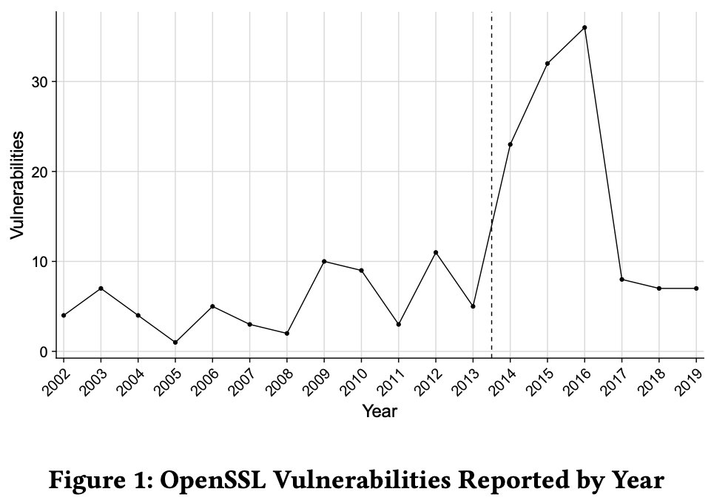
OpenSSL metrics after the Heartbleed
Study at home
# of vulnerabilities
# of vulnerabilities found increase dramatically
James Walden. The Impact of a Major Security Event on an Open Source Project: The Case of OpenSSL. MSR 2020.

Slide 30
Automated Vulnerability Repair in Source Code

Slide 31
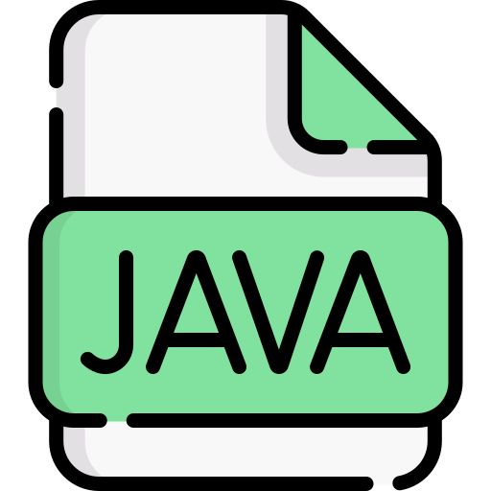

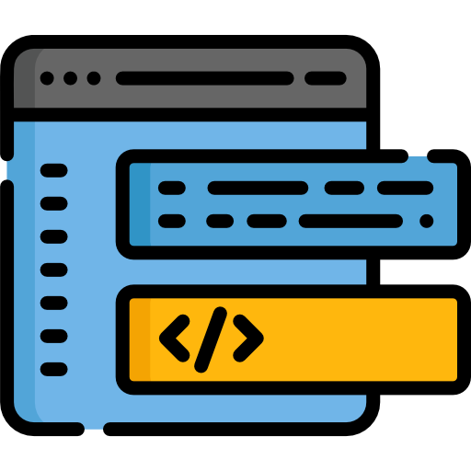

Automated Program Repair - APR
APR
Buggy Program
Patches that pass whole testsuite
Testsuite with at least 1 failing test
Automated Program Repair aims to repair software bugs automatically, help to reduce or even remove human intervention from bug fixing process

Slide 32
Inside an APR Tool
Is the generated patch correct?
Fail Some Tests
Feedbacks
Fault Localization
Suspicious
Statements
Patch
Generator
Patch
Validator
Patch
Candidates
Buggy Program
Testsuite with at least 1 failing test
Pass
All Tests
Where is the code to be fixed?
How to generate patches?
Plausible patches might NOT be semantically correct when compared to the developer’s patches!
→ Overfitting Problem of APR
Plausible Patches

Slide 33
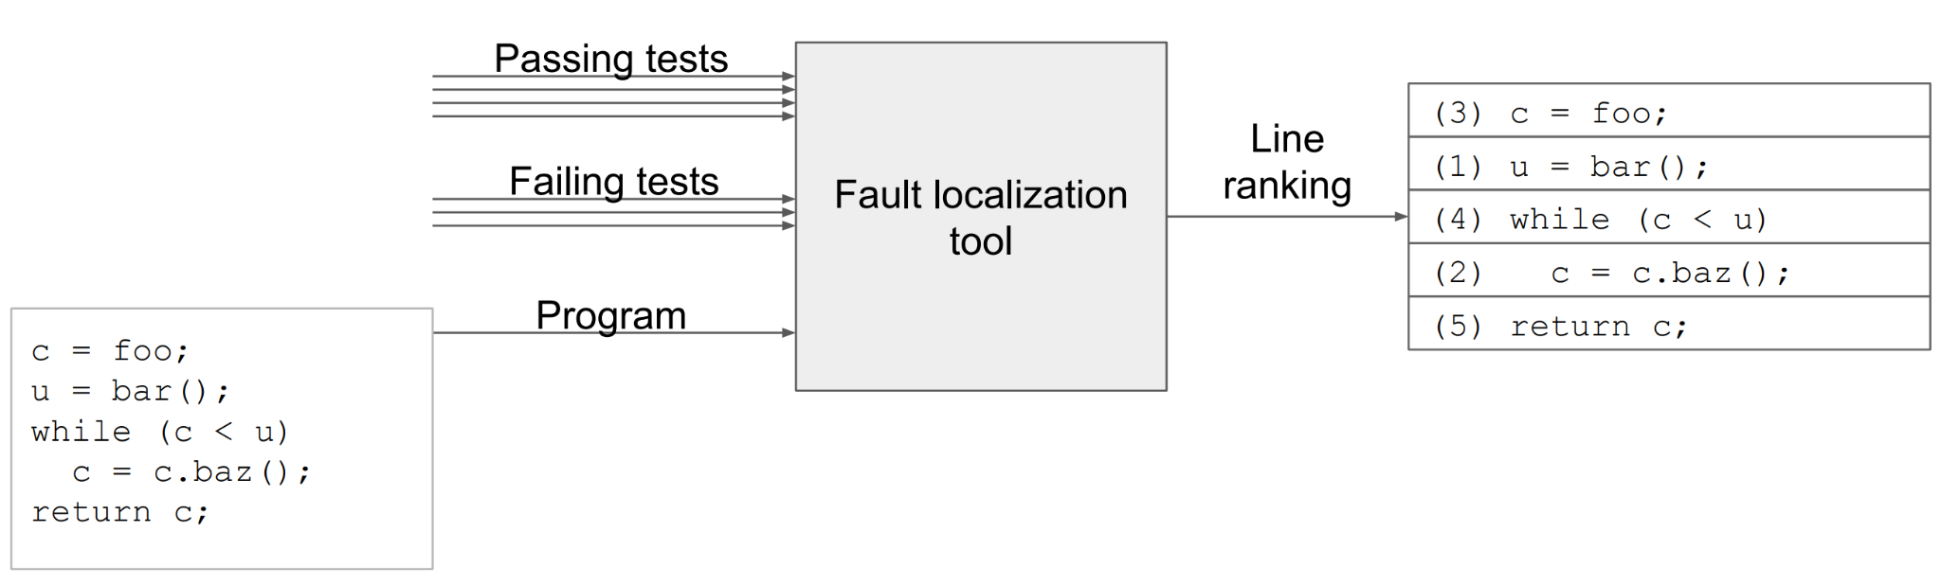
Fault Localization
Based on testing results
Spectrum-based Fault Localization (SBFL)
Mutation-based Fault Localization (MBFL)
https://homes.cs.washington.edu/~mernst/pubs/fault-localization-icse2017-slides-long.pdf

Slide 34
Mutant-based Fault Localization (MBFL)
Only for your info
Change a single line of code
Execute P/F tests
Collect results
Compute suspiciousness and sort accordingly
VERY expensive
(run all the tests on a large number of mutants)

Slide 35


Spectrum-based Fault Localization
Leveraging the coverage information of passing tests and failing tests
The more failing tests execute the statement S, the more suspicious it is
Many similarity coefficients to compute suspiciousness
a₁₁ = executed and failed
a₁₀ = executed and passed
a₀₁ = not executed and failed
a₀₀ = not executed and passed

Slide 36
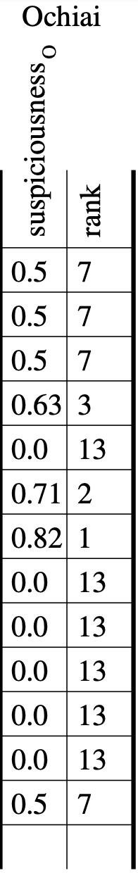
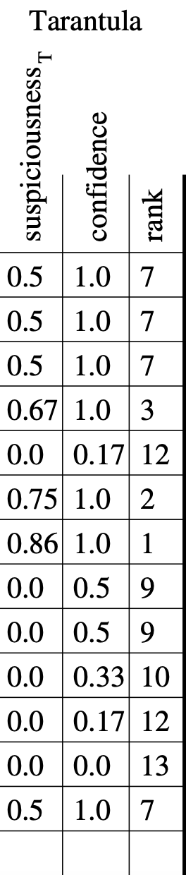
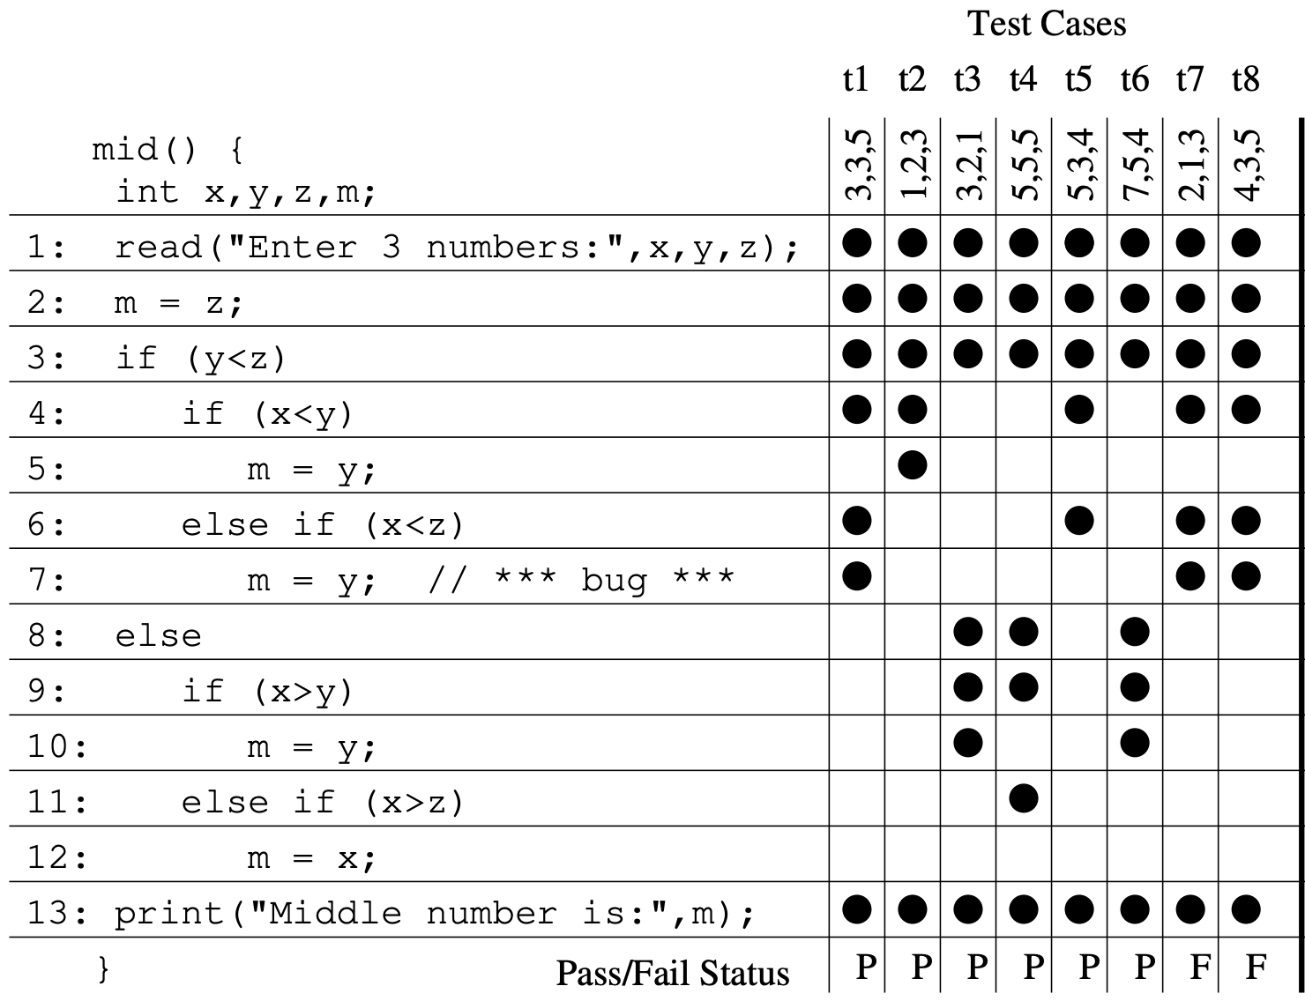
SBFL Example
Observation Matrix
Yanbing Yu et. al. An empirical study of the effects of test-suite reduction on fault localization. ICSE 2008.

Slide 37
APR Technique Families
Patch Generator
Heuristics-based Repair (Aka Generate-and-Test Repair)
Constraint-based Repair (Aka Synthesis-based Repair)
  Based on symbolic execution
Learning-based Repair
  E.g., deap learning on AST-to-AST transformation templates that summarize how patches modify buggy code into correct code
  Learning can also be used to assess the generated patch (”similarity with regard to the code corpus”)
Claire Le Goues, Michael Pradel, Abhik Roychoudhury, Automated Program Repair, Communications of ACM, 2019

Slide 38
APR for Security Vulnerabilities
Security vulnerabilities don’t often come with proof-of-vulnerability test cases
  SBFL could not be applied to locate the faults
FL module could be replaced/ combined with SAST tools or in-house prediction techniques
  SAST tools provide useful information about the location and the presence of vulnerable code
Only few work done for vulnerability repair in the literature so far

Slide 39
APR for Security Vulnerabilities
C/C++
  Zhen Huang et al. Using Safety Properties to Generate Vulnerability Patches. S&P’19.
  Jacob Harer et al. Learning to Repair Software Vulnerabilities with Generative Adversarial Networks. NIPS'18.
Java: Siqi Ma et al. VuRLE: Automatic Vulnerability Detection and Repair by Learning from Examples. ESORICS'17.
Android: Ruian Duan et al. Automating Patching of Vulnerable Open-Source Software Versions in Application Binaries. NDSS’19.

